Slide 1
Annual Report 2024 Launch
Thursday 14 November 2024
Welcome by Alisa Pedrana

Slide 4
Housekeeping
Data highlights
Followed by a moderated Q and A
burnet.edu.au and kirby.unsw.edu.au
Download full report here: https://burnet.edu.au/aushepC

Slide 5
Introducing today’s guests
Margaret Hellard
Burnet Institute
Greg Dore
Kirby Institute
Ele Morrison
Australian Injecting and Illicit Drug Users League (AIVL)
Lucy Clynes
Hepatitis Australia
Tom Rees
South Australian Department for Health and Wellbeing
Notes:
Ele is pronounced like Elly

Slide 6
Editors
Data Contributors
Anna Wilkinson

Slide 7
Editors
Margaret Hellard | Alisa Pedrana | Timothy Broady
Mark Stoové | Joseph Doyle | Troy Combo
Gregory Dore | Alexander Thompson
Jason Grebely | Behzad Hajarizadeh
Notes:
The annual report is a partnership between the Burnet Institute and the Kirby Institute.
Thank you to the Editors for generous contributions of their time and energy.
With thanks to Samara Griffin (Burnet Institute) for preparation of the report this year as well.

Slide 8
Data Contributors (in order of data presented)
Australian Collaboration for Coordinated Enhanced Sentinel Surveillance of Sexually Transmissible Infections and Blood Borne Viruses
MIXMAX Melbourne Cohort hepatitis C sub‑study
ATLAS Indigenous Primary Care Surveillance and Research Network
Australian Needle Syringe Program Survey
National Prisons Hepatitis Network
Australian Hepatitis and Risk Survey in Prisons
Monitoring hepatitis C treatment uptake in Australia
National Retreatment Project
National hepatitis C diagnosis and care cascade
Notes:
The report comes together because people provide data from their respective projects.
I would like to acknowledge the projects and thank those that provided data.
I will thank some people specifically, in the interest of time, acknowledging they represent their projects and teams behind them.
1. Jason Asselin and Michael Traeger from the ACCESS project
2. Rachel Sacks-Davis from the MIXMAX Cohort
3. James Ward and Shellee WIlliams from ATLAS
4. Brad Mathers, Sue Heard, and Lisa Maher from the Australian Needle Syringe Program Survey
5. Rebecca Winter and Yumi Sheehan from NPHN
6. Behzad Hajarizadeh from AusHep
7. Behzad Hajarizadeh, Greg Dore, and Joanne Carson from the Monitoring Treatment Uptake Project and National Retreatment Project
8. Amy Kwon, Richard Gray, Jonathan King, and Skye MacGregor from the ASR and Cascades group

Slide 9
Data Contributors (cont.)
Australia and New Zealand Liver and Intestinal Transplant Registry
Stigma Indicators Monitoring Project
Needle Syringe Program National Minimum Data Collection
Gay Community Periodic Survey
Viral Hepatitis Mapping Project
Mathematical modelling (Kirby Institute)
Mathematical modelling (Burnet Institute).
Notes:
9. Wing-Yee Lo from the Australia and New Zealand Liver and Intestinal Transplant Registry
10. Tim Broady from the Stigma Indicators Monitoring Project and GCPS
11. Brad Mathers, Sue Heard, and Lisa Maher from the NSPMDC
12. Jenn Machlachlan and Ben Cowie from the Mapping Project
13. Amy Kwon, Richard Gray, and Greg Dore from Kirby modelling team
14. Chris Baille and Nick Scott from the Burnet modelling team

Slide 10
Community organisations
Paul Armstrong (Burnet Institute)
The following organisations are thanked for their generous contributions during consultation processes:
ASHM
Australian Injecting and Illicit Drug Users League (AIVL)
Health Equity Matters
Hepatitis Australia
National Association of People with HIV Australia (NAPWHA)

Slide 11
Data highlights
Anna Wilkinson

Slide 12
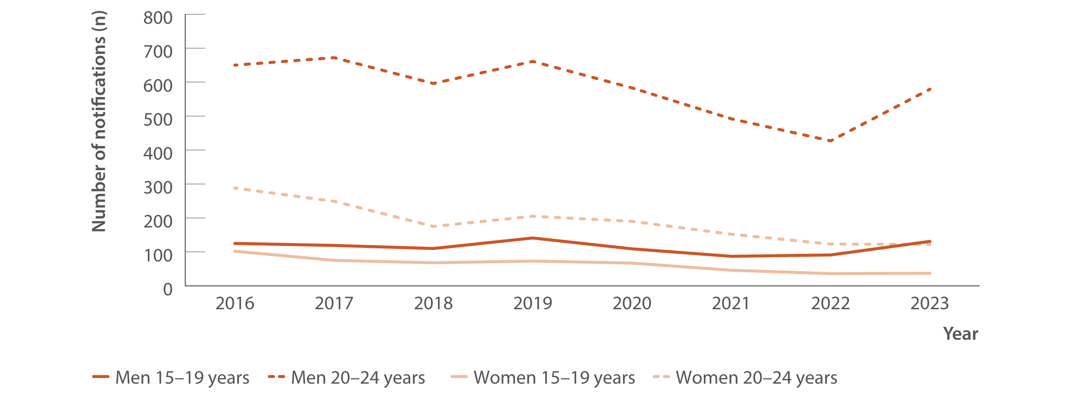
Figure 1. Number of hepatitis C (unspecified and newly acquired) notifications by age group and gender, 2016–2023
New infections
Source: Australian National Notifiable Diseases Surveillance System.(4,9)
Notes:
Starting with new infections. Notifications are a staple of understanding the epidemiology of hepatitis C. This is notifications among people aged 15-24, as these notifications are likely to be recent infections, so a proxy for incidence.
Notably, there is a general decreasing and then stable trend, however we see an increase in number of notifications among men 20 to 24 years old in 2023 compared to 2022.

Slide 13
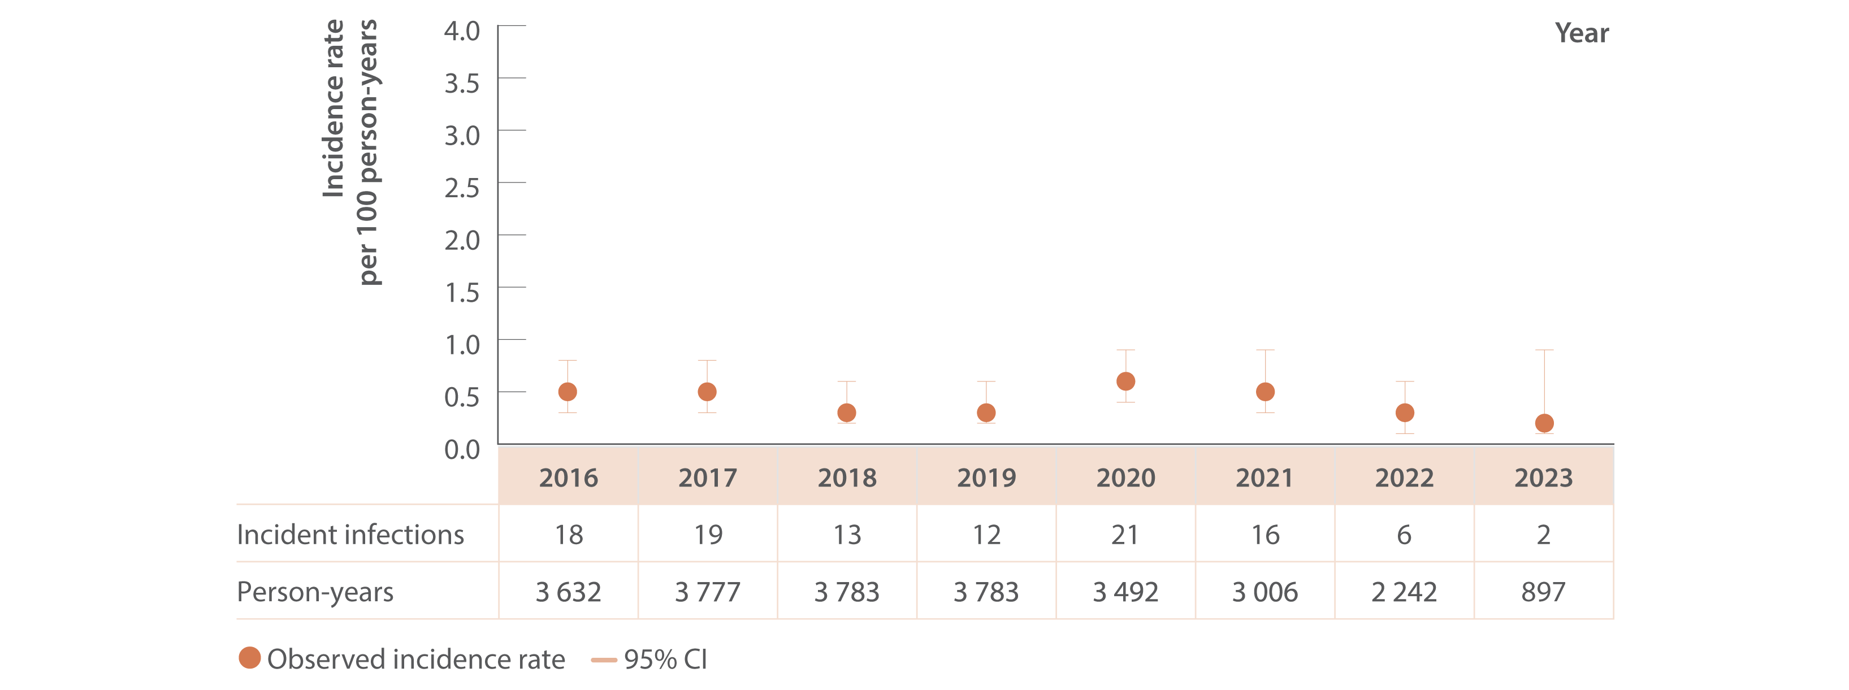
Figure 2. Incidence of primary hepatitis C infection among individuals tested at ACCESS primary care clinics, ACCESS, 2016–2023
New infections
Source: ACCESS.⁽¹¹⁾
Notes:
Measuring new infections for hepatitis C can be challenging; however ACCESS, a sentinel surveillance system, that recruits clinical sites, has data on patients linked over time, meaning we observe repeat tests and can therefore measure new hepatitis C infection and an incidence rate.
Data presented here were from patients who attended an ACCESS primary care clinic, these clinics provide services to people at-risk of hepatitis C such as co located needle syringe programs and opioid agonist prescribing, as well as general health services.
The key finding here is the trend, which is stable, remaining low from 2016. So there are few new infections being recorded at these clinics.

Slide 14
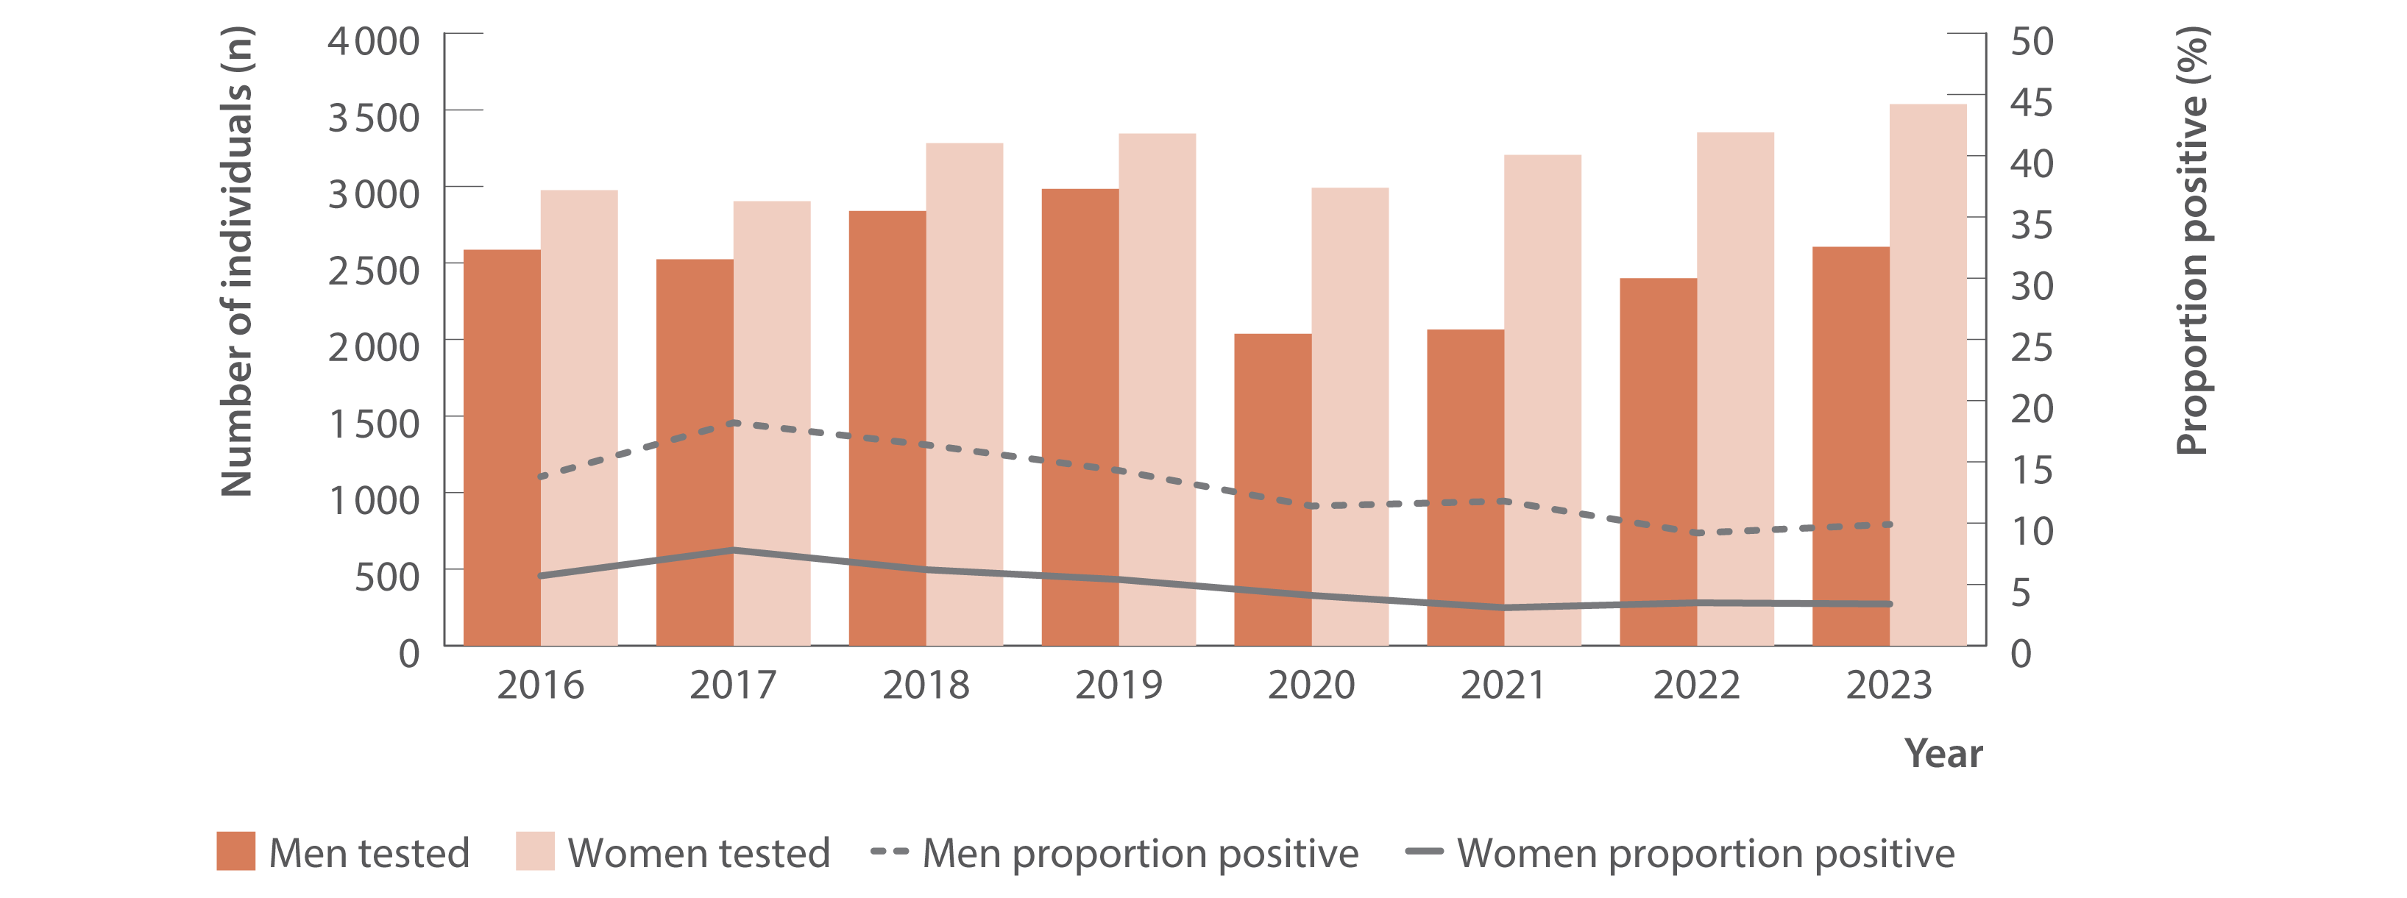
Figure 8. Number of individuals tested for HCV antibody at ACCESS primary care clinics and proportion of HCV antibody tests positive by gender, ACCESS, 2016–2023
Testing and diagnosis
Source: ACCESS.⁽¹¹⁾
Notes:
It's important when thinking about rates of notifications or new infections, to also look at testing activity, which influences detection of infections.
Here we're looking again at ACCESS primary care clinics.
Dark bars are the number of men hepatitis C antibody tested, and the lighter bars are the number of women hepatitis C antibody tested within each year.
The lines are the proportion of people testing hepatitis C antibody positive, and we see among women in the solid line, just under 5% of women tested were antibody positive in 2023, which has remained stable from 2016. Among men, at these clinics, positivity has stablised at around 10% in 2023.

Slide 15
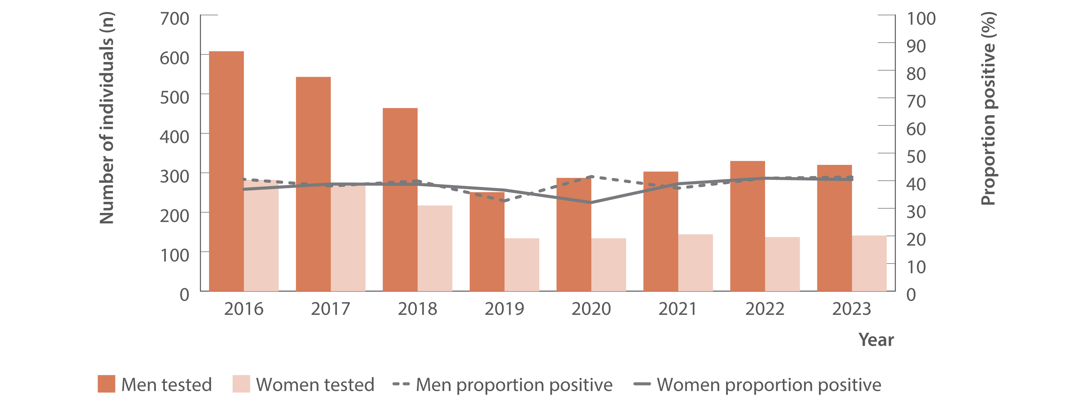
Figure 10. Number of individuals ever prescribed opioid agonist therapy tested for HCV antibody at ACCESS primary care clinics and proportion of HCV antibody tests positive by gender, ACCESS, 2016–2023
Testing and diagnosis
Source: ACCESS.⁽¹¹⁾
Notes:
Here we’re looking at primary care clinics participating in ACCCESS, and antibody testing and proportion positive among people with a history of ever being prescribed opioid agonist therapy.
The dark bars again represent the number of men tested, and lighter bars represent the number of women tested. More men were tested than women and among men and women, hepatitis C antibody positivity was around 40%.
These data highlights that among this priority population, over 1 in 3 people tested had a new hepatitis C antibody positive result, demonstrating the importance of screening this population.

Slide 16
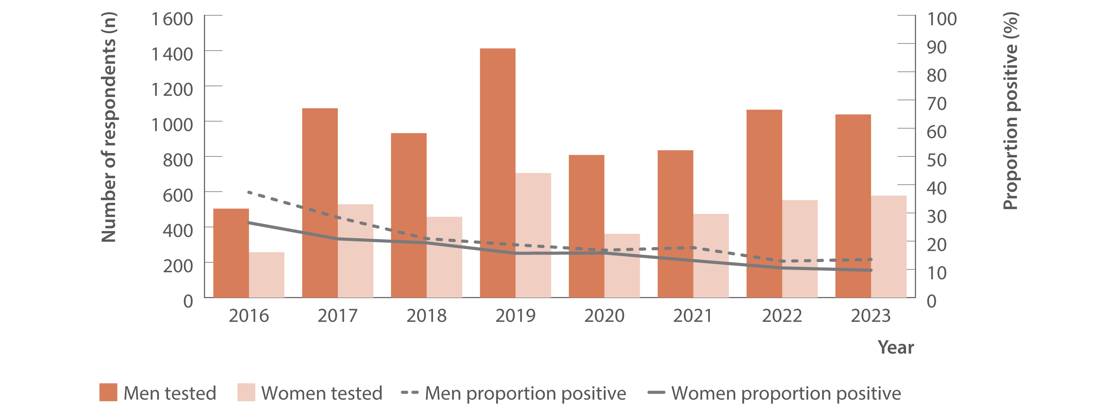
Figure 18. Number of Australian Needle Syringe Program Survey respondents tested for HCV RNA and proportion positive by gender, 2016–2023
Testing and diagnosis
Source: Australian Needle Syringe Program Survey. 25-year National Data Report 1995–2019.⁽²⁶⁾ Australian Needle Syringe Program Survey. National Data Report 2019–2023.⁽¹⁹⁾
Notes:
The data presented here is from the Australian Needle Syringe Program Survey. This is a long standing serial cross-sectional survey of people attending needle syringe program sites, with recruitment at over 50 sites in 2023.
The data here is hepatitis C RNA testing, which is conducted from dried blood spot.
We have seen a substantial decline in the proportion of people with current infection, to around 10% among both men and women.

Slide 17
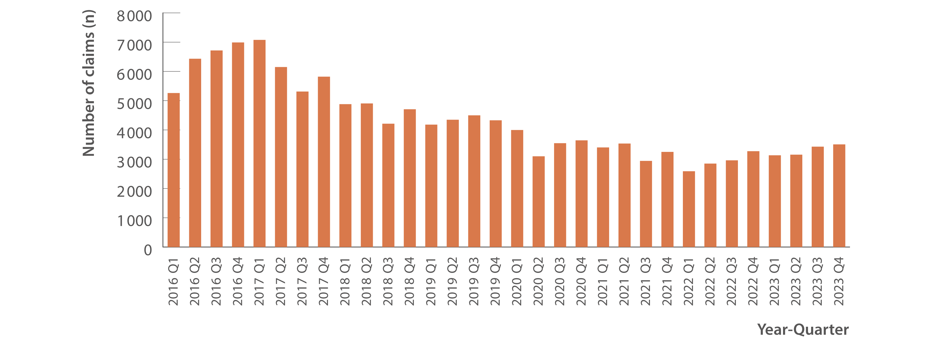
Figure 19. Number of claims to Medicare for items 69499 and 69500 (detection of HCV RNA, new infections only), 2016–2023
Testing and diagnosis
Source: Medicare Australia Statistics.⁽²⁰⁾
Notes:
Here we have the publicly available Medicare data on hepatitis C RNA tests for each quarter. These item numbers are RNA tests for diagnosis only and are not used for on or post-treatment monitoring.
We can see that there have been declines in testing year-on-year since 2017; 2023 saw a stabilization in the number of hepatitis C RNA tests conducted.

Slide 18
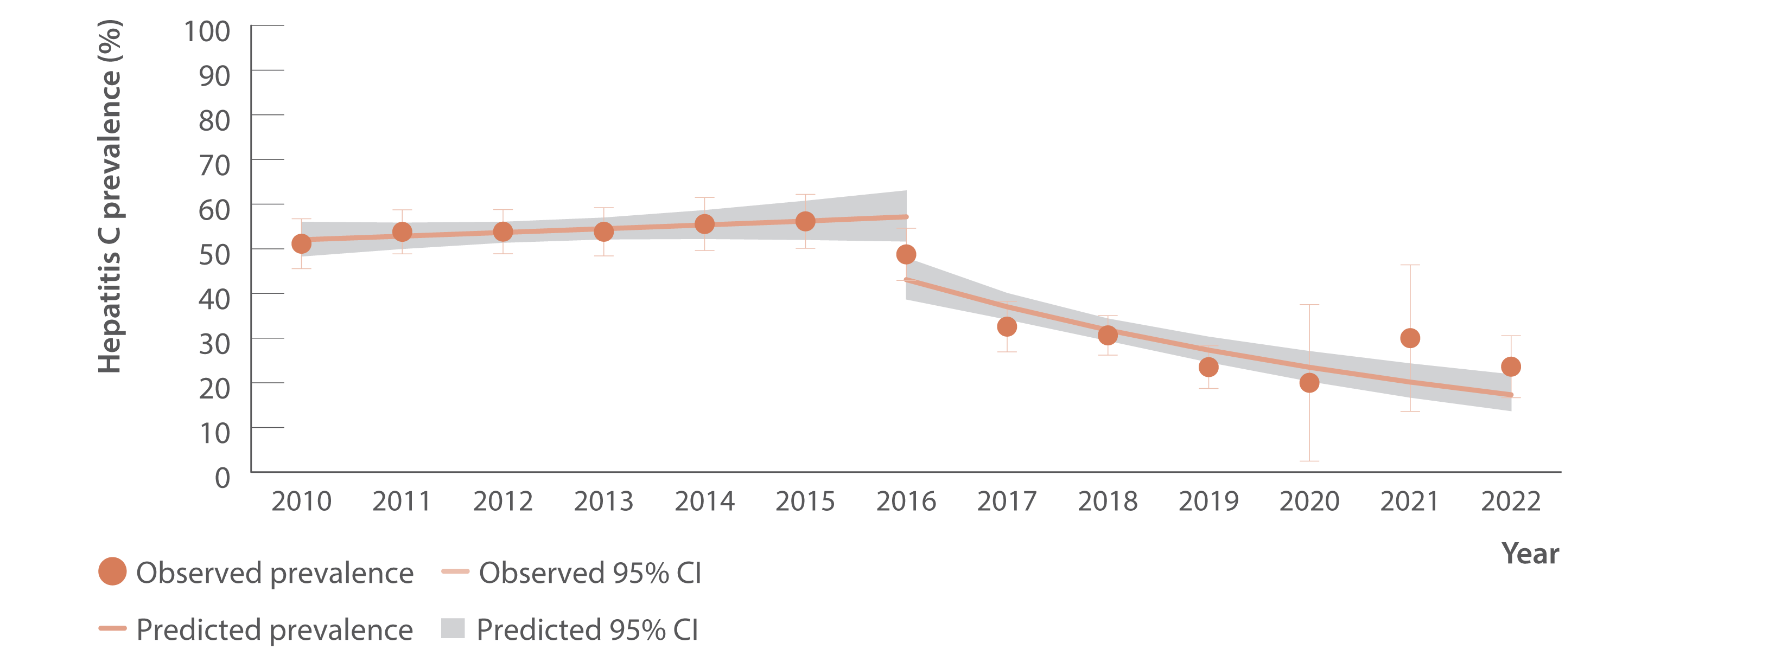
Figure 22. Proportion of people who inject drugs participating in the MIXMAX Melbourne Cohort HCV RNA positive before and after subsidisation of DAAs in March 2016, March 2010–December 2022
Testing and diagnosis
Source: Adapted from Fisher et al.⁽¹⁵⁾
Notes:
This is new data this year, from a longitudinal cohort of people who inject drugs living in Melbourne.
The analysis is of HCV RNA tests conducted as part of the cohort study, and shows a substantial decline of HCV RNA prevalence since 2016.

Slide 19
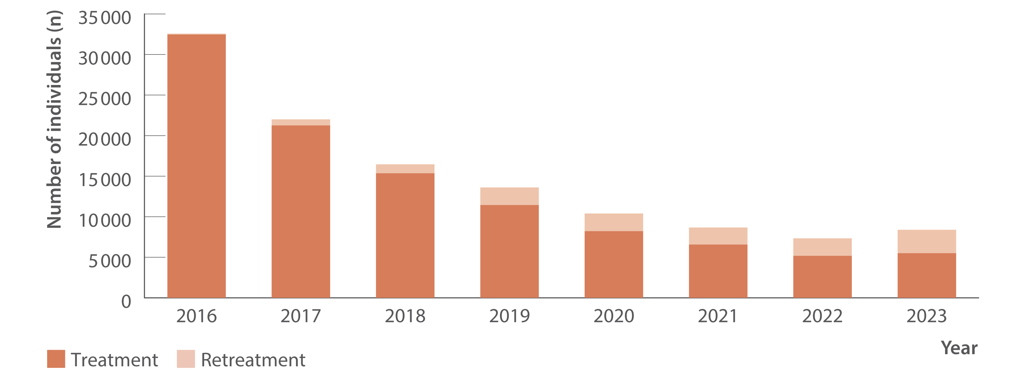
Figure 23. Total estimated number of individuals initiating DAA treatment (including retreatment), PBS database, March 2016–December 2023
Uptake of treatment
Source: Monitoring hepatitis C treatment uptake in Australia.⁽³¹⁾
Notes:
Moving on now to chapter 3, on the uptake of treatment.
Here we have data from the Monitoring treatment uptake project and National Retreatment Project, which use Pharmaceutical Benefits Scheme claims data to monitor trends in direct-acting antiviral treatment initiations. This shows us the number of individuals initiating first treatment and retreatment.
Between 2016 and the end of 2023, over 105,000 people nationally had been treated for hepatitis C for the first time.

Slide 20
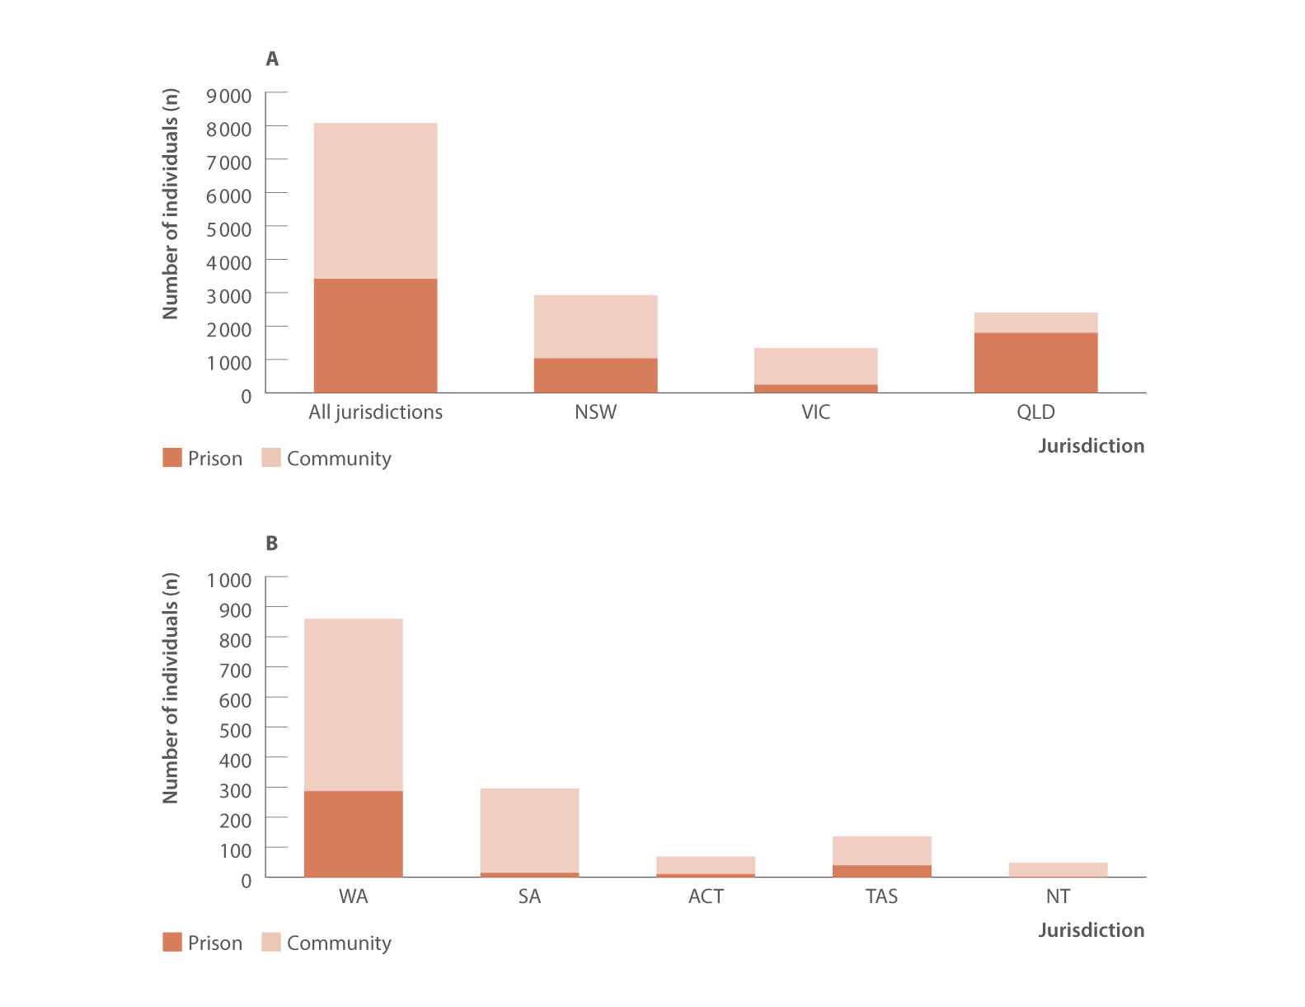
Figure 28. Number of individuals receiving DAA treatment in prison versus in the community nationally and by jurisdiction, National Prisons Hepatitis Network and PBS database, 2023
Uptake of treatment
Source: State and Territory Justice Health authorities via the National Prisons Hepatitis Network.⁽²²⁾ Monitoring treatment uptake in Australia.⁽³¹⁾
Notes:
We have data here collated by the National Prisons Hepatitis Network.
This figure presents the number of people who started treatment nationally, and in each jurisdiction in 2023, and the proportion of treatments that were initiated in prison versus in the community.
In 2023, 42% of all people who started treatment, started in prisons.

Slide 21
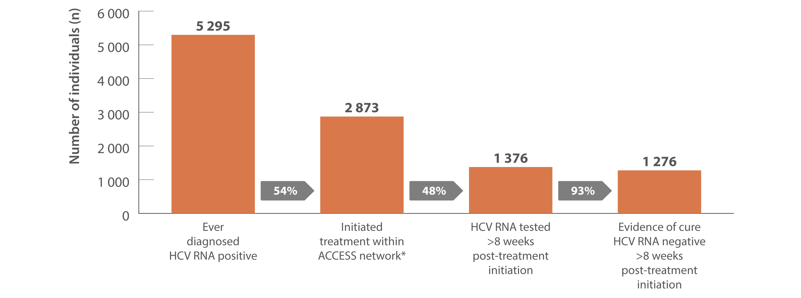
Figure 30. Hepatitis C treatment cascade at ACCESS primary care clinics: number of individuals hepatitis C diagnosed, number and proportion of individuals who initiated treatment, and tested for HCV RNA post‑treatment initiation, 2016–2023
Uptake of treatment
Source: ACCESS.⁽¹¹⁾ Updated from Traeger et al., PLOS One 2020.⁽³⁵⁾
Notes:
We are familiar with diagnosis and care cascades, which show people moving through the steps from screening and diagnosis, to cure.
Data from ACCESS were used to construct a cascade. People included in this analysis attended primary care clinics and data were from 2016 to 2023. This is a patient cohort, and ACCESS data allows us to see all hepatitis C tests and treatment over time. We can see that approximately half of the people included in this analysis, who were eligible for treatment, that is were, hepatitis C RNA positive, initiated treatment.

Slide 22
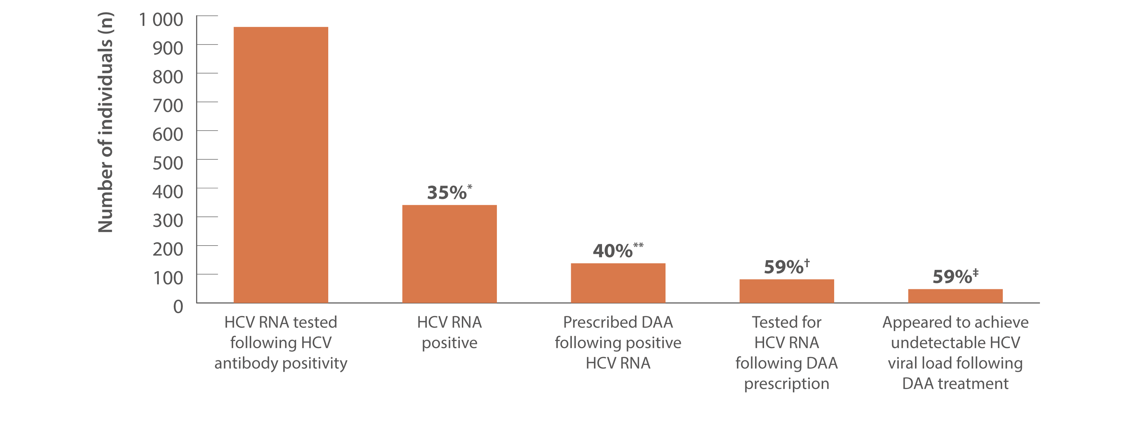
Figure 31. Hepatitis C treatment cascade: number and proportion of individuals attending ACCHS tested for HCV RNA and prescribed DAAs, and among those treated, the number and proportion who appeared to achieve an undetectable HCV viral load, ATLAS network, aggregated for years 2016–2023
Uptake of treatment
Source: ATLAS Indigenous Primary Care Surveillance and Research Network, 2016–2023.⁽¹⁸⁾
Notes:
The ATLAS surveillance network similarly can be used to construct cascades of care for monitoring progress on testing and treatment, among a cohort of patients.
The cascade starts at hepatitis C RNA testing, of those were tested for RNA, around one-third were RNA positive. Of individuals who were hepatitis C RNA positive, 40% were prescribed DAA treatment.
Whilst the drop-off from testing to treatment seen here can give us an indication on where we want to focus our efforts on retaining people in the cascade, similar to the ACCESS cascade, it’s important to note that patients may have accessed treatment elsewhere, which is not captured in the data.

Slide 23
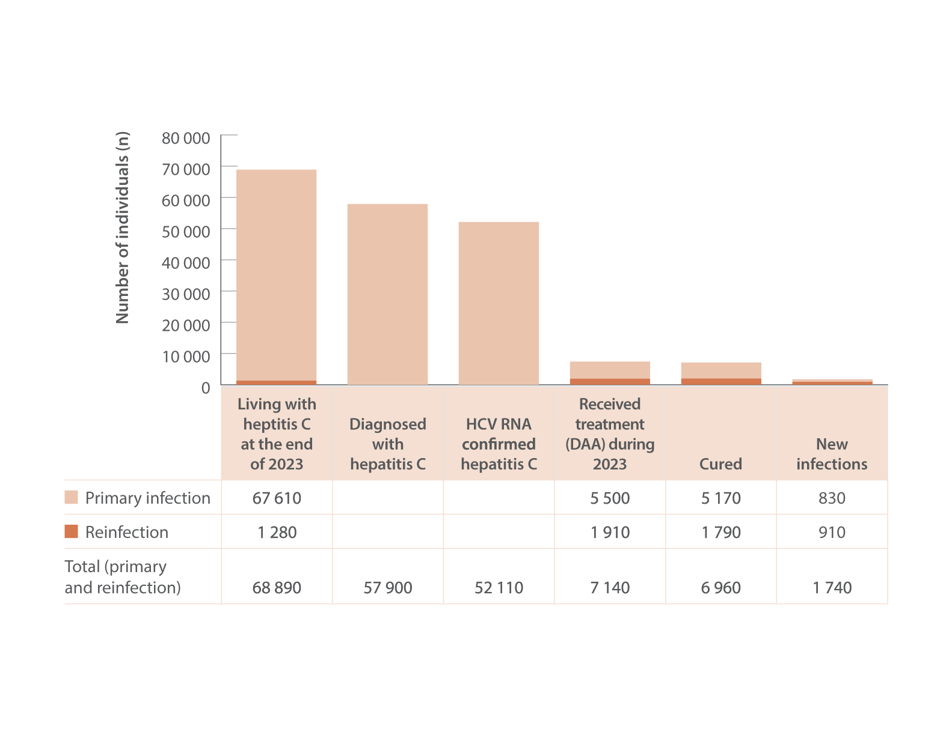
Figure 32. The 2023 hepatitis C diagnosis and care cascade, HIV, viral hepatitis and sexually transmissible infections in Australia, Annual Surveillance Report
Uptake of treatment
Source: Updated by Kirby Institute, from the HIV, viral hepatitis and sexually transmissible infections in Australia: annual surveillance report 2023.^{(2,3,4)}
Notes:
Each year, the Annual Surveillance Report provides modelled estimates for a national cascade of care. This is a population-level, cross-sectional cascade, which uses observed data and mathematical modelling.
There were 5,500 people treated for hepatitis C during 2023.
At the end of 2023, an estimated 68,890 people remained living with hepatitis C.

Slide 24
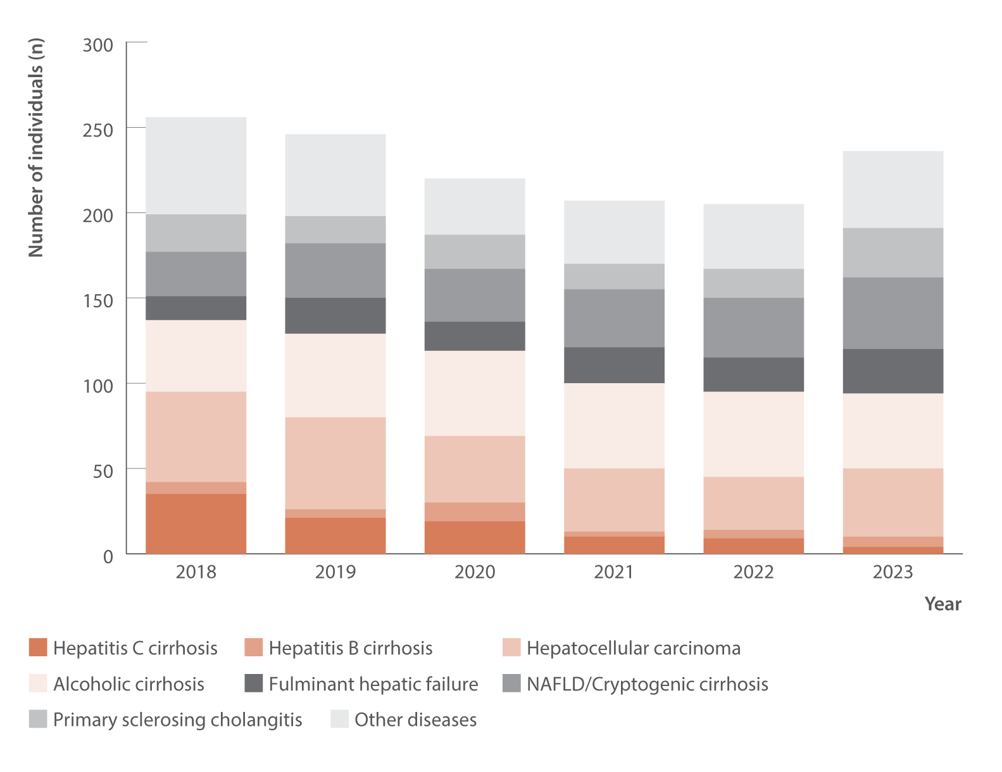
Figure 33. Number of Australian adult liver transplant recipients by primary diagnosis and year of first transplant, Australia and New Zealand Liver and Intestinal Transplant Registry, 2018–2023
Morbidity
Source: Australia and New Zealand Liver and Intestinal Transplant Registry.⁽³⁷⁾
Notes:
It remains a challenge to collate data on the longer-term outcomes of hepatitis C. However, we have data from the Australia and New Zealand Liver and Intestinal Transplant Registry on liver transplants among Australian adults.
In the dark orange at the bottom, the number of liver transplants with a primary diagnosis of hepatitis C-related cirrhosis has declined over time, which is good news.

Slide 25
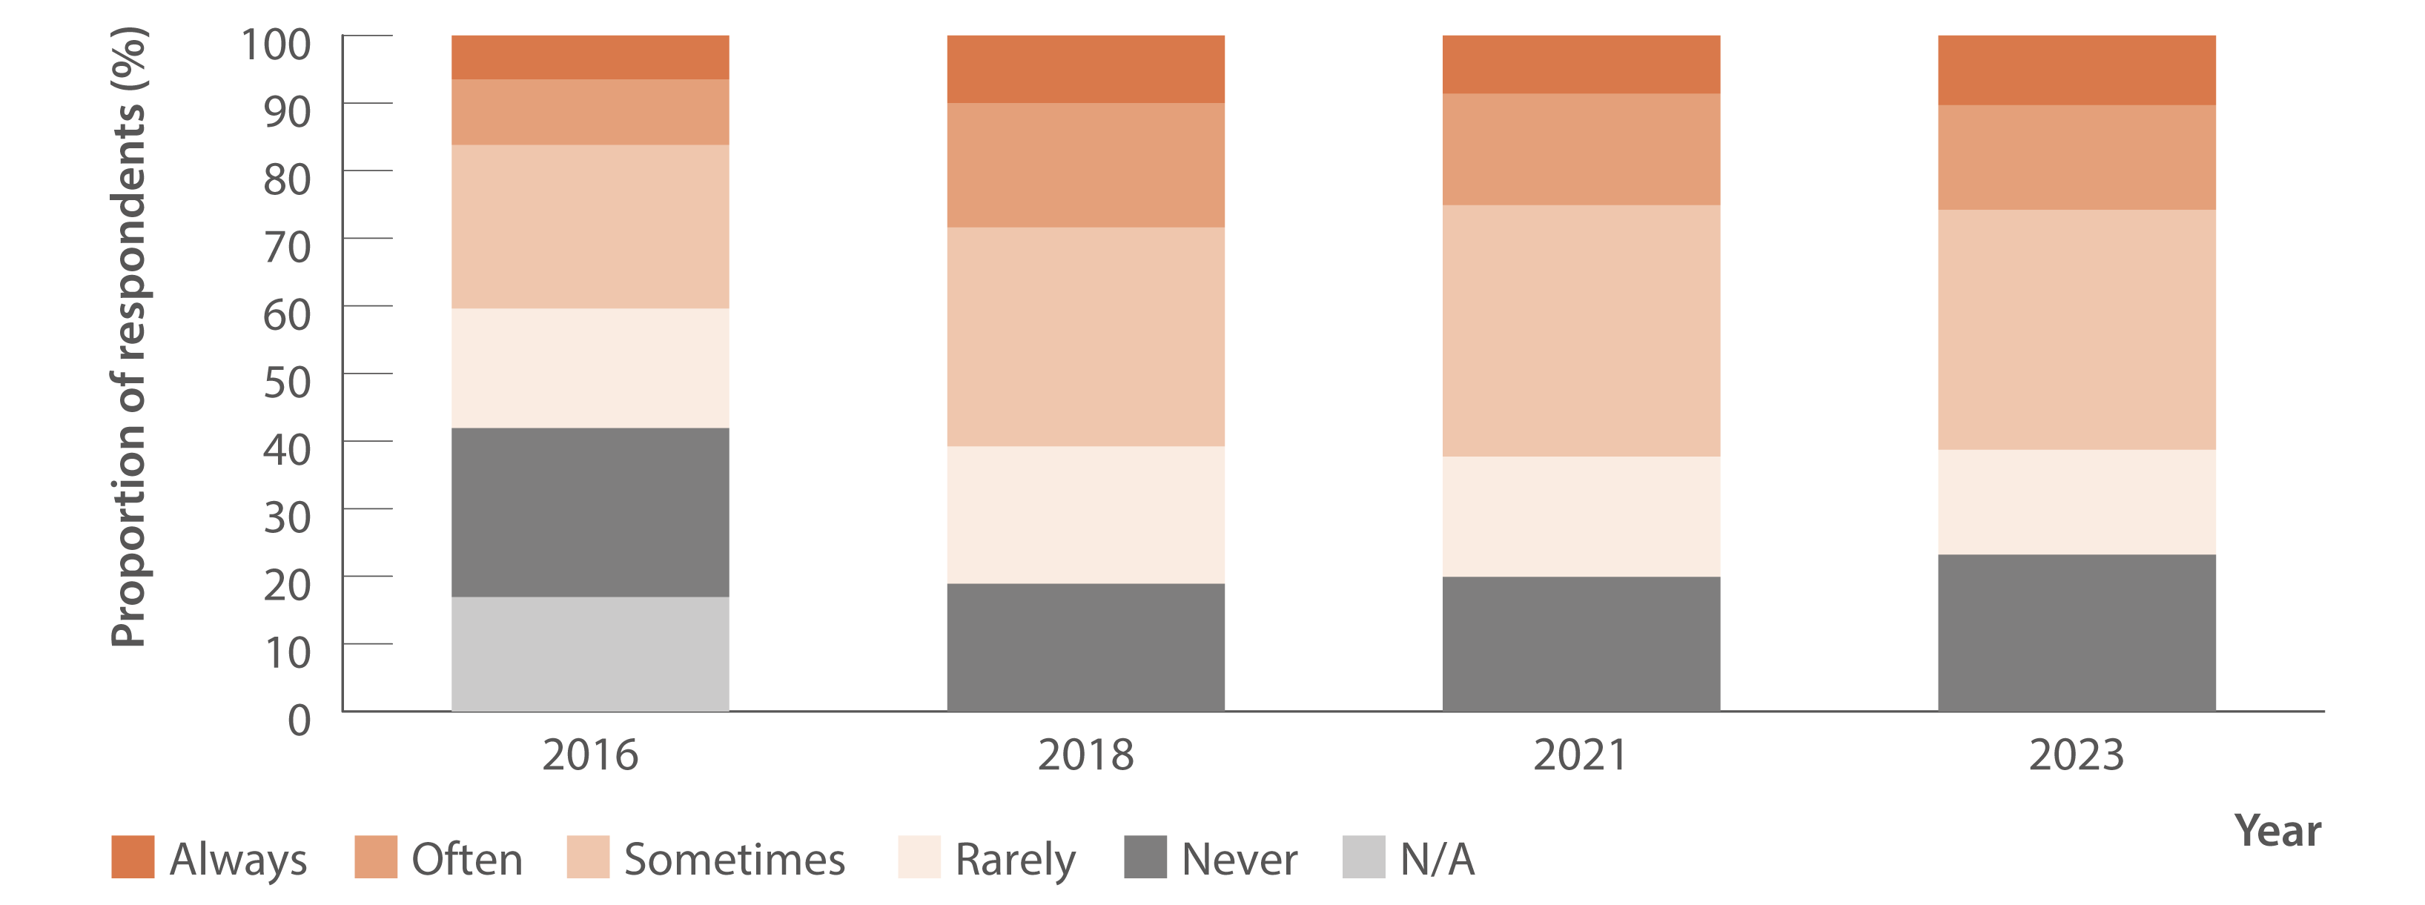
Figure 34. Reports of injecting drug use‑related stigma or discrimination in the past 12 months by people who inject drugs, 2016–2023
Stigma and discrimination
Source: Stigma Indicators Monitoring Project.⁽⁴²⁾
Notes:
We have data here from the Stigma Indicators Monitoring Project, from surveys of people who inject drugs. This data highlights is there is a substantial number of people who have experienced injecting drug use-related stigma or discrimination. Approximately 70% of people surveyed reported experiencing stigma or discrimination in the past 12 months related to their injecting drug use.

Slide 26
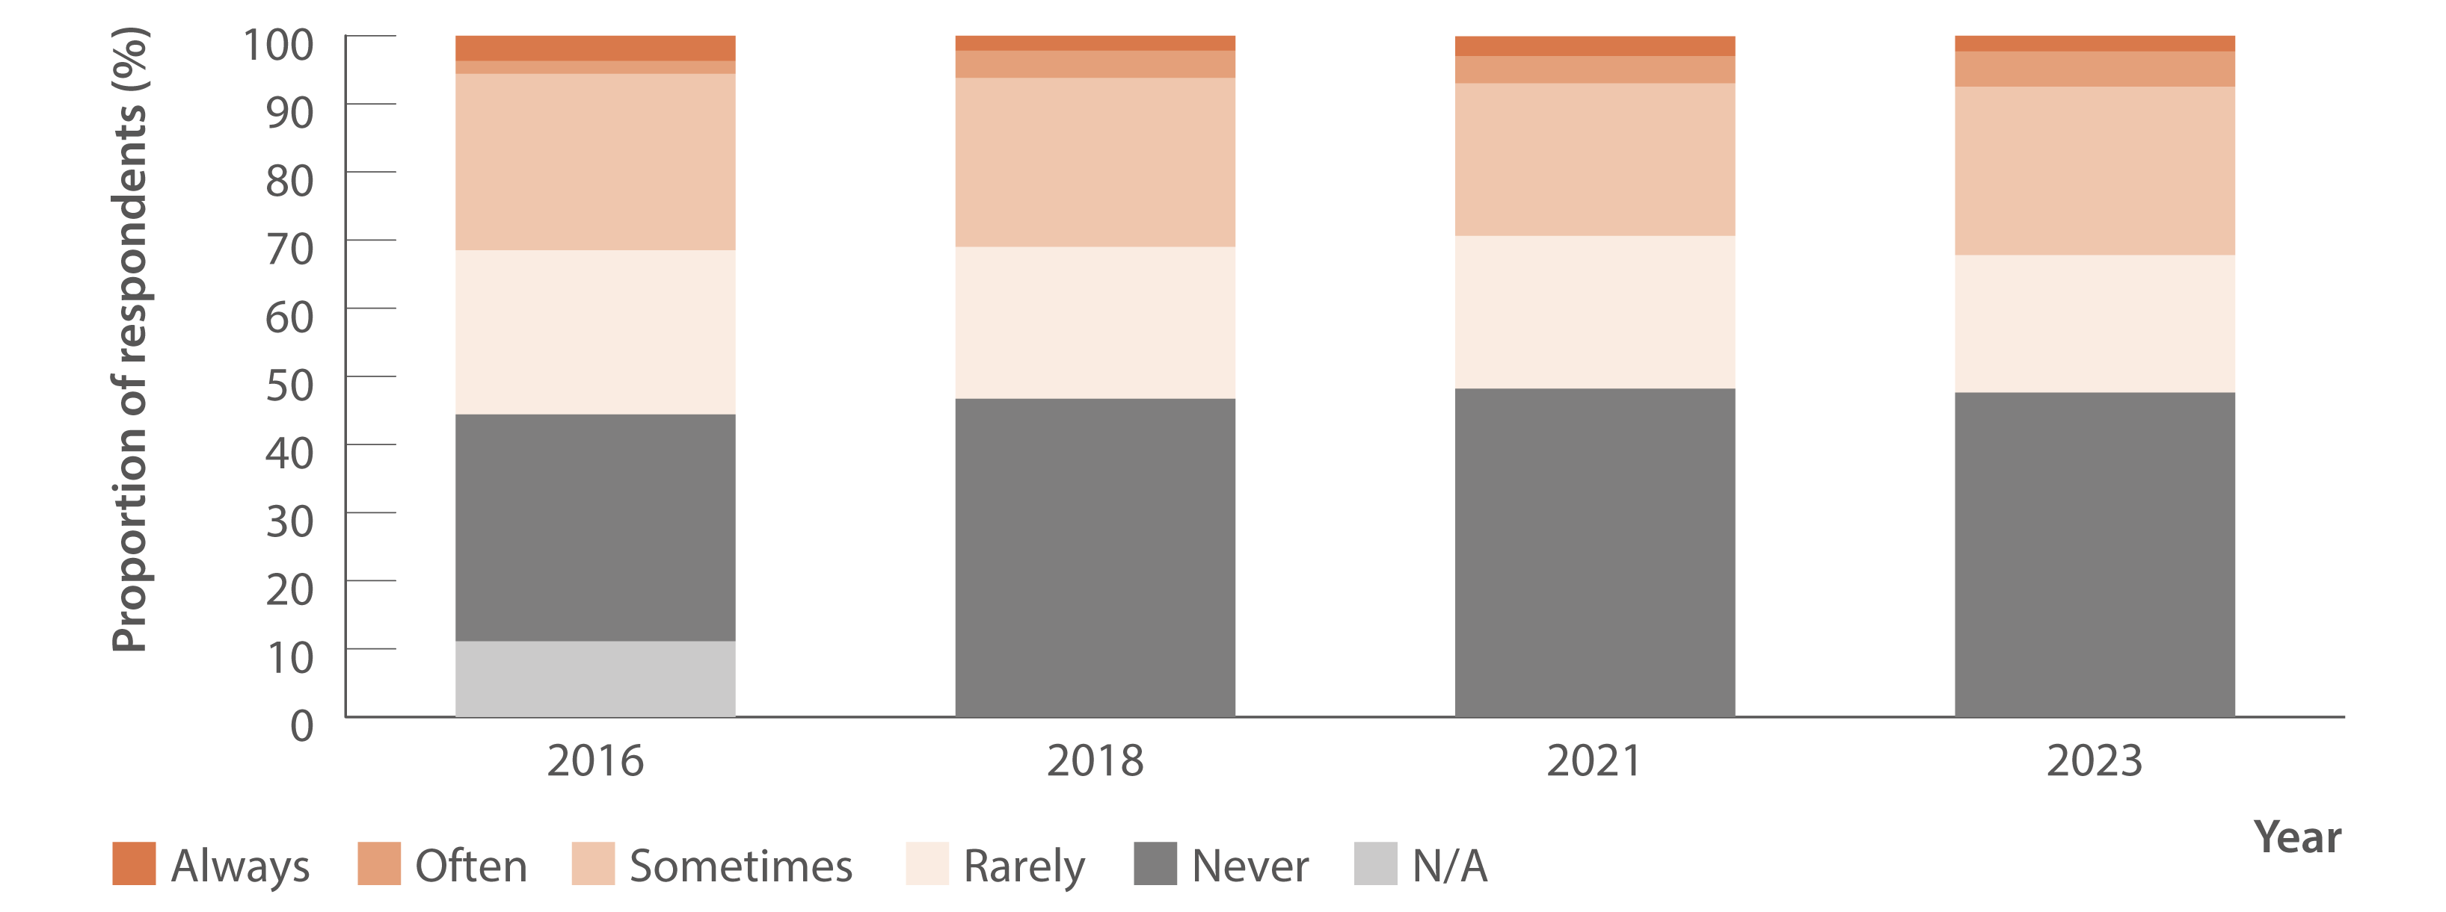
Figure 35. Reports of hepatitis C‑related stigma or discrimination in the past 12 months by people diagnosed with hepatitis C, 2016–2023
Stigma and discrimination
Source: Stigma Indicators Monitoring Project.⁽⁴³⁾
Notes:
In this data we see that substantial proportions of people surveyed have experienced stigma or discrimination relating to living with hepatitis C.

Slide 27
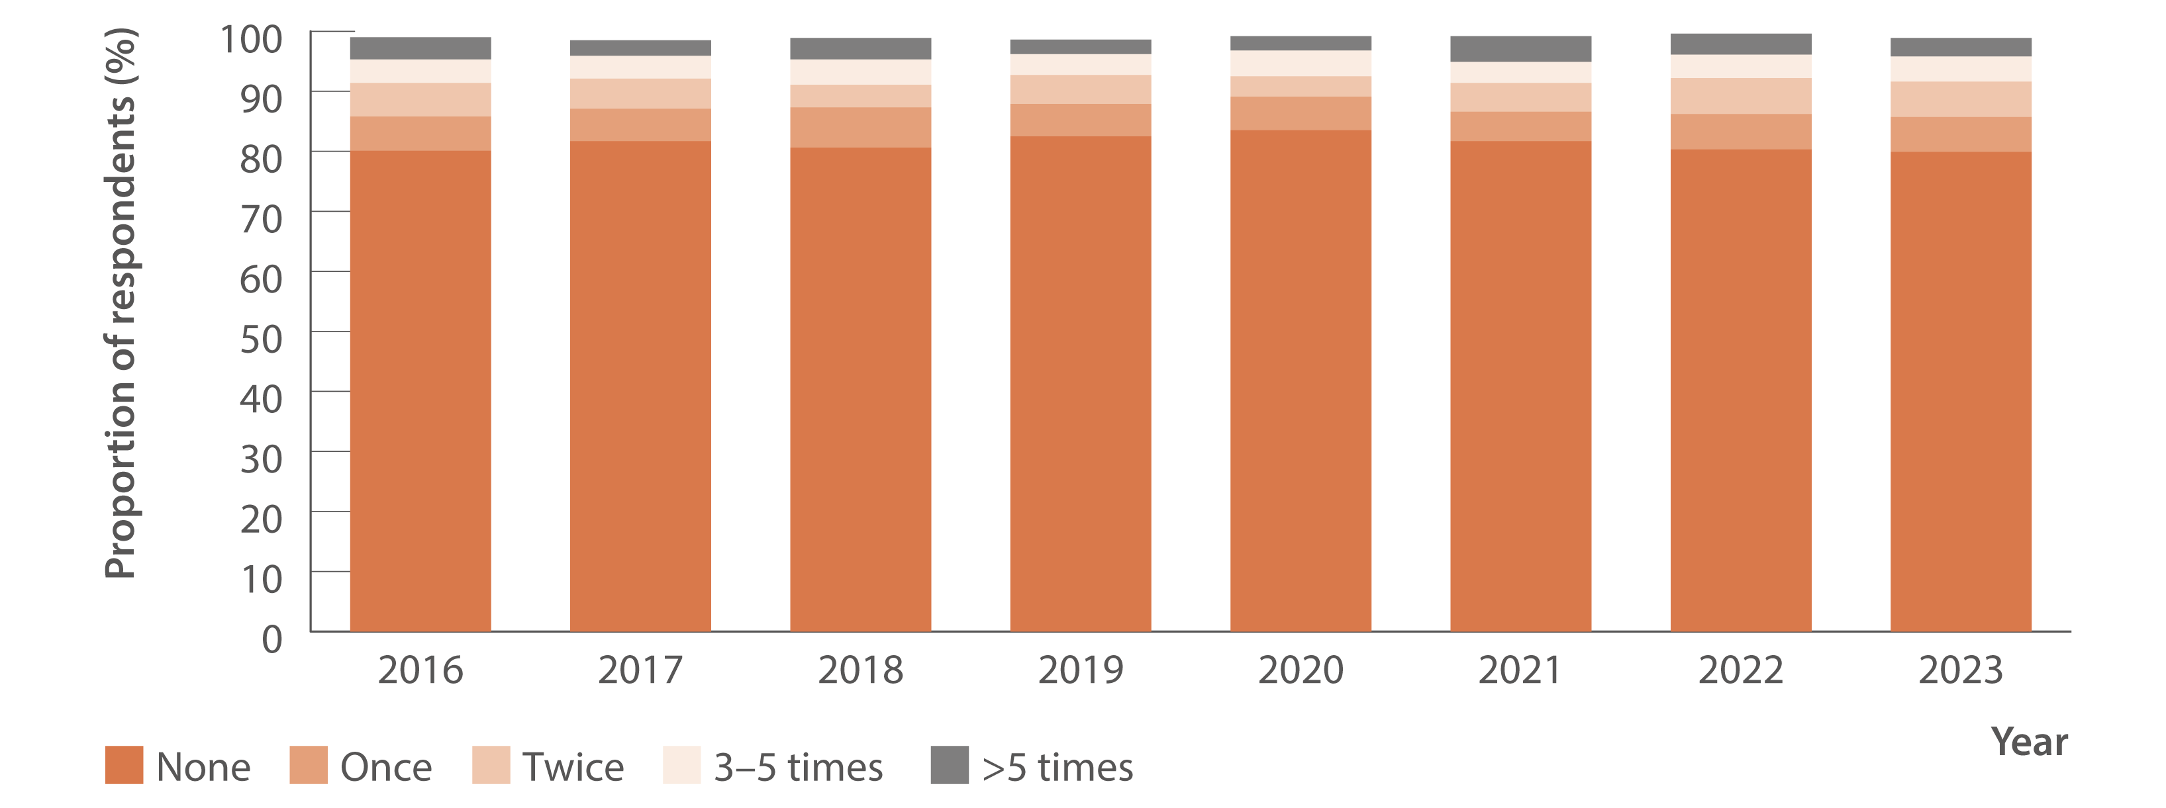
Figure 38. Proportion of Australian Needle Syringe Program Survey respondents reporting re‑use of someone else’s needles and syringes in the past month, 2016–2023
Prevention
Source: Australian Needle Syringe Program Survey. 25-year National Data Report 1995–2019.⁽²⁶⁾ Australian Needle Syringe Program Survey. National Data Report 2019–2023.⁽¹⁹⁾
Notes:
Primary prevention is a key pillar in the response to hepatitis C.
The Australian Needle Syringe Program Survey is a long-standing annual bio-behavioural survey of people attending needle and syringe programs. A strength of studies of this design is the consistency of data collection, and we can see here that up to 20% of people surveyed reported re-use of someone else’s needles and syringes in the past month, and there has been limited change in this proportion over time.

Slide 28
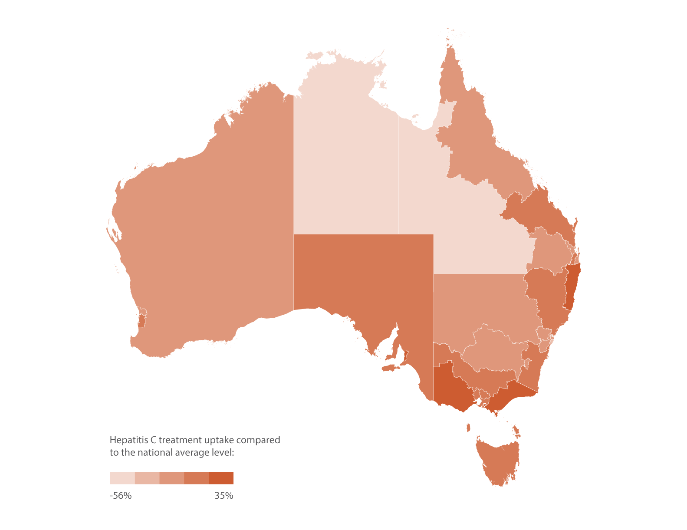
Figure 42. Geographic variation in hepatitis C treatment uptake, March 2016–October 2023
Equity
Source: The National Viral Hepatitis Mapping Project (WHO Collaborating Centre for Viral Hepatitis, The Doherty Institute).⁽⁵¹⁾
Notes:
The Viral Hepatitis Mapping Project provide detail on hepatitis C prevalence, management, and treatment uptake by Primary Health Networks (PHNs) compared to the national average.
This figure gives insight into geographic diversity in treatment uptake, with higher treatment uptake than the national average seen in some PHNs.

Slide 29
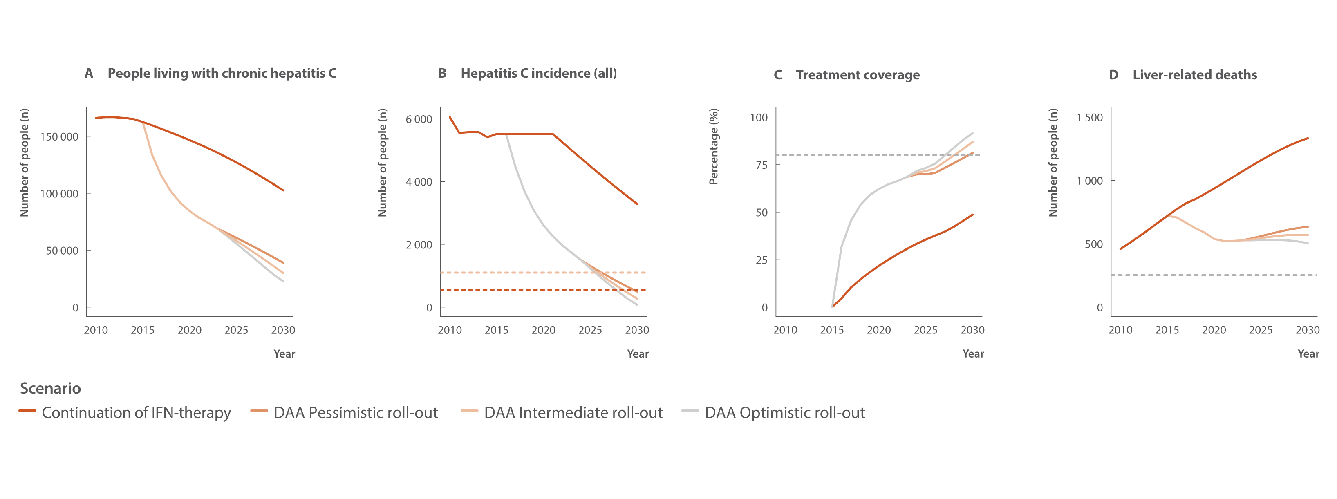
Figure 43. Annual change in people living with chronic hepatitis C, hepatitis C incidence (all), treatment coverage, and liver‑related deaths (viraemic and cured) in Australia 2030 (2010–2030) with WHO HCV elimination targets (dotted lines: Panel B: 80% and 90% reductions in incidence, Panel C: 80% eligible treated, and Panel D: 65% reduction in deaths)
Modelling elimination
Source: Updated from Kwon et al., J Viral Hepat 2019(2) and Kwon et al., PLoS One 2021.(3)
Notes:
This takes us to our final chapter, Modelling elimination.
Modelling from the Kirby Institute group here maps estimated rates of hepatitis C prevalence, incidence, treatment coverage, and liver-related death against World Health Organization elimination goals. Figure A shows people living with hepatitis C, figure B shows hepatitis C incidence, C shows treatment coverage, and D shows liver-related deaths.
Just looking at figure C, we can see that treatment goals will be met by 2030 under even a pessimistic scenario of around 4000 people treated with DAAs each year.

Slide 30
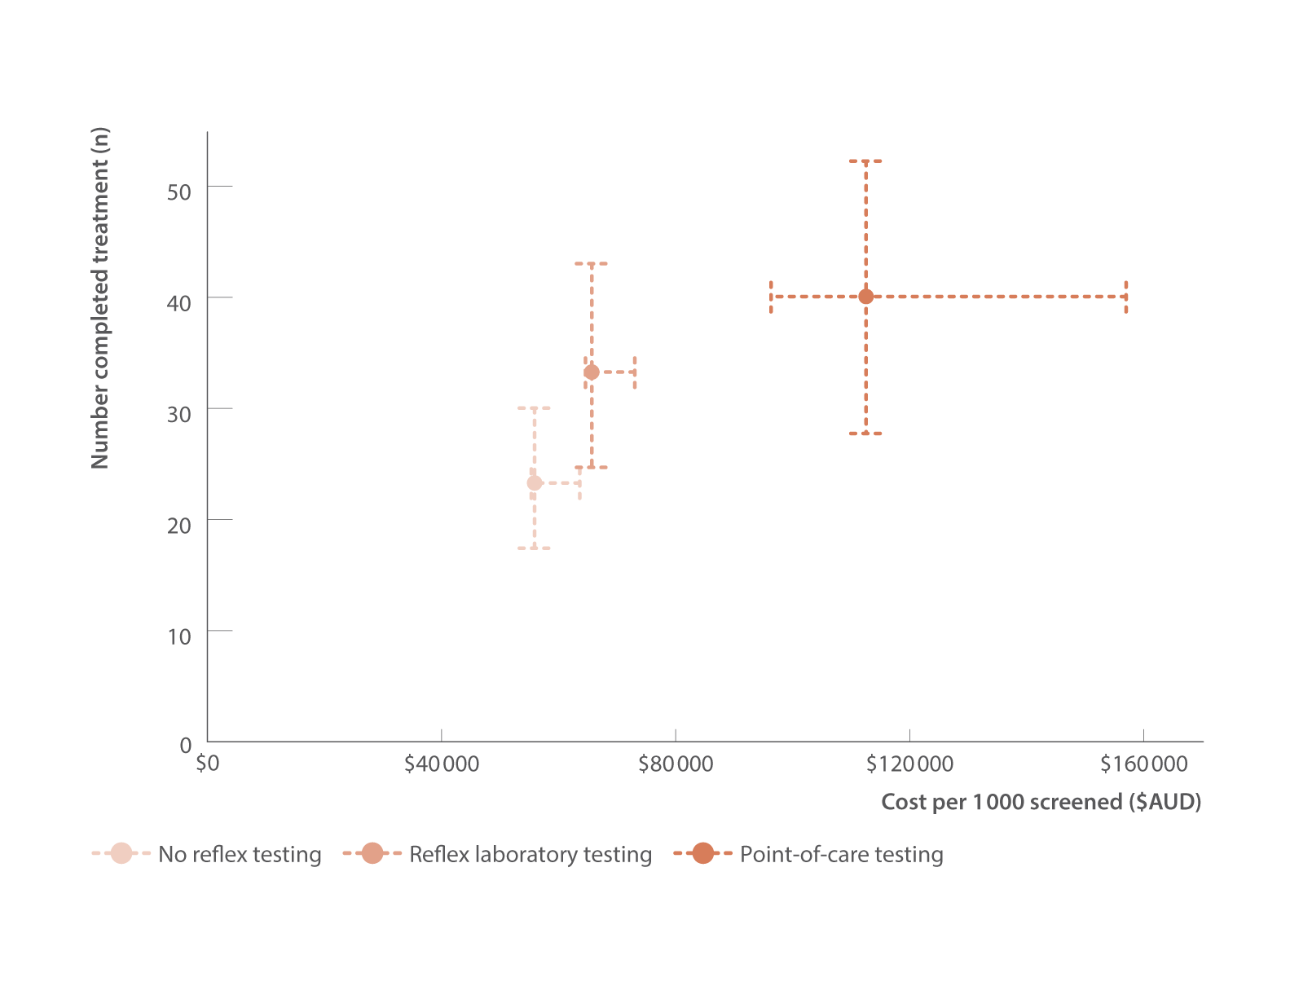
Figure 45. Estimated costs (2023 $AUD) and effectiveness of hepatitis C treatment initiation approaches for treatment‑naive people who inject drugs
Modelling elimination
Source: Adapted from Baille et al. 2024.(personal communication, Joseph Doyle, Burnet Institute).
Notes:
Modelling by the Burnet Institute compared the cost‑effectiveness of laboratory reflex testing to other hepatitis C testing approaches.
Effectiveness (number of treatment completions) and costs per 1 000 people screened are shown for each scenario.
The model estimated that reflex testing cost modestly more than the no reflex testing approach to screening, but increased treatment completions from 23 to 33.
The point‑of‑care strategy was substantially more costly but resulted in the highest number of treatment completions—40.
These findings emphasise the potential benefits of policies that improve the efficiency of existing hepatitis C laboratory testing approaches by enabling and encouraging routine reflex testing in addition to roll out of new testing technologies that expand reach.

Slide 31
Q & A
Alisa Pedrana
Notes:
I will now handover to Alisa Pedrana for our Q & A.
I invite our panel guests to turn on their camera, and invite the audience to use the Q & A feature to ask your questions.

