Slide 1
Acknowledgement of country

Slide 2
We acknowledge the Traditional Owners on whose Country we are based. We pay our respect to their Elders past and present, and emerging leaders, and acknowledge their continuing connection to land, sea and community.
Sovereignty was never ceded.
This always was, and always will be Aboriginal land.

Slide 3
Facilitator introduction

Slide 4
Housekeeping

Slide 5
Recording/Photography

Slide 6
Background of workshop

Slide 7
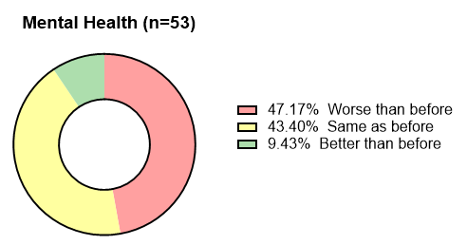
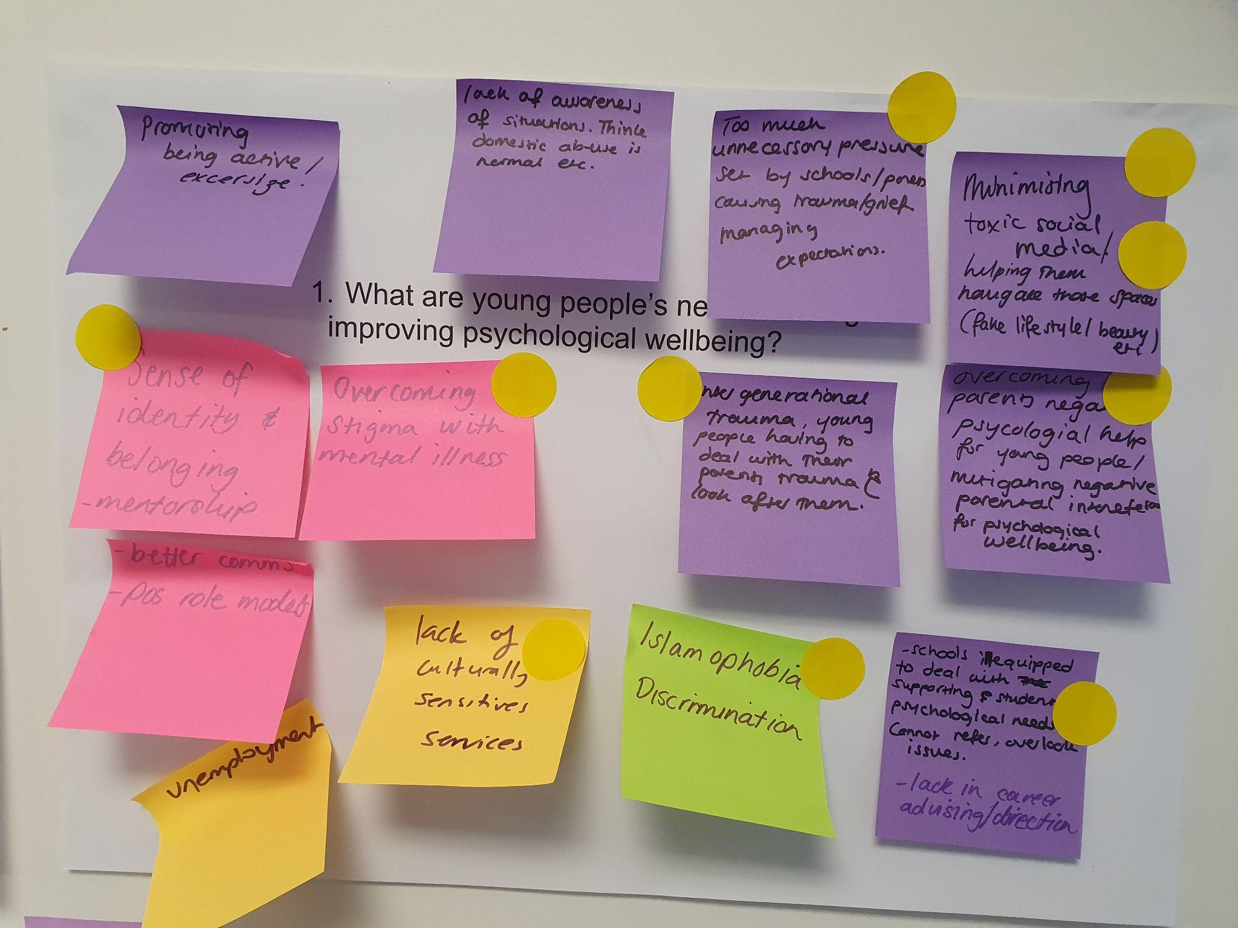
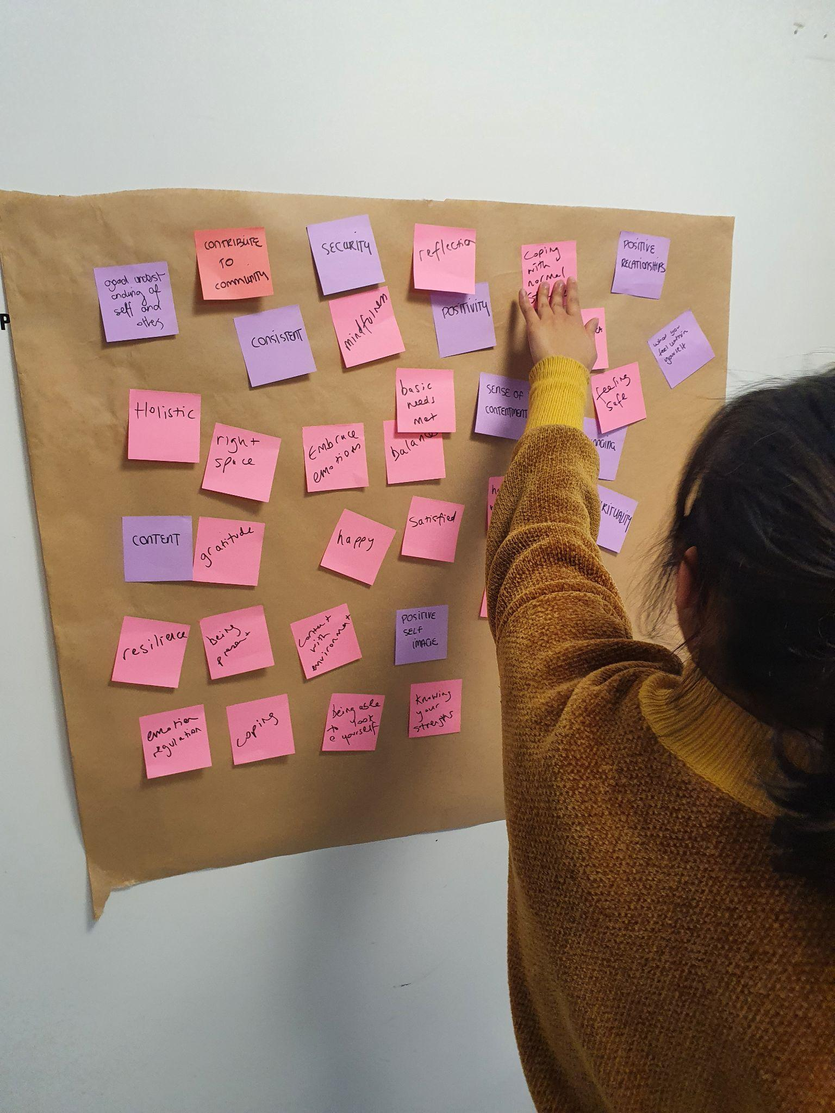
Darebin Muslim Community Project
In 2023, the Burnet Institute and its project partners Your Community Health, the Islamic Museum of Australia and the Australian Multicultural Foundation collaborated on developing an intervention for the Muslim community based in Darebin
The project aim was to better understand the Darebin Muslim community pandemic experiences and current and emerging needs
Research had revealed that the community were disengaged with pandemic related communications; a survey revealed the need for accessible mental health services and supports that address social isolation and disconnection from services and community
Burnet and partners used this information to co design this workshop with members of the community

Slide 8
Workshop aims

Slide 9
Today’s workshop aims to answer the question ‘How can we equip a community with better tools for good mental health?’
The aims of the activities are as follows:
Developing mental health literacy and cultural understanding of mental health in the community
Creatively developing a vision of a community which is supportive of mental health and wellbeing
Creating messages and materials that can be shared with a wider audience in order to improve community mental health and wellbeing

Slide 10
Overview

Slide 11
Activity 1: Icebreaker (15-25 minutes)
Activity 2: What does mental health mean to us? (45-60 minutes)
Activity 3: Our town: a strong and supportive community (75 minutes)
Activity 4: Expanding the city limits: sharing what we have created (40-45 minutes)
Activity 5: Evaluation (10 minutes)

Slide 12
Icebreaker

Slide 13
What words come to mind when people use the term ‘wellbeing’?

Slide 14
What kinds of things can affect a positive sense of wellbeing, or throw it off balance?

Slide 15
Is wellbeing something that people need to learn how to ‘tune into’ only at certain times, or is it something we can help develop and nurture over a period of time?

Slide 16
Introductions

Slide 17
Draw or write an item, place or activity that elicits a sense of wellbeing/self-care, then share with the group:
Your name
Why you are here today and what you hope to get out of the session
Your activity

Slide 18
What does mental health mean to us?

Slide 19
Let’s reflect on definitions of mental health from the worksheets.
What do you like?
What don’t you like?
Are there any keywords in the definitions that you think are important to keep?
Are there any keywords in the definition that you’re not sure about or should be removed?

Slide 20
Building our own definition

Slide 21
In groups ( 2-3 participants)
Develop a definition of mental health using worksheets provided
Present it to the wider group
What did you like most or like least about other group’s interpretations of the activity?
Is there anything you want to change about your own definition now you have heard others?

Slide 22
Mental health needs and supports

Slide 23
Reflect on the needs described in the worksheet
Do you feel that the mental health needs of young people and parents resonate?
Why? Why not?

Slide 24
Where can people access supports for mental health in their community?

Slide 25
Our town: a strong and supportive community

Slide 26
In groups ( 2-3 participants) creatively develop a community which is supportive of mental health using craft materials
  Use worksheet as guide to help support the development of your town
  Build and get creative in how your community could be stronger and more supportive of mental health
  Use a list of potential supports and services that already exist in the community
  Select 1-2 key places from the activity on where you would like to access mental health supports in your community and include those too
  Share your town with the wider group

Slide 27
Expanding the city limits

Slide 28
In your same groups reflect on your town and the others you heard about
What were the similarities and differences between the towns?
What did you like most about other group’s towns?
Are there some ideas that could be combined from the different towns to make a bigger or better idea that is more likely to succeed?

Slide 29
Wrap up and evaluation

Slide 30
What are your key takeaways from the workshop?

Slide 31
What are the things that you would like to improve on in your community?

Slide 32
Written surveys
Feedback on workshop and any improvements

Slide 33
Thank You

Slide 34
Feel free to use these, build on them to create something new, or come up with your own thing altogether! We would love to hear about how you have used and adapted them and any feedback you would like us to incorporate into the resources to improve them.
Email us at voice@burnet.edu.au

