Slide 1
Annual Report 2022

Slide 3
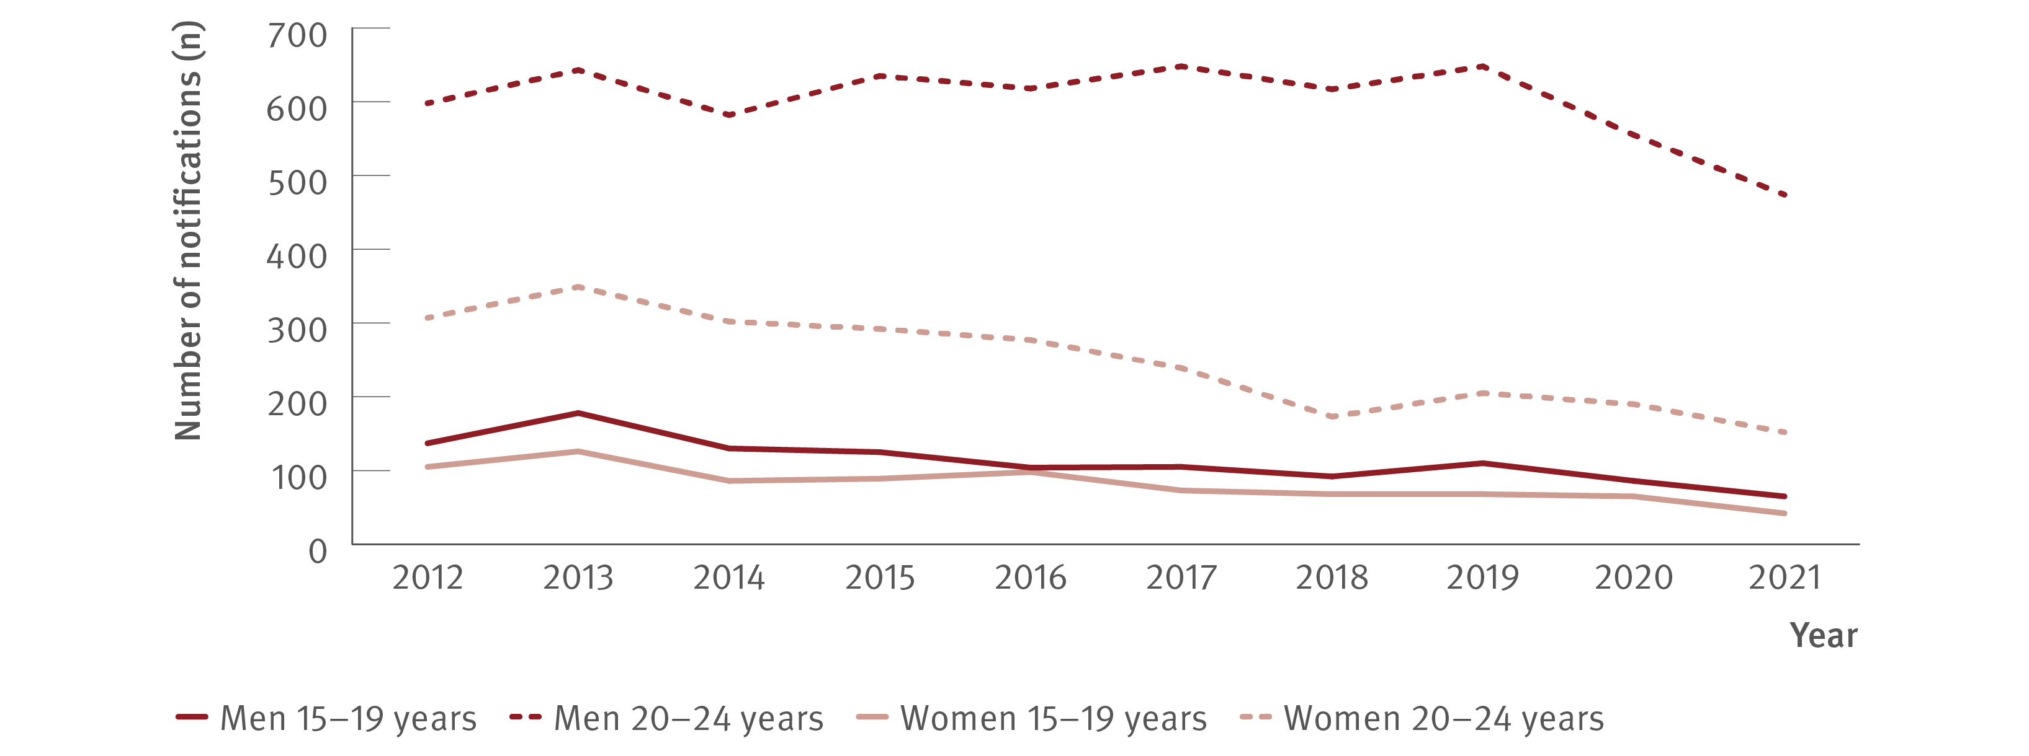
Figure 1. Number of hepatitis C (unspecified and newly acquired) notifications by age group and gender, 2012–2021
New infections
Source: Australian National Notifiable Diseases Surveillance System.^{(4,9,10)}
Notes:
Notes: Cases other than newly acquired were assigned as unspecified.

Slide 4
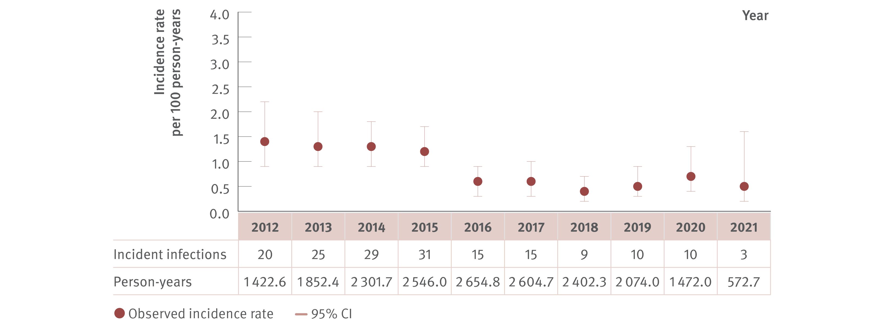
Figure 2. Incidence of primary hepatitis C infection among individuals tested at ACCESS primary care clinics, ACCESS, 2012–2021
New infections
Source: ACCESS.⁽¹²⁾
Notes:
Notes: N=7 190. Analysis includes nine sites: seven in VIC, one in Western Australia (WA), and one in Queensland (QLD). The WA site contributed data from 2016 onwards. Primary care clinics see high caseloads of people at risk of hepatitis C and provide both specialist services to current or former people who inject drugs as well as general health services. First incident infection only included in analysis. Incident infection date was assigned as the midpoint between the positive HCV antibody or HCV RNA test date and previous HCV antibody negative test date. ACCESS collates data from January 2009. Individuals included tested HCV antibody negative on their first test observed and had at least one follow‑up test (HCV antibody or HCV RNA or both on or before 31st December 2021). Individuals were 15 years or older. CI: confidence interval.

Slide 5
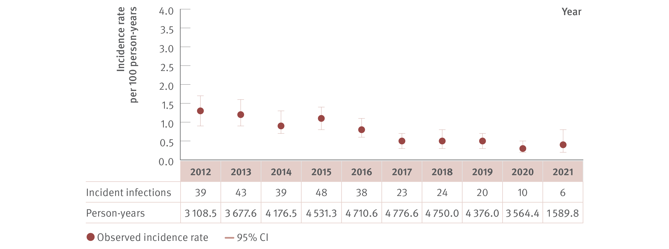
Figure 3. Incidence of primary hepatitis C infection among HIV‑positive GBM tested at ACCESS GBM or sexual health clinics, ACCESS, 2012–2021
New infections
Source: ACCESS.⁽¹²⁾
Notes:
Notes: N=7 519. Analysis includes 16 sites: six in NSW, four in VIC, one in South Australia (SA), two in Australian Capital Territory (ACT), one in WA, one in QLD, and one in Tasmania (TAS). The TAS site contributed data from 2013 onwards. GBM were classed as being HIV‑positive for the entire calendar year of their diagnosis and were 15 years or older. First incident infection only included in analysis. Incident infection date was assigned as the midpoint between the positive HCV antibody or HCV RNA test date and previous HCV antibody negative test date. ACCESS collates data from January 2009. Individuals included tested HCV antibody negative on their first test observed, and had at least one follow‑up test (HCV antibody or HCV RNA or both on or before 31st December 2021). CI: confidence interval.

Slide 6
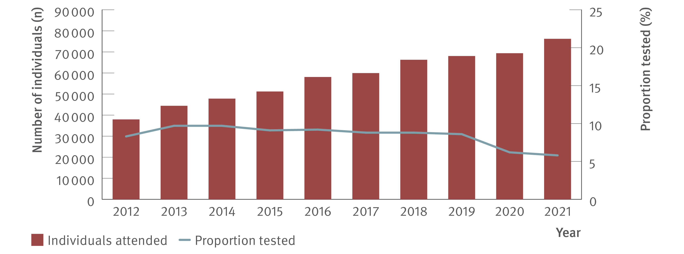
Figure 4. Number of individuals attending ACCESS primary care clinics and proportion tested for HCV (HCV antibody only or HCV antibody and RNA or HCV RNA only), ACCESS, 2012–2021
Testing and diagnosis
Source: ACCESS.⁽¹²⁾
Notes:
Notes: Analysis includes nine sites: seven in VIC, one in WA, and one in QLD. The WA site contributed data from 2016 onwards. Primary care clinics have high caseloads of people at risk of hepatitis C and provide both specialist services to current and former people who inject drugs as well as general health services. Clinic attendances included in‑person and telehealth consultations. Individuals were 15 years or older and contributed one consultation and one test per year.

Slide 7
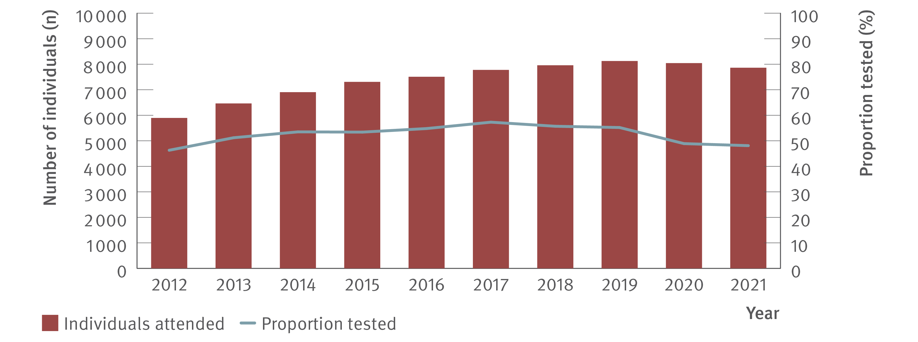
Figure 5. Number of HIV‑positive GBM attending ACCESS GBM or sexual health clinics and proportion tested for HCV (HCV antibody only or HCV antibody and RNA or HCV RNA only), ACCESS, 2012–2021
Testing and diagnosis
Source: ACCESS.⁽¹²⁾
Notes:
Notes: Analysis includes 16 sites: six in NSW, four in VIC, one in SA, two in ACT, one in WA, one in QLD, and one in TAS. The TAS site contributed data from 2013 onwards. Clinic attendances included in‑person and telehealth consultations. GBM were classed as being HIV‑positive for the entire calendar year of their diagnosis, were 15 years or older, and contributed one consultation and one test per year.

Slide 8
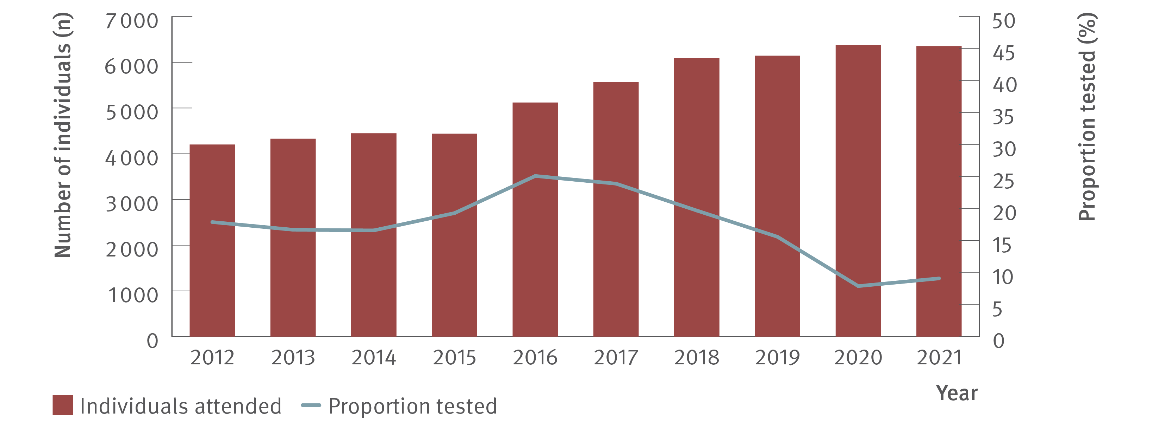
Figure 6. Number of individuals ever prescribed OAT attending ACCESS primary care clinics and proportion tested for HCV (HCV antibody only or HCV antibody and RNA or HCV RNA only), ACCESS, 2012–2021
Testing and diagnosis
Source: ACCESS.⁽¹²⁾
Notes:
Notes: Analysis includes nine sites: seven in VIC, one in WA, and one in QLD. The WA site contributed data from 2016 onwards. Primary care clinics have high caseloads of people at risk of hepatitis C and provide both specialist services to current and former people who inject drugs as well as general health services. Clinic attendances included in‑person and telehealth consultations. Individuals were 15 years or older, had at least one electronic medical record of a prescription for OAT between January 2009 and December 2021, and contributed one consultation and one test per year.

Slide 9
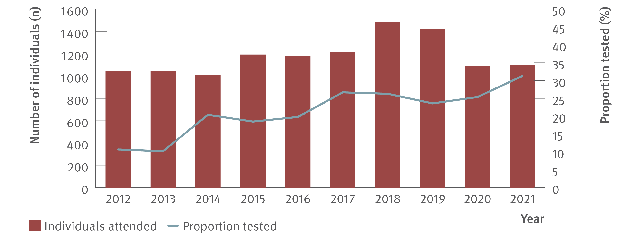
Figure 7. Number of Aboriginal and Torres Strait Islanders attending ACCESS sexual health clinics and proportion tested for HCV (HCV antibody only or HCV antibody and RNA or HCV RNA only), ACCESS, 2012–2021
Testing and diagnosis
Source: ACCESS.⁽¹²⁾
Notes:
Notes: Analysis includes seven sites: four in NSW, one in VIC, one in ACT, and one in SA. Clinic attendances included in‑person and telehealth consultations. Individuals were 15 years or older and contributed one consultation and one test per year. Overall, of individuals who attended included clinics 2012–2021 for a consultation (N=850 984), 4.4% had no Aboriginal or Torres Strait Islander status recorded (missing), 6.5% were recorded as ‘not stated’, 86.2% were neither Aboriginal nor Torres Strait Islander, and 2.9% were Aboriginal and Torres Strait Islander.

Slide 10
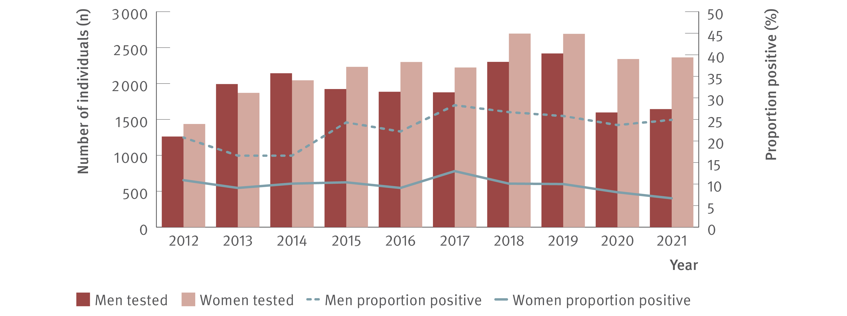
Figure 8. Number of individuals tested for HCV antibody at ACCESS primary care clinics and proportion of HCV antibody tests positive by gender, ACCESS, 2012–2021
Testing and diagnosis
Source: ACCESS.⁽¹²⁾
Notes:
Notes: Analysis includes nine sites: seven in VIC, one in WA, and one in QLD. The WA site contributed data from 2016 onwards. Primary care clinics have high caseloads of people at risk of hepatitis C and provide both specialist services to current and former people who inject drugs as well as general health services. Clinic attendances included in‑person and telehealth consultations. Individuals were 15 years or older and contributed one test per year. Individuals recorded as ‘Other’ sex or sex not recorded were not included due to small sample size.

Slide 11
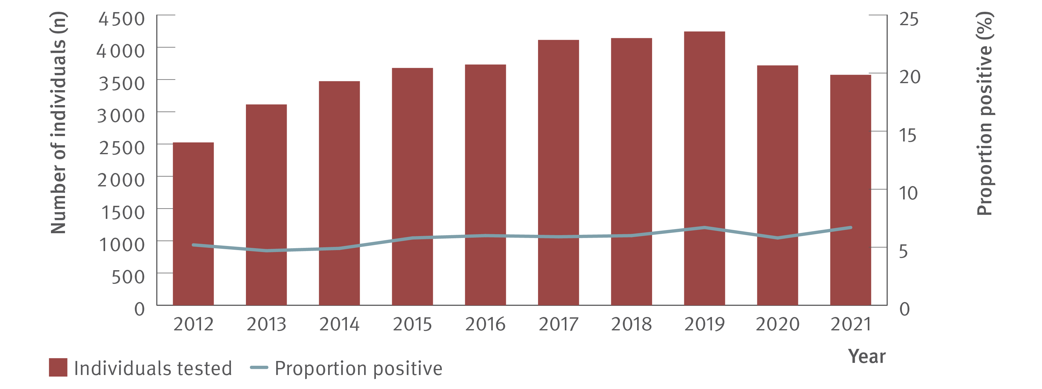
Figure 9. Number of HIV‑positive GBM tested for HCV antibody at ACCESS GBM or sexual health clinics and proportion of HCV antibody tests positive, ACCESS, 2012–2021
Testing and diagnosis
Source: ACCESS.⁽¹²⁾
Notes:
Notes: Analysis includes 16 sites: six in NSW, four in VIC, one in SA, two in ACT, one in WA, one in QLD, and one in TAS. The TAS site contributed data from 2013 onwards. GBM were classed as being HIV‑positive for the entire calendar year of their diagnosis, were 15 years or older, and contributed one test per year.

Slide 12
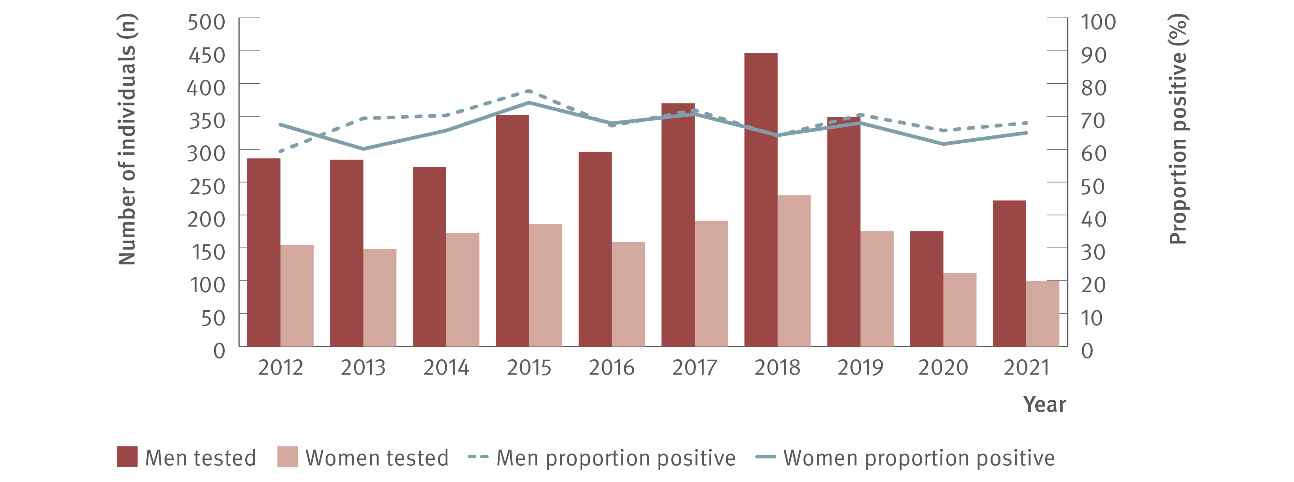
Figure 10. Number of individuals ever prescribed OAT tested for HCV antibody at ACCESS primary care clinics and proportion of HCV antibody tests positive by gender, ACCESS, 2012–2021
Testing and diagnosis
Source: ACCESS.⁽¹²⁾
Notes:
Notes: Analysis includes nine sites: seven in VIC, one in WA, and one in QLD. The WA site contributed data from 2016 onwards. Primary care clinics have high caseloads of people at risk of hepatitis C and provide both specialist services to current and former people who inject drugs as well as general health services. Individuals were 15 years or older, had at least one electronic medical record of a prescription for OAT between January 2009 and December 2021, and contributed one test per year. Individuals recorded as ‘Other’ sex or sex not recorded were not included due to small sample size.

Slide 13
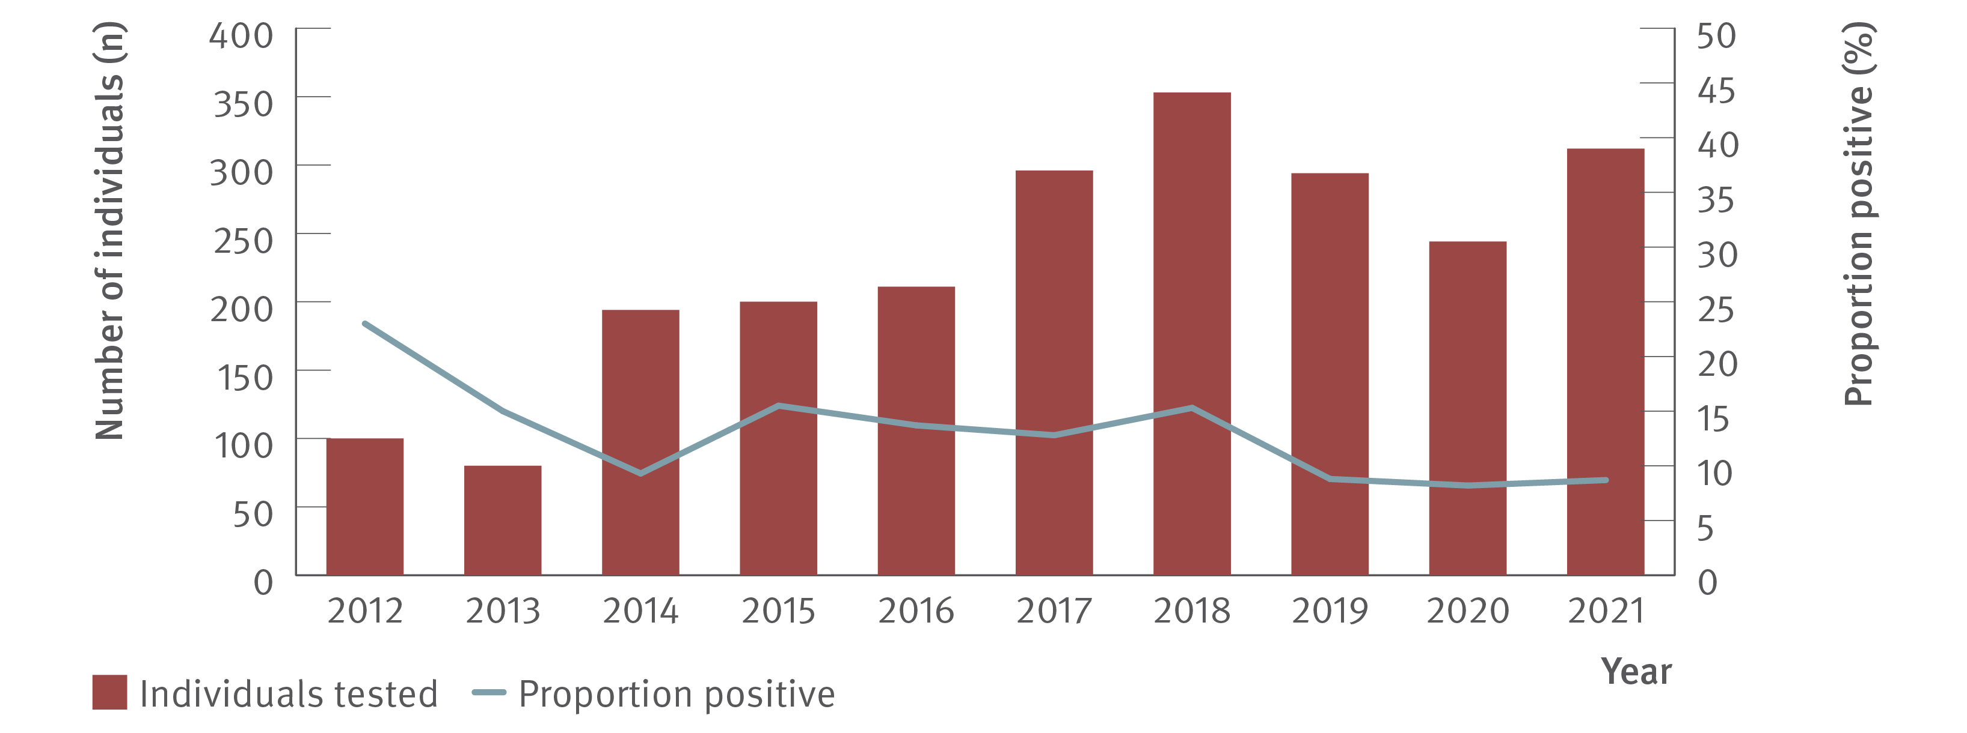
Figure 11. Number of Aboriginal and Torres Strait Islanders tested for HCV antibody at ACCESS sexual health clinics and proportion of HCV antibody tests positive, ACCESS, 2012–2021
Testing and diagnosis
Source: ACCESS.⁽¹²⁾
Notes:
Notes: Analysis includes seven sites: four in NSW, one in VIC, one in ACT, and one in SA. Clinic attendances included in‑person and telehealth consultations. Individuals were 15 years or older and contributed one test per year.

Slide 14
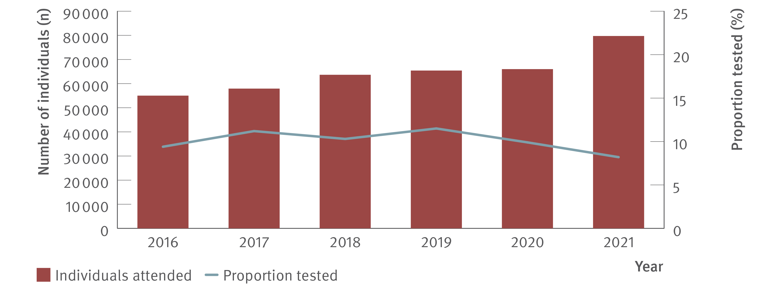
Figure 12. Number of individuals attending ACCHSs and proportion tested for HCV (HCV antibody only or HCV antibody and RNA or HCV RNA only), ATLAS network, 2016–2021
Testing and diagnosis
Source: ATLAS sexual health surveillance network, 2016–2021.⁽¹⁸⁾
Notes:
Notes: Individuals defined as people aged 15 years or older, who visited a doctor, nurse, or Aboriginal health practitioner (‘medical consultations’) between 2016 and 2021.

Slide 15
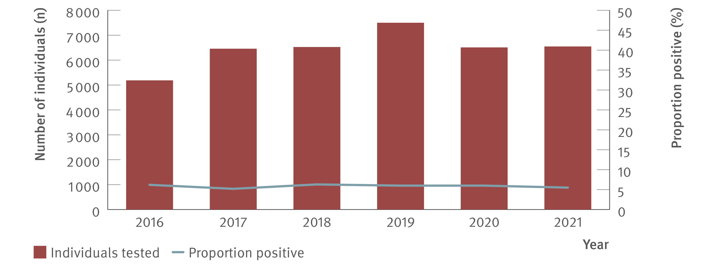
Figure 13. Number of individuals attending ACCHSs tested for HCV antibody and proportion positive,
ATLAS network, 2016–2021
Testing and diagnosis
Source: ATLAS sexual health surveillance network, 2016–2021.⁽¹⁸⁾
Notes:
Notes: Individuals defined as people aged 15 years or older, who visited a doctor, nurse, or Aboriginal health practitioner (‘medical consultations’) between 2016 and 2021.

Slide 16
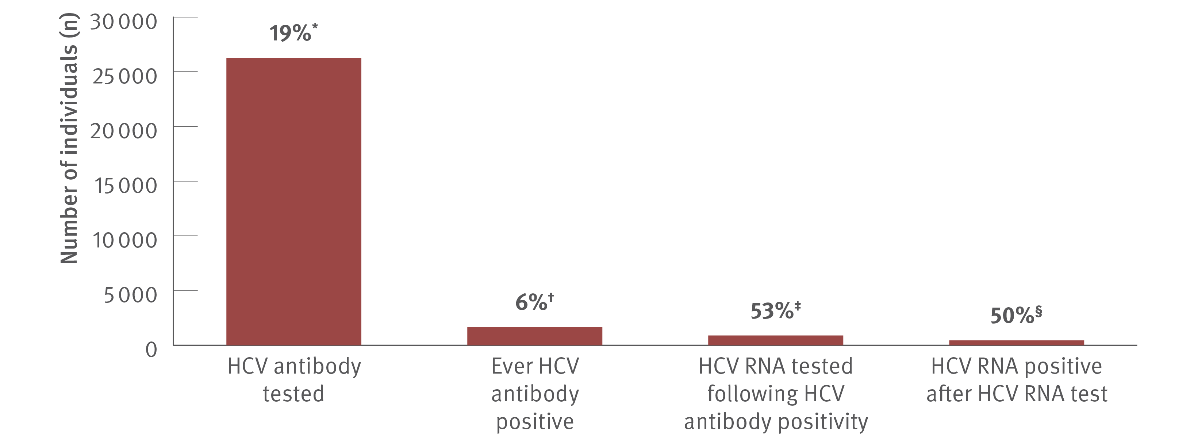
Figure 14. Hepatitis C testing cascade: number and proportion of individuals attending ACCHSs tested for HCV antibody or RNA and among those tested, the number and proportion testing positive, ATLAS network, aggregated for years 2016–2021
Testing and diagnosis
Source: ATLAS sexual health surveillance network, 2016–2021.⁽¹⁸⁾
Notes:
Notes: Individuals defined as people aged 15 years or older, who visited a doctor, nurse, or Aboriginal health practitioner (‘medical consultations’) between 2016 and 2021. ‘Ever HCV antibody positive’ was defined as having had a positive test result at any time since data collection began (1st January 2016) until end of the sample period (December 2021). *A total of 136 379 individuals aged 15 years or older attended medical appointments between 2016 and 2021, of whom 19.2% (26 243/136 379) had an HCV antibody test. †Of those tested for HCV antibody, 6.4% (1 679/26 243) tested HCV antibody positive. ‡Of those HCV antibody positive, 53.4% (896/1 679) had an HCV RNA test following HCV antibody positivity of which §50.4% (452/896) were HCV RNA positive.

Slide 17
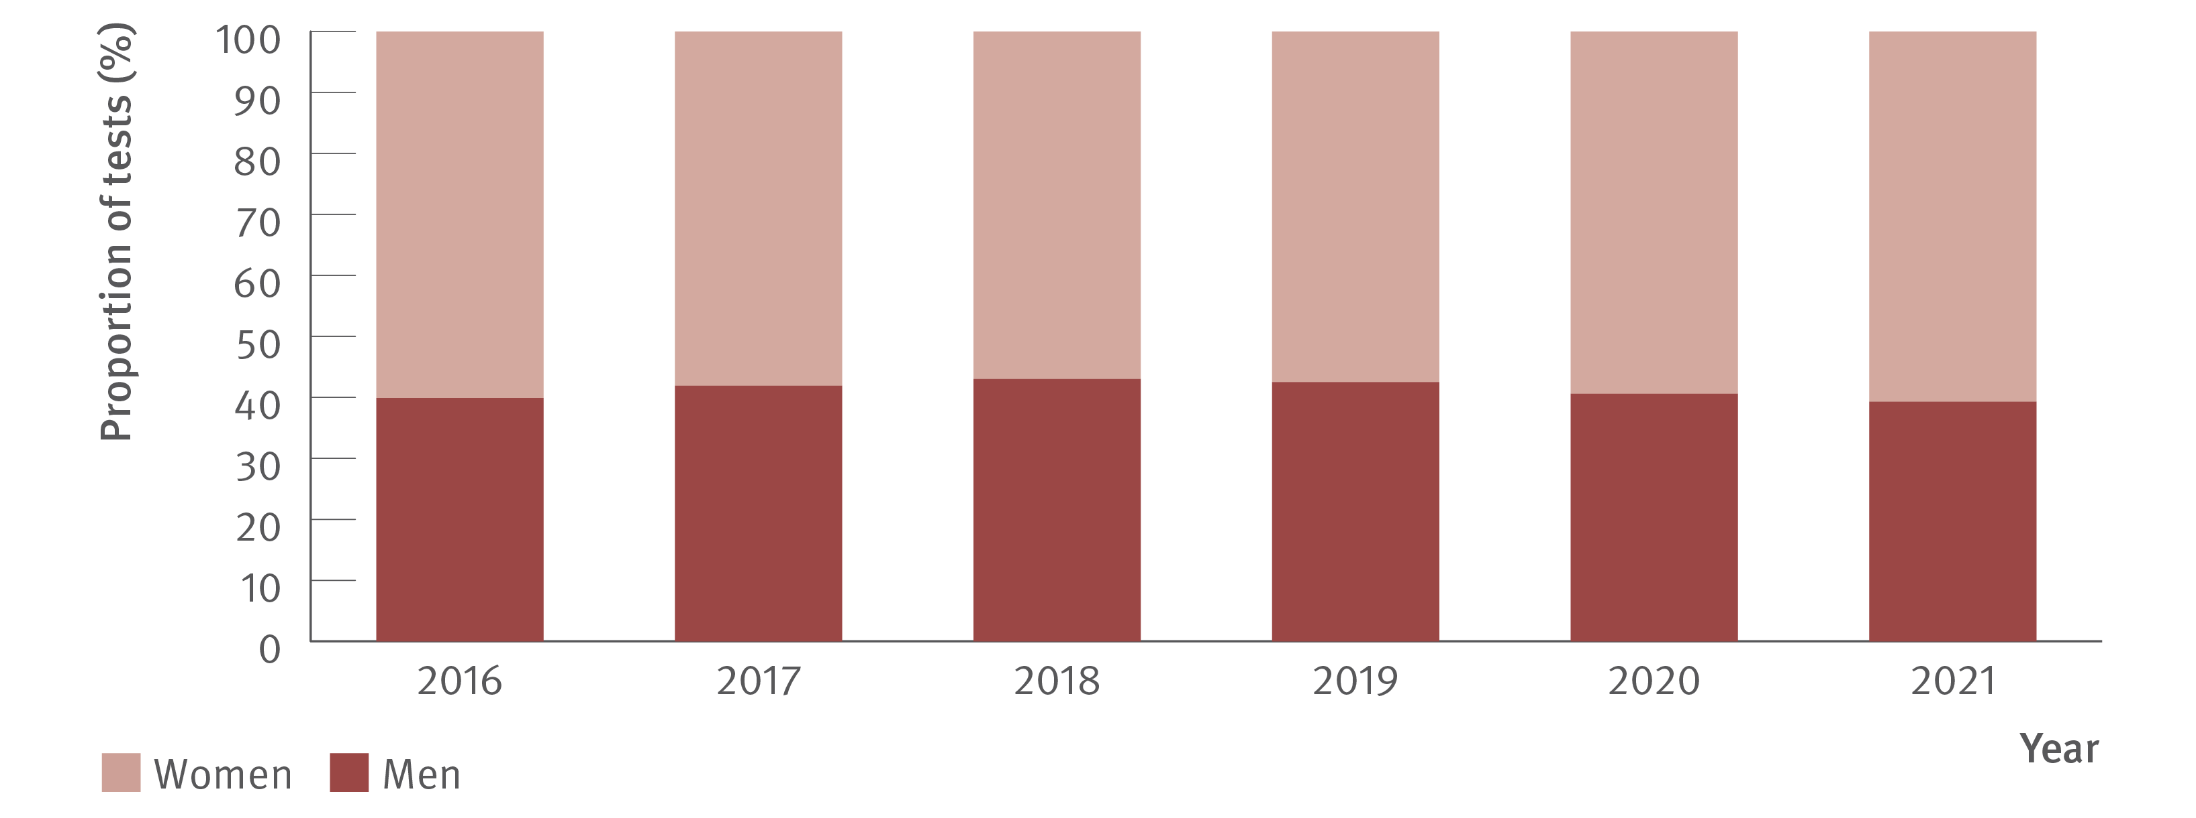
Figure 15. Proportion of HCV tests (HCV antibody only or HCV antibody and RNA or HCV RNA only) at ACCHSs by gender, ATLAS network, 2016–2021
Testing and diagnosis
Source: ATLAS sexual health surveillance network, 2016–2021.⁽¹⁸⁾
Notes:
Notes: Individuals defined as people aged 15 years or older, who visited a doctor, nurse, or Aboriginal health practitioner (‘medical consultations’) between 2016 and 2021. Number of people tested per year as follows: 2016: 2 070 men, 3 117 women; 2017: 2 710 men, 3 754 women; 2018: 2 806 men, 3 723 women; 2019: 3 193 men, 4 314 women; 2020: 2 641 men, 3 869 women; and 2021: 2 576 men, 3 975 women.

Slide 18
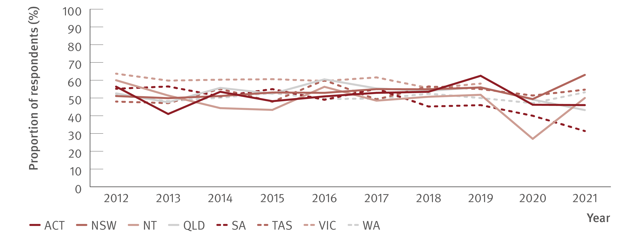
Figure 16. Proportion of ANSPS respondents self‑reporting recent (past 12 months) hepatitis C testing by jurisdiction, 2012–2021
Testing and diagnosis
Source: Australian Needle Syringe Program Survey. National Data Report 2017–2021.⁽¹⁹⁾
Notes:
Notes: No participant recruitment occurred in VIC in 2020.

Slide 19
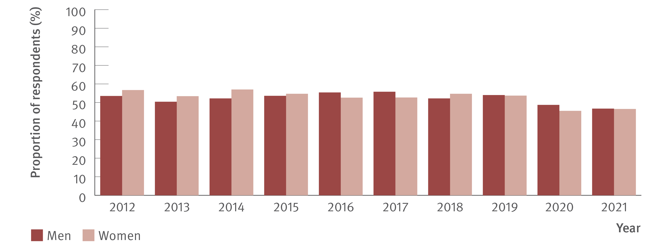
Figure 17. Proportion of ANSPS respondents reporting recent (past 12 months) hepatitis C testing by gender, 2012–2021
Testing and diagnosis
Source: Australian Needle Syringe Program Survey. National Data Report 2017–2021.⁽¹⁹⁾
Notes:
Notes: No participant recruitment occurred in VIC in 2020.

Slide 20
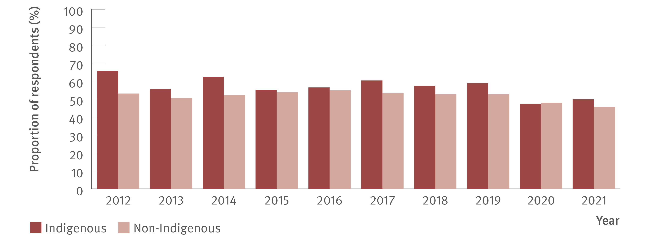
Figure 18. Proportion of ANSPS respondents reporting recent (past 12 months) hepatitis C testing by Indigenous status, 2012–2021
Testing and diagnosis
Source: Australian Needle Syringe Program Survey. National Data Report 2017–2021.⁽¹⁹⁾
Notes:
Notes: No participant recruitment occurred in VIC in 2020.

Slide 21
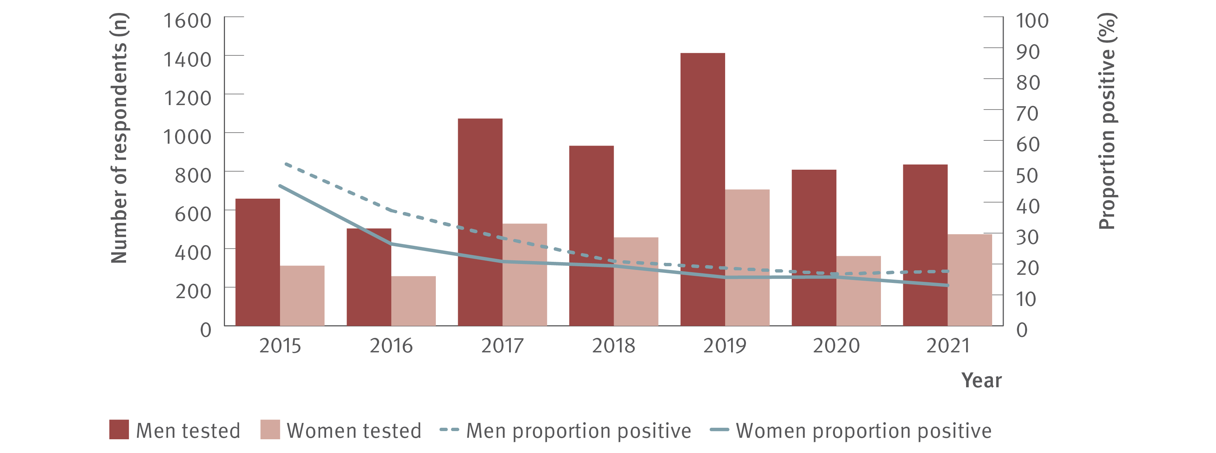
Figure 19. Number of ANSPS respondents tested for HCV RNA and proportion positive by gender, 2015–2021
Testing and diagnosis
Source: Australian Needle Syringe Program Survey. National Data Report 2017–2021;⁽¹⁹⁾ Australian Needle Syringe Program Survey 25 year National Data Report 1995–2019.⁽²³⁾
Notes:
Notes: No participant recruitment occurred in VIC in 2020. Weighted for gender and HCV antibody status.

Slide 22
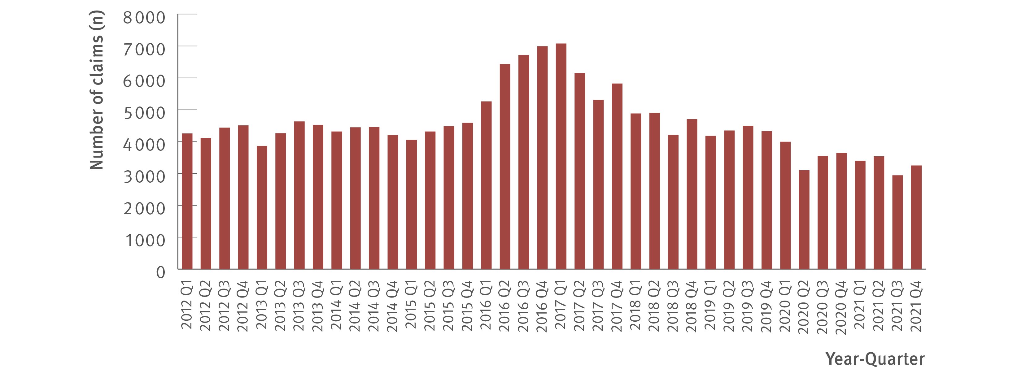
Figure 20. Number of claims to Medicare for items 69499 and 69500 (detection of HCV RNA, new infections only), 2012–2021
Testing and diagnosis
Source: Medicare Australia Statistics.⁽²⁰⁾
Notes:
Notes: MBS item numbers (69499 and 69500) are used for testing to detect current hepatitis C infection which are not used for tests associated with treatment monitoring. Prison‑based testing not included in MBS data.

Slide 23
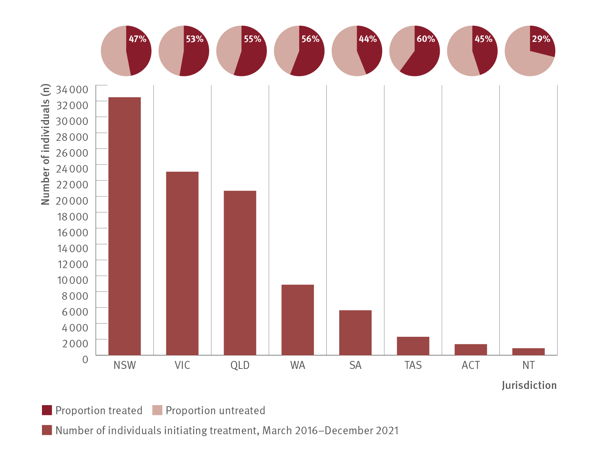
Figure 21. Estimated number of individuals initiating DAA treatment and the proportion of individuals living with chronic hepatitis C who initiated DAA treatment by jurisdiction, PBS database, March 2016–December 2021
Uptake of treatment
Source: Monitoring hepatitis C treatment uptake in Australia.⁽³⁰⁾
Notes:
Notes: Includes individuals initiating first treatment; data of the second or further courses of treatment are available from the Monitoring treatment uptake project. Treatment numbers may vary from previous or future reports due to refinements made to the PBS data between releases. Estimated proportion of individuals living with chronic hepatitis C who initiated DAA treatment was based on people living with chronic hepatitis C at the end of 2015 (N= 188 690)⁽⁴⁾ and does not encompass individuals with new infections from the end of 2015, some of whom will have been treated. Jurisdiction data were not available for 16 individuals; these individuals contributed to the national estimates only.

Slide 24
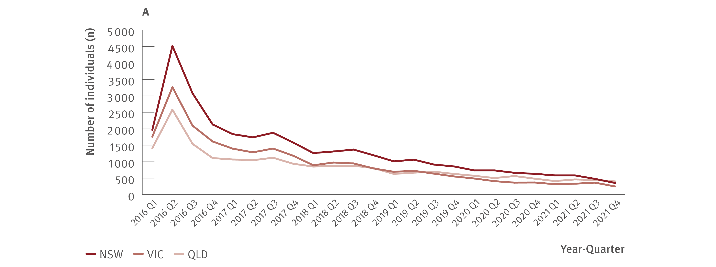
Figure 22. Estimated number of individuals initiating DAA treatment by jurisdiction, PBS database, March 2016–December 2021
Uptake of treatment
Source: Monitoring hepatitis C treatment uptake in Australia.⁽³⁰⁾
Notes:
Notes: 2016 Q1 is data from March 2016 only. Treatment numbers may vary from previous or future reports due to refinements made to the PBS data between releases.

Slide 25
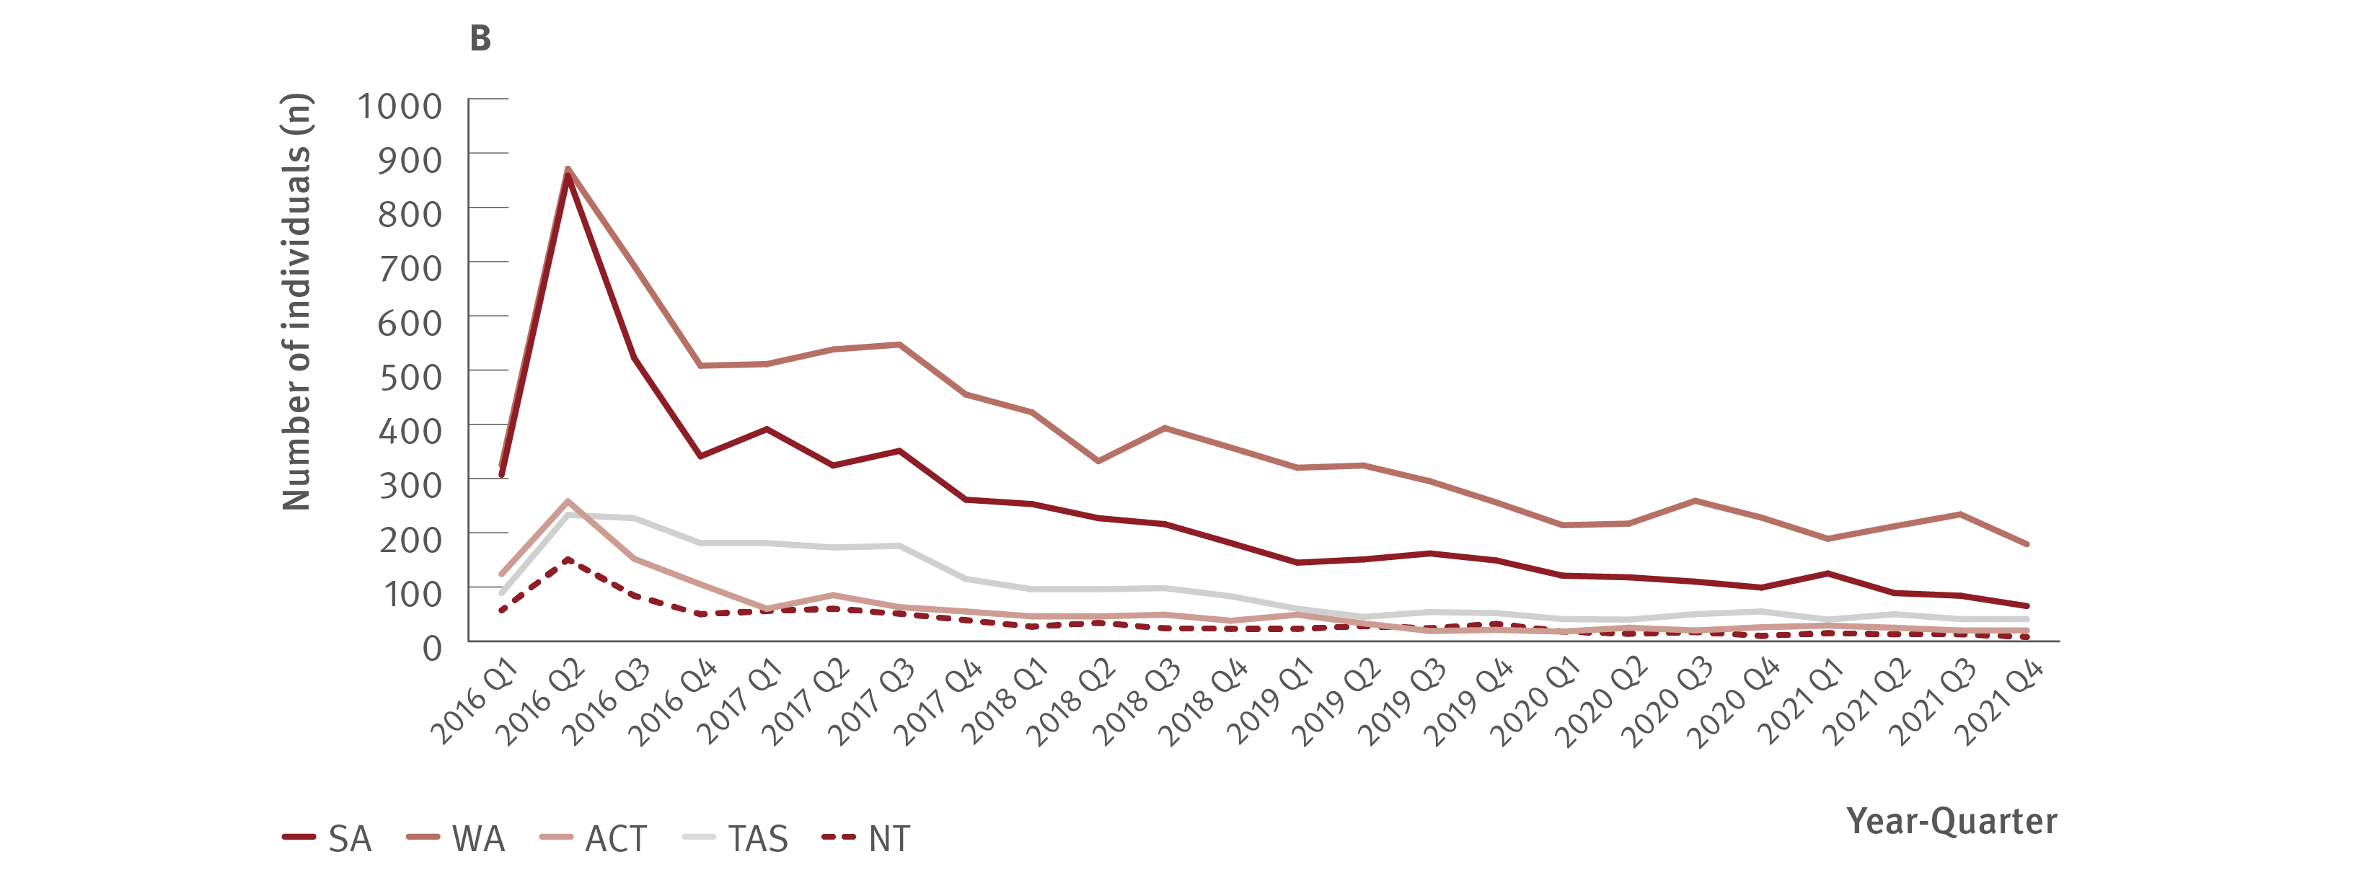
Figure 22. Estimated number of individuals initiating DAA treatment by jurisdiction, PBS database, March 2016–December 2021
Uptake of treatment
Source: Monitoring hepatitis C treatment uptake in Australia.⁽³⁰⁾
Notes:
Notes: 2016 Q1 is data from March 2016 only. Treatment numbers may vary from previous or future reports due to refinements made to the PBS data between releases.

Slide 26
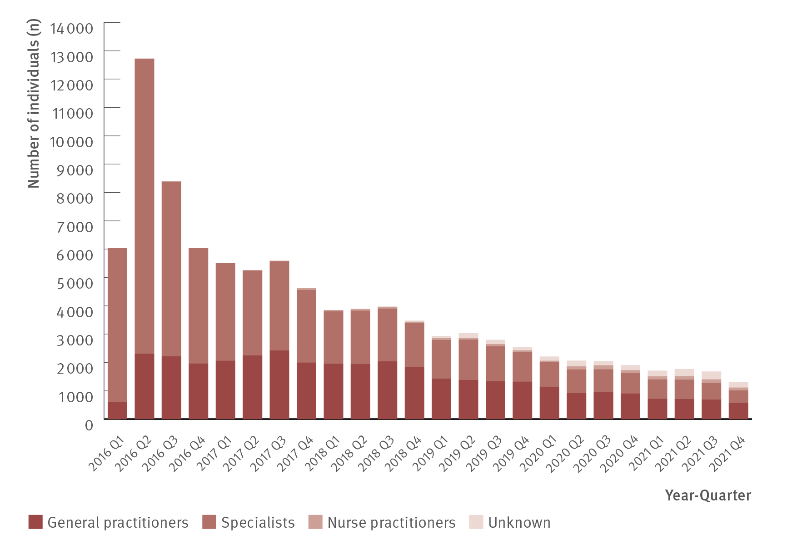
Figure 23. Estimated number of individuals initiating DAA treatment by prescriber type, PBS database, March 2016–December 2021
Uptake of treatment
Source: Monitoring hepatitis C treatment uptake in Australia.⁽³⁰⁾
Notes:
Notes: 2016 Q1 is data from March 2016 only. Treatment numbers may vary from previous or future reports due to refinements made to the PBS data between releases. Nurse practitioners have been authorised to prescribe DAA therapy for hepatitis C treatment since June 2017. The proportion of treatment initiations by prescriber type between 2019 and 2021 should be interpreted cautiously given the increasing number of unidentified prescriber type in these years.

Slide 27
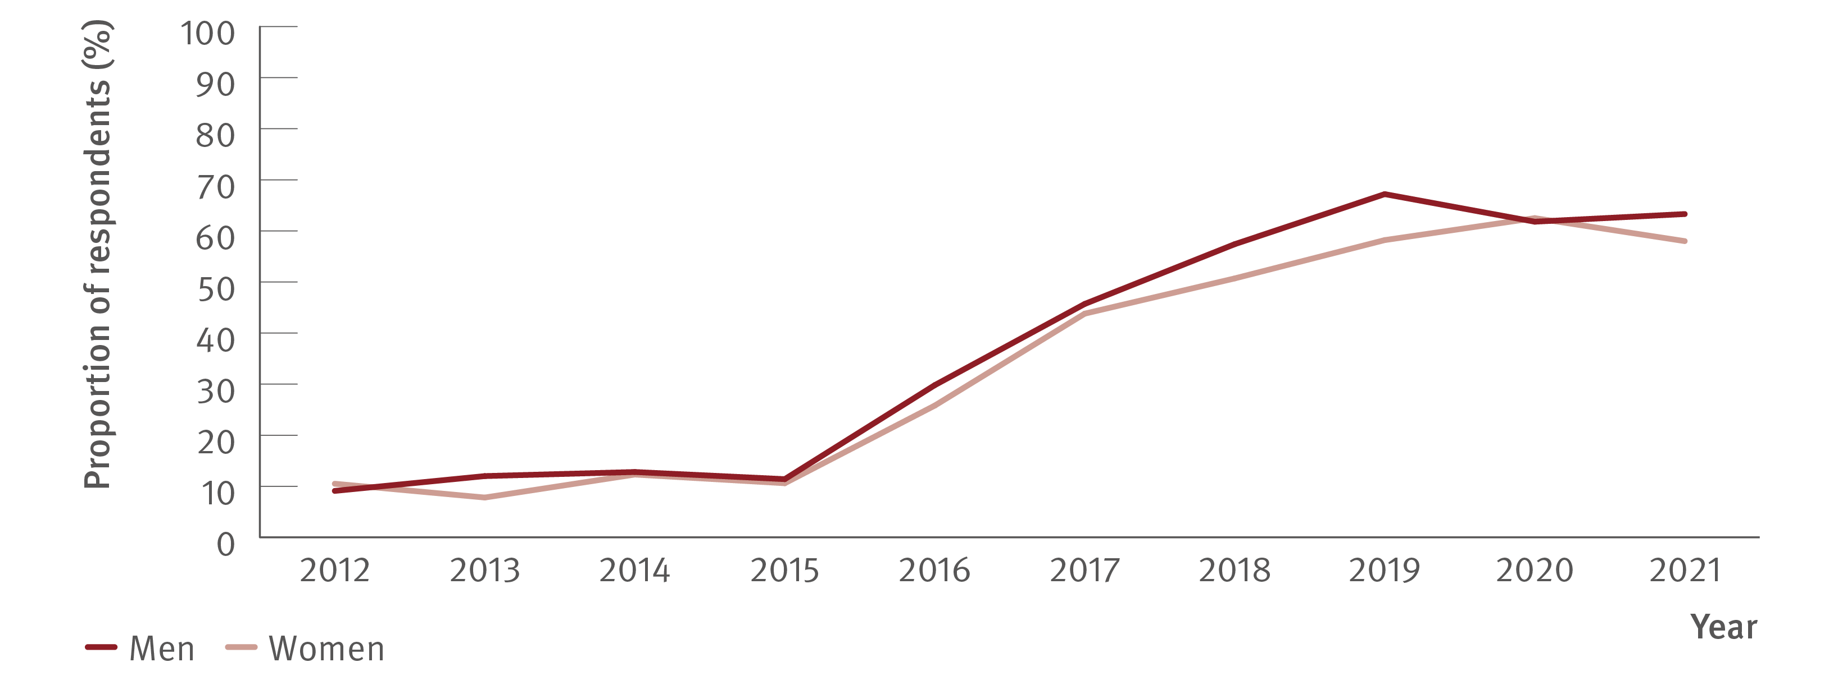
Figure 24. Proportion of ANSPS respondents who tested HCV antibody positive, self‑reporting lifetime history of hepatitis C treatment by gender, 2012–2021
Uptake of treatment
Source: Australian Needle Syringe Program Survey. National Data Report 2017–2021.⁽¹⁹⁾
Notes:
Notes: Includes respondents who tested HCV antibody positive and excludes those self‑reporting spontaneous HCV clearance. No participant recruitment occurred in VIC in 2020.

Slide 28
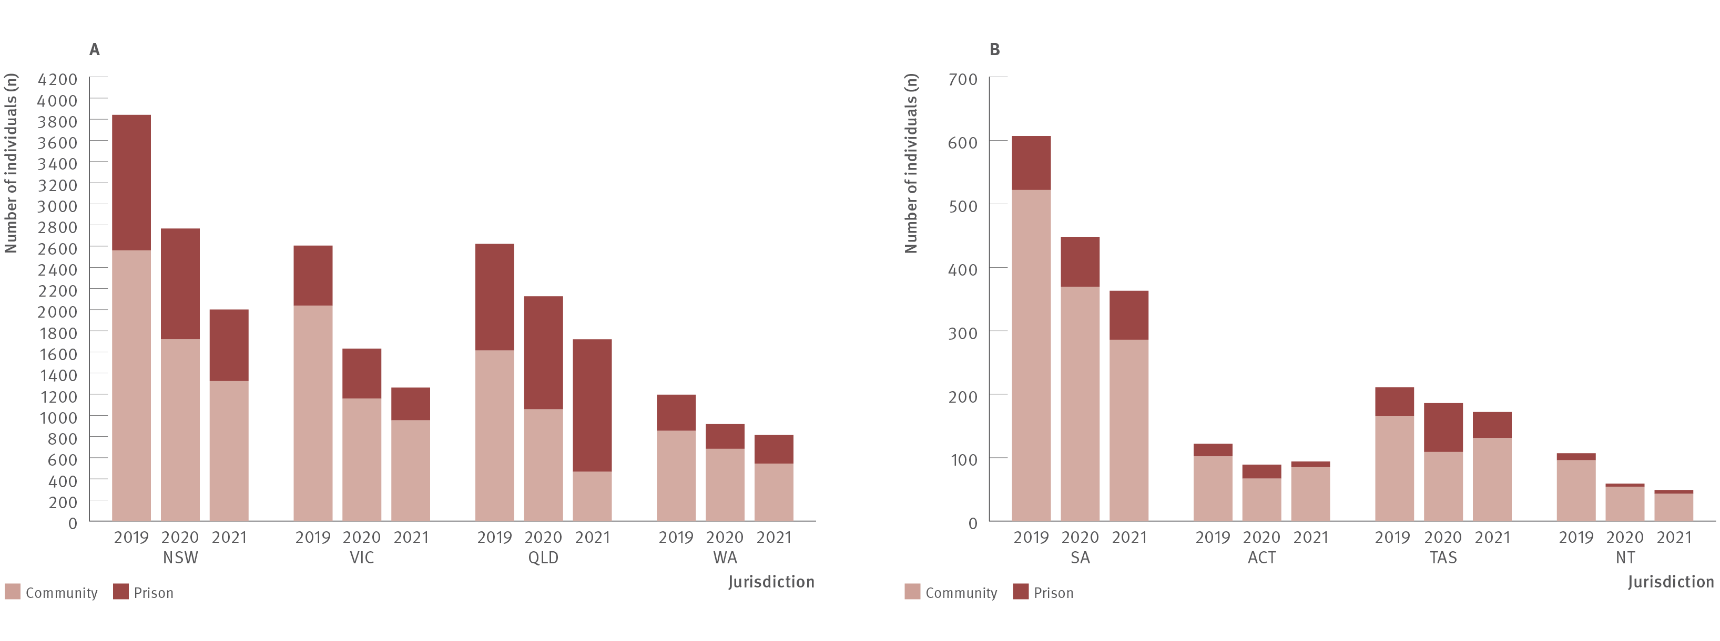
Figure 25. Number and estimated proportion* of individuals who initiated DAA treatment in prison versus in the community by jurisdiction, National Prisons Hepatitis Network and PBS Database, 2019, 2020, and 2021
Uptake of treatment
Sources: State and Territory justice health authorities via the National Prisons Hepatitis Network.⁽³¹⁾ Monitoring treatment uptake in Australia.⁽³⁰⁾
Notes:
Notes: *The proportion of all treatments that were initiated in prisons was estimated using the actual number of treatments reported by jurisdictional hepatitis services as a proportion of all treatments derived from the PBS database. PBS treatment numbers may vary from previous or future reports due to refinements made to PBS data between releases (2019 and 2020 data from 2021 release of data). aOne prison and one mental health correctional facility; bTwo prisons and one youth detention; cBetween 2019 and 2020, five prisons closed. For 2020, data were collected from 31 public prisons (January–December) and one private prison (January–June only), data were not collected from two private prisons. dData were collected from 95 prisons; eData were collected from 32 public prisons; data were not collected from three private prisons.

Slide 29
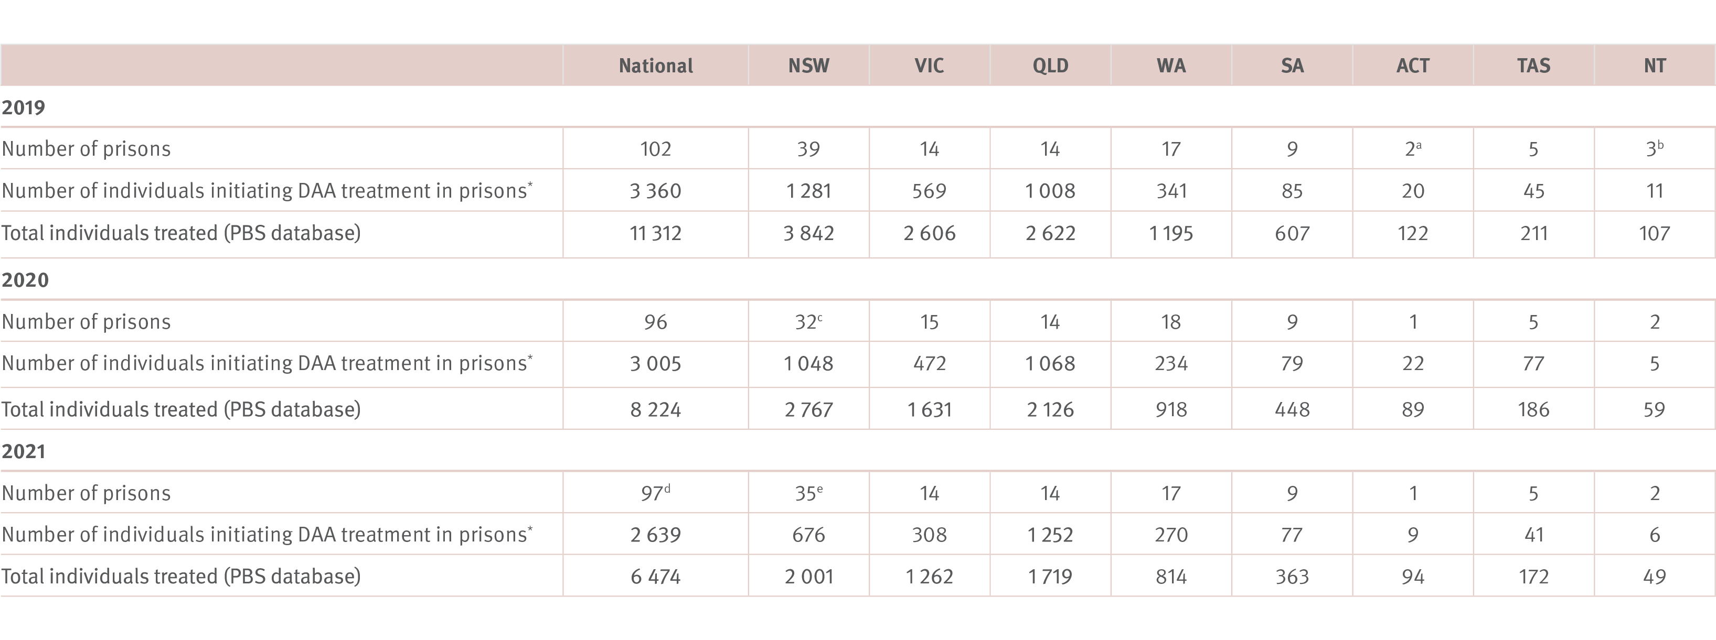
Table 1 (Figure 25 cont.). Number and estimated proportion* of individuals who initiated DAA treatment in prison versus in the community by jurisdiction,
National Prisons Hepatitis Network and PBS Database, 2019, 2020, and 2021
Uptake of treatment
Sources: State and Territory justice health authorities via the National Prisons Hepatitis Network.⁽³¹⁾ Monitoring treatment uptake in Australia.⁽³⁰⁾
Notes:
Notes: *The proportion of all treatments that were initiated in prisons was estimated using the actual number of treatments reported by jurisdictional hepatitis services as a proportion of all treatments derived from the PBS database. PBS treatment numbers may vary from previous or future reports due to refinements made to PBS data between releases (2019 and 2020 data from 2021 release of data). aOne prison and one mental health correctional facility; bTwo prisons and one youth detention; cBetween 2019 and 2020, five prisons closed. For 2020, data were collected from 31 public prisons (January–December) and one private prison (January–June only), data were not collected from two private prisons. dData were collected from 95 prisons; eData were collected from 32 public prisons; data were not collected from three private prisons.

Slide 30
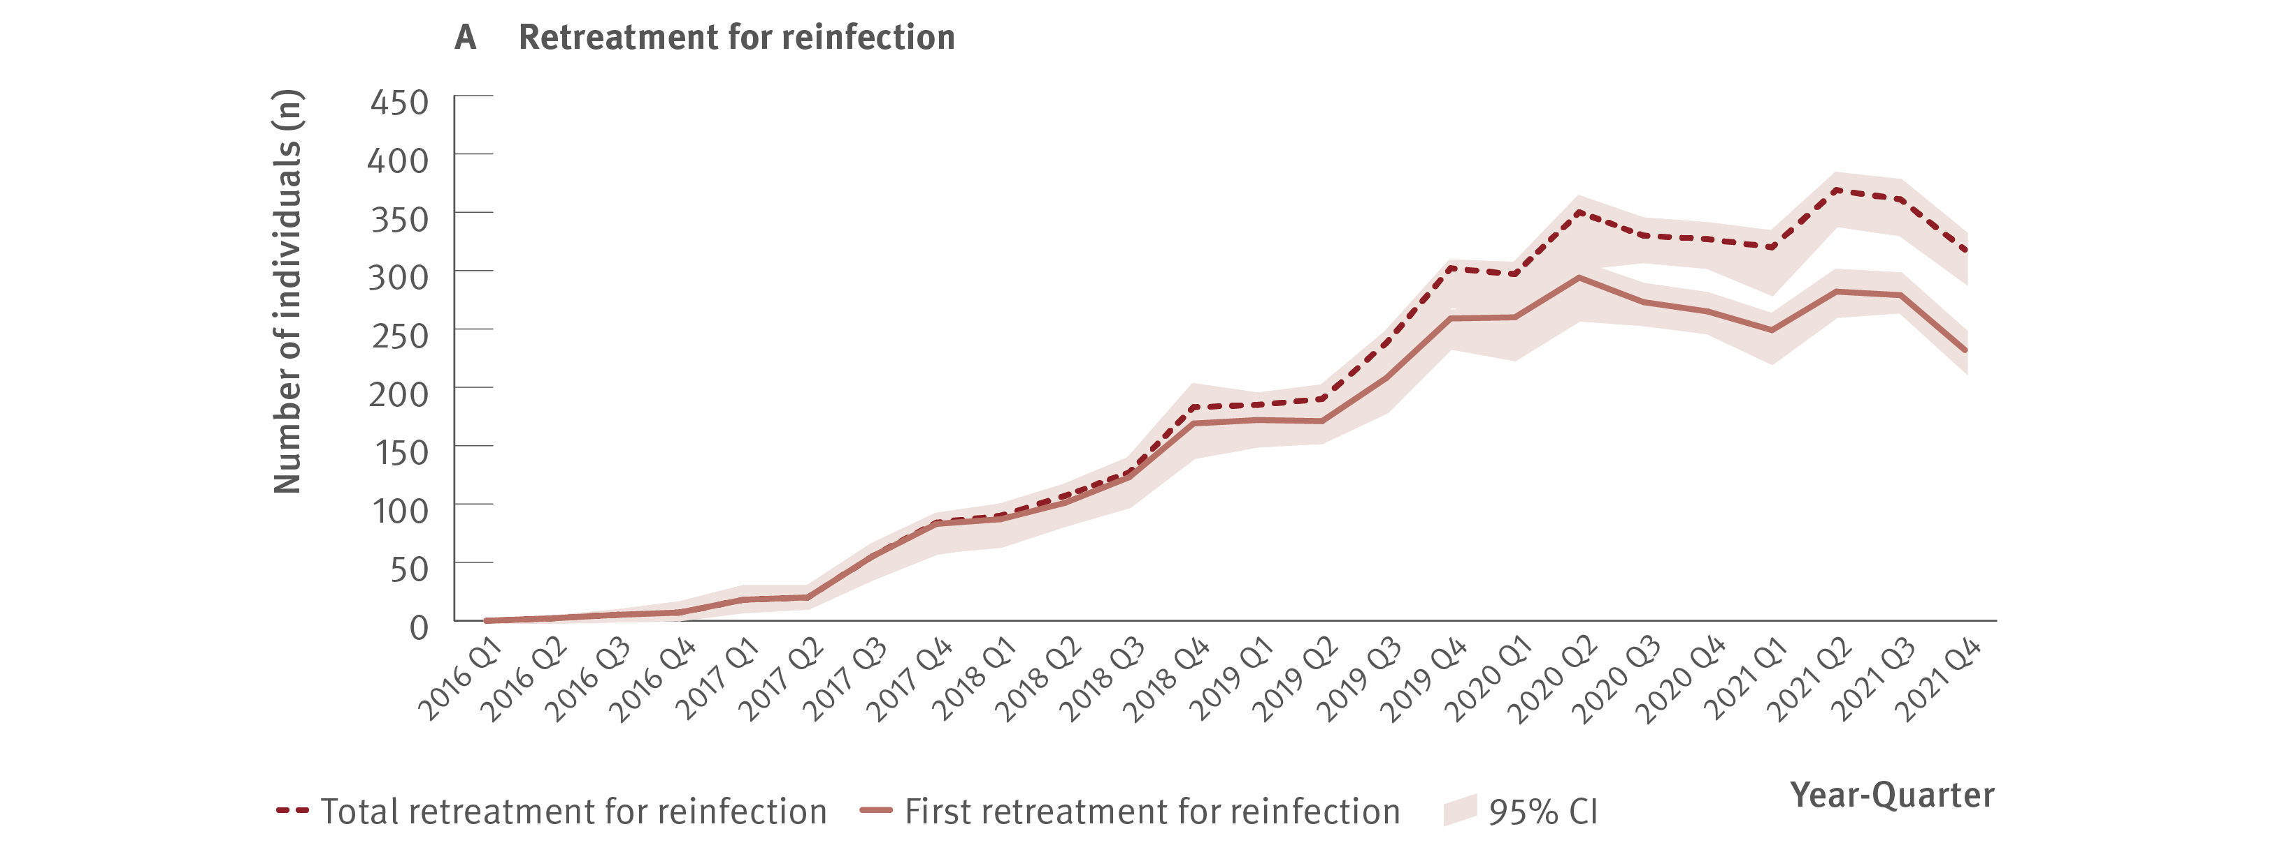
Figure 26. Estimated number of individuals retreated for hepatitis C reinfection (A) or treatment failure (B), National Retreatment Project, 2016–2021
Uptake of treatment
Source: National Retreatment Project.⁽³⁷⁾
Notes:
Notes: Includes all individuals with hepatitis C who initiated DAA treatment through the PBS and were retreated, 2016–2021. As the PBS data does not capture reason for retreatment, retreatment data from the REACH‑C cohort were used to train a Random Forest machine learning model to classify retreatment for reinfection or treatment failure. Of individuals initiating DAAs through the PBS between 2016 and 2021 (N=95 272), 7.3% received retreatment (n=6 980). The model classified 51.8% (95% CI: 46.7–53.6%; n=3 614) as reinfection and 48.2% (95% CI: 46.4–53.3%; n=3 366) as treatment failure.

Slide 31
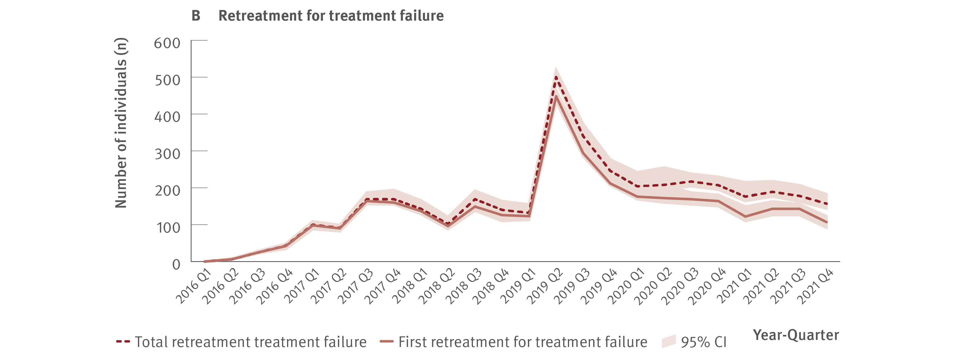
Figure 26. Estimated number of individuals retreated for hepatitis C reinfection (A) or treatment failure (B), National Retreatment Project, 2016–2021
Uptake of treatment
Source: National Retreatment Project.⁽³⁷⁾
Notes:
Notes: Includes all individuals with hepatitis C who initiated DAA treatment through the PBS and were retreated, 2016–2021. As the PBS data does not capture reason for retreatment, retreatment data from the REACH‑C cohort were used to train a Random Forest machine learning model to classify retreatment for reinfection or treatment failure. Of individuals initiating DAAs through the PBS between 2016 and 2021 (N=95 272), 7.3% received retreatment (n=6 980). The model classified 51.8% (95% CI: 46.7–53.6%; n=3 614) as reinfection and 48.2% (95% CI: 46.4–53.3%; n=3 366) as treatment failure.

Slide 32
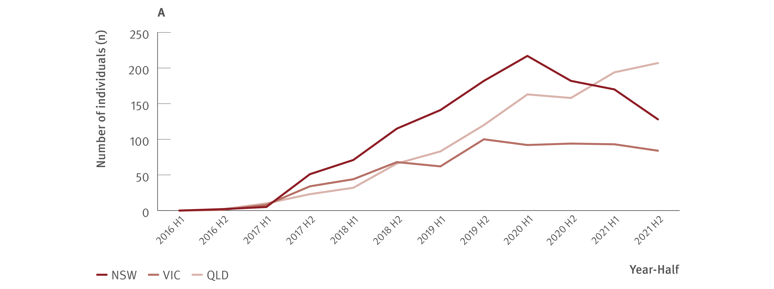
Figure 27. Estimated number of individuals retreated for hepatitis C reinfection by jurisdiction, National Retreatment Project, 2016–2021
Uptake of treatment
Source: National Retreatment Project.⁽³⁷⁾

Slide 33
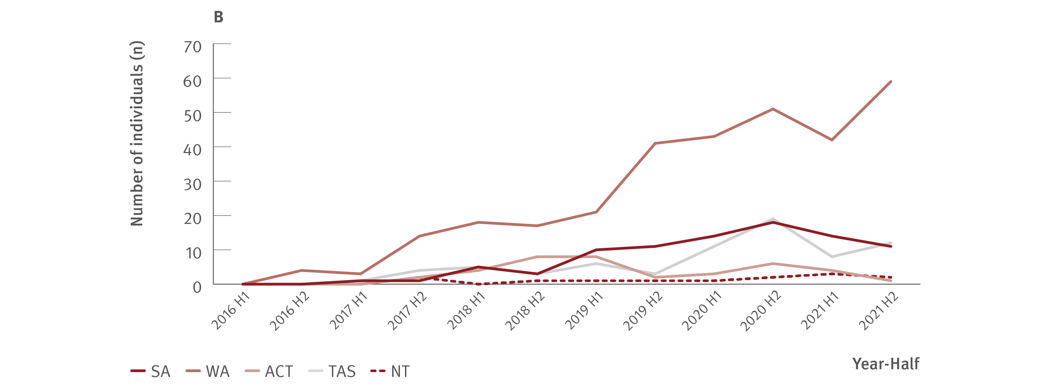
Figure 27. Estimated number of individuals retreated for hepatitis C reinfection by jurisdiction, National Retreatment Project, 2016–2021
Uptake of treatment
Source: National Retreatment Project.⁽³⁷⁾

Slide 34
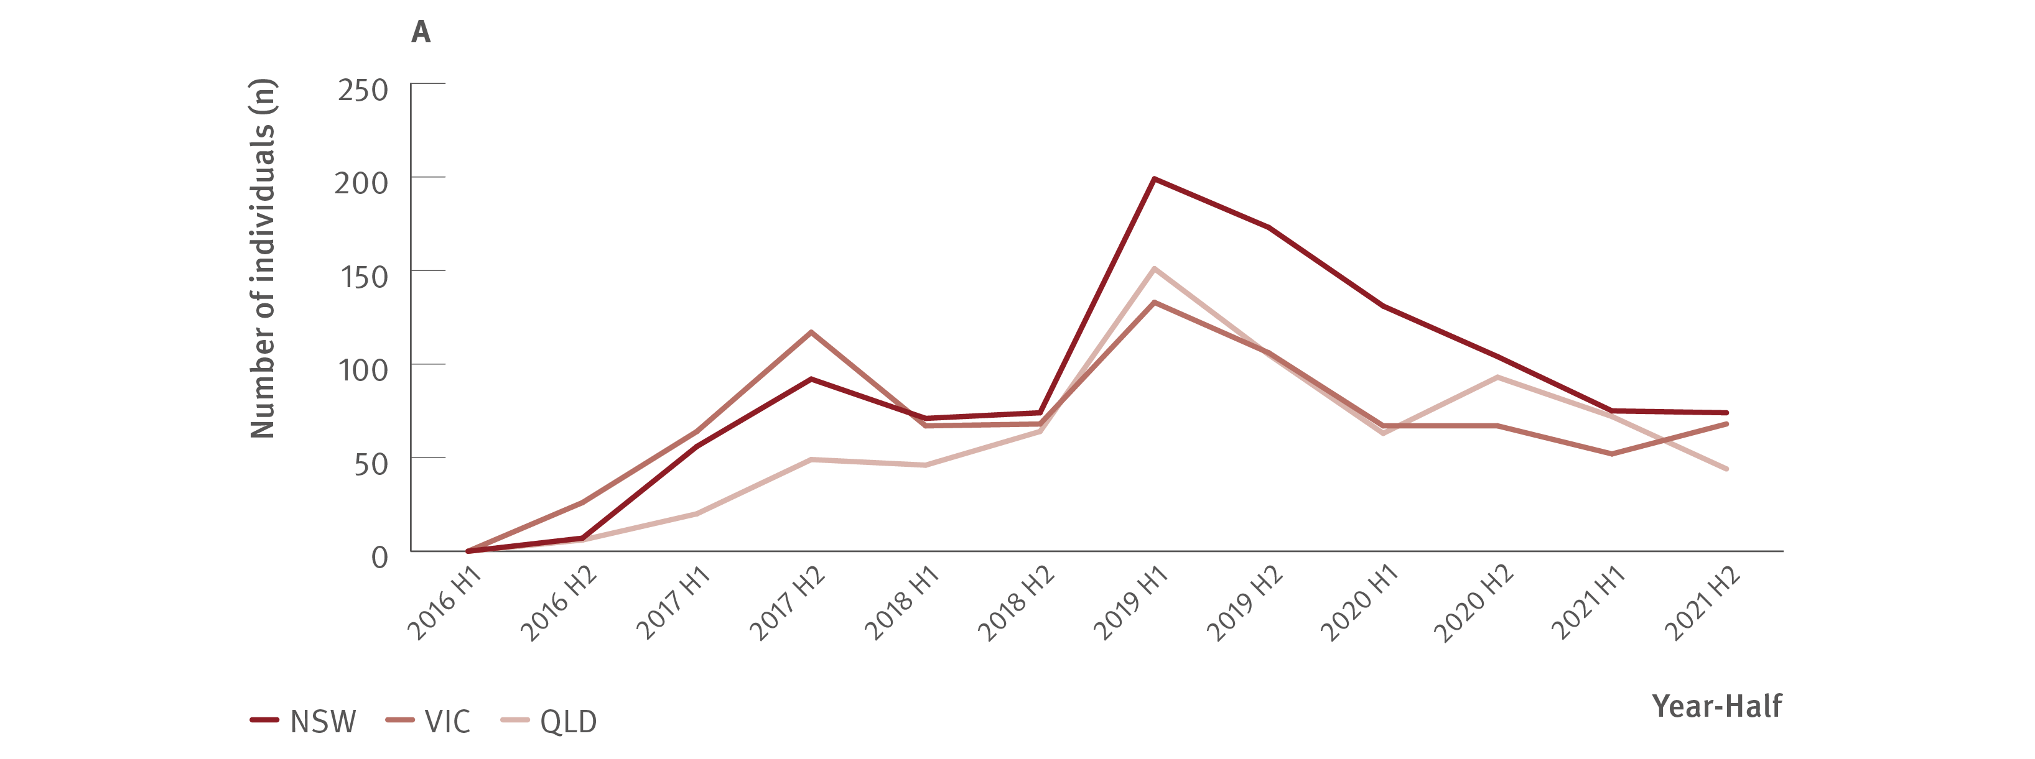
Figure 28. Estimated number of individuals retreated for hepatitis C treatment failure by jurisdiction, National Retreatment Project, 2016–2021
Uptake of treatment
Source: National Retreatment Project.⁽³⁷⁾

Slide 35
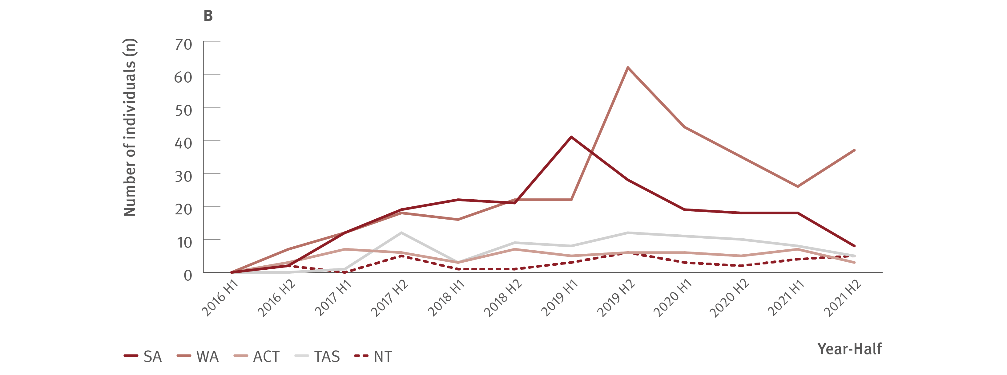
Figure 28. Estimated number of individuals retreated for hepatitis C treatment failure by jurisdiction, National Retreatment Project, 2016–2021
Uptake of treatment
Source: National Retreatment Project.⁽³⁷⁾

Slide 36
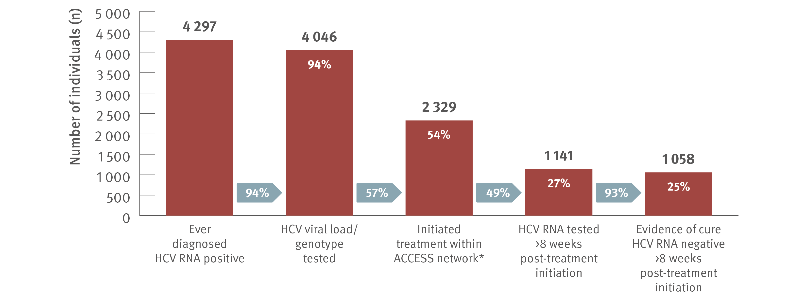
Figure 29. Hepatitis C treatment cascade at ACCESS primary care clinics: number of individuals hepatitis C diagnosed, number and proportion of individuals who initiated treatment, and tested for HCV RNA post‑treatment initiation, 2016–2021
Uptake of treatment
Source: ACCESS.⁽¹²⁾ Updated from Traeger et al., PLOS One. 2020.⁽³⁸⁾
Notes:
Notes: Cascade includes individuals with evidence of ever being diagnosed HCV RNA positive, i.e., a positive HCV RNA test result recorded in ACCESS since 2009. The cascade reflects the status of individuals on 31st December 2021 and is restricted to individuals who had a clinical consultation within the five years prior (2016–2021). Includes individuals attending ACCESS primary care clinics (same primary care clinics as other ACCESS sections in report). *Treatment initiation was indicated by the presence of an electronic medical record of a prescription of DAA therapy recorded at an ACCESS clinic. Individuals were assumed to have progressed through preceding cascade stages if evidence of reaching a subsequent stage was present.

Slide 37
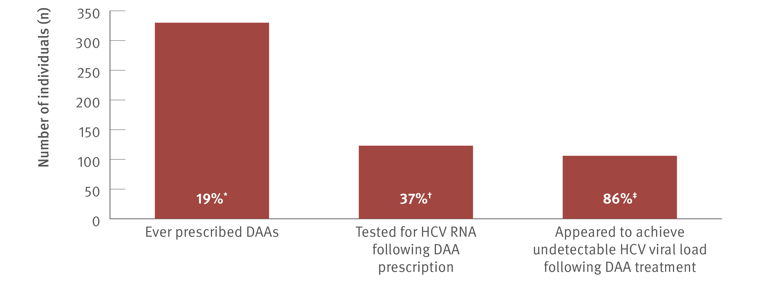
Figure 30. Hepatitis C treatment cascade: number and proportion of individuals attending ACCHSs tested for HCV RNA and prescribed DAAs, and among those treated, the number and proportion who appeared to achieve an undetectable HCV viral load, ATLAS network, aggregated for years 2016–2021
Uptake of treatment
Source: ATLAS sexual health surveillance network, 2016–2021.⁽¹⁸⁾
Notes:
Notes: Individuals defined as people aged 15 years or older, who visited a doctor, nurse, or Aboriginal health practitioner (‘medical consultations’) 2016–2021. ‘Undetectable viral load’ defined as testing negative for HCV RNA or HCV viral load following DAA treatment. A total of 136 379 individuals aged 15 years or older attended medical appointments between 2016 and 2021. *Of individuals who were ever HCV RNA tested, 18.9% (330/1 750) were prescribed DAA treatment. †Of those prescribed DAAs, 37.3% (123/330) had an HCV RNA test following treatment, of whom ‡86.2% (106/123) had an undetectable viral load and 13.8% (17/123) were either positive or not tested (data unavailable to define these 13 further).

Slide 38
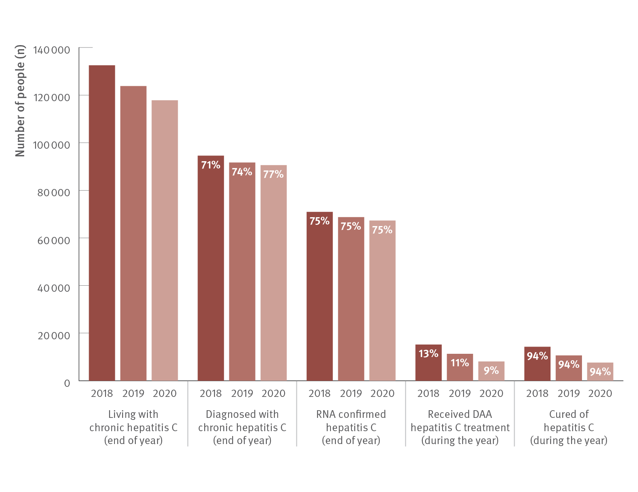
Figure 31. The hepatitis C diagnosis and care cascade, 2020
Uptake of treatment
Source: Kirby Institute. HIV, viral hepatitis and sexually transmissible infections in Australia: annual surveillance report 2021.^{(2,3,4,9)}
Notes:
Notes: An estimated 117 810 people were living with hepatitis C at the end of 2020. Between 2016 and 2020, almost 90 000 people in Australia had been treated with DAAs, meaning that in this period, 43% of all people living with hepatitis C, including those who had been cured, had received treatment.⁽⁴⁾

Slide 39
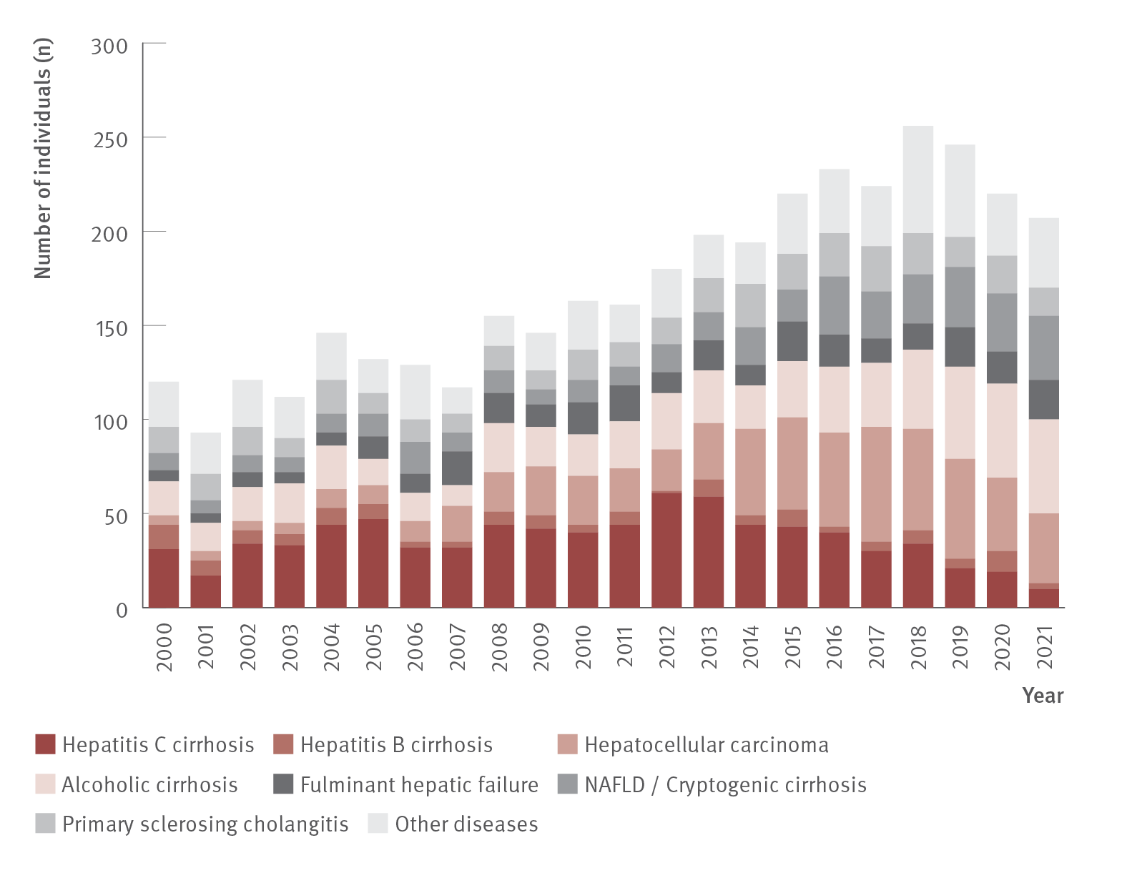
Figure 32. Number of Australian adult liver transplant recipients by primary diagnosis and year of first transplant, 2001–2021
Morbidity
Source: Australia and New Zealand Liver and Intestinal Transplant Registry.⁽⁴⁴⁾
Notes:
Notes: Australian transplant recipients only. Adults defined as 16 years or older. NAFLD: non‑alcoholic fatty liver disease.

Slide 40
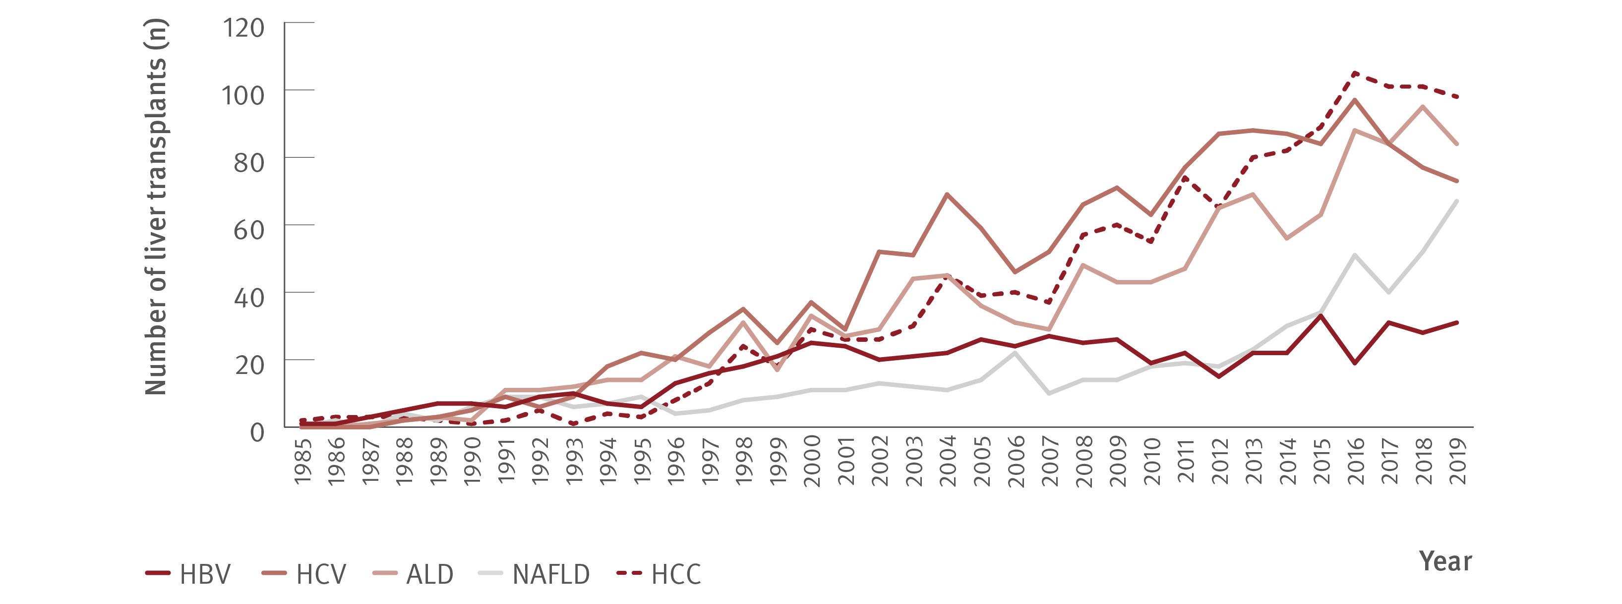
Figure 33. Number of Australian and New Zealand adult liver transplants by aetiology and year of transplant, 1985–2019
Morbidity
Source: Adapted from Howell et al., Liver Transplantation. 2021.⁽⁴³⁾
Notes:
Notes: N=5 460 for the whole registry cohort and n=5 254 for the diagnostic categories shown (other diagnostic categories not shown). HCV cases include HCV‑related liver failure and HCV‑related HCC. Diagnostic categories are non‑exclusive. HBV: hepatitis B virus; ALD: alcoholic liver disease; NAFLD: non‑alcoholic fatty liver disease.

Slide 41
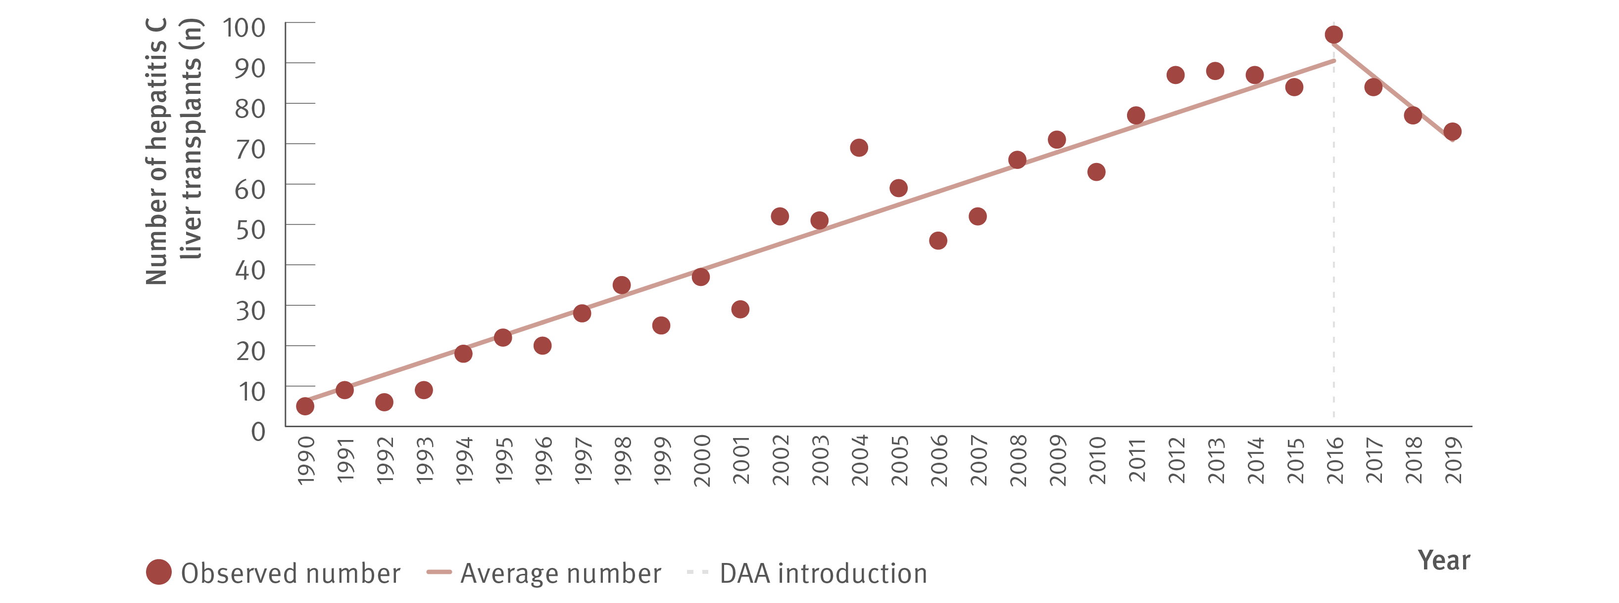
Figure 34. Number of Australian and New Zealand adult liver transplants for hepatitis C and average number of hepatitis C‑related annual transplants before and after 2016 (unrestricted access to DAAs), 1990–2019
Morbidity
Source: Adapted from Howell et al., Liver Transplantation. 2021.⁽⁴³⁾
Notes:
Notes: N=1 526. Includes both hepatitis C‑related liver failure and hepatitis C‑related HCC cases.

Slide 42
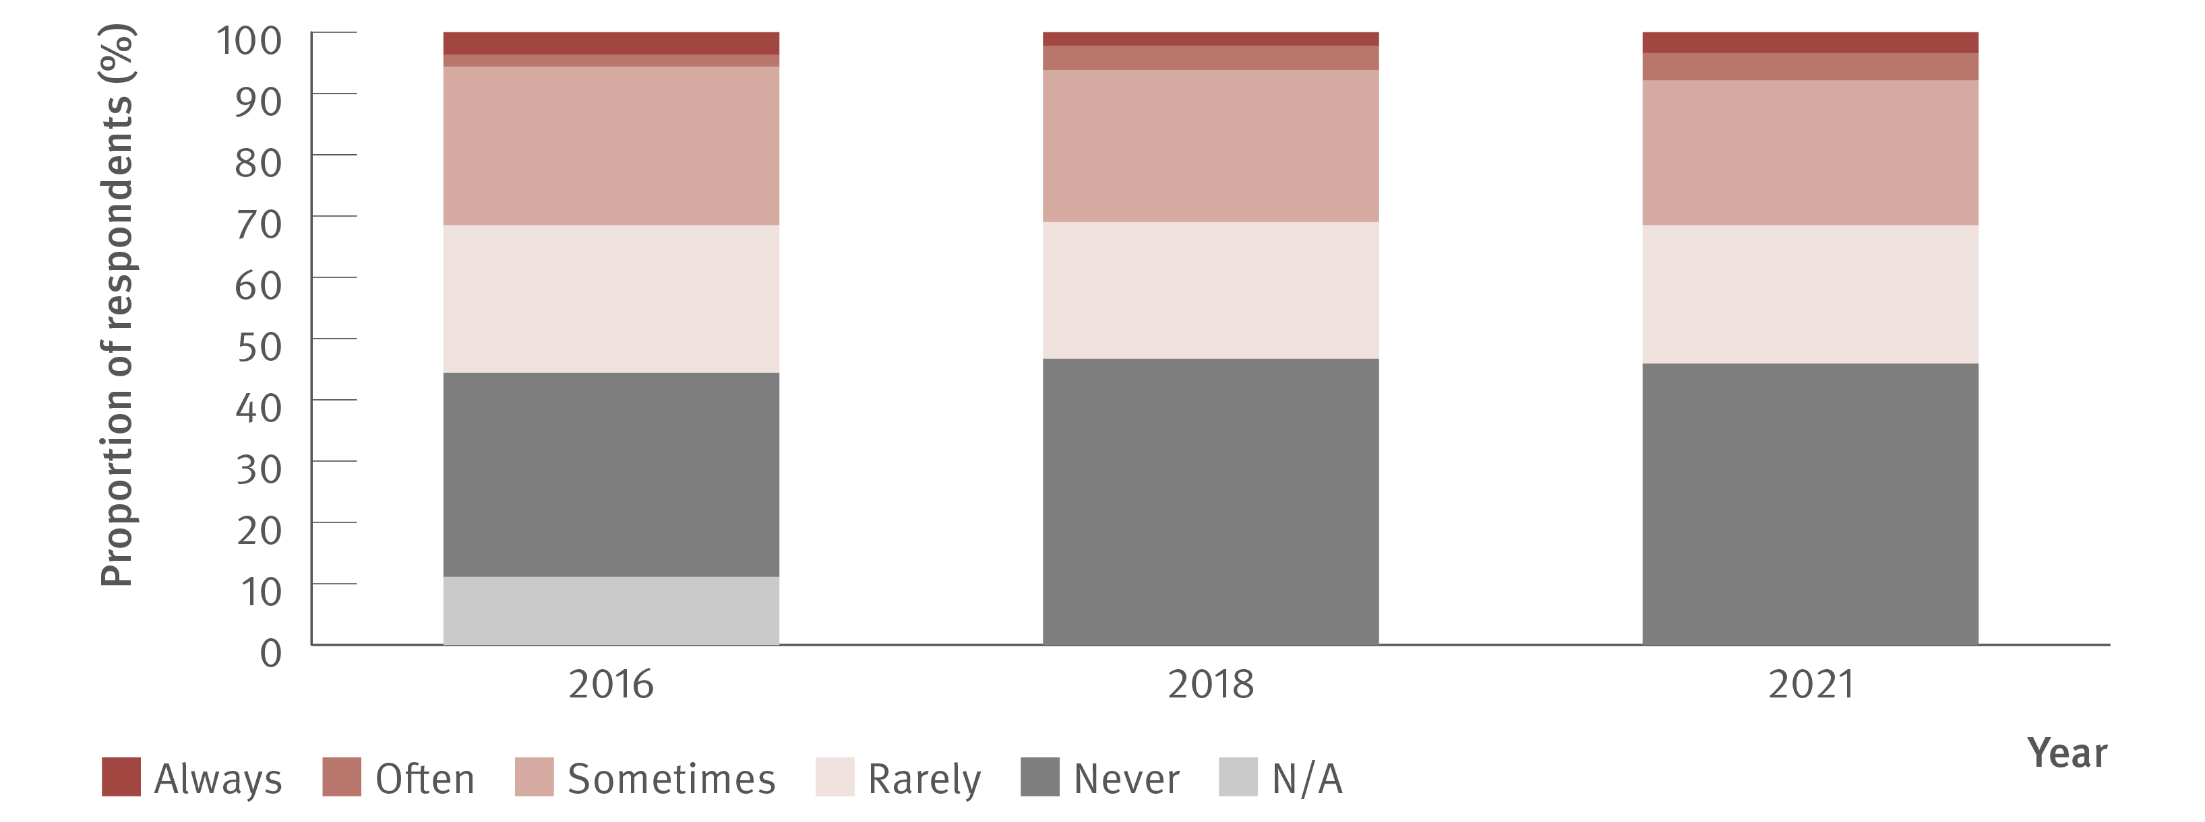
Figure 35. Reports of hepatitis C‑related stigma or discrimination in the past 12 months by people living with hepatitis C, 2016–2021
Stigma and discrimination
Source: Stigma Indicators Monitoring Project.⁽⁴⁸⁾ 2021 data Stigma Indicators Monitoring Project, unpublished data.
Notes:
Notes: “N/A” was not provided as a response option after 2016. Details of sample sizes available in the Methods section.

Slide 43
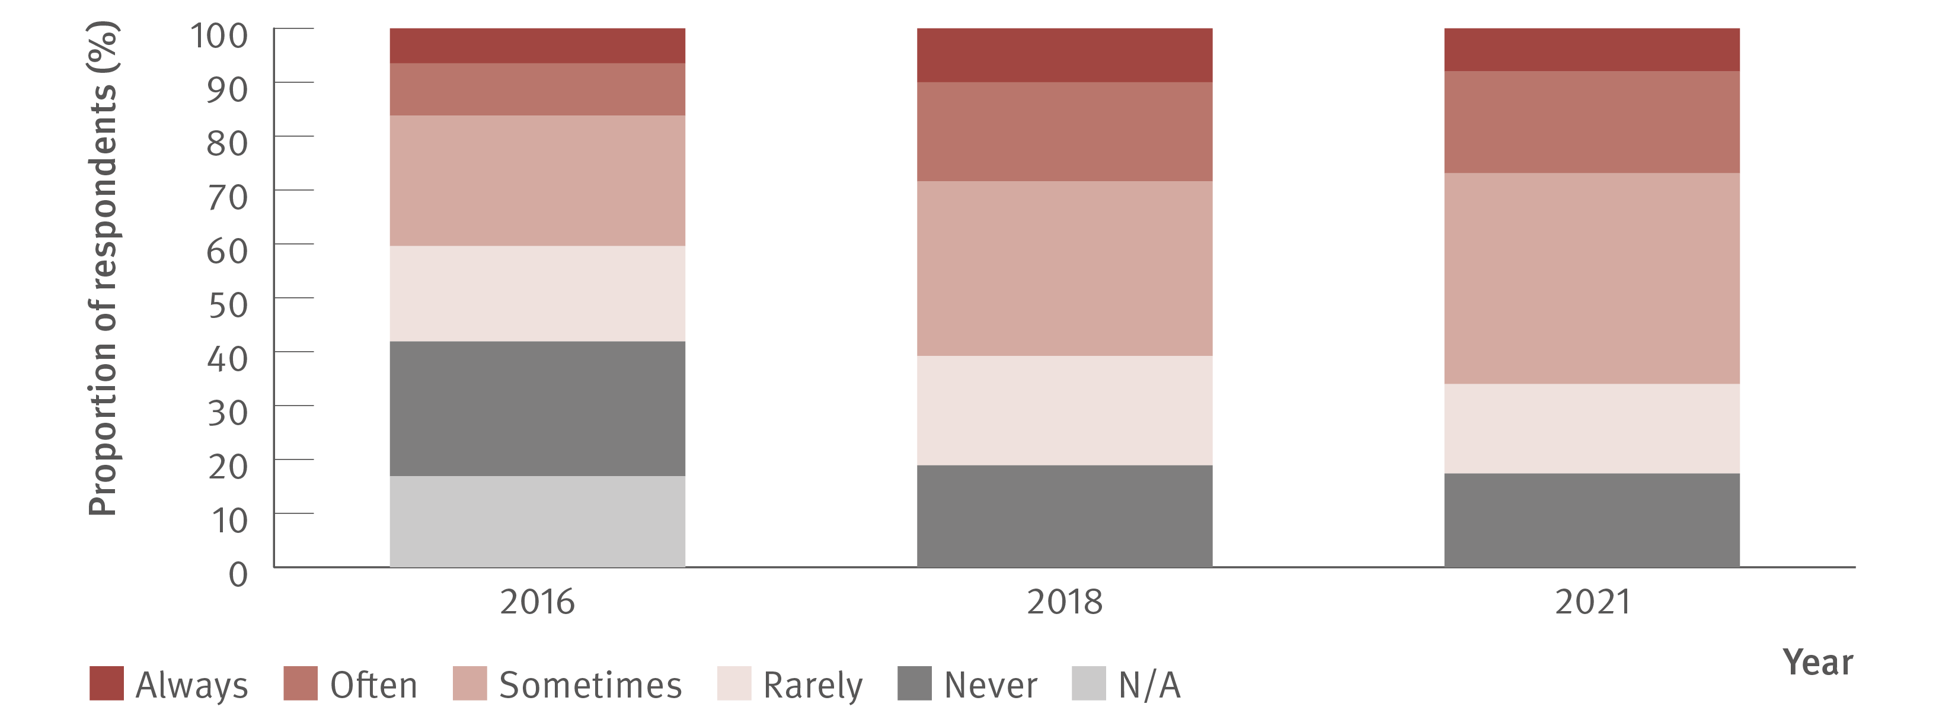
Figure 36. Reports of IDU‑related stigma or discrimination in the past 12 months by people who inject drugs, 2016–2021
Stigma and discrimination
Source: Stigma Indicators Monitoring Project.⁽⁴⁸⁾ 2021 data Stigma Indicators Monitoring Project, unpublished data.
Notes:
Notes: “N/A” was not provided as a response option after 2016. Details of sample sizes available in the Methods section.

Slide 44
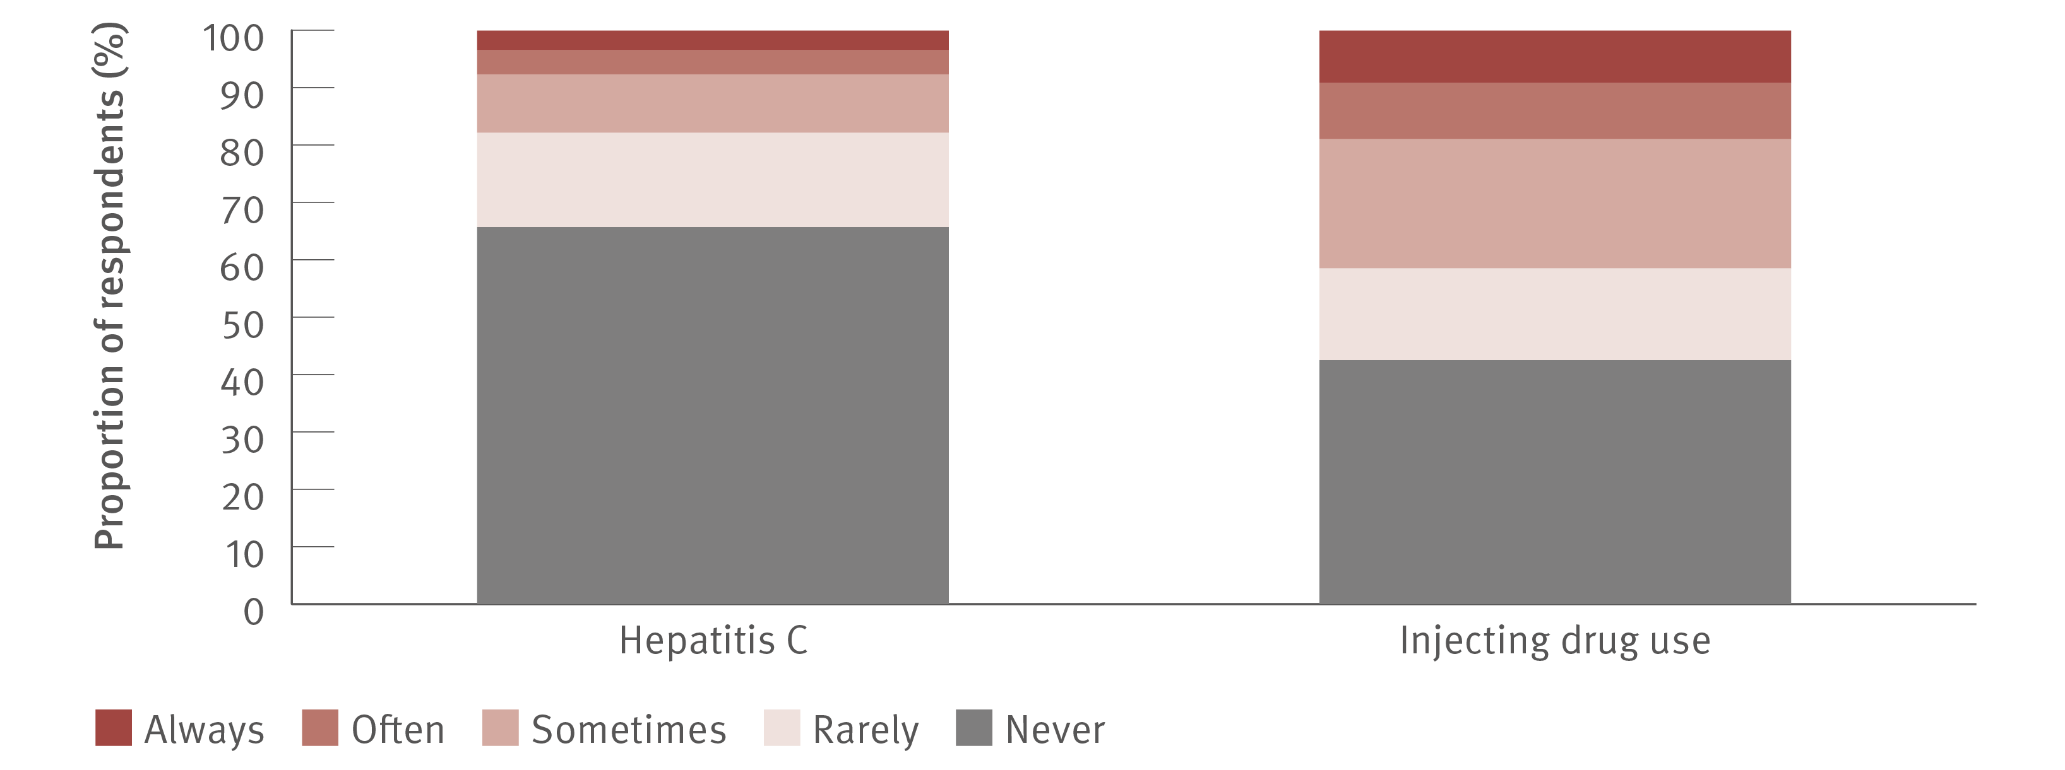
Figure 37. Reports of hepatitis C‑ and IDU‑related stigma or discrimination in the past 12 months by people who inject drugs, ETHOS Engage, Wave 2 (November 2019–June 2021)
Stigma and discrimination
Source: ETHOS Engage study.⁽²⁴⁾ Wave 2 data, ETHOS Engage study, unpublished data.
Notes:
Notes: N=791 respondents for hepatitis C‑related stigma experiences, and N=1 211 respondents for IDU‑related stigma experiences.

Slide 45
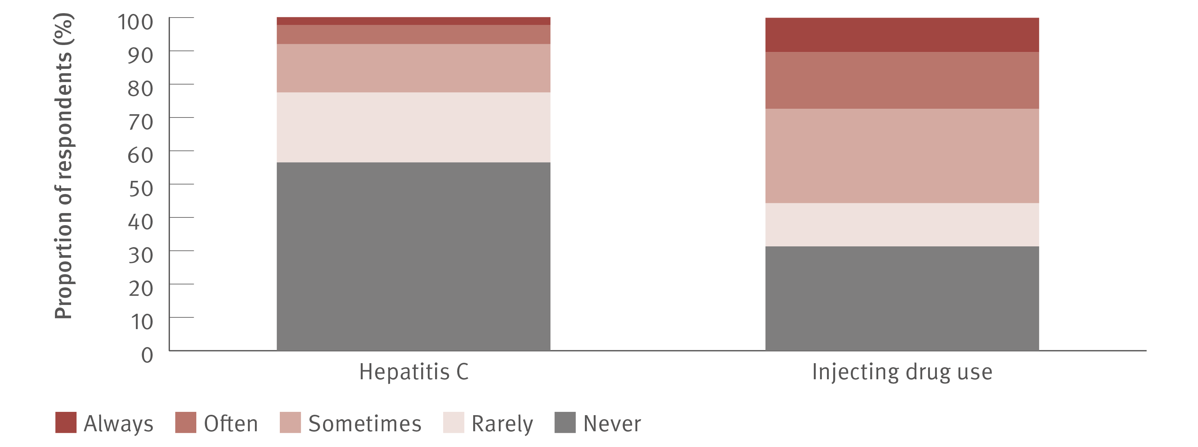
Figure 38. Reports of hepatitis C‑ and IDU‑related stigma or discrimination in the past 12 months by people who inject drugs, EC Experience, 2018–2022
Stigma and discrimination
Source: EC Experience.⁽⁴⁹⁾ Baseline data from EC Experience cohort (2018–2022), unpublished data.
Notes:
Notes: Participants were only asked the question about hepatitis C‑related stigma if they were living with hepatitis C at the time of the interview. Baseline data only. N=124 respondents for hepatitis C‑related stigma experiences and N=300 respondents for IDU‑related stigma experiences.

Slide 46
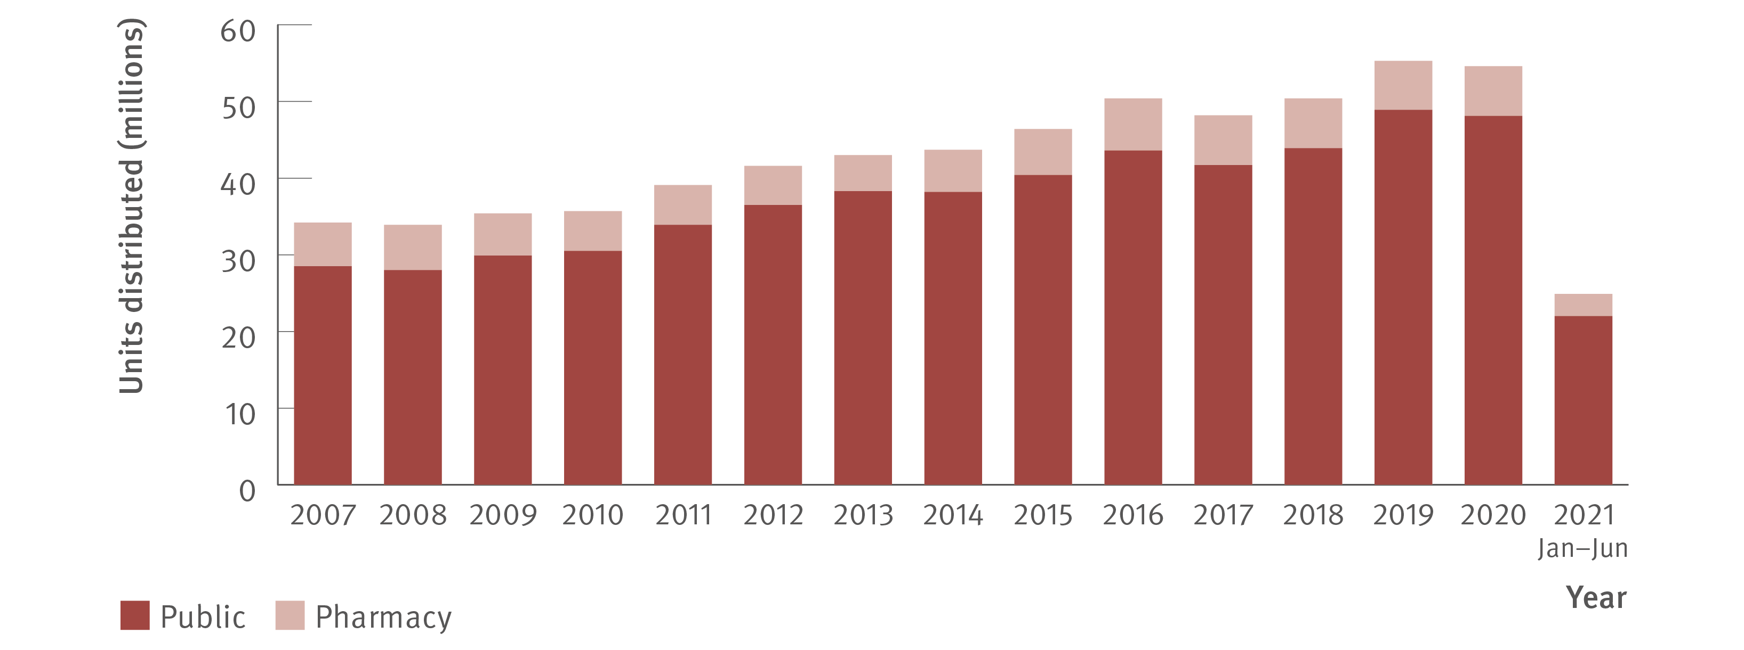
Figure 39. Number of needle and syringe units distributed by public and pharmacy sector, NSP NMDC, 2007–June 2021
Prevention
Source: Needle Syringe Program National Minimum Data Collection: National Data Report 2021.⁽⁵⁶⁾
Notes:
Notes: July–December 2021 data not available at the time of reporting.

Slide 47
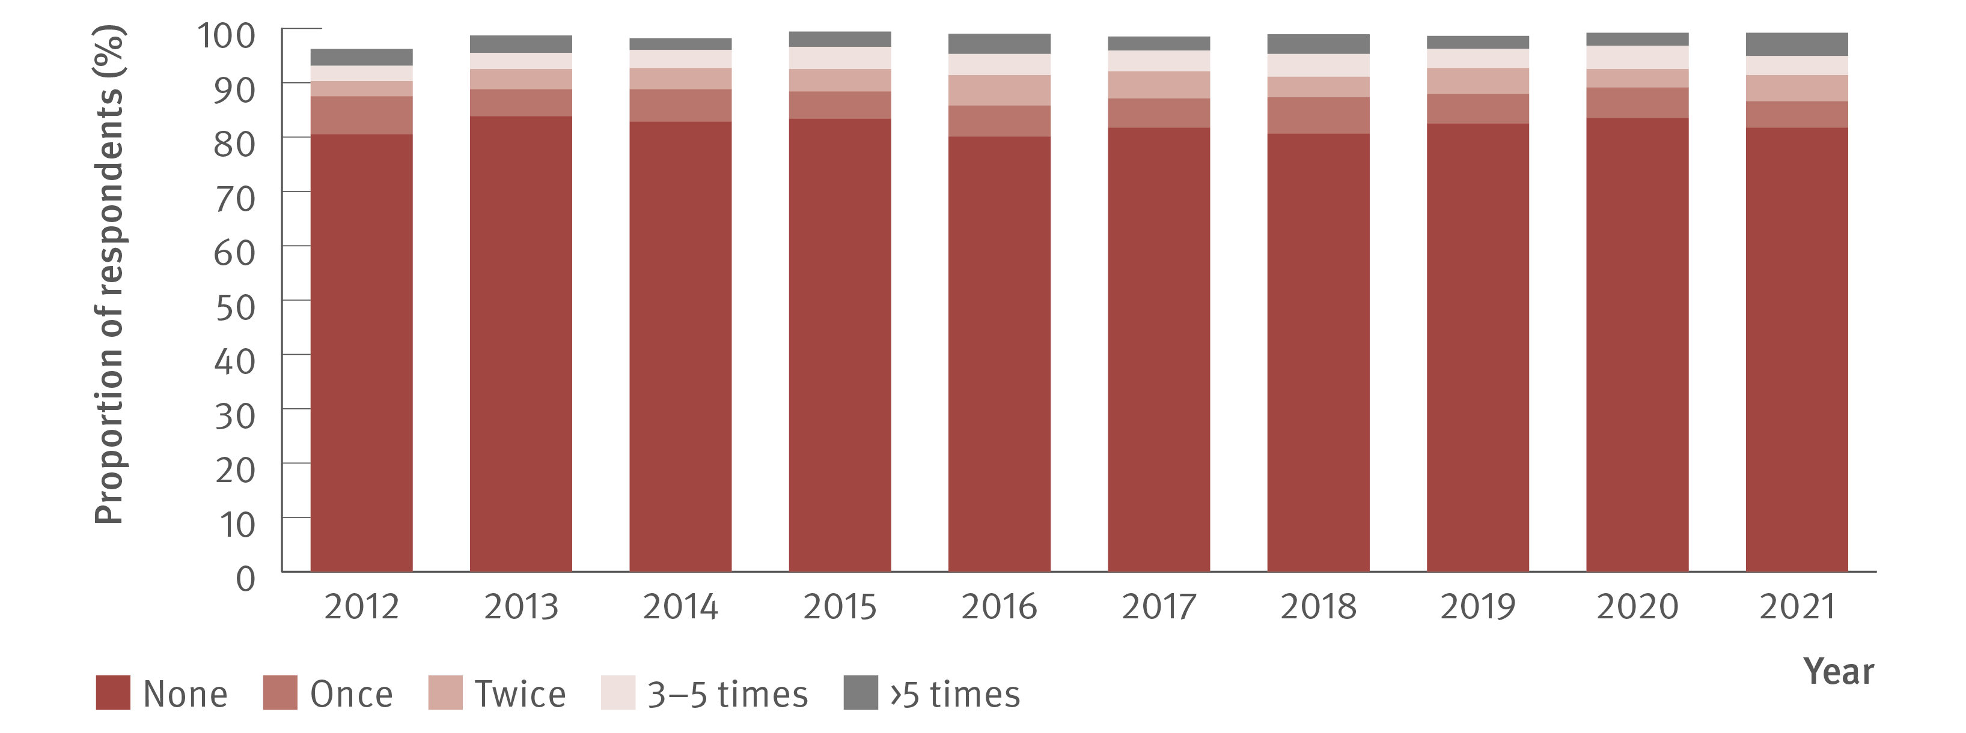
Figure 40. Proportion of ANSPS respondents reporting re‑use of someone else’s needles and syringes in the past month, 2012–2021
Prevention
Source: Australian Needle Syringe Program Survey. National Data Report 2017–2021.⁽¹⁹⁾
Notes:
Notes: Not reported not included. Injection risk behaviour variables are presented among those who injected in the previous month, not the entire sample. For 2012 to 2021, sample size was (in order): 2 127, 2 111, 2 141, 2 071,1 993, 2 314, 2 452, 2 333, 1 173, and 1 259.

Slide 48
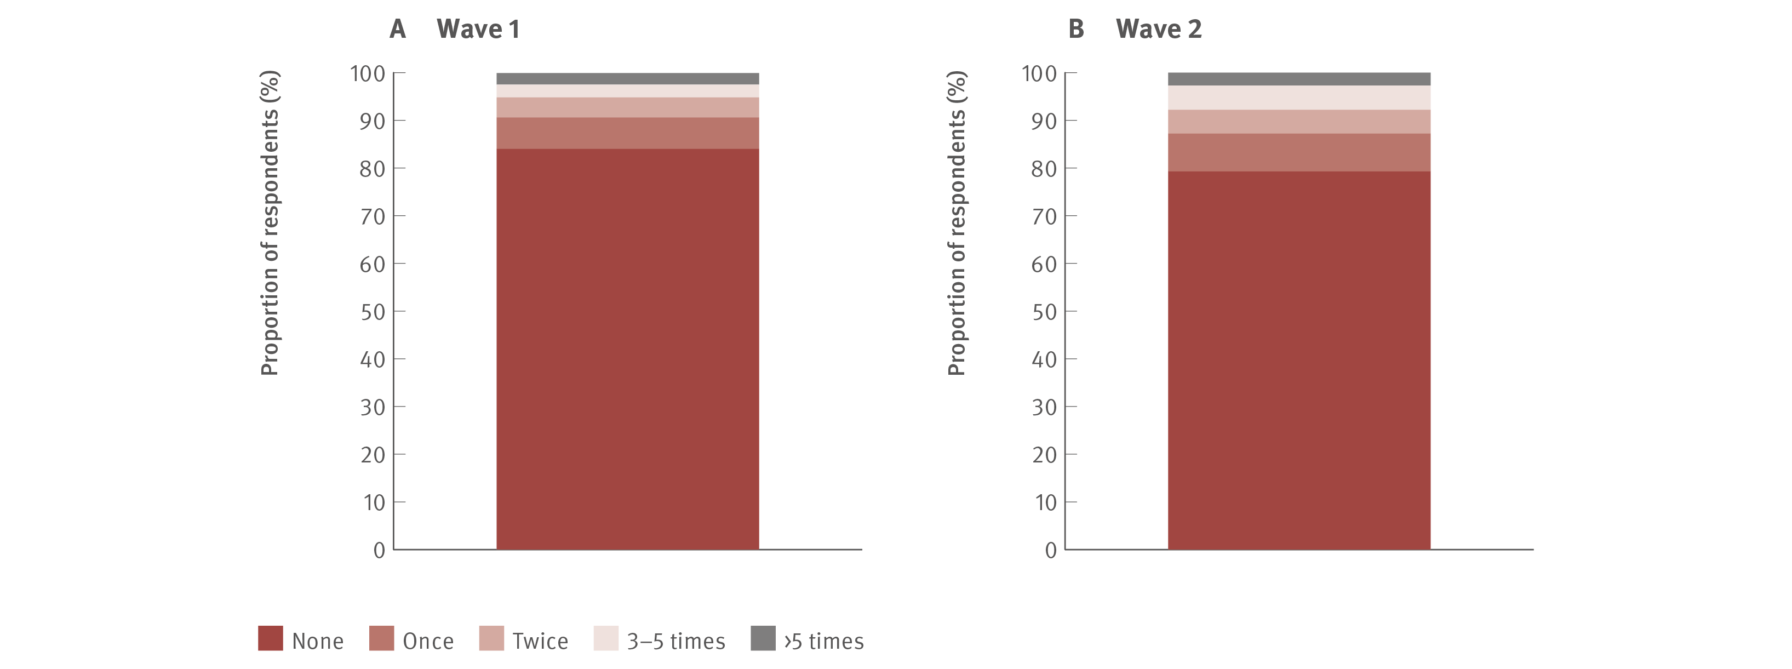
Figure 41. Proportion of respondents reporting re‑use of someone else’s needles and syringes in the past month, ETHOS Engage, A: Wave 1 (May 2018–September 2019) and B: Wave 2 (November 2019–June 2021)
Prevention
Source: ETHOS Engage study.⁽²⁴⁾ Wave 1 and Wave 2 data, ETHOS Engage study, unpublished data.
Notes:
Notes: Participants were asked “How many times in the last month have you used a needle and/or syringe after someone else had already used it?”. Wave 1 N=921 respondents and Wave 2 N=777.

Slide 49
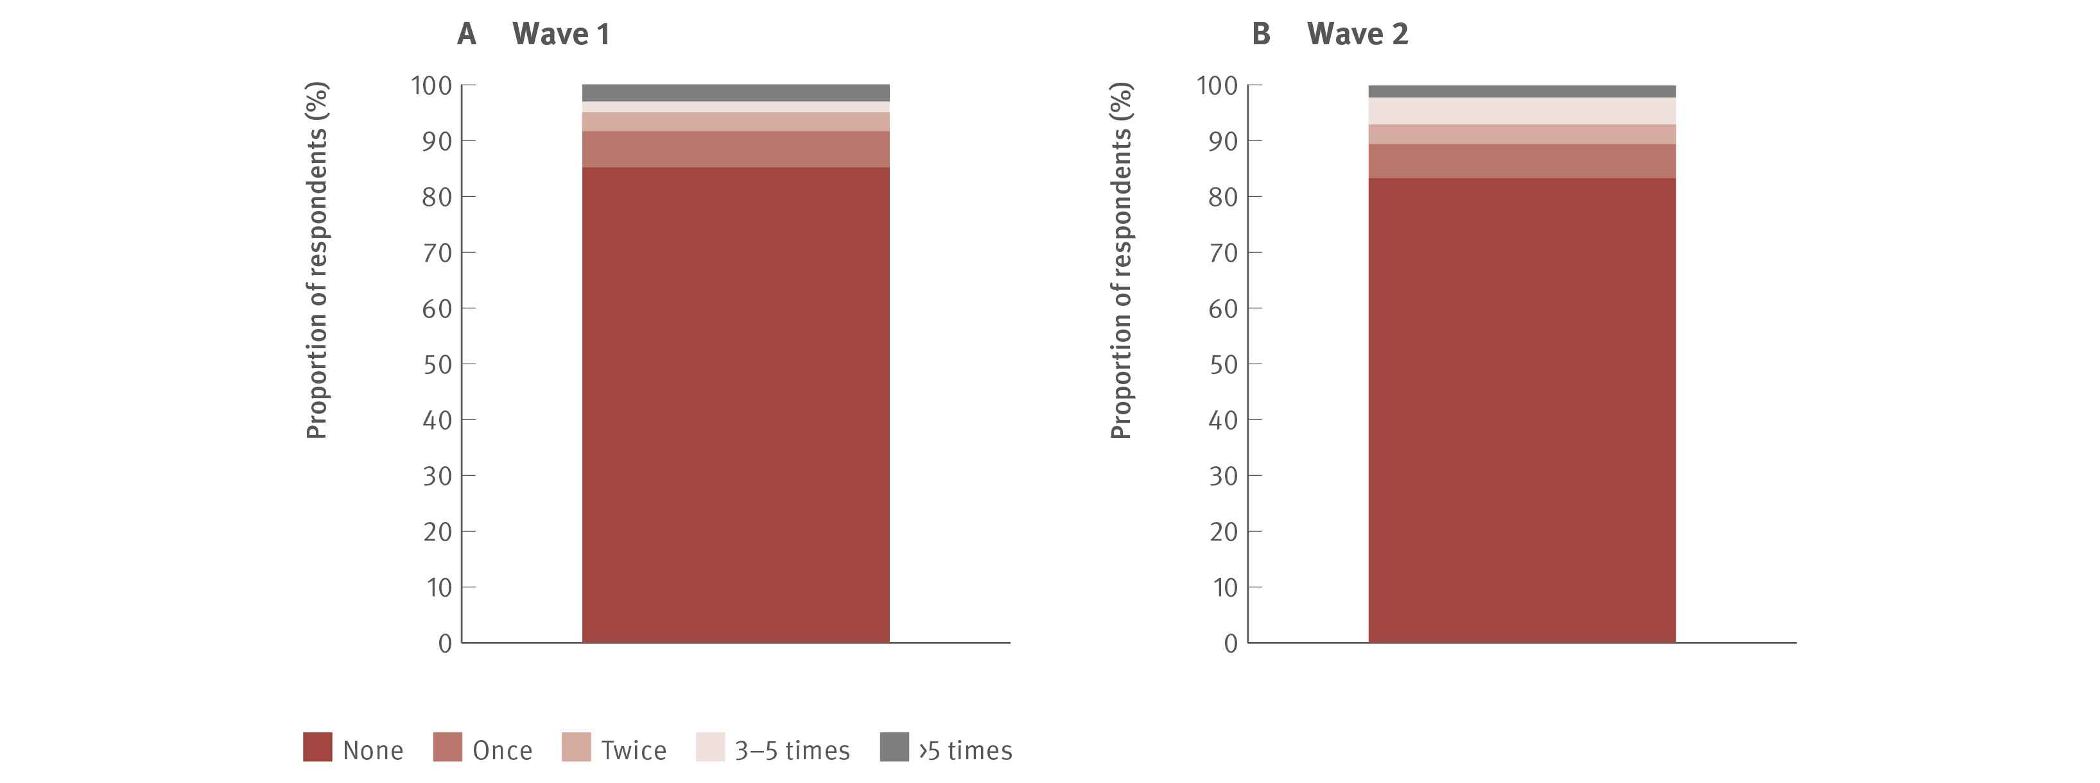
Figure 42. Proportion of respondents previously treated for hepatitis C reporting re‑use of someone else’s needles and syringes in the past month, ETHOS Engage, A: Wave 1 (May 2018–September 2019) and B: Wave 2 (November 2019–June 2021)
Prevention
Source: ETHOS Engage study.⁽²⁴⁾ Wave 1 and Wave 2 data, ETHOS Engage study, unpublished data.
Notes:
Notes: Participants were asked “How many times in the last month have you used a needle and/or syringe after someone else had already used it?”. Wave 1 N=324 respondents and Wave 2 N=312.

Slide 50
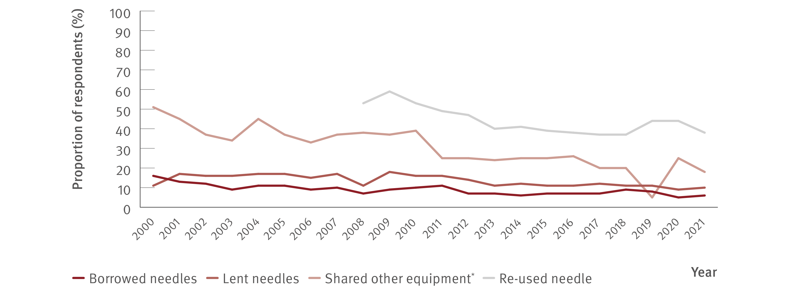
Figure 43. Proportion of respondents reporting borrowing and lending of needles, sharing of injecting equipment, and re‑use of needles in the past month, national, IDRS, 2000–2021
Prevention
Source: Australian Drug Trends 2021. Key findings from the National Illicit Drug Reporting System (IDRS) Interviews.⁽⁵⁶⁾
Notes:
Notes: Collection of data about re‑use of needles began in 2008. *Includes spoons, water, tourniquets, and filters.

Slide 51
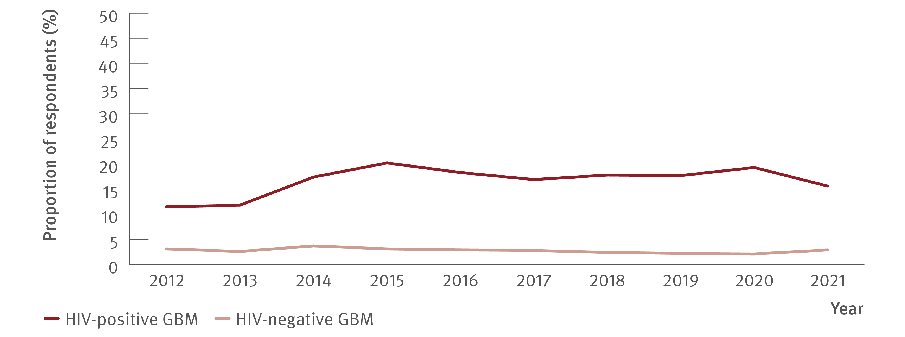
Figure 44. Proportion of GBM who reported any drug injection in the six months prior to the survey by HIV status, national, Gay Community Periodic Survey, 2012–2021
Prevention
Source: Annual Report of Trends in Behaviour 2021: HIV and STIs in Australia.^{(58,59)}
Notes:
Notes: Unadjusted data.

Slide 52
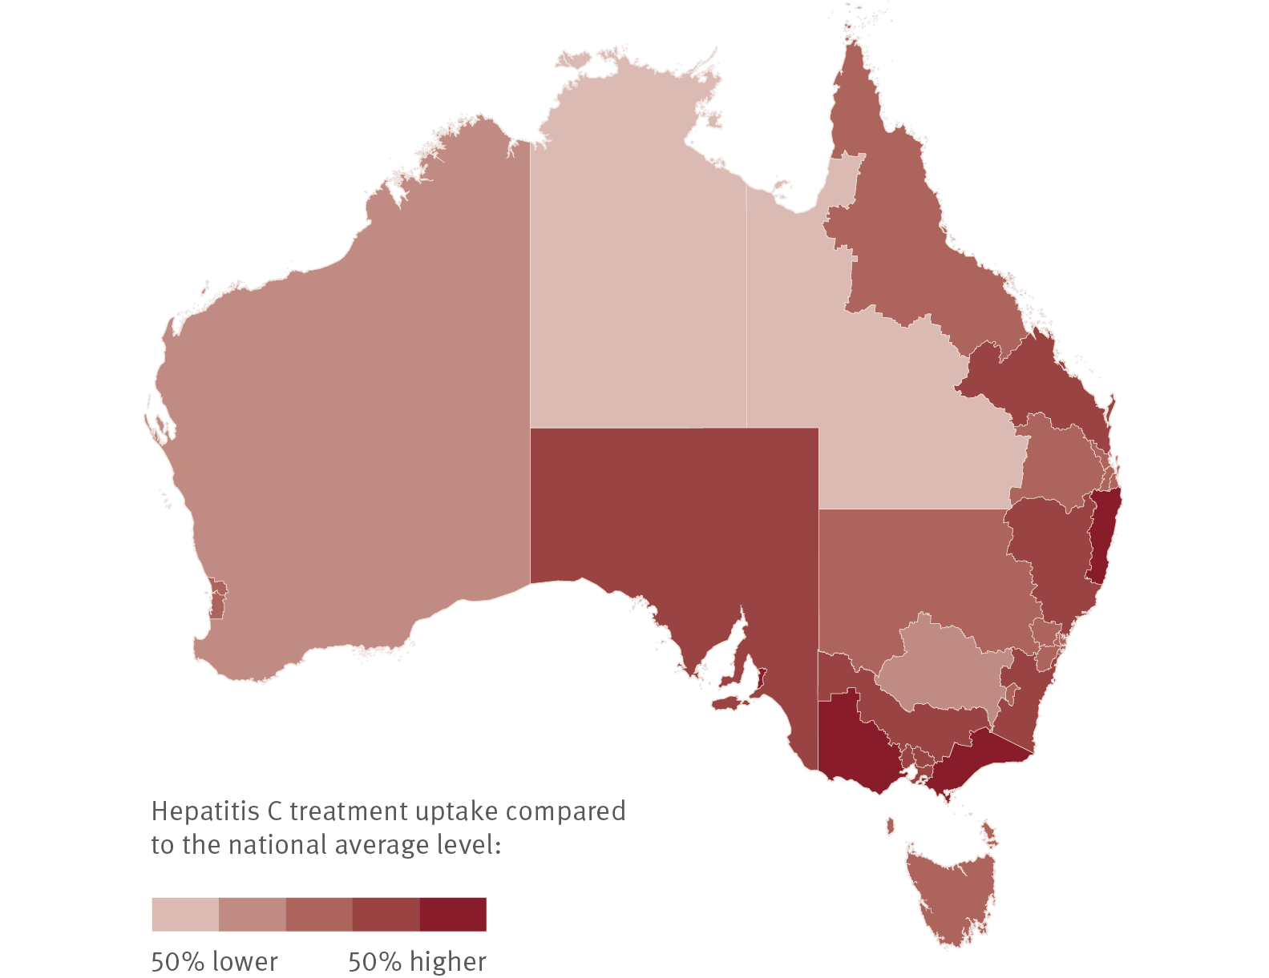
Figure 45. Geographic variation in hepatitis C treatment uptake, March 2016–December 2020
Equity
Source: The National Viral Hepatitis Mapping Project (WHO Collaborating Centre for Viral Hepatitis, The Doherty Institute).⁽⁶⁰⁾
Notes:
Notes: Hepatitis C prevalence estimates based on mathematical modelling incorporating population‑specific prevalence and Australian Bureau of Statistics population data. Note that the prevalence estimates are based on the 2020 diagnosis and care cascade. Treatment data sourced from Department of Human Services Medicare statistics.

Slide 53

Figure 46. Hepatitis C treatment uptake variation in Australia by PHN, March 2016–December 2020
Equity
Source: The National Viral Hepatitis Mapping Project (WHO Collaborating Centre for Viral Hepatitis, The Doherty Institute).⁽⁶⁰⁾
Notes:
Notes: Hepatitis C prevalence estimates based on mathematical modelling incorporating population‑specific prevalence and Australian Bureau of Statistics population data. Note that the prevalence estimates are based on the 2020 diagnosis and care cascade. Treatment data sourced from Department of Human Services Medicare statistics.

Slide 54

Figure 47. For different incentive values (a) the percentage of HCV RNA‑positive people that need to complete testing (receive their HCV RNA‑positive result) and (b) the percentage of HCV RNA diagnosed people that need to initiate treatment to maintain the same unit cost
Modelling elimination
Source: Adapted from Palmer et al. J Viral Hepatitis. 2021.^{(61,62)}

Slide 55
Supported by

Slide 56
Data contributors

Slide 57
References
1. Alavi M, Law MG, Valerio H, et al. Declining hepatitis C virus-related liver disease burden in the
direct-acting antiviral therapy era in New South Wales, Australia. J Hepatol. 2019;71(2):281–288.
doi: https://doi.org/10.1016/j.jhep.2019.04.014.
2. Kwon JA, Dore GJ, Grebely J, et al. Australia on track to achieve WHO HCV elimination targets
following rapid initial DAA treatment uptake: a modelling study. J Viral Hepat. 2019;26(1):83–92.
doi: https://doi.org/10.1111/jvh.13013.
3. Kwon JA, Dore GJ, Hajarizadeh B, et al. Australia could miss the WHO hepatitis C virus elimination
targets due to declining treatment uptake and ongoing burden of advanced liver disease complications.
PLoS One. 2021;16(9):e0257369. doi: https://doi.org/10.1371/journal.pone.0257369.
4. Kirby Institute. HIV, viral hepatitis and sexually transmissible infections in Australia: annual
surveillance report 2021. Sydney, Australia: Kirby Institute, UNSW Sydney; 2021. Available at:
https://kirby.unsw.edu.au/report/asr2021 (accessed 3rd March, 2022).
5. Kirby Institute. Progress towards hepatitis C elimination among Aboriginal and Torres Strait
Islander people in Australia: monitoring and evaluation report, 2021. Sydney, Australia: Kirby Institute,
UNSW Sydney; 2021. Available at: https://kirby.unsw.edu.au/report/progress-towards-hepatitis-celimination-
among-aboriginal-and-torres-strait-islander-people (accessed 26th September, 2022).
6. Dore GJ, Feld JJ. Hepatitis C virus therapeutic development: in pursuit of “perfectovir”. Clin Infect Dis.
2015;60(12):1829–1836. doi: https://doi.org/10.1093/cid/civ197.
7. Doyle JS, Aspinall E, Liew D, et al. Current and emerging antiviral treatments for hepatitis C infection.
British J Clinical Pharmacol. 2013;75(4):931–943. doi: https://doi.org/10.1111/j.1365-2125.2012.04419.x.
8. Australian Government, Department of Health. Fifth National Hepatitis Strategy 2018–2022. Canberra,
Australia: Australian Government, Department of Health; 2018. Available at: https://www.health.gov.au/
resources/publications/fifth-national-hepatitis-c-strategy-2018-2022 (accessed 13th June, 2022).
9. King J, McManus H, Kwon JA, Gray R, McGregor S. HIV, viral hepatitis and sexually transmissible
infections in Australia: annual surveillance report 2022. Sydney, Australia: Kirby Institute, UNSW
Sydney; 2022. Available at: http://doi.org/10.26190/sx44-5366 (accessed 19th October, 2022).
10. Australian Government, Department of Health. National Notifiable Disease Surveillance
System. Canberra, Australia: Australian Government, Department of Health; 2022. Available at:
https://www.health.gov.au/initiatives-and-programs/nndss (accessed 13th August, 2022).
11. O’Keefe D, Horyniak D, Dietze P. From initiating injecting drug use to regular injecting: retrospective
survival analysis of injecting progression within a sample of people who inject drugs regularly. Drug Alcohol
Depend. 2016;158:177–180. doi: https://doi.org/10.1016/j.drugalcdep.2015.11.022.
12. Burnet Institute, Kirby Institute, and NRL Quality. The Australian Colloboration for Coordinated Enhanced
Sentinel Surveillance of Blood Borne Viruses and Sexually Transmissible Infections (ACCESS). Melbourne,
Australia: Burnet Institute, Kirby Institute, and NRL Quality; 2022. Available at: https://accessproject.org.au/
(accessed 15th May, 2022).
13. Callander D, Moreira C, El-Hayek C, et al. Monitoring the control of sexually transmissible infections
and blood-borne viruses: protocol for the Australian Collaboration for Coordinated Enhanced Sentinel
Surveillance (ACCESS). JMIR Res Protoc. 2018;7(11):e11028. doi: https://www.researchprotocols.
org/2018/11/e11028/.
14. Nguyen L, Stoové M, Boyle D, et al. Privacy-preserving record linkage of deidentified records
within a public health surveillance system: evaluation study. J Med Internet Res. 2020;22(6):e16757.
doi: https://www.jmir.org/2020/6/e16757/.
15. Harney BL, Sacks-Davis R, van Santen DK, et al. The incidence of hepatitis C among gay, bisexual,
and other men who have sex with men in Australia, 2009–2019. Clin Infect Dis. 2022;74(10):1804–1811.
doi: https://doi.org/10.1093/cid/ciab720.
16. Palmer AY, Wilkinson A, Aitken C, et al. Estimating the number of new hepatitis C infections in
Australia in 2015, prior to the scale-up of direct-acting antiviral treatment. J Gastroenterol Hepatol.
2021;36(8):2270–2274. doi: https://doi.org/10.1111/jgh.15485.
17. Australasian Society for HIV, Viral Hepatitis and Sexual Health Medicine (ASHM). National
Hepatitis C Testing Policy 2012 v1.2. Sydney, Australia: Australasian Society for HIV, Viral Hepatitis and
Sexual Health Medicine (ASHM); 2020. Available at: http://testingportal.ashm.org.au/national-hcvtesting-
policy/ (accessed 1st June, 2022).
18. Bradley C, Hengel B, Crawford K, et al. Establishment of a sentinel surveillance network for sexually
transmissible infections and blood borne viruses in Aboriginal primary care services across Australia:
the ATLAS project. BMC Health Serv. Res. 2020;20(769). doi: https://doi.org/10.1186/s12913-020-
05388-y.
19. Heard S, Iversen J, Maher L. Australian Needle Syringe Program Survey National Data Report
2017–2021: prevalence of HIV, HCV and injecting and sexual behaviour among NSP attendees, 2021.
Sydney, Australia: Kirby Institute, UNSW Sydney; 2021. Available at: https://kirby.unsw.edu.au/project/
australian-needle-and-syringe-program-survey-ansps (accessed 1st September, 2022).
20. Australian Government. Medicare Australia Statistics. Canberra, Australia: Australian Government,
Department of Human Services; 2022. Available at: http://medicarestatistics.humanservices.gov.au/
statistics/mbs_item.jsp (accessed 5th June, 2022).
21. Dawe J, Wilkinson AL, Asselin J, et al. Hepatitis C antibody testing among opioid agonist
therapy recipients, Victoria, Australia, 2012 to 2020. Int J Drug Policy. 2022;104:103696.
doi: https://doi.org/10.1016/j.drugpo.2022.103696.
22. Traeger MW, van Santen DK, Sacks-Davis R, et al. Impact of COVID-19 lockdown restrictions on
hepatitis C testing in Australian primary care services providing care for people who inject drugs. J Viral
Hepat. 2022;[online early]. doi: https://doi.org/10.1111/jvh.13723.

Slide 58
References
23. Heard S, Iversen J, Geedes L, et al. Australian NSP survey: prevalence of HIV, HCV and injecting and
sexual behaviour among NSP attendees, 25-year National Data Report 1995–2019. Sydney, Australia:
Kirby Institute, UNSW Sydney; 2020. Available at: https://kirby.unsw.edu.au/report/australian-nspsurvey-
25-year-national-data-report-1995-2019 (accessed 15th April, 2022).
24. Valerio H, Alavi M, Conway A, et al. Declining prevalence of current HCV infection and increased
treatment uptake among people who inject drugs: the ETHOS Engage study. Int J Drug Policy.
2022;105:103706. doi: https://doi.org/10.1016/j.drugpo.2022.103706.
25. Valerio H, Alavi M, Silk D, et al. Progress towards elimination of hepatitis C infection among
people who inject drugs in Australia: the ETHOS Engage Study. Clin Infect Dis. 2020;73(1):e69–e78.
doi: https://doi.org/10.1093/cid/ciaa571.
26. Burnet Institute and Kirby Institute. Australia’s progress towards hepatitis C elimination: annual
report 2021. Melbourne, Australia: Burnet Institute; 2021. Available at: https://burnet.edu.au/system/
asset/file/5001/BurnetKirby-hepC-2021-report.pdf (accessed 5th March, 2022).
27. Scott N, Sacks-Davis R, Wade AJ, et al. Australia needs to increase testing to achieve hepatitis C
elimination. Med J Aust. 2020;212(8):365–370. doi: https://doi.org/10.5694/mja2.50544.
28. Martin NK, Thornton A, Hickman M, et al. Can hepatitis C Virus (HCV) direct-acting antiviral
treatment as prevention reverse the HCV epidemic among men who have sex with men in the
United Kingdom? Epidemiological and modeling insights. Clin Infect Dis. 2016;62(9):1072–1080.
doi: https://doi.org/10.1093/cid/ciw075.
29. Scott N, McBryde ES, Thompson A, et al. Treatment scale-up to achieve global HCV incidence
and mortality elimination targets: a cost-effectiveness model. Gut. 2017;66(8):1507–1515.
doi: http://dx.doi.org/10.1136/gutjnl-2016-311504.
30. Kirby Institute. Monitoring hepatitis C treatment uptake in Australia (Issue 12). Sydney, Australia:
Kirby Institute, UNSW Sydney; July 2022. Available at: https://kirby.unsw.edu.au/report/monitoringhepatitis-
c-treatment-uptake-australia-issue-12-july-2022 (accessed 4th August, 2022).
31. National Prisons Hepatitis Network. Sydney, Australia: Kirby Institute, UNSW Sydney; 2022.
Available at: https://www.nphn.net.au/about (accessed 5th March, 2022).
32. Papaluca T, Craigie A, McDonald L, et al. Care navigation increases initiation of hepatitis C treatment
after release from prison in a prospective randomized controlled trial: the C-LINK Study. Open Forum
Infectious Diseases. 2022;9(8):ofac350. doi: https://doi.org/10.1093/ofid/ofac350.
33. Grimstrup D, Kvassay A. Prison Transition Program: a community-based program that facilitates the
continuity of care for clients in different phases of HCV treatment among people transitioning in or out
of correctional centres in South East Queensland. 12th Australasian Viral Hepatitis Conference; 2021:
Virtual. Available at: https://az659834.vo.msecnd.net/eventsairaueprod/production-ashm-public/
f8eea6acbc804788a61ee115ac4b7c70 (accessed 15th August, 2022).
34. Tibbs J, Nguyen W. Learnings from a community outreach nurse—improving engagement and HCV
care coordination for a hard-to-reach cohort in community corrections. Australasian Viral Hepatitis
Conference; 2022: Brisbane, QLD. Available at: https://az659834.vo.msecnd.net/eventsairaueprod/
production-ashm-public/55118b29340d46a6ba370b5bb3c1b17f (accessed 17th September, 2022).
35. Yee J, Carson J, Hanson J, et al. Real world efficacy of antiviral therapy in chronic hepatitis C in Australia
(REACH-C). Sydney, Australia: Kirby Institute, UNSW Sydney; 2019. Available at: https://kirby.unsw.edu.au/
project/reach-c (accessed 7th July, 2022).
36. Carson JM, Hajarizadeh B, Hanson J, et al. Retreatment for hepatitis C virus direct acting
antiviral therapy virological failure in primary and tertiary settings: the REACH-C cohort. J Viral Hepat.
2022;9(24):661–676. doi: https://doi.org/10.1111/jvh.13705.
37. Carson JM, Barbieri S, Matthews GV, et al. National trends in retreatment of HCV due to reinfection
or treatment failure in Australia. J Hepatol. 2022;[online early]. doi: https://doi.org/10.1016/j.
jhep.2022.09.011.
38. Traeger MW, Pedrana AE, van Santen DK, et al. The impact of universal access to direct-acting
antiviral therapy on the hepatitis C cascade of care among individuals attending primary and community
health services. PLoS One. 2020;15(6):e0235445. doi: https://doi.org/10.1371/journal.pone.0235445.
39. Merone L, Ashton S, Harris A, et al. A complex increase in hepatitis C virus in a correctional facility:
bumps in the road. 2022;46(3):377–381. doi: https://doi.org/10.1111/1753-6405.13238.
40. Hajarizadeh B, Grebely J, Byrne M, et al. Evaluation of hepatitis C treatment-as-prevention within
Australian prisons (SToP-C): a prospective cohort study. Lancet Gastroenterol Hepatol. 2021;6(7):533–546.
doi: https://doi.org/10.1016/S2468-1253(21)00077-7.
41. Cunningham EB, Hajarizadeh B, Bretana NA, et al. Ongoing incident hepatitis C virus infection
among people with a history of injecting drug use in an Australian prison setting, 2005–2014: the
HITS-p study. J Viral Hepat. 2017;24(9):733–741. doi: https://doi.org/10.1111/jvh.12701.
42. Butler T, Simpson M. National prison entrant’s blood-borne virus survey report 2004, 2007, 2010, 2013
and 2016. Sydney, Australia: Kirby Institute, UNSW Sydney; 2017. Available at: https://kirby.unsw.edu.
au/report/national-prison-entrants-bloodborne-virus-and-risk-behaviour-survey-report-2004-2007-2010
(accessed 22nd August, 2022).

Slide 59
References
43. Howell J, Majumdar A, Fink MA, et al. Turning the tide on hepatitis C virus-related liver
transplantation: the return on investment in hepatitis C virus treatment in Australia and New Zealand.
Liver Transplantation. 2022;28(2):236–246. doi: https://doi.org/10.1002/lt.26329.
44. Australian and New Zealand Liver and Intestinal Transplant Registry. Melbourne, Australia:
Austin Hospital; 2022. Available at: https://www.anzlitr.org/ (accessed 15th June, 2022).
45. Flores JE, Craigie A, McDonald L, et al. Stable rates of cirrhosis diagnosed by Fibroscan despite
changing trends in liver disease epidemiology: a single centre retrospective cohort study. The International
Liver Congress; 2022: London. Available at: https://easl.eu/wp-content/uploads/2022/06/ILC-2022-
Abstract-Book-15.06-Web.pdf (accessed 1st September, 2022).46. Hong TP, Gow P, Fink M, et al. Novel population-based study finding higher than reported
hepatocellular carcinoma incidence suggests an updated approach is needed. Hepatology.
2016;63(4):1205–1212. doi: https://doi.org/10.1002/hep.28267.
47. Flores JE, Hong TP, Thompson A, et al. Metabolic-associated fatty liver disease and alcohol-related
liver disease are leading causes of hepatocellular carcinoma: interim analysis of the HOMER-2 study.
Gastroenterological Society of Australia (GESA) Australian Gastroenterology Week (AGW) 2022; 2022:
Sydney. Available at: https://onlinelibrary.wiley.com/doi/epdf/10.1111/jgh.15951?utm_source=google&utm_
medium=paidsearch&utm_campaign=R3MR425&utm_content=Medicine (access 17th September, 2022).
48. Broady TR, Cama E, Brener L, et al. Responding to a national policy need: development of a stigma
indicator for blood-borne viruses and sexually transmissible infections. Aust NZ J Public Health.
2018;42(6):513–515. doi: https://doi.org/10.1111/1753-6405.12809.
49. O’Keefe D, Gunn J, Ryan K, et al. Exploring hepatitis C virus testing and treatment engagement over
time in Melbourne, Australia: a study protocol for a longitudinal cohort study (EC Experience Cohort study).
BMJ Open. 2022;12(1):e057618. doi: http://dx.doi.org/10.1136/bmjopen-2021-057618.
50. Broady T, Brener L, Cama E, et al. Stigma snapshot: people who inject drugs 2021. Sydney, Australia:
Centre for Social Research in Health, UNSW Sydney; 2022. Available at: https://www.unsw.edu.au/
arts-design-architecture/our-research/research-centres-institutes/centre-social-research-health/ourprojects/
stigma-indicators-monitoring-project (accessed 1st September, 2022).
51. Djordjevic F, Ryan K, Gunn J, et al. Health service utilization and experiences of stigma
amongst people who inject drugs in Melbourne, Australia. J Viral Hepat. 2021;28(12):1738–1743.
doi: https://doi.org/10.1111/jvh.13612.
52. Broady TR, Brener L, Vuong T, et al. Online interventions to reduce stigma towards population
groups affected by blood borne viruses in Australia. Int J Drug Policy. 2021;96:103292. doi: https://doi.
org/10.1016/j.drugpo.2021.103292.
53. Silano JA, Treloar C, Leadbeatter K, et al. Peer-facilitated treatment access for hepatitis C: the Live
Hep C Free project. Harm Reduct. J. 2022;19(1):40. doi: https://doi.org/10.1186/s12954-022-00619-3.
54. Elsum I, Gunn J, Wright M, et al. Peers Assisting Treatment of Hepatitis C (PATH) project and evaluation
report 2021. Melbourne, Australia: Burnet Institute; 2021. Available at: https://ecpartnership.org.au/
(accessed 20th March, 2022).
55. Treloar C, Cama E, Lancaster K, et al. A universal precautions approach to reducing stigma in health
care: getting beyond HIV-specific stigma. Harm Reduct J. 2022;19(1):74. doi: https://doi.org/10.1186/
s12954-022-00658-w.
56. Heard S, Iversen J, Geddes L, et al. Needle Syringe Program National Minimum Data Collection:
National Data Report 2021. Sydney, Australia: Kirby Institute, UNSW Sydney; 2021. Available at:
https://kirby.unsw.edu.au/report/needle-syringe-program-national-minimum-data-collectionreport-
2018 (accessed 15th September, 2022).
57. Sutherland R, Uporova J, Chandrasena U, et al. Australian Drug Trends 2021: Key findings from the
National Illicit Drug Reporting System (IDRS) Interviews. Sydney, Australia: National Drug and Alcohol
Research Centre, UNSW Sydney; 2021. Available at: https://ndarc.med.unsw.edu.au/project/illicitdrug-
reporting-system-idrs (accessed 8th September, 2022).
58. Mao L, Broady T, Holt M, et al. Annual Report of Trends in Behaviour 2021: HIV and STIs in Australia.
Sydney, Australia: UNSW Centre for Social Research in Health; 2021. Available at: https://www.unsw.
edu.au/arts-design-architecture/our-research/research-centres-institutes/centre-social-researchhealth/
our-projects/annual-report-of-trends-in-behaviour (accessed 20th September, 2022).
59. Holt M, Lea T, Mao L, et al. Adapting behavioural surveillance to antiretroviral-based HIV
prevention: reviewing and anticipating trends in the Australian Gay Community Periodic Surveys.
Sex Health. 2017;14(1):72–79. doi: https://doi.org/10.1071/SH16072.
60. MacLachlan J, Smith C, Towell V, et al. Viral Hepatitis Mapping Project: National Report 2018–19. Sydney,
Australia: Australasian Society for HIV, Viral Hepatitis and Sexual Health Medicine (ASHM); 2020. Available
at: https://ashm.org.au/programs/Viral-Hepatitis-Mapping-Project/ (accessed 15th August, 2022).
61. Palmer AY, Chan K, Gold J, et al. A modelling analysis of financial incentives for hepatitis C
testing and treatment uptake delivered through a community-based testing campaign. J Viral Hepat.
2021;28(11):1624–1634. doi: https://doi.org/10.1111/jvh.13596.

Slide 60
References
62. Chan K, Elsum I, Gold J, et al. Increasing hepatitis C testing and linkage to care: results of a testing
campaign with incentives at primary care clinics in Melbourne, Australia. J Viral Hepat. 2021;28(3):569–572.
doi: https://doi.org/10.1111/jvh.13447.
63. Ampt FH, El Hayek C, Agius PA, et al. Anorectal swabs as a marker of male-to-male sexual exposure
in STI surveillance systems. Epidemiol Infect. 2017;145(12):2530–2535. doi: https://doi.org/10.1017/
S095026881700098X.
64. Australian Government, Department of Health. Australian national notifiable diseases and case
definitions. Canberra, Australia: Australian Government, Department of Health; 2021. Available at:
https://www.health.gov.au/resources/collections/cdna-surveillance-case-definitions?utm_
source=health.gov.au&utm_medium=callout-auto-custom&utm_campaign=digital_transformation
(accessed 7th June, 2022).

