Slide 1
Annual Report 2023

Slide 4
Citation
Suggested citation: Burnet Institute and Kirby Institute. Australia’s progress towards hepatitis C elimination: annual report 2023. Melbourne: Burnet Institute; 2023
ISBN: 978-0-646-88903-0
DOI: 10.26190/4d4f-5n41
Download full report here: https://burnet.edu.au/aushepC

Slide 5
Prepared by: Anna Wilkinson and Samara Griffin
Editors:
Margaret Hellard | Alexander Thompson
Mark Stoové | Behzad Hajarizadeh
Gregory Dore | Campbell Aitken
Jason Grebely | Timothy Broady
Alisa Pedrana | Troy Combo
Joseph Doyle

Slide 6
Data Contributors (in order of data presented)
Australian Collaboration for Coordinated Enhanced Sentinel Surveillance of Sexually Transmissible
Infections and Blood Borne Viruses: Margaret Hellard, Mark Stoové, Jason Asselin, Michael Traeger,
Victoria Polkinghorne, Nyssa Watson, Thi Nguyen, Long Nguyen, Carol El‑Hayek, and Samara Griffin
(Burnet Institute); Rebecca Guy, Basil Donovan, Allison Carter, Htein Linn Aung, and Greta Baillie
(Kirby Institute); Wayne Dimech (NRL Quality).
ATLAS Indigenous Primary Care Surveillance and Research Network: James Ward, Clare Bradley, and
Alan Ho (University of Queensland Poche Centre for Indigenous Health); ATLAS network investigator
group and participating Aboriginal Community Controlled Health Services.
Australian Needle Syringe Program Survey: Sue Heard, Farzaneh Zolala, Jenny Iversen, and Lisa Maher
(Kirby Institute).
Migrant Blood‑borne Virus and Sexual Health Survey: Daniel Vujcich, Alison Reid, Roanna Lobo,
Meagan Roberts, Lisa Hartley (Curtin University); Limin Mao (Centre for Social Research in Health,
University of New South Wales); Rebecca Guy (Kirby Institute); Graham Brown (Australian Research
Centre in Sex, Health and Society, La Trobe University); Jo Durham (Queensland University of
Technology); Amy Mullens (University of Southern Queensland).

Slide 7
Monitoring hepatitis C treatment uptake in Australia: Behzad Hajarizadeh and Gregory Dore
(Kirby Institute).
National Retreatment Project: Joanne Carson, Gail Matthews, Gregory Dore, and Behzad Hajarizadeh
(Kirby Institute); Sebastiano Barbieri (Centre for Big Data Research in Health, University of New
South Wales).
National Prisons Hepatitis Network: Yumi Sheehan, Andrew Lloyd, and Behzad Hajarizadeh
(Kirby Institute); Alexander Thompson (St Vincent’s Hospital Melbourne); Rebecca Winter and
Mark Stoové (Burnet Institute).
National hepatitis C diagnosis and care cascade: Jisoo Amy Kwon, Gregory Dore, Behzad Hajarizadeh,
Maryam Alavi, Heather Valerio, Jason Grebely, Rebecca Guy, Richard Gray, Jenny Iversen, Lisa Maher,
Jonathan King, and Skye McGregor (Kirby Institute); members of the Australian HCV Diagnosis and
Care Reference Group.
Australia and New Zealand Liver and Intestinal Transplant Registry: Michael Fink and Mandy Byrne
(Victorian Liver Transplant Unit, Austin Health); Geoff McCaughan (Australian National Liver
Transplant Unit, Royal Prince Alfred Hospital); Peter Hodgkinson (Queensland Liver Transplant
Service, Princess Alexandra Hospital); John Chen (South Australian Liver Transplant Unit, Flinders
Medical Centre); Robert Jones (Victorian Liver Transplant Unit, Austin Health); Bryon Jaques
(Western Australian Liver Transplantation Service, Sir Charles Gairdner Hospital).

Slide 8
Stigma Indicators Monitoring Project: Timothy Broady, Loren Brener, Elena Cama, and Carla Treloar
(Centre for Social Research in Health, University of New South Wales).
Illicit Drug Reporting System: Rachel Sutherland and Amy Peacock (National Drug and Alcohol
Research Centre, University of New South Wales); Paul Dietze (Burnet Institute); Raimondo Bruno
(University of Tasmania).
Needle Syringe Program National Minimum Data Collection: Sue Heard, Jenny Iversen, and Lisa Maher
(Kirby Institute).
Gay Community Periodic Survey: Timothy Broady, James MacGibbon, Anthony Smith, Limin Mao, and
Martin Holt (Centre for Social Research in Health, University of New South Wales); Benjamin Bavinton
and Curtis Chan (Kirby Institute).
Mathematical modelling: Jisoo Amy Kwon, Gregory Dore, Jason Grebely, Behzad Hajarizadeh,
Rebecca Guy, and Richard Gray (Kirby Institute); Chris Estes and Homie Razavi (Centre for
Disease Analysis).
Mathematical modelling: Jacob Cumming, Nick Scott, Jessica Howell, Damian Pavlyshyn,
Margaret Hellard, Joseph Doyle, and Rachel Sacks‑Davis (Burnet Institute); Joan Flores, Marno Ryan,
Alexander Thompson, Tom Sutherland, and Leon Winata (St Vincent’s Hospital Melbourne).

Slide 9
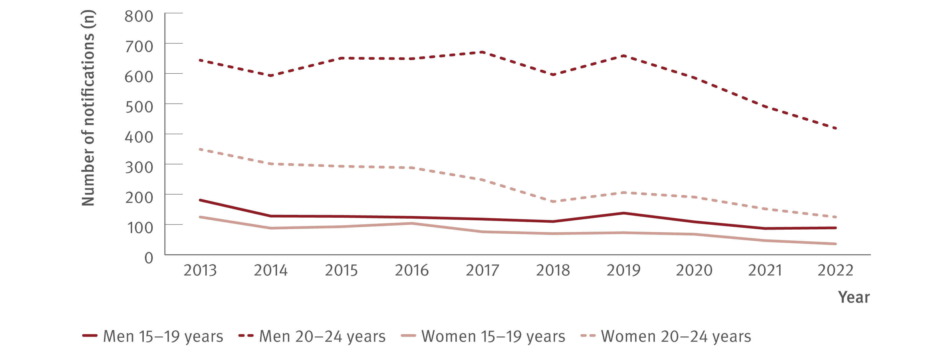
Figure 1. Number of hepatitis C (unspecified and newly acquired) notifications by age group and gender, 2013–2022
New infections
Source: Australian National Notifiable Diseases Surveillance System.^{(4,9,10)}
Notes:
Notes: Cases other than newly acquired were assigned as unspecified.

Slide 10
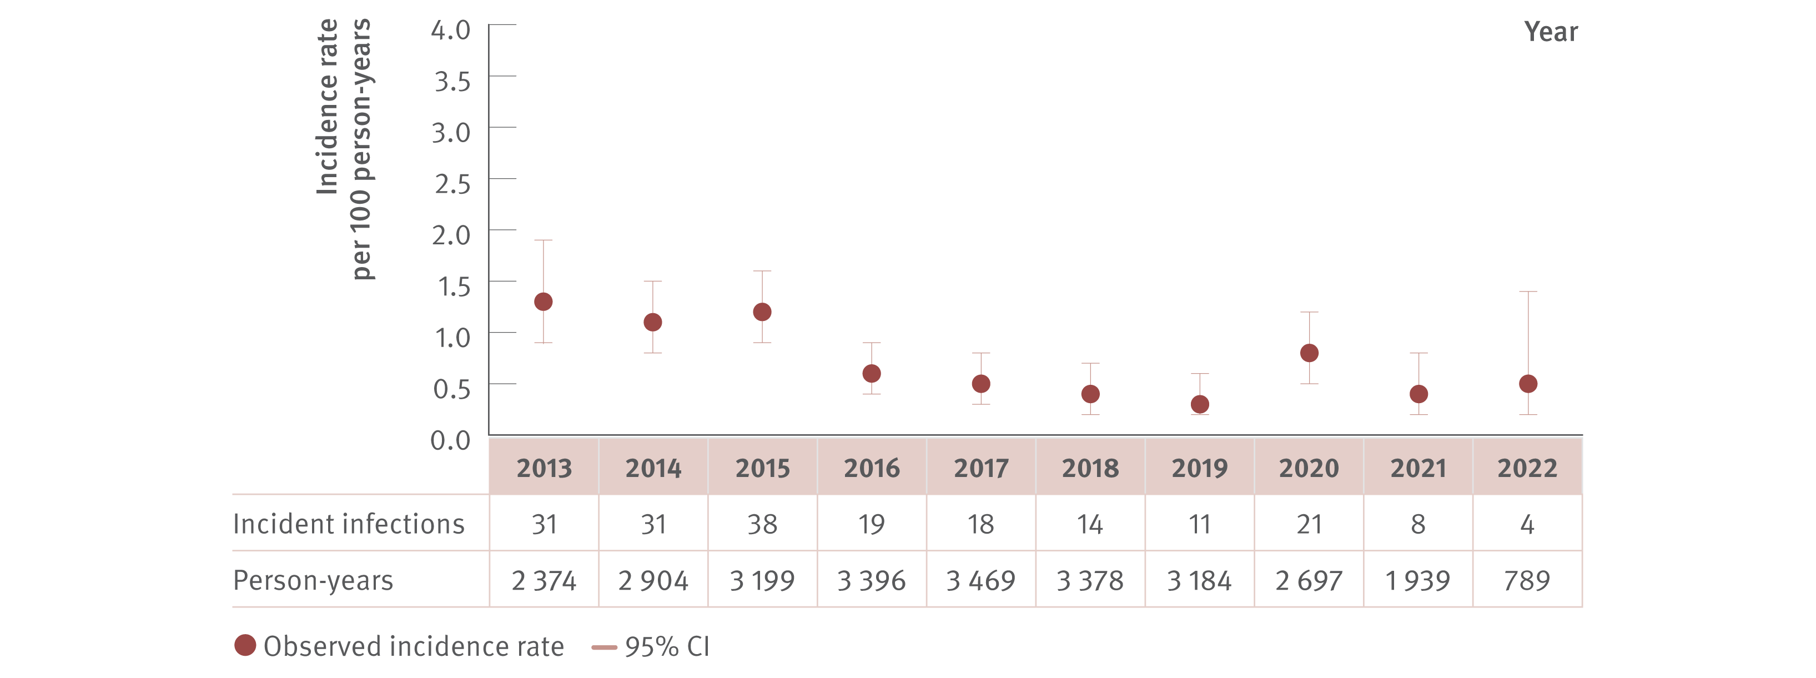
Figure 2. Incidence of primary hepatitis C infection among individuals tested at ACCESS primary care clinics, ACCESS, 2013–2022
New infections
Source: ACCESS.(12)
Notes:
Notes: Analysis includes 23 sites: 12 in NSW, four in VIC, one in SA, two in ACT, one in WA, two in QLD, and one in TAS. The TAS site contributed data from 2013 onwards. GBM were classed as being HIV‑positive for the entire calendar year of their diagnosis, were 15 years or older, and contributed one test per year. Individuals included either had no previous HCV antibody test recorded in ACCESS since 2009 or had previously tested HCV antibody negative. Individual’s HCV antibody tests after an HCV antibody positive test being observed were excluded from analysis.

Slide 11
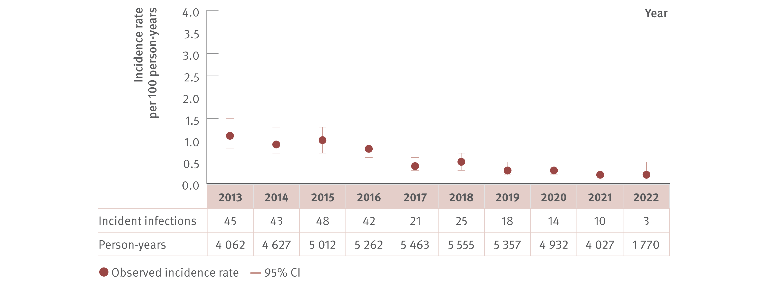
Figure 3. Incidence of primary hepatitis C infection among HIV‑positive GBM tested at ACCESS GBM or sexual health clinics, ACCESS, 2013–2022
New infections
Source: ACCESS.(12)
Notes:
Notes: N=8 681 individuals and 111 721 hepatitis C tests (HCV antibody and/or HCV RNA). Analysis includes 23 sites: 12 in NSW, four in VIC, one in South Australia (SA), two in Australian Capital Territory (ACT), one in WA, two in QLD, and one in Tasmania (TAS). The TAS site contributed data from 2013 onwards. GBM were classed as being HIV‑positive for the entire calendar year of their diagnosis and were 15 years or older. First incident infection only included in analysis. Incident infection date was assigned as the midpoint between the positive HCV antibody or HCV RNA test date and previous HCV antibody negative test date. ACCESS collates data from January 2009. Individuals included tested HCV antibody negative on their first test observed, and had at least one follow‑up test (HCV antibody or HCV RNA or both on or before 31st December 2022). CI: confidence interval.

Slide 12
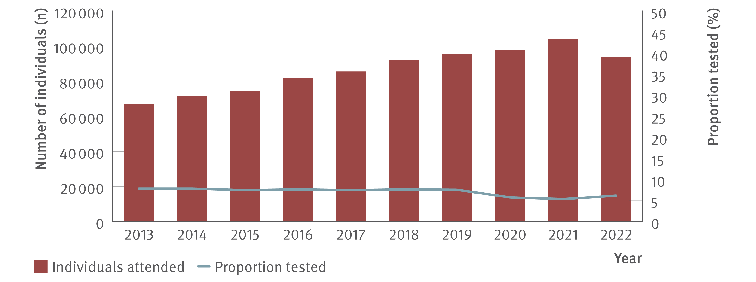
Figure 4. Number of individuals attending ACCESS primary care clinics and proportion tested for HCV (HCV antibody only or HCV antibody and RNA or HCV RNA only), ACCESS, 2013–2022
Testing and diagnosis
Source: ACCESS.(12)
Notes:
Notes: Analysis includes 14 sites: 12 in VIC, one in WA, and one in QLD. The WA site contributed data from 2016 onwards. Primary care clinics have high caseloads of people at risk of hepatitis C and provide both specialist services to current and former people who inject drugs as well as general health services. Clinic attendances included in‑person and telehealth consultations. Individuals were 15 years or older and contributed one consultation and one test per year.

Slide 13
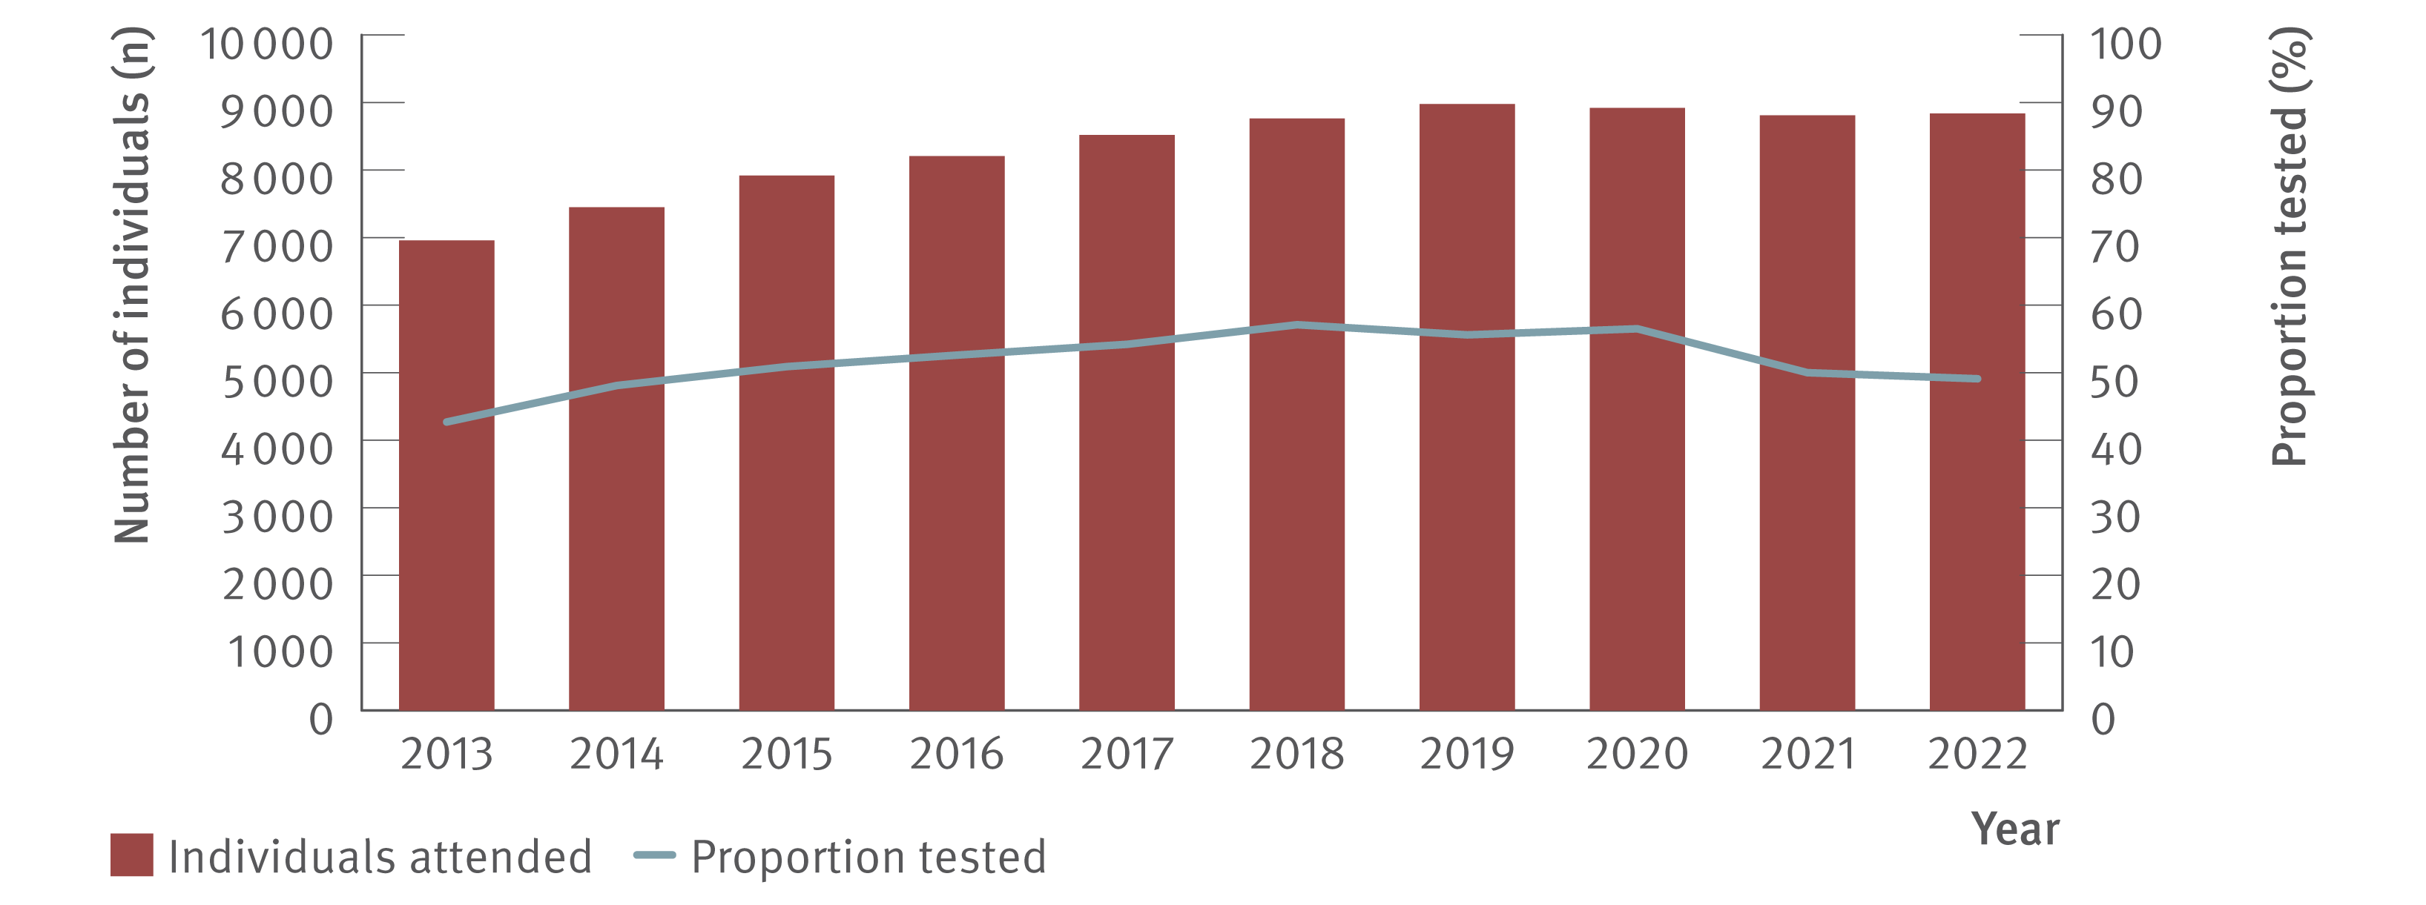
Figure 5. Number of HIV‑positive GBM attending ACCESS GBM or sexual health clinics and proportion tested for HCV (HCV antibody only or HCV antibody and RNA or HCV RNA only), ACCESS, 2013–2022
Testing and diagnosis
Source: ACCESS.(12)
Notes:
Notes: Analysis includes 23 sites: 12 in NSW, four in VIC, one in SA, two in ACT, one in WA, two in QLD, and one in TAS. The TAS site contributed data from 2013 onwards. Clinic attendances included in‑person and telehealth consultations. GBM were classed as being HIV‑positive for the entire calendar year of their diagnosis, were 15 years or older, and contributed one consultation and one test per year.

Slide 14
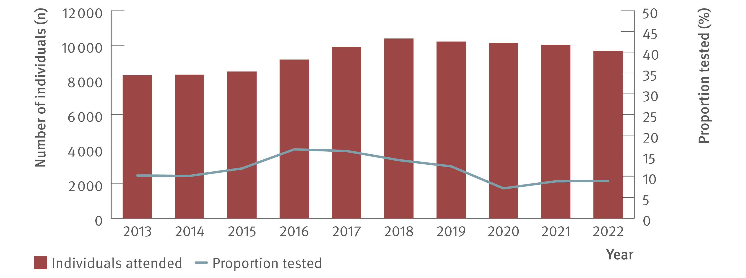
Figure 6. Number of individuals ever prescribed opioid agonist therapy attending ACCESS primary care clinics and proportion tested for HCV (HCV antibody only or HCV antibody and RNA or HCV RNA only), ACCESS, 2013–2022
Testing and diagnosis
Source: ACCESS.(12)
Notes:
Notes: Analysis includes 14 sites: 12 in VIC, one in WA, and one in QLD. The WA site contributed data from 2016 onwards. Primary care clinics have high caseloads of people at risk of hepatitis C and provide both specialist services to current and former people who inject drugs as well as general health services. Clinic attendances included in‑person and telehealth consultations. Individuals were 15 years or older, had at least one electronic medical record of a prescription for opioid agonist therapy between January 2009 and December 2022, and contributed one consultation and one test per year.

Slide 15
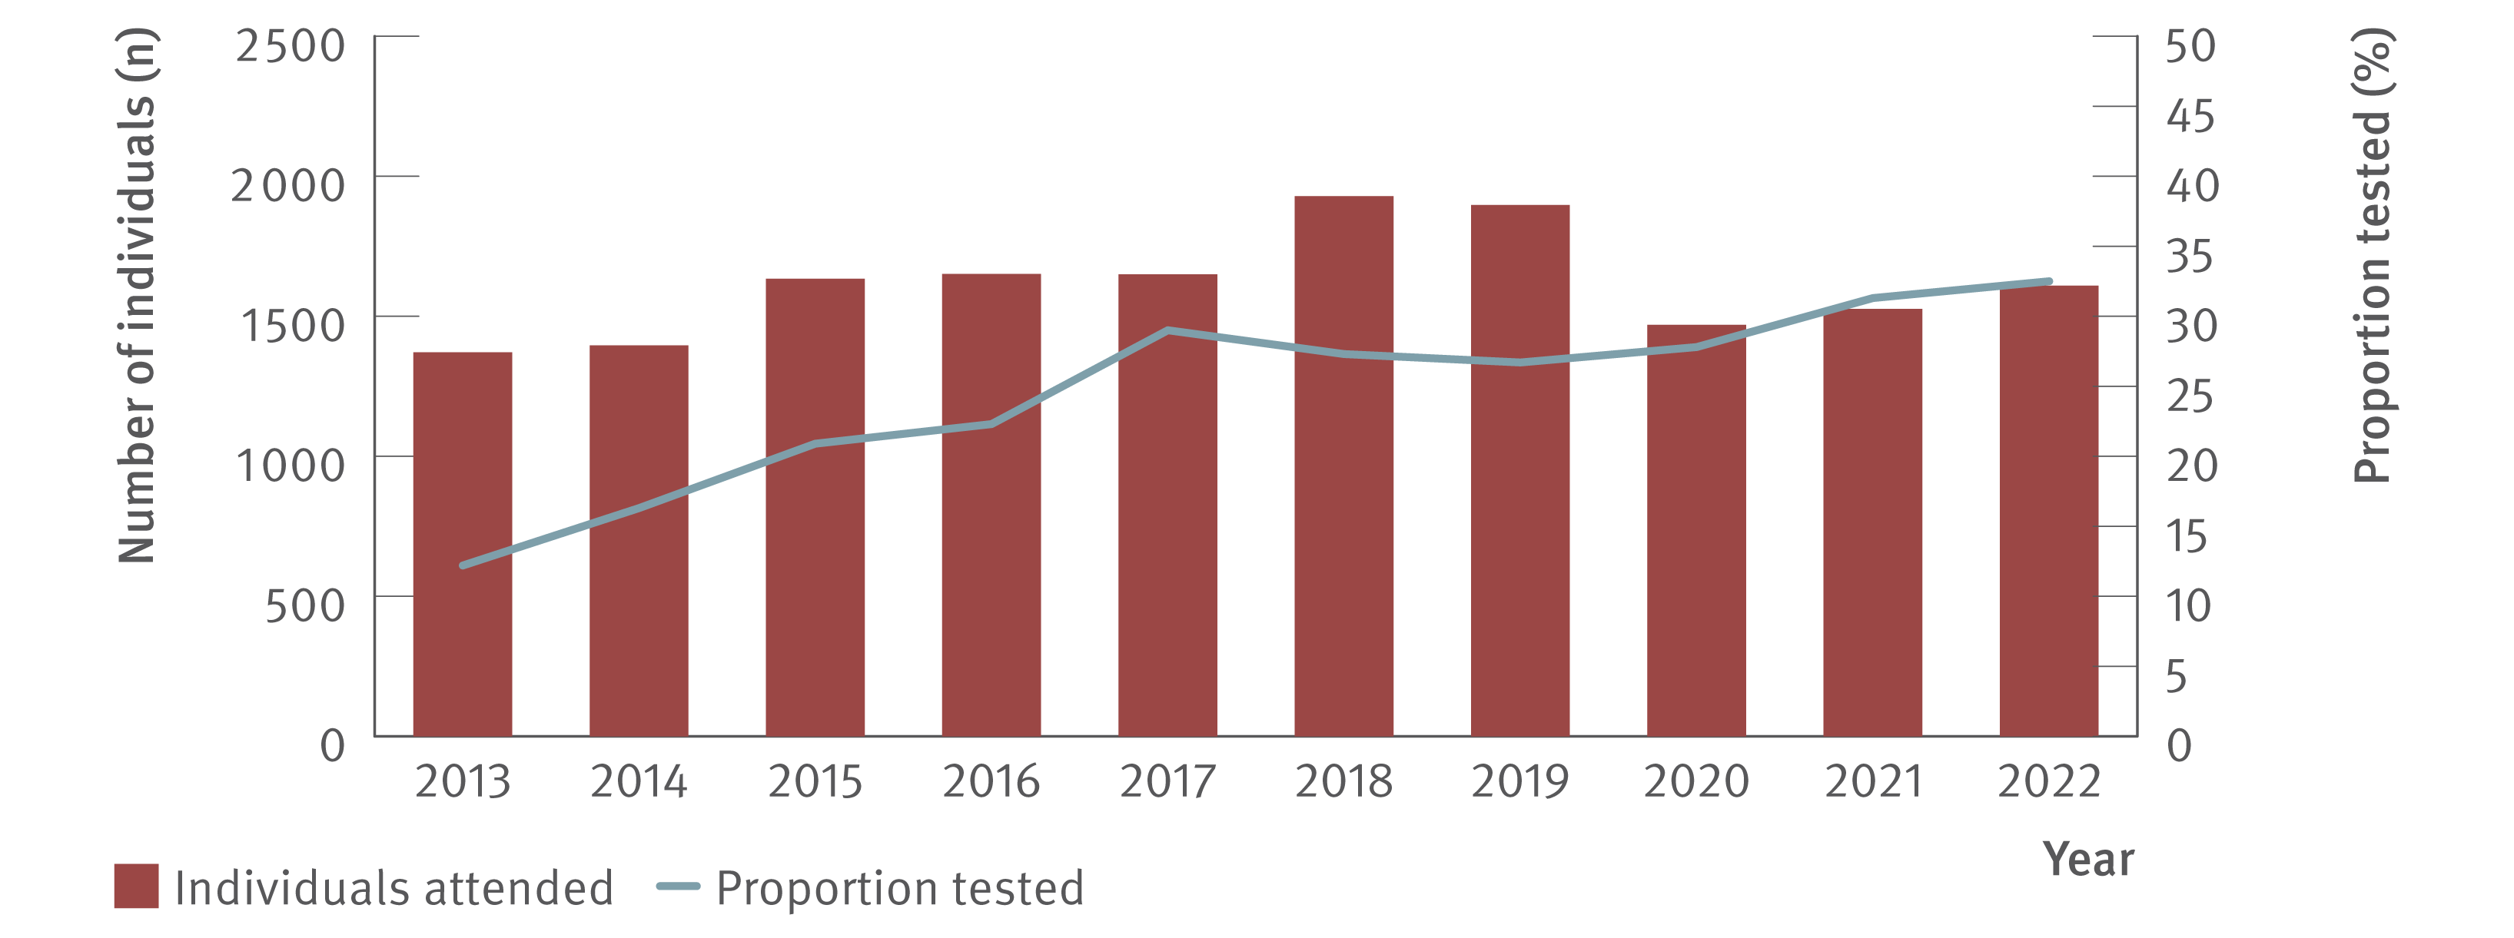
Figure 7. Number of Aboriginal and Torres Strait Islander people attending ACCESS sexual health clinics and proportion tested for HCV (HCV antibody only or HCV antibody and RNA or HCV RNA only), ACCESS, 2013–2022
Testing and diagnosis
Source: ACCESS.(12)
Notes:
Notes: Analysis includes seven sites: four in NSW, one in VIC, one in ACT, and one in SA. Clinic attendances included in‑person and telehealth consultations. Individuals were 15 years or older and contributed one consultation and one test per year. Overall, of unique individuals who attended included clinics 2013–2022 for a consultation (N=346 313), 15% of people had no Aboriginal or Torres Strait Islander status recorded (missing), 19% were recorded as ‘not stated’, 63% were neither Aboriginal nor Torres Strait Islander people, and 3% were Aboriginal and Torres Strait Islander people.

Slide 16
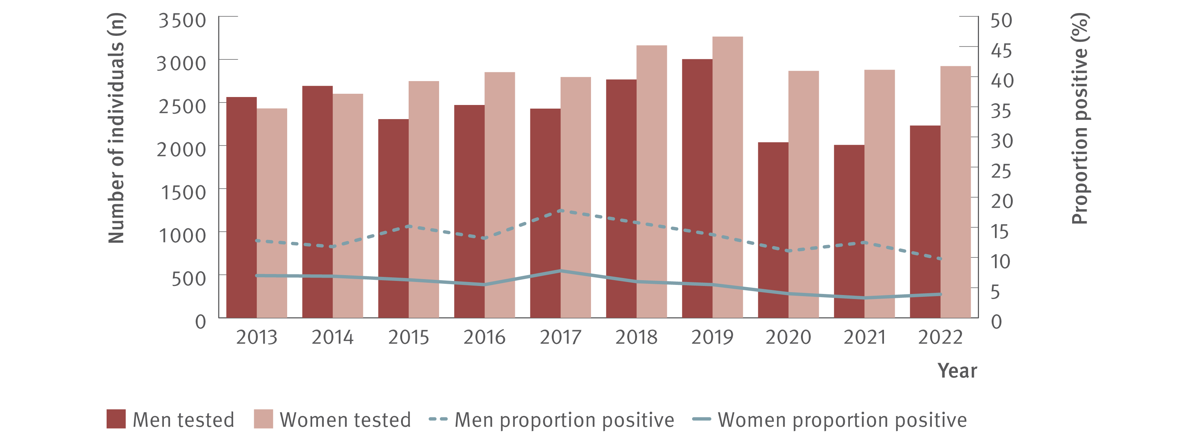
Figure 8. Number of individuals tested for HCV antibody at ACCESS primary care clinics and proportion of HCV antibody tests positive by gender, ACCESS, 2013–2022
Testing and diagnosis
Source: ACCESS.(12)
Notes:
Notes: Analysis includes 14 sites: 12 in VIC, one in WA, and one in QLD. The WA site contributed data from 2016 onwards. Primary care clinics have high caseloads of people at risk of hepatitis C and provide both specialist services to current and former people who inject drugs as well as general health services. Clinic attendances included in‑person and telehealth consultations. Individuals were 15 years or older and contributed one test per year. Individuals recorded as a gender other than man or woman were not reported due to small sample size. Individuals included either had no previous HCV antibody test recorded in ACCESS since 2009 or had previously tested HCV antibody negative. Individual’s HCV antibody tests after an HCV antibody positive test being observed were excluded from analysis.

Slide 17
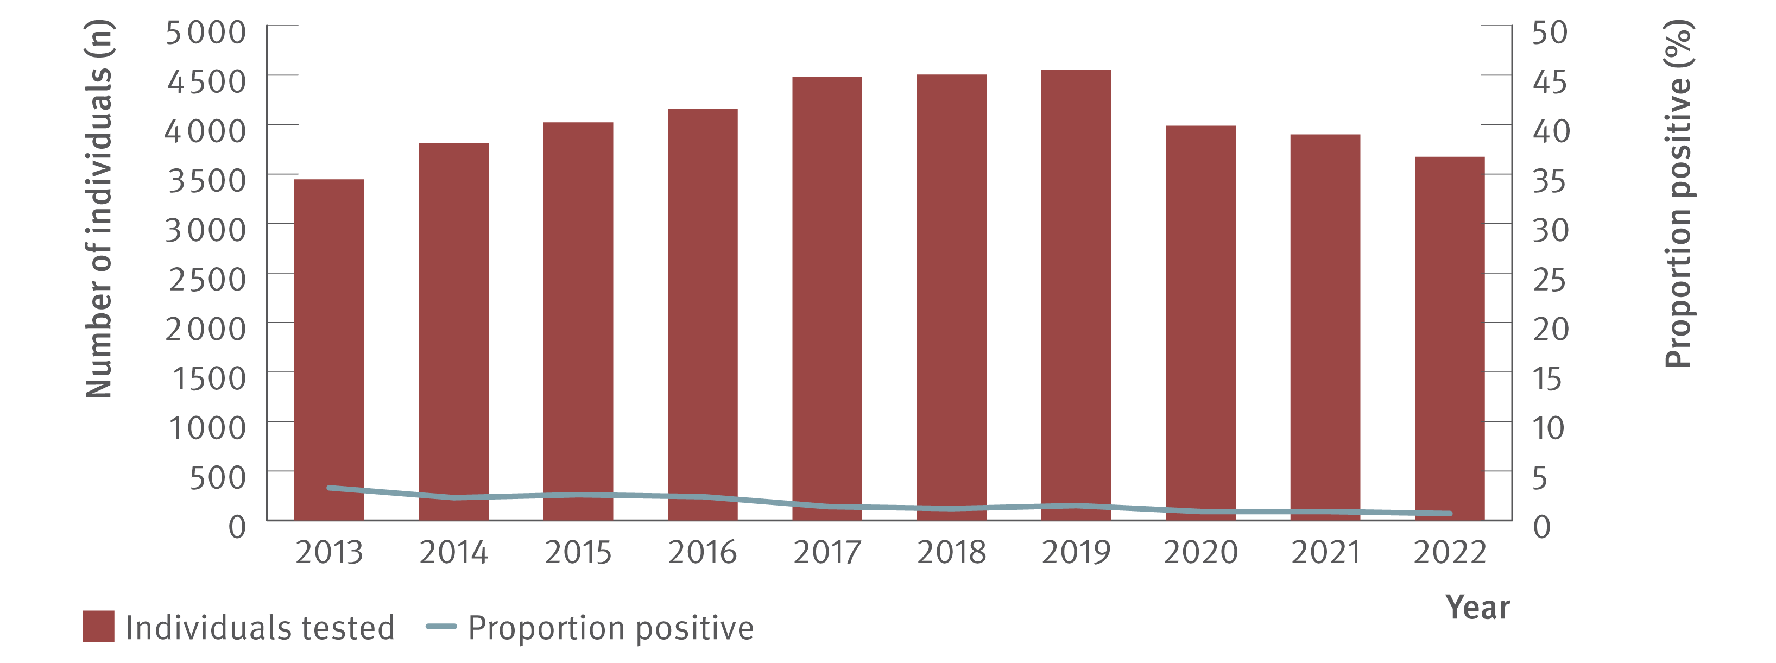
Figure 9. Number of HIV‑positive GBM tested for HCV antibody at ACCESS GBM or sexual health clinics and proportion of HCV antibody tests positive, ACCESS, 2013–2022
Testing and diagnosis
Source: ACCESS.(12)
Notes:
Notes: Analysis includes 23 sites: 12 in NSW, four in VIC, one in SA, two in ACT, one in WA, two in QLD, and one in TAS. The TAS site contributed data from 2013 onwards. GBM were classed as being HIV‑positive for the entire calendar year of their diagnosis, were 15 years or older, and contributed one test per year. Individuals included either had no previous HCV antibody test recorded in ACCESS since 2009 or had previously tested HCV antibody negative. Individual’s HCV antibody tests after an HCV antibody positive test being observed were excluded from analysis.

Slide 18
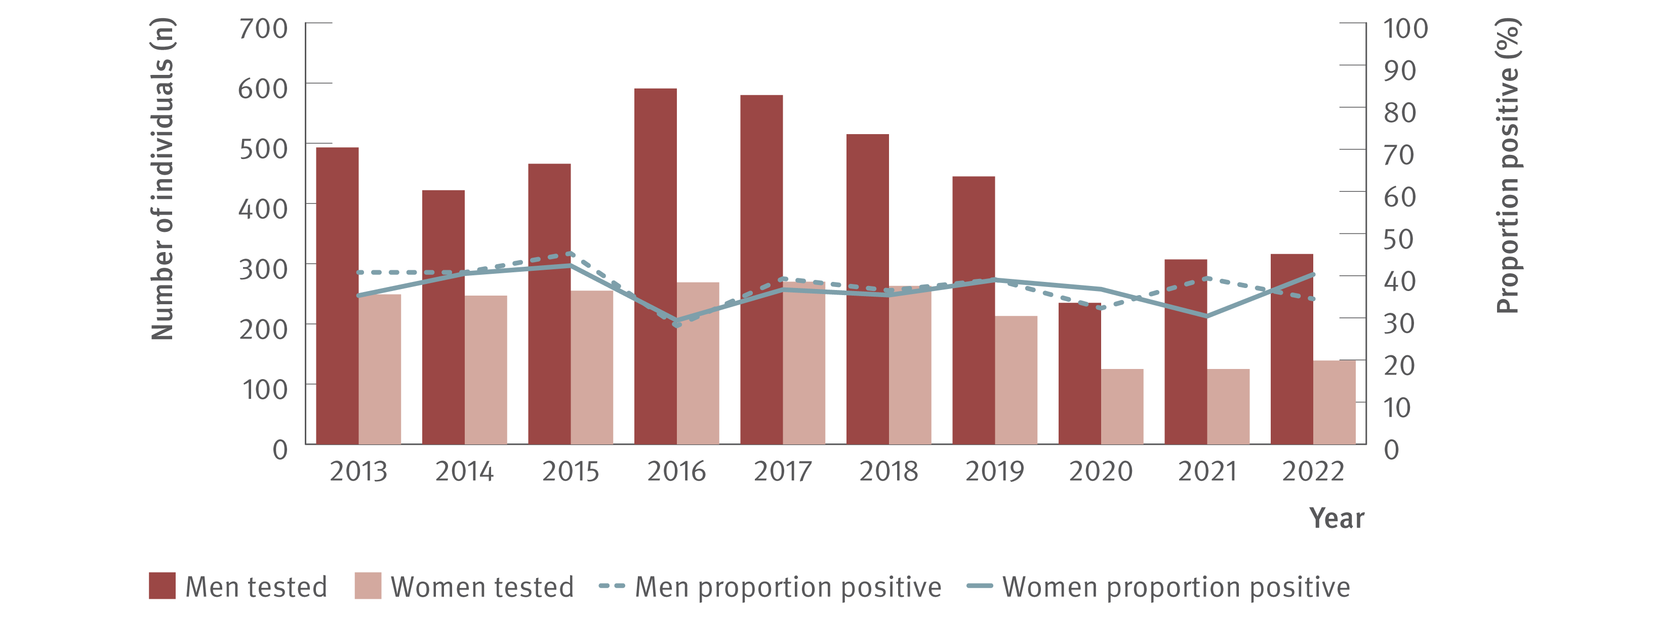
Figure 10. Number of individuals ever prescribed opioid agonist therapy tested for HCV antibody at ACCESS primary care clinics and proportion of HCV antibody tests positive by gender, ACCESS, 2013–2022
Testing and diagnosis
Source: ACCESS.(12)
Notes:
Notes: Analysis includes 14 sites: 12 in VIC, one in WA, and one in QLD. The WA site contributed data from 2016 onwards. Primary care clinics have high caseloads of people at risk of hepatitis C and provide both specialist services to current and former people who inject drugs as well as general health services. Individuals were 15 years or older, had at least one electronic medical record of a prescription for opioid agonist therapy between January 2009 and December 2022, and contributed one test per year. Individuals recorded as a gender other than man or woman were not reported due to small sample size. Individuals included either had no previous HCV antibody test recorded in ACCESS since 2009 or had previously tested HCV antibody negative. Individual’s HCV antibody tests after an HCV antibody positive test being observed were excluded from analysis.

Slide 19
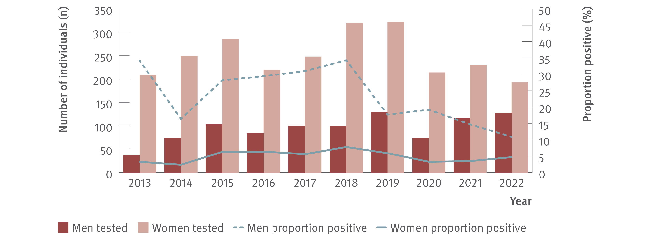
Figure 11. Number of Aboriginal and Torres Strait Islander people tested for HCV antibody at ACCESS sexual health clinics and proportion of HCV antibody tests positive, ACCESS, 2013–2022
Testing and diagnosis
Source: ACCESS.(12)
Notes:
Notes: Analysis includes seven sites: four in NSW, one in VIC, one in ACT, and one in SA. Clinic attendances included in‑person and telehealth consultations. Individuals were 15 years or older and contributed one test per year. Individuals recorded as a gender other than man or woman were not reported due to small sample size. Individuals included either had no previous HCV antibody test recorded in ACCESS since 2009 or had previously tested HCV antibody negative. Individual’s HCV antibody tests after an HCV antibody positive test being observed were excluded from analysis. Overall, of unique individuals who attended included clinics 2013–2022 for a consultation (N=346 313), 15% of people had no Aboriginal or Torres Strait Islander status recorded (missing), 19% were recorded as ‘not stated’, 63% were neither Aboriginal nor Torres Strait Islander people, and 3% were Aboriginal and Torres Strait Islander people.

Slide 20
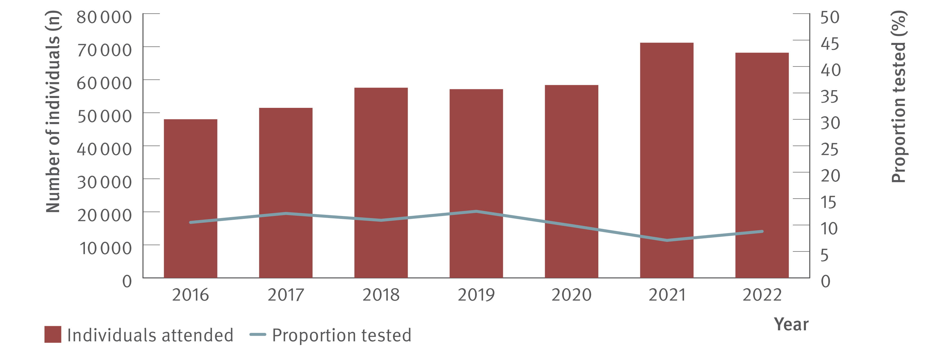
Figure 12. Number of individuals attending ACCHS and proportion tested for HCV (HCV antibody only or HCV antibody and RNA or HCV RNA only), ATLAS network, 2016–2022
Testing and diagnosis
Source: ATLAS Indigenous Primary Care Surveillance and Research Network, 2016–2022.(17)
Notes:
Notes: Individuals defined as people aged 15 years or older, who visited a doctor, nurse, or Aboriginal health practitioner (‘medical consultations’) between 2016 and 2022.

Slide 21
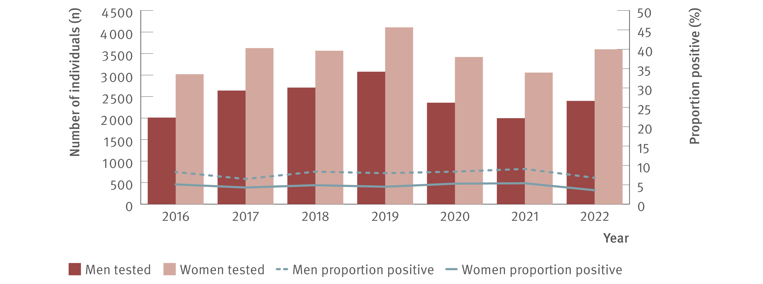
Figure 13. Number of individuals attending ACCHS tested for HCV antibody and proportion positive by gender, ATLAS network, 2016–2022
Testing and diagnosis
Source: ATLAS Indigenous Primary Care Surveillance and Research Network, 2016–2022.(17)
Notes:
Notes: Individuals defined as people aged 15 years or older, who visited a doctor, nurse, or Aboriginal health practitioner (‘medical consultations’) between 2016 and 2022. Number of people tested per year as follows: 2016: 2 012 men, 3 020 women; 2017: 2 640 men, 3 626 women; 2018: 2 709 men, 3 566 women; 2019: 3 077 men, 4 108 women; 2020: 2 358 men, 3 420 women; 2021: 1 998 men, 3 058 women; 2022: 2 399 men, 3 598 women.

Slide 22
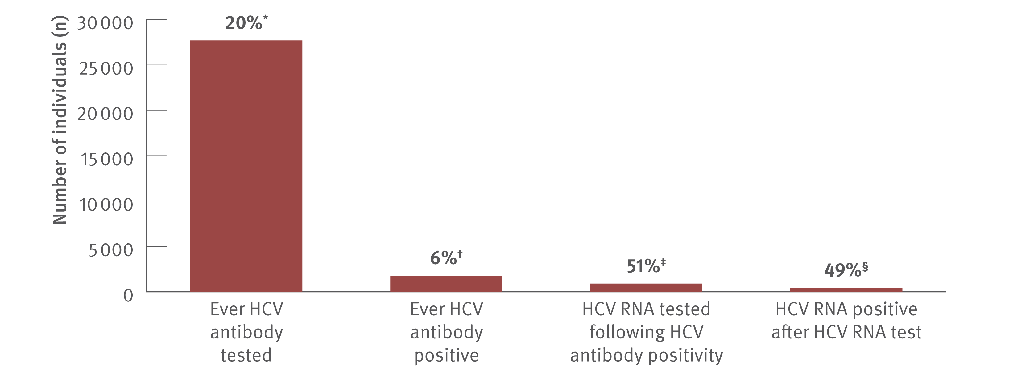
Figure 14. Hepatitis C testing cascade: number and proportion of individuals attending ACCHS tested for HCV antibody or RNA and among those tested, the number and proportion testing positive, ATLAS network, aggregated for years 2016–2022
Testing and diagnosis
Source: ATLAS Indigenous Primary Care Surveillance and Research Network, 2016–2022.(17)
Notes:
Notes: Individuals defined as people aged 15 years or older, who visited a doctor, nurse, or Aboriginal health practitioner (‘medical consultations’) between 2016 and 2022. ‘Ever HCV antibody positive’ was defined as having had a positive test result at any time since data collection began (1st January 2016) until end of the sample period (December 2022). *A total of 135 838 individuals aged 15 years or older attended medical appointments between 2016 and 2022, of whom 20.4% (27 683/135 838) had an HCV antibody test. †Of those tested for HCV antibody, 6.4% (1 785/27 683) tested HCV antibody positive. ‡Of those HCV antibody positive, 50.9% (908/1 785) had an HCV RNA test following HCV antibody positivity of which §49.2% (447/908) were HCV RNA positive.

Slide 23
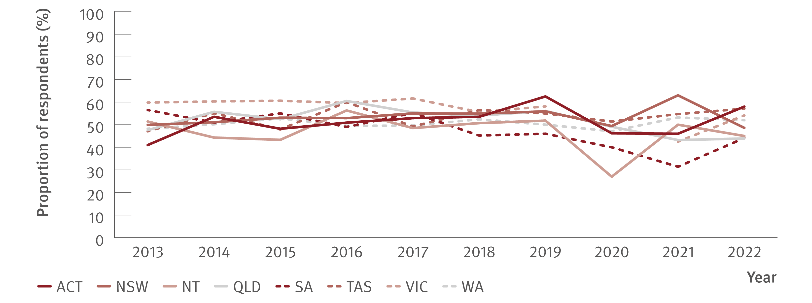
Figure 15. Proportion of Australian Needle Syringe Program Survey respondents self‑reporting recent (past 12 months) hepatitis C testing by jurisdiction, 2013–2022
Testing and diagnosis
Source: Australian Needle Syringe Program Survey. National Data Report 2018–2022.(18). Australian Needle Syringe Program Survey 25 year National Data Report 1995–2019.(23)
Notes:
Notes: No participant recruitment occurred in VIC in 2020.

Slide 24
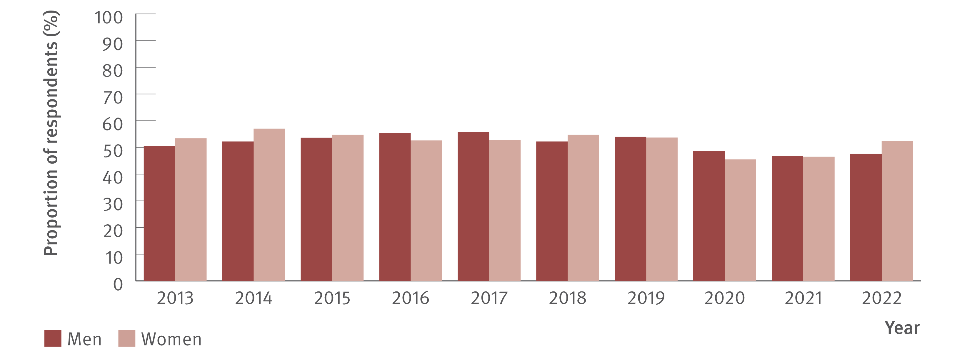
Figure 16. Proportion of Australian Needle Syringe Program Survey respondents reporting recent (past 12 months) hepatitis C testing by gender, 2013–2022
Testing and diagnosis
Source: Australian Needle Syringe Program Survey. National Data Report 2018–2022.(18) Australian Needle Syringe Program Survey 25 year National Data Report 1995–2019.(23)

Slide 25
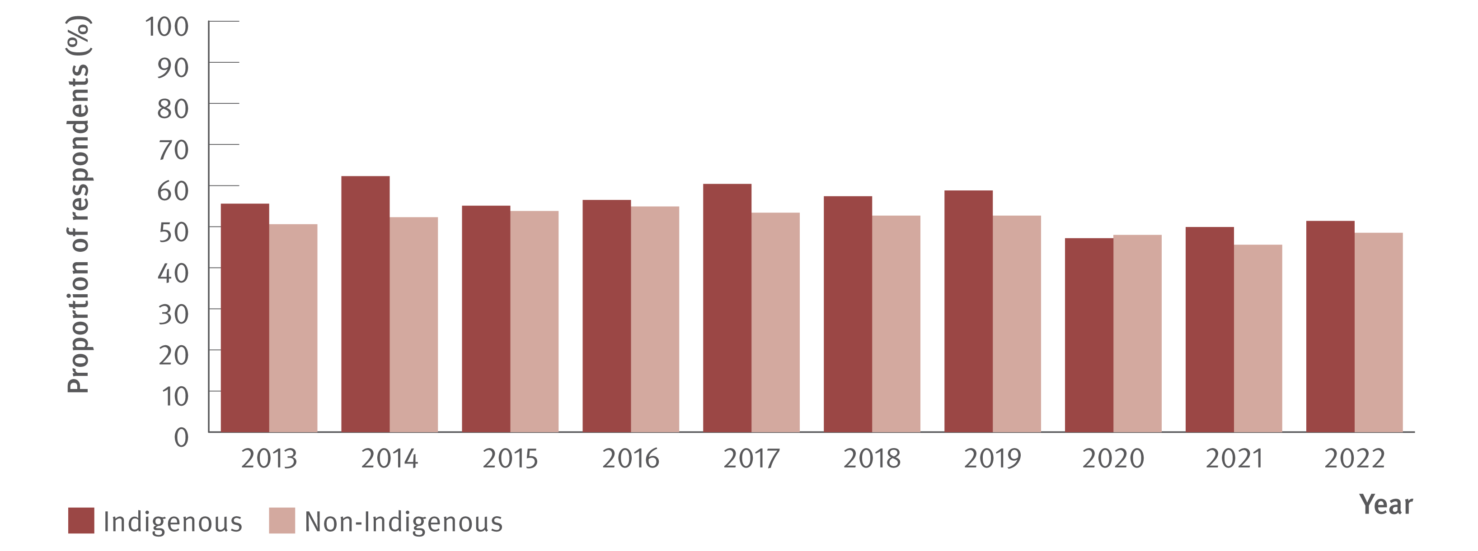
Figure 17. Proportion of Australian Needle Syringe Program Survey respondents reporting recent (past 12 months) hepatitis C testing by Indigenous status, 2013–2022
Testing and diagnosis
Source: Australian Needle Syringe Program Survey. National Data Report 2018–2022.(18) Australian Needle Syringe Program Survey 25 year National Data Report 1995–2019.(23)
Notes:
Notes: No participant recruitment occurred in VIC in 2020.

Slide 26
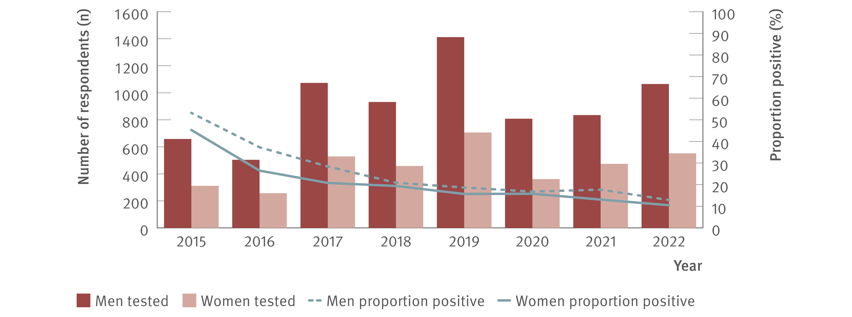
Figure 18. Number of Australian Needle Syringe Program Survey respondents tested for HCV RNA and proportion positive by gender, 2015–2022
Testing and diagnosis
Source: Australian Needle Syringe Program Survey. National Data Report 2018–2022.(18) Australian Needle Syringe Program Survey 25 year National Data Report 1995–2019.(23)
Notes:
Notes: No participant recruitment occurred in VIC in 2020. Weighted for gender and HCV antibody status 2015–2019.

Slide 27
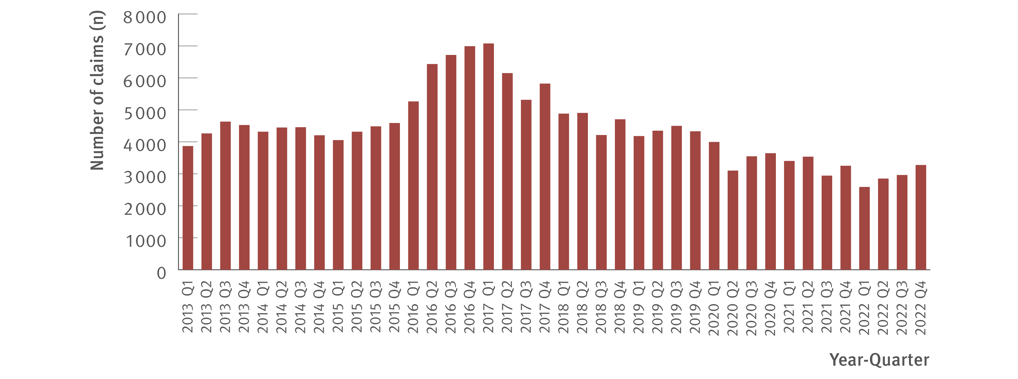
Figure 19. Number of claims to Medicare for items 69499 and 69500 (detection of HCV RNA, new infections only), 2013–2022
Testing and diagnosis
Source: Medicare Australia Statistics.(19)
Notes:
Notes: Medical Benefit Scheme item numbers (69499 and 69500) are used for testing to detect current hepatitis C infection which are not used for tests associated with treatment monitoring. Prison‑based testing is not included in Medical Benefit Scheme data.

Slide 28
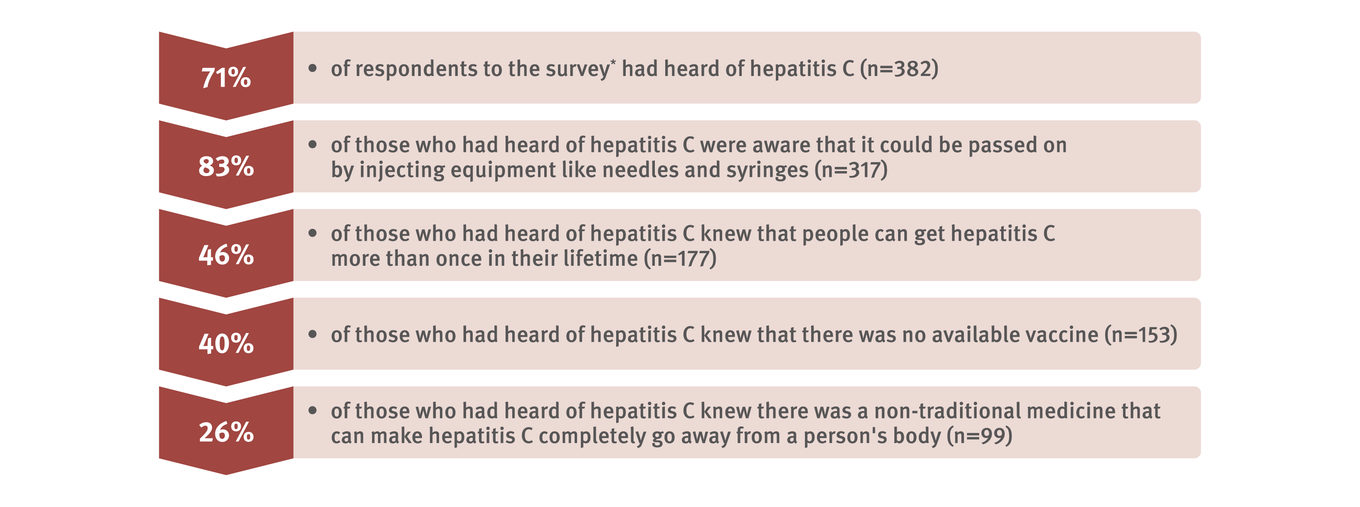
Figure 20. Awareness and knowledge of hepatitis C among people from culturally and linguistically diverse backgrounds, Migrant Blood‑borne Virus and Sexual Health Survey, national, 2020–2021 N=538*
Testing and diagnosis
Source: Migrant Blood‑borne Virus and Sexual Health Survey.(22)
Notes:
Notes: *A total of 1 489 people completed the Migrant Blood‑borne Virus and Sexual Health Survey. Of the 1 489 respondents, 538 were asked about hepatitis C specifically and were included in this data; respondents to the survey who had never heard of hepatitis, or who knew the difference between hepatitis A, B, or C, were prompted to skip remaining hepatitis questions so were excluded from this data.

Slide 29
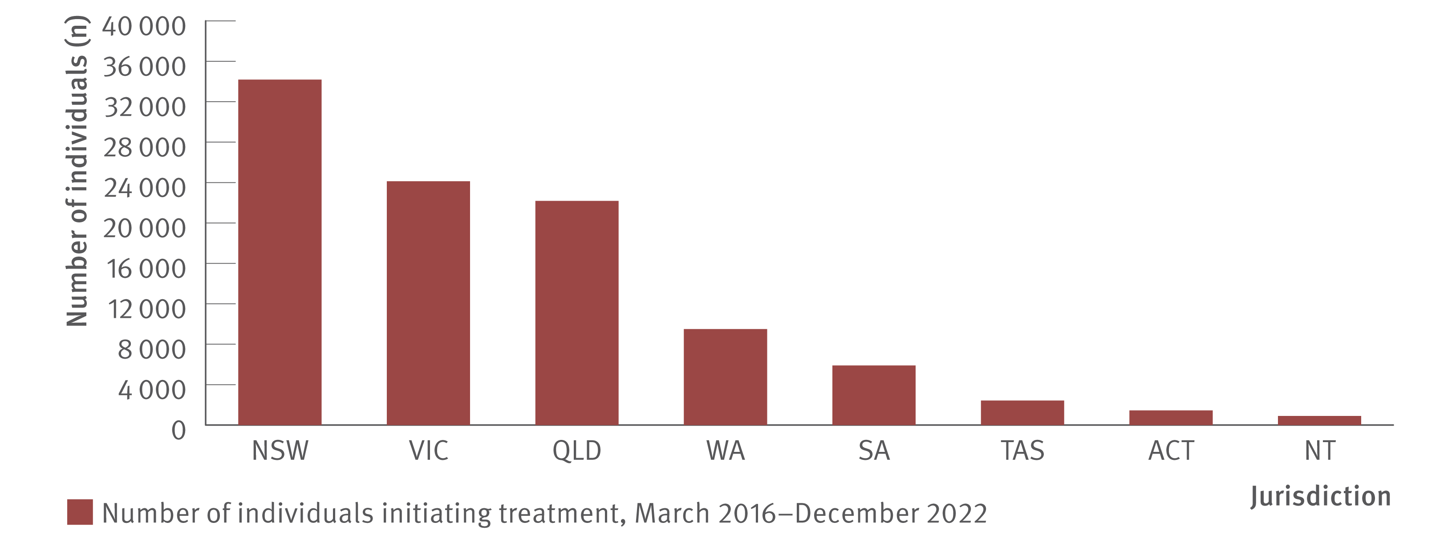
Figure 21. Estimated number of individuals initiating DAA treatment by jurisdiction, PBS database, March 2016–December 2022
Uptake of treatment
Source: Monitoring hepatitis C treatment uptake in Australia.(27)
Notes:
Notes: Includes individuals initiating first treatment. Treatment numbers may vary from previous or future reports due to refinements made to the PBS data between releases. Jurisdiction data were not available for 16 individuals.

Slide 30
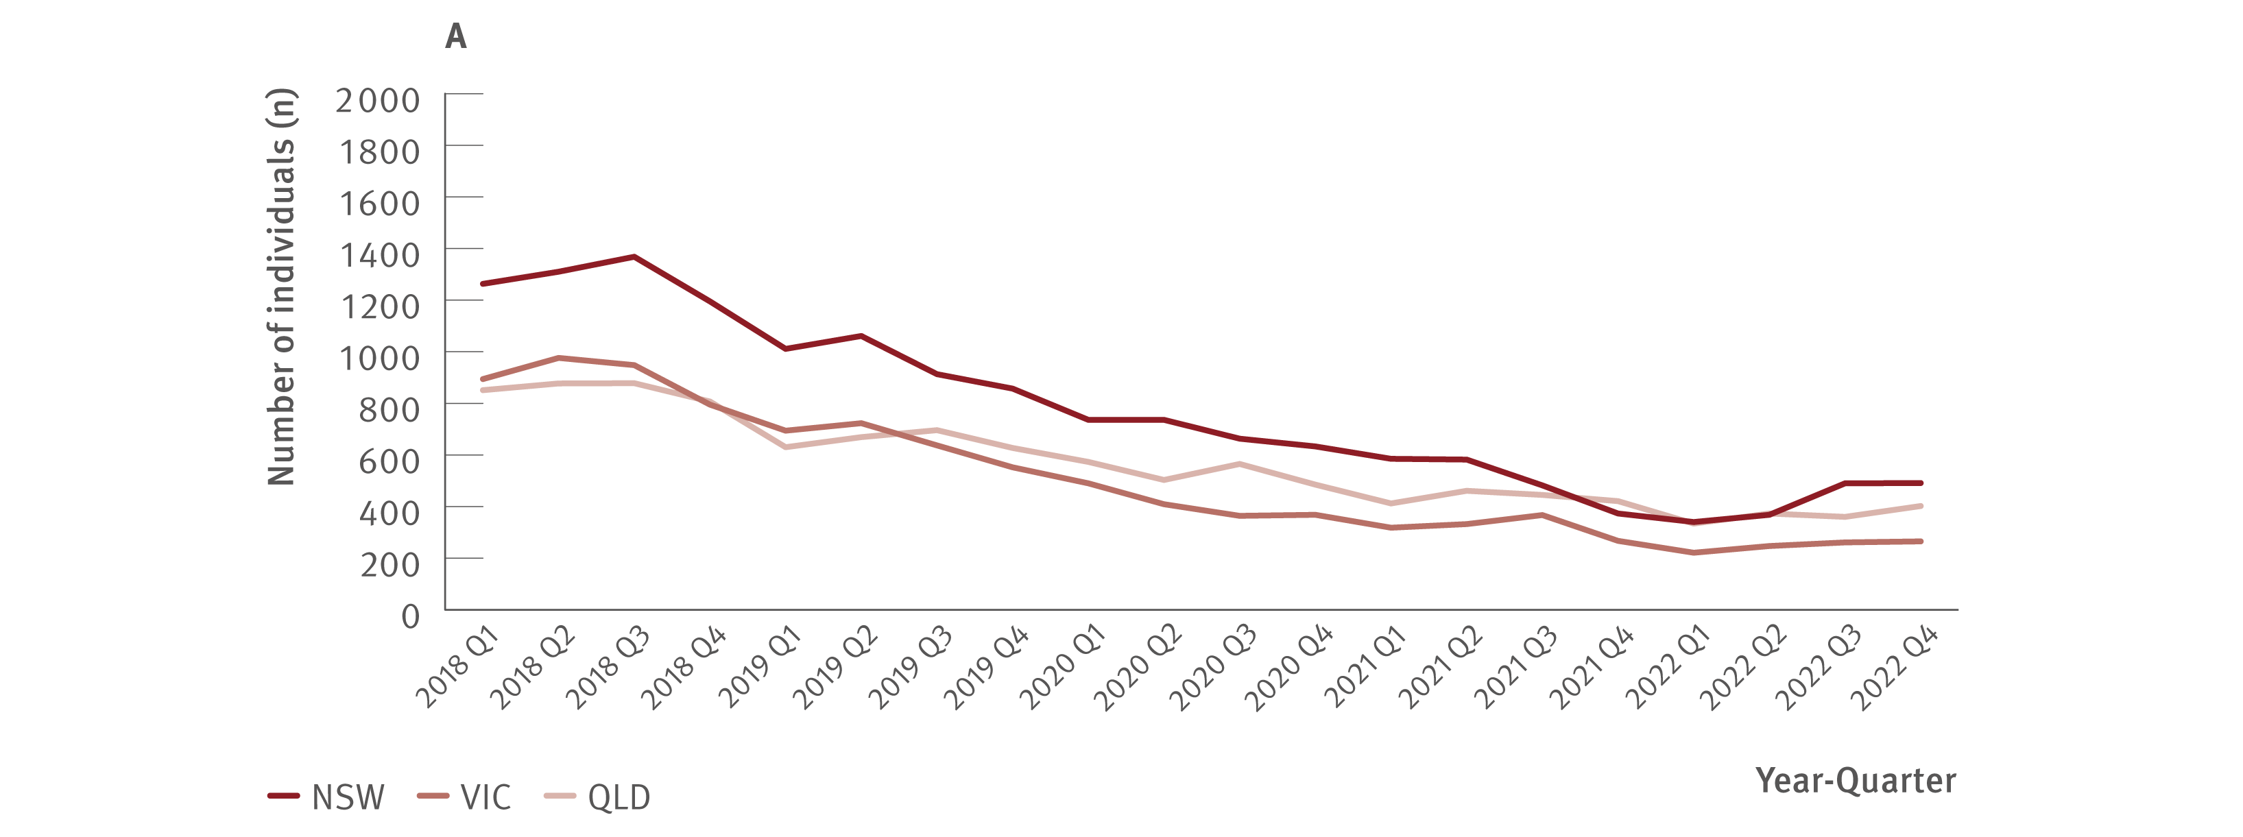
Figure 22. Estimated number of individuals initiating DAA treatment by jurisdiction, PBS database, 2018–2022
Uptake of treatment
Source: Monitoring hepatitis C treatment uptake in Australia.(27)
Notes:
Notes: Treatment numbers may vary from previous or future reports due to refinements made to the PBS data between releases.

Slide 31
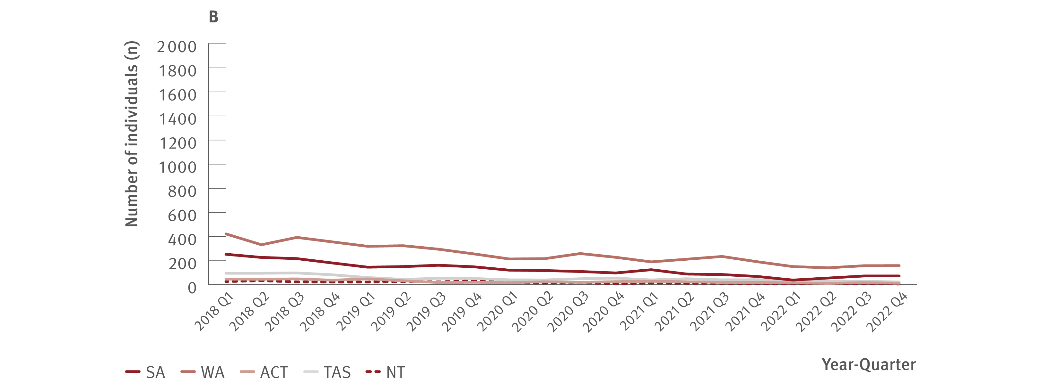
Figure 22. Estimated number of individuals initiating DAA treatment by jurisdiction, PBS database, 2018–2022
Uptake of treatment
Source: Monitoring hepatitis C treatment uptake in Australia.(27)
Notes:
Notes: Treatment numbers may vary from previous or future reports due to refinements made to the PBS data between releases.

Slide 32
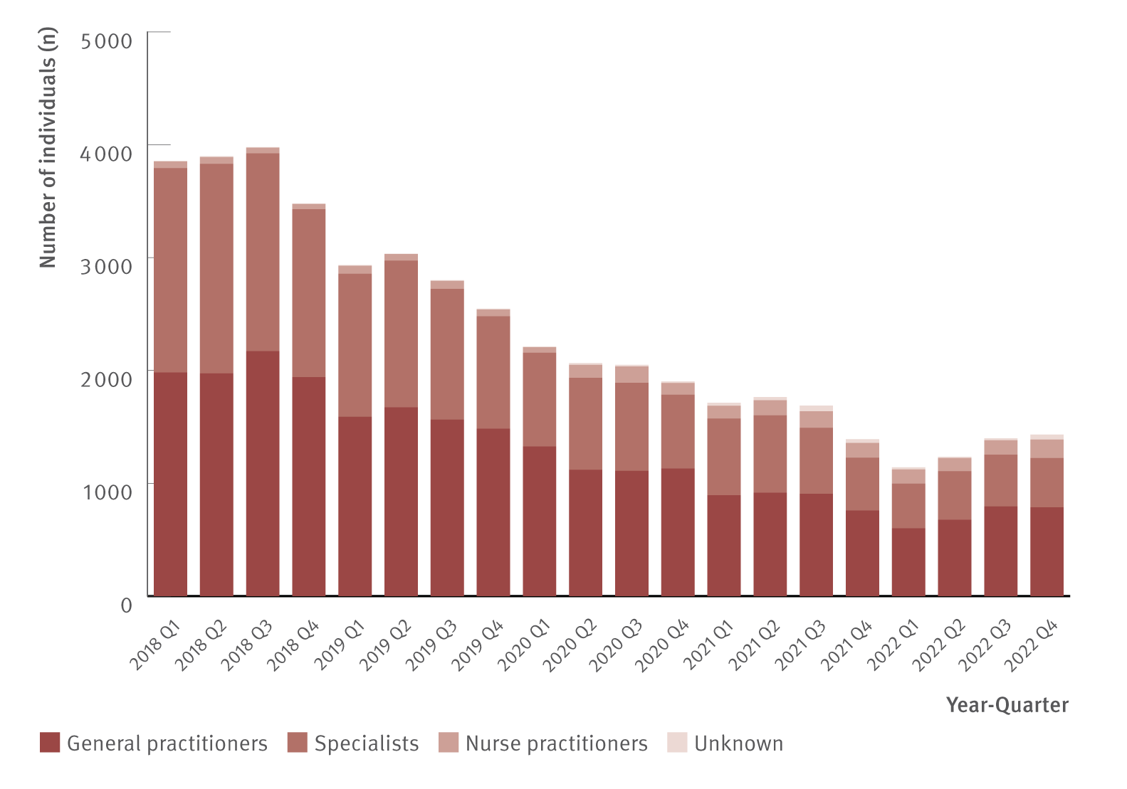
Figure 23. Estimated number of individuals initiating DAA treatment by prescriber type, PBS database, 2018– 2022
Uptake of treatment
Source: Monitoring hepatitis C treatment uptake in Australia.⁽²⁷⁾
Notes:
Notes: Treatment numbers may vary from previous or future reports due to refinements made to the PBS data between releases. Nurse practitioners have been authorised to prescribe DAA therapy for hepatitis C treatment since June 2017.

Slide 33
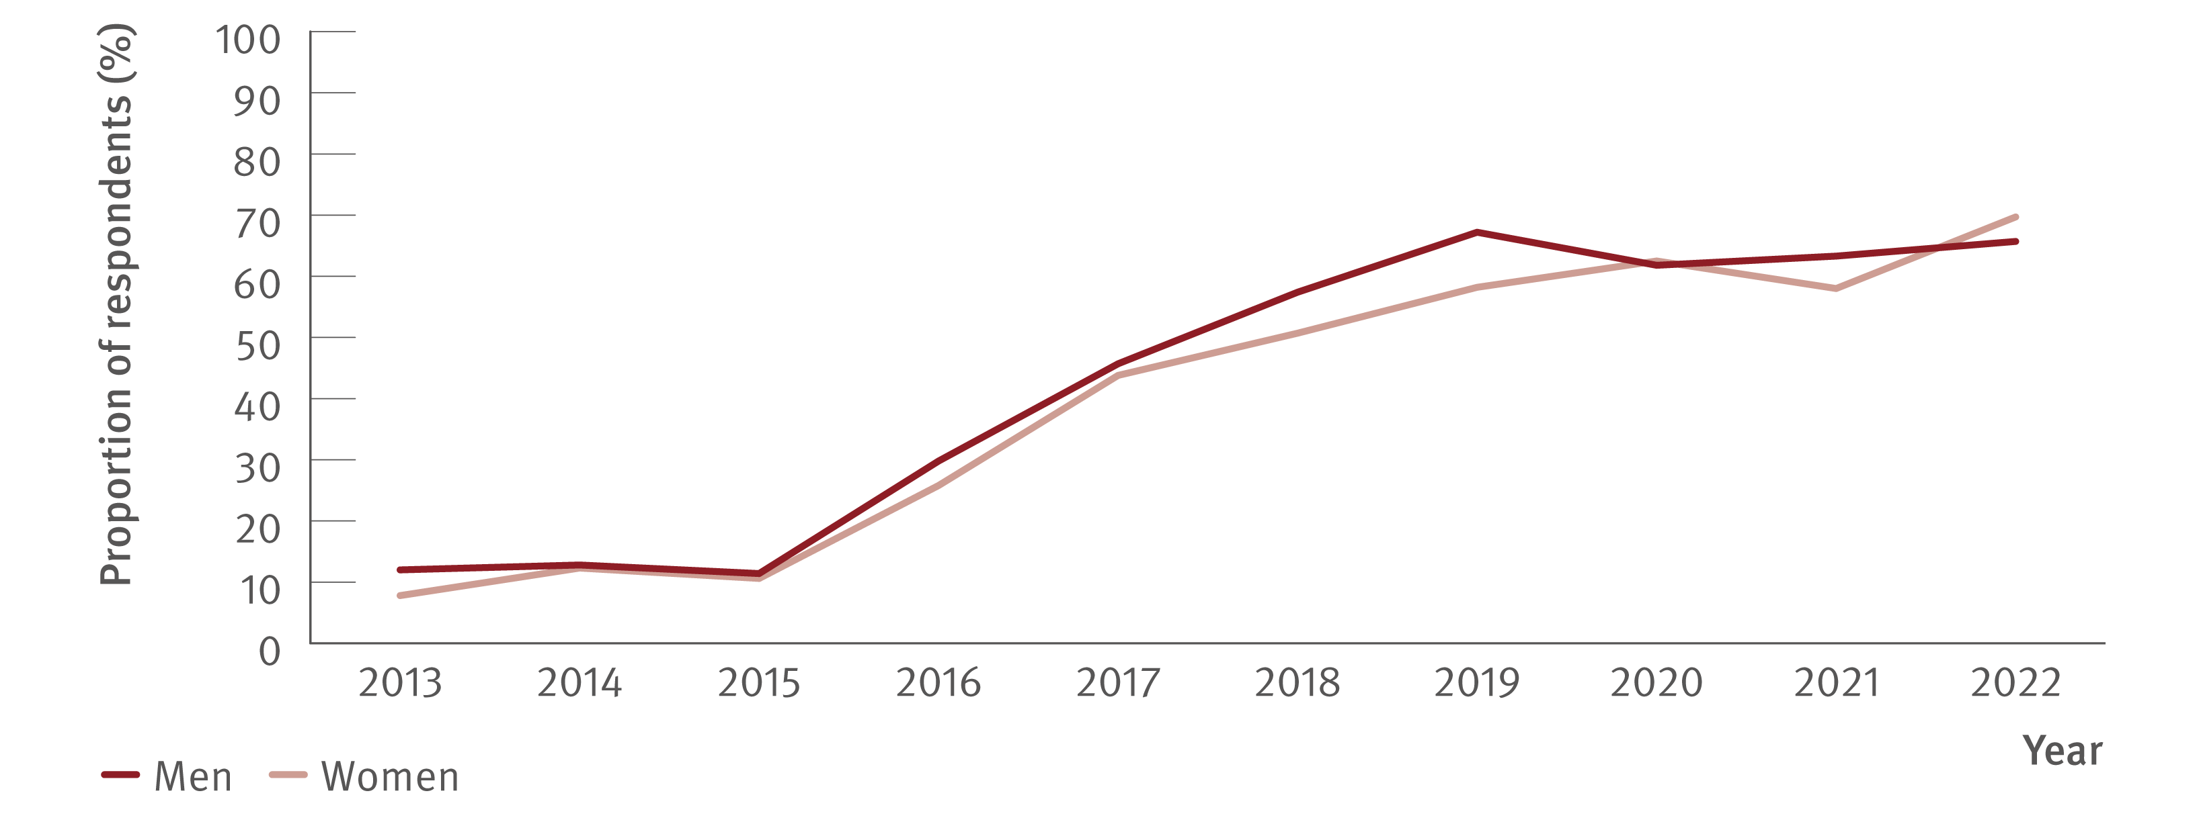
Figure 24. Proportion of Australian Needle Syringe Program Survey respondents who tested HCV antibody positive, self‑reporting lifetime history of hepatitis C treatment by gender, 2013–2022
Uptake of treatment
Source: Australian Needle Syringe Program Survey. National Data Report 2018–2022.(18). Australian Needle Syringe Program Survey 25 year National Data Report 1995–2019.(23)
Notes:
Notes: Includes respondents who tested HCV antibody positive and excludes those self‑reporting spontaneous hepatitis C clearance. No participant recruitment occurred in VIC in 2020.

Slide 34
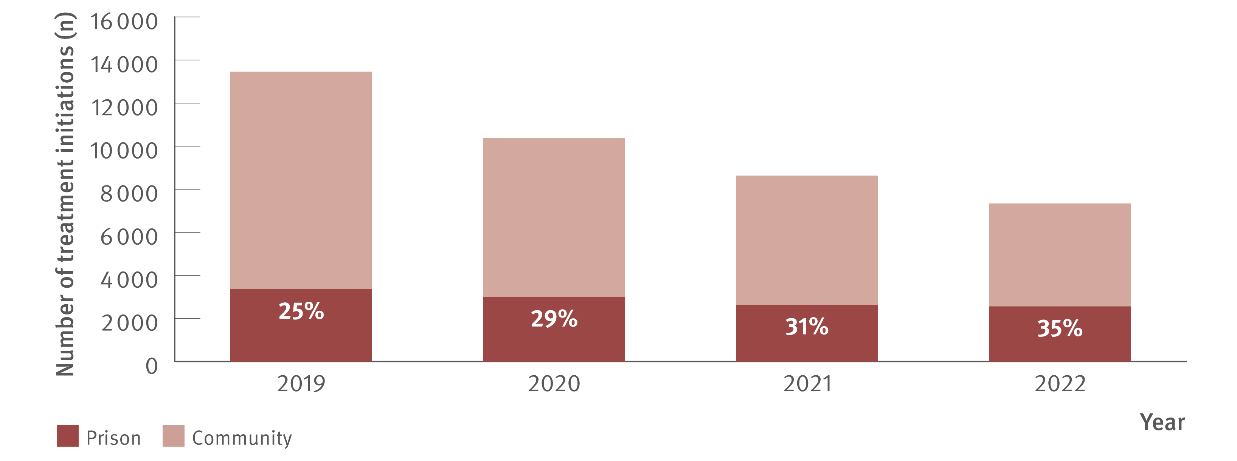
Figure 25. Number and proportion* of DAA treatment initiations in prison versus in the community nationally, National Prisons Hepatitis Network and PBS database, 2019, 2020, 2021, and 2022
Uptake of treatment
Source: State and Territory justice health authorities via the National Prisons Hepatitis Network.(28) Monitoring treatment uptake in Australia.(27)
Notes:
Notes: *The proportion of all treatments that were initiated in prisons nationally was calculated using the actual number of treatments reported by jurisdictional hepatitis services as a proportion of all treatments derived from the PBS database. ‘Community’ treatment initiations are therefore defined as all PBS treatments minus all treatments reported by jurisdictional prison‑based hepatitis services.

Slide 35
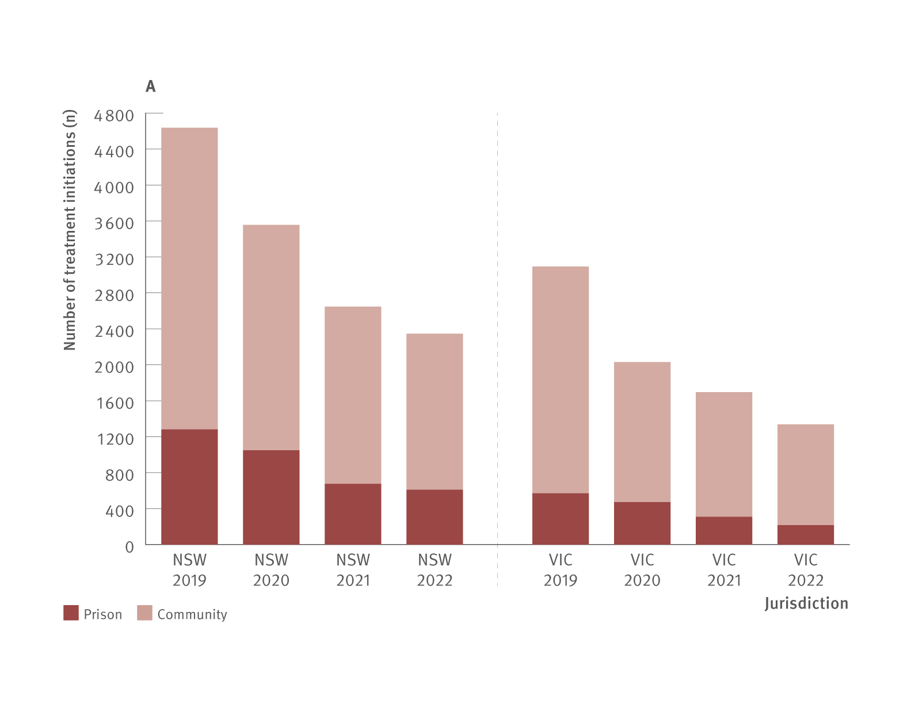
Figure 26. Number of DAA treatment initiations in prison versus in the community by jurisdiction (A, B, C, and D), National Prisons Hepatitis Network and PBS database, 2019, 2020, 2021, and 2022
Uptake of treatment
Source: State and Territory justice health authorities via the National Prisons Hepatitis Network.(28) Monitoring treatment uptake in Australia.(27)

Slide 36
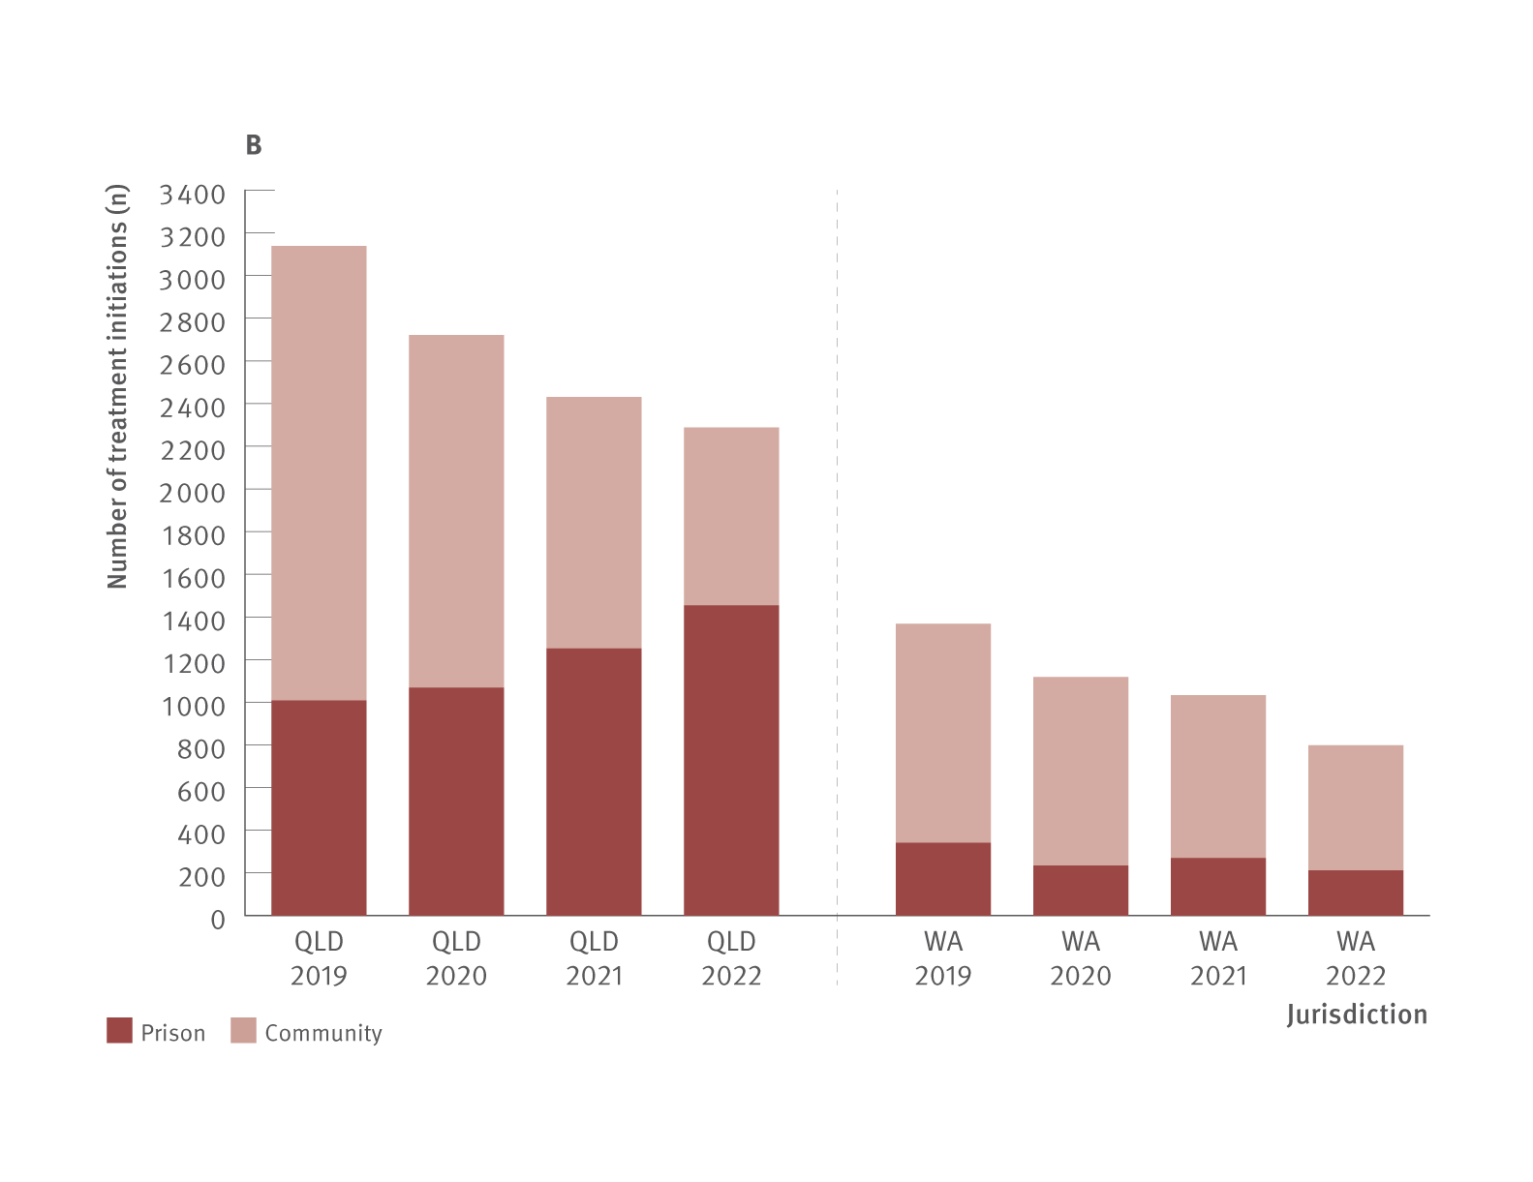
Figure 26. Number of DAA treatment initiations in prison versus in the community by jurisdiction (A, B, C, and D), National Prisons Hepatitis Network and PBS database, 2019, 2020, 2021, and 2022
Uptake of treatment
Source: State and Territory justice health authorities via the National Prisons Hepatitis Network.(28) Monitoring treatment uptake in Australia.(27)

Slide 37
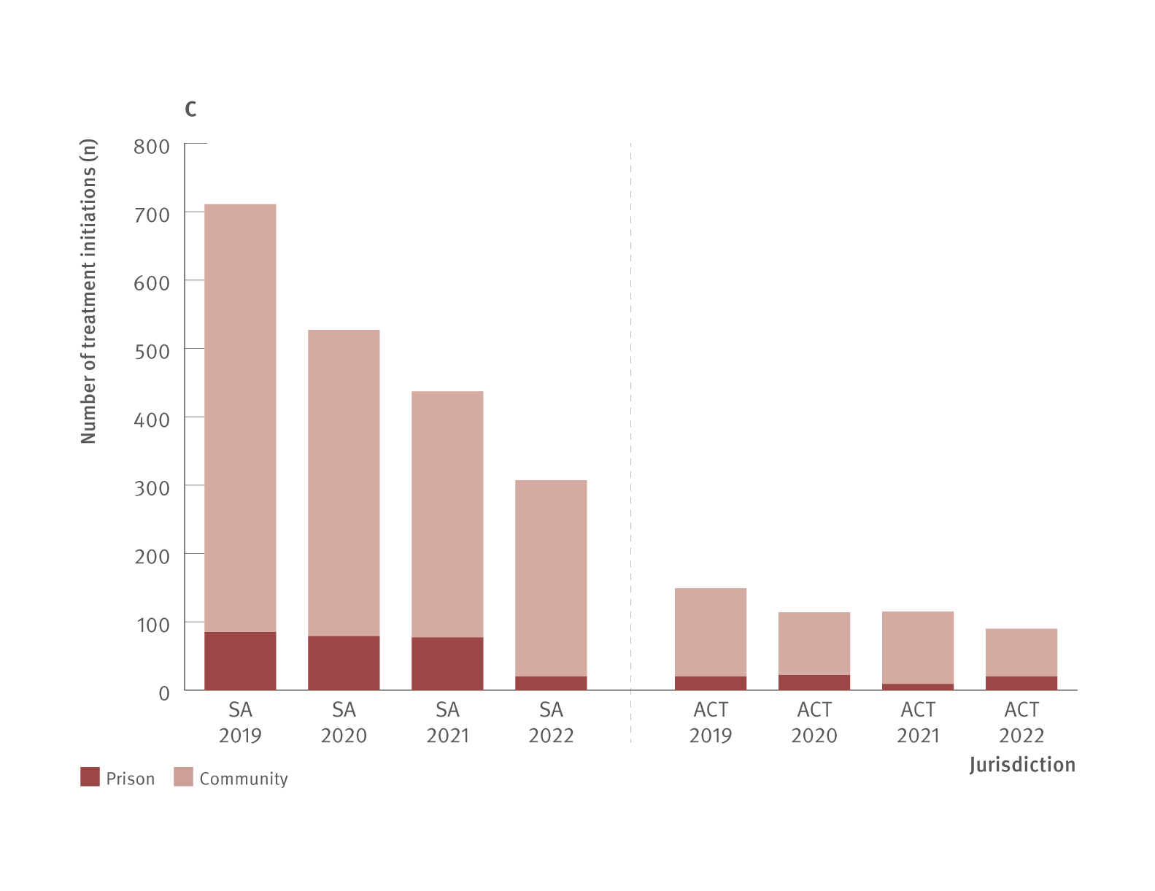
Figure 26. Number of DAA treatment initiations in prison versus in the community by jurisdiction (A, B, C, and D), National Prisons Hepatitis Network and PBS database, 2019, 2020, 2021, and 2022
Uptake of treatment
Source: State and Territory justice health authorities via the National Prisons Hepatitis Network.(28) Monitoring treatment uptake in Australia.(27)

Slide 38
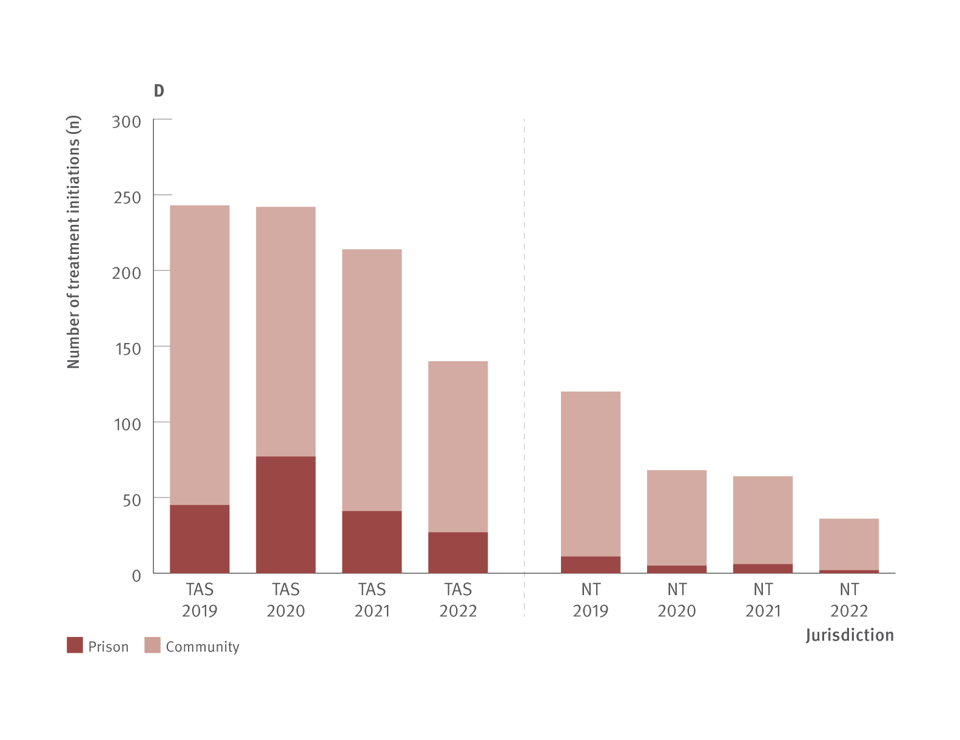
Figure 26. Number of DAA treatment initiations in prison versus in the community by jurisdiction (A, B, C, and D), National Prisons Hepatitis Network and PBS database, 2019, 2020, 2021, and 2022
Uptake of treatment
Source: State and Territory justice health authorities via the National Prisons Hepatitis Network.(28) Monitoring treatment uptake in Australia.(27)

Slide 39
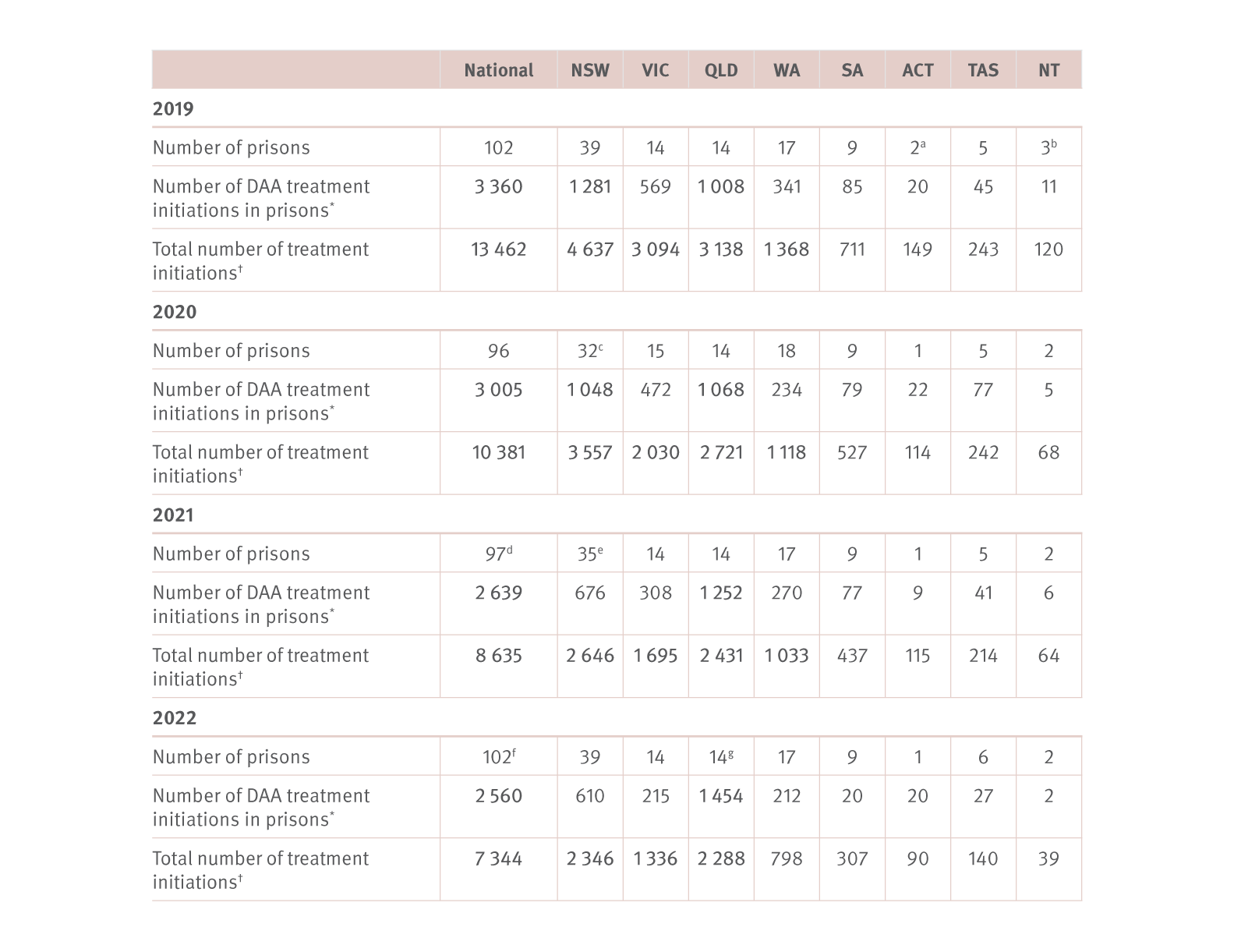
Table 1. Number of DAA treatment initiations in prison versus in the community, nationally and by jurisdiction, National Prisons Hepatitis Network and PBS database, 2019, 2020, 2021, and 2022
Uptake of treatment
Source: State and Territory justice health authorities via the National Prisons Hepatitis Network.⁽²⁸⁾ Monitoring treatment uptake in Australia.⁽²⁷⁾
Notes:
Notes: PBS treatment numbers may vary from previous or future reports due to refinements made to PBS data between releases (2019–2022 data from 2023 release of data).*Total number of treatment initiations reported by jurisdictional prison‑based hepatitis services. †Total treatment initiations (including retreatments) obtained from PBS database; national total includes treatment initiations with no jurisdiction recorded. aOne prison and one mental health correctional facility. bTwo prisons and one youth detention. cBetween 2019 and 2020, five prisons closed. Data were collected from 31 public prisons (January–December) and one private prison (June–June 2020), data were not collected from two private prisons. dData were collected from 95 prisons. eData were collected from 32 public prisons; data were not collected from three private prisons. fData were collected from 92 public prisons and nine private prisons. gData were collected from 13 prisons.

Slide 40
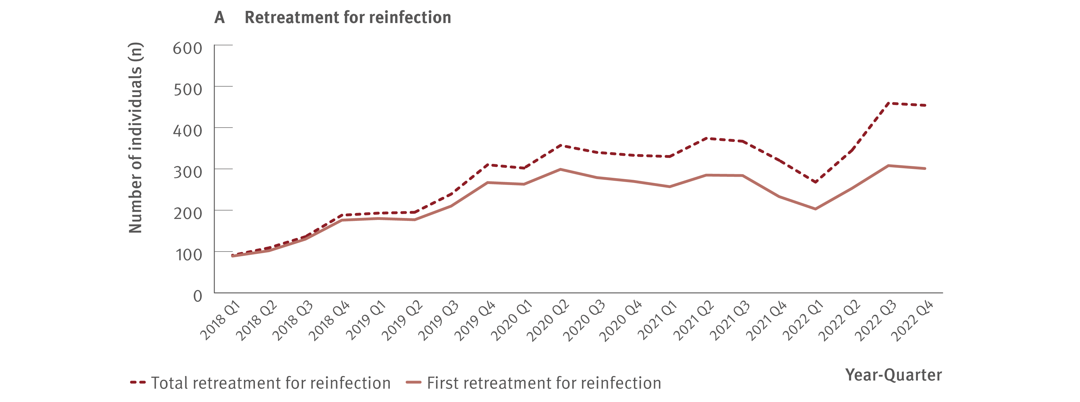
Figure 27. Estimated number of individuals retreated for hepatitis C reinfection (A) or treatment failure (B), National Retreatment Project, 2018–2022
Uptake of treatment
Source: National Retreatment project.(31)
Notes:
Notes: Data on retreatment is shown from 2018, to highlight trends in more recent years. Full analysis includes all individuals with hepatitis C who initiated DAA treatment through the PBS and were retreated, 2016–2022. As the PBS data does not capture reason for retreatment, retreatment data from the REACH‑C cohort were used to train a Random Forest machine learning model to classify retreatment for reinfection or virological failure. Of individuals initiating DAA treatment through the PBS between 2016 and 2022 (N=100 449), 9% received retreatment (n=8 514). The model classified 56% (n=4 776) as reinfection and 44% (n=3 738) as treatment failure. Half (53%) of all individuals retreated for treatment failure discontinued initial treatment (≥28 days of treatment course had not been dispensed).

Slide 41
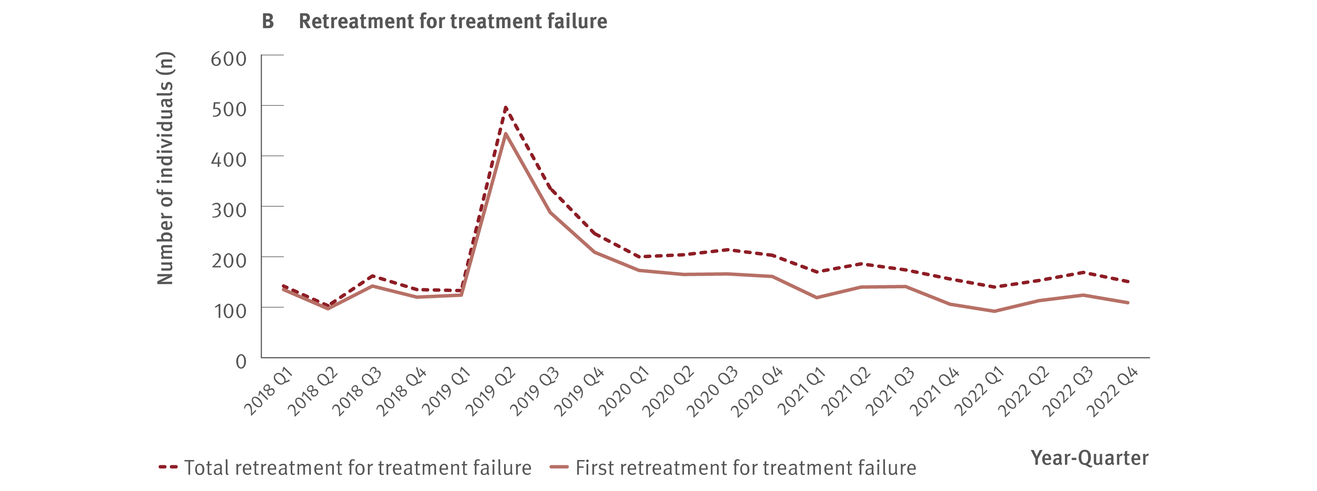
Figure 27. Estimated number of individuals retreated for hepatitis C reinfection (A) or treatment failure (B), National Retreatment Project, 2018–2022
Uptake of treatment
Source: National Retreatment project.(31)
Notes:
Notes: Data on retreatment is shown from 2018, to highlight trends in more recent years. Full analysis includes all individuals with hepatitis C who initiated DAA treatment through the PBS and were retreated, 2016–2022. As the PBS data does not capture reason for retreatment, retreatment data from the REACH‑C cohort were used to train a Random Forest machine learning model to classify retreatment for reinfection or virological failure. Of individuals initiating DAA treatment through the PBS between 2016 and 2022 (N=100 449), 9% received retreatment (n=8 514). The model classified 56% (n=4 776) as reinfection and 44% (n=3 738) as treatment failure. Half (53%) of all individuals retreated for treatment failure discontinued initial treatment (≥28 days of treatment course had not been dispensed).

Slide 42
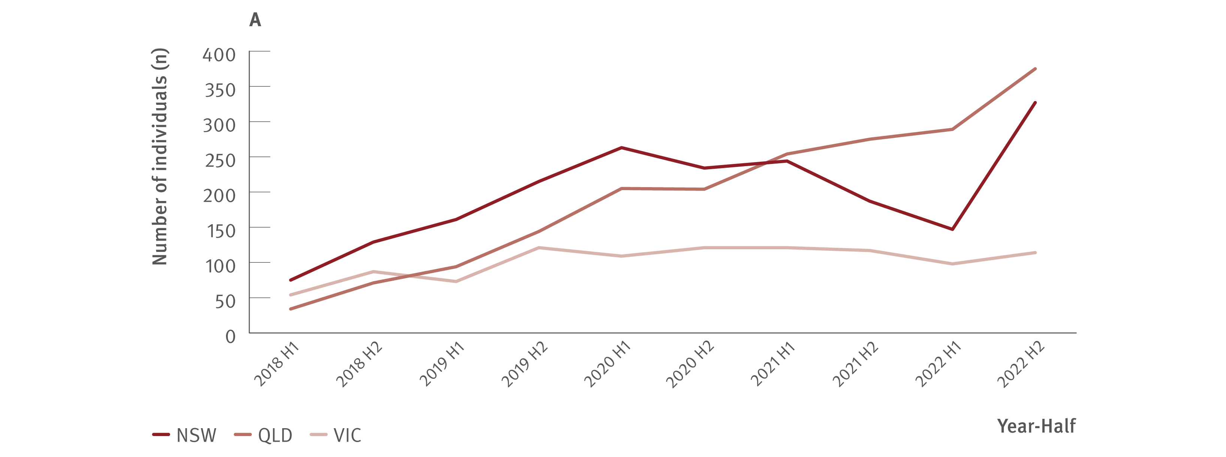
Figure 28. Estimated number of individuals retreated for hepatitis C reinfection by jurisdiction, National Retreatment Project, 2018–2022
Uptake of treatment
Source: National Retreatment Project.(31)
Notes:
Notes: Data on retreatment is shown from 2018, to highlight trends in more recent years. Full analysis includes all individuals with hepatitis C who initiated DAA treatment through the PBS and were retreated, 2016–2022. As the PBS data does not capture reason for retreatment, retreatment data from the REACH‑C cohort were used to train a Random Forest machine learning model to classify retreatment for reinfection or treatment failure. Of individuals initiating DAA treatment through the PBS between 2016 and 2022 (N=100 449), 9% received retreatment (n=8 514). The model classified 56% (n=4 776) as reinfection and 44% (n=3 738) as treatment failure.

Slide 43
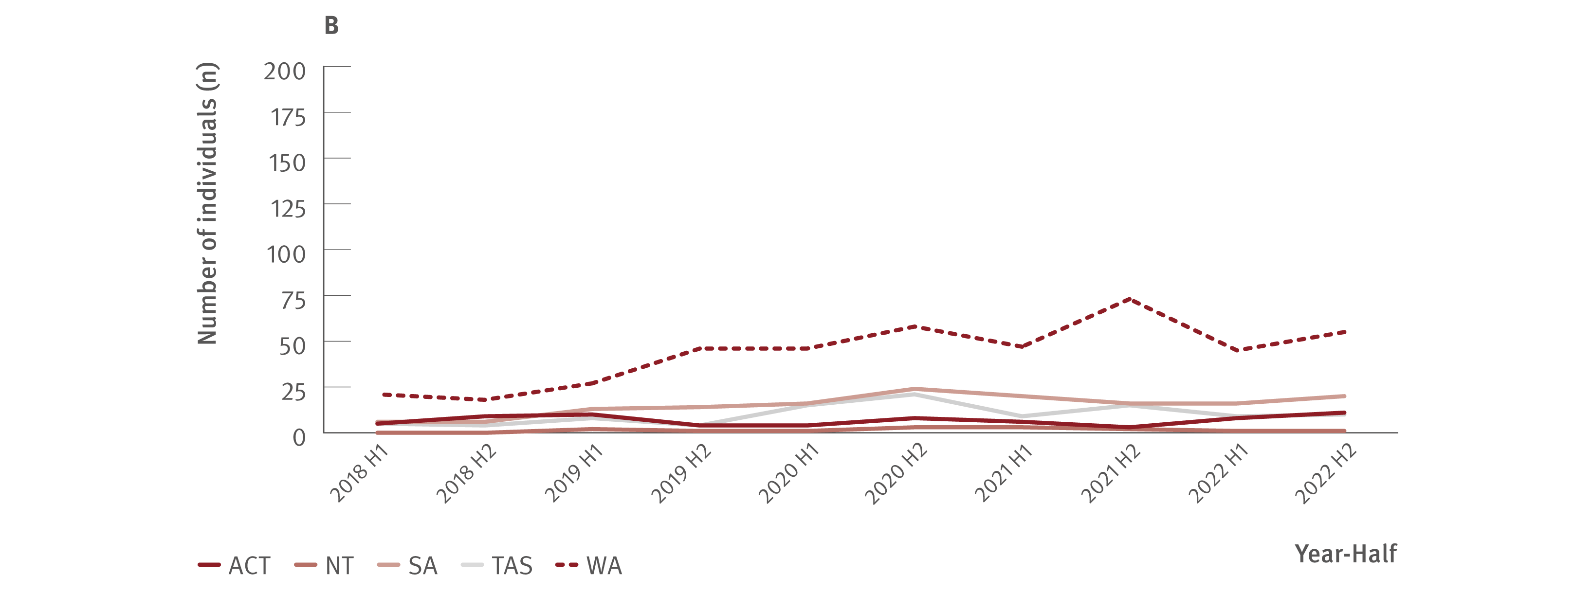
Figure 28. Estimated number of individuals retreated for hepatitis C reinfection by jurisdiction, National Retreatment Project, 2018–2022
Uptake of treatment
Source: National Retreatment Project.(31)
Notes:
Notes: Data on retreatment is shown from 2018, to highlight trends in more recent years. Full analysis includes all individuals with hepatitis C who initiated DAA treatment through the PBS and were retreated, 2016–2022. As the PBS data does not capture reason for retreatment, retreatment data from the REACH‑C cohort were used to train a Random Forest machine learning model to classify retreatment for reinfection or treatment failure. Of individuals initiating DAA treatment through the PBS between 2016 and 2022 (N=100 449), 9% received retreatment (n=8 514). The model classified 56% (n=4 776) as reinfection and 44% (n=3 738) as treatment failure.

Slide 44
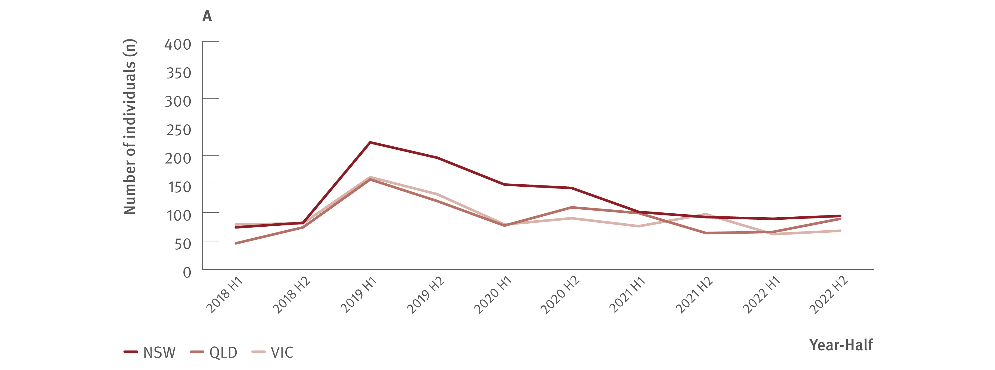
Figure 29. Estimated number of individuals retreated for hepatitis C treatment failure by jurisdiction, National Retreatment Project, 2018–2022
Uptake of treatment
Source: National Retreatment Project.(31)
Notes:
Notes: Data on retreatment is shown from 2018, to highlight trends in more recent years. Full analysis includes all individuals with hepatitis C who initiated DAA treatment through the PBS and were retreated, 2016–2022. As the PBS data does not capture reason for retreatment, retreatment data from the REACH‑C cohort were used to train a Random Forest machine learning model to classify retreatment for reinfection or treatment failure. Of individuals initiating DAAs through the PBS between 2016 and 2022 (N=100 449), 9% received retreatment (n=8 514). The model classified 56% (n=4 776) as reinfection and 44% (n=3 738) as treatment failure.

Slide 45
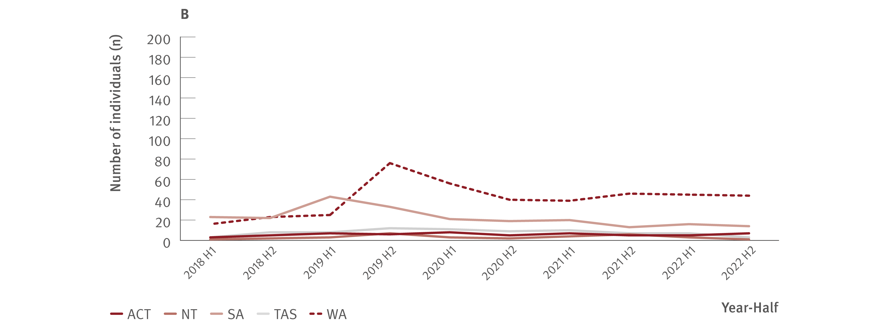
Figure 29. Estimated number of individuals retreated for hepatitis C treatment failure by jurisdiction, National Retreatment Project, 2018–2022
Uptake of treatment
Source: National Retreatment Project.(31)
Notes:
Notes: Data on retreatment is shown from 2018, to highlight trends in more recent years. Full analysis includes all individuals with hepatitis C who initiated DAA treatment through the PBS and were retreated, 2016–2022. As the PBS data does not capture reason for retreatment, retreatment data from the REACH‑C cohort were used to train a Random Forest machine learning model to classify retreatment for reinfection or treatment failure. Of individuals initiating DAAs through the PBS between 2016 and 2022 (N=100 449), 9% received retreatment (n=8 514). The model classified 56% (n=4 776) as reinfection and 44% (n=3 738) as treatment failure.

Slide 46
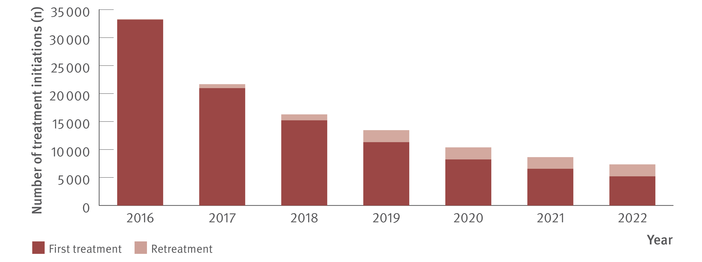
Figure 30. Total estimated number of individuals receiving DAA treatment (including retreatment), PBS database, March 2016–December 2022
Uptake of treatment
Source: Monitoring hepatitis C treatment uptake in Australia.(27)
Notes:
Notes: Treatment numbers may vary from previous or future reports due to refinements made to the PBS data between releases.

Slide 47
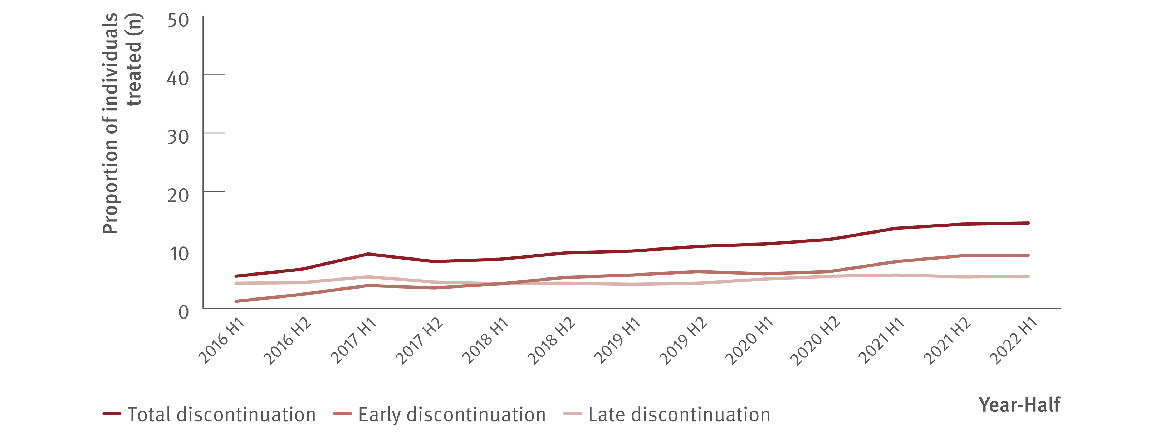
Figure 31. Estimated number of DAA treatment discontinuations, National Retreatment Project, 2016–June 2022
Uptake of treatment
Source: National Retreatment Project.(32)
Notes:
Notes: Individuals with a single dispensation of their entire treatment course were excluded. Treatment discontinuation was defined as one or more repeat authorised prescription courses (28‑day supply) not dispensed. Early discontinuation was defined as discontinuing after the first 28 days of treatment. Late discontinuation was defined as discontinuing after 56 days or more of treatment. Individuals who discontinued initial treatment and restarted a different regimen ≤28 days before estimated end of treatment were considered treatment switches and were not considered treatment discontinuations or retreatments. Of 97 558 individuals who were treated with DAAs between 2016 to mid‑2022, 90 843 were included in analysis, of whom 7 796 (8%) discontinued treatment.

Slide 48
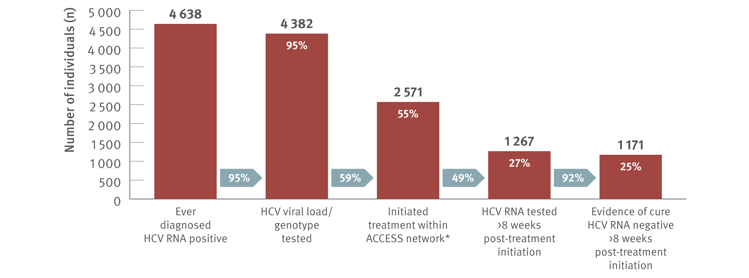
Figure 32. Hepatitis C treatment cascade at ACCESS primary care clinics: number of individuals hepatitis C diagnosed, number and proportion of individuals who initiated treatment, and tested for HCV RNA post‑treatment initiation, 2016–2022
Uptake of treatment
Source: ACCESS.(12) Updated from Traeger et al., PLOS One. 2020.(33)
Notes:
Notes: Cascade includes individuals with evidence of ever being diagnosed HCV RNA positive, i.e., a positive HCV RNA test result recorded in ACCESS since 2009. The cascade reflects the status of individuals on 31st December 2022 and is restricted to individuals who had a clinical consultation within the six years prior (2016–2022). Includes individuals attending ACCESS primary care clinics (same primary care clinics as other ACCESS sections in report). *Treatment initiation was indicated by the presence of an electronic medical record of a prescription of DAA therapy recorded at an ACCESS clinic. Individuals were assumed to have progressed through preceding cascade stages if evidence of reaching a subsequent stage was present.

Slide 49
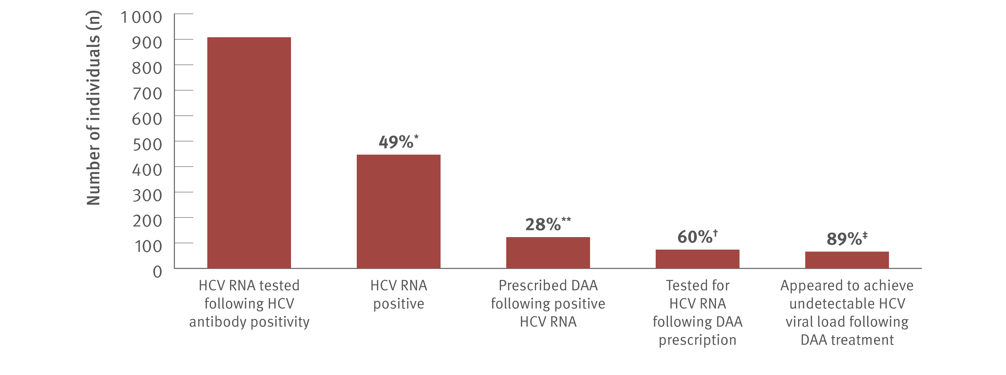
Figure 33. Hepatitis C treatment cascade: number and proportion of individuals attending ACCHS tested for HCV RNA and prescribed DAAs, and among those treated, the number and proportion who appeared to achieve an undetectable HCV viral load, ATLAS network, aggregated for years 2016–2022
Uptake of treatment
Source: ATLAS Indigenous Primary Care Surveillance and Research Network, 2016–2022.(17)
Notes:
Notes: Individuals defined as people aged 15 years or older, who visited a doctor, nurse, or Aboriginal health practitioner (‘medical consultations’) 2016–2022. ‘Undetectable viral load’ defined as testing negative for HCV RNA or HCV viral load following DAA treatment. A total of 135 838 individuals aged 15 years or older attended medical appointments between 2016 and 2022. *Of individuals HCV RNA tested, 49% (447/908) were HCV RNA positive. **Of individuals who tested HCV RNA positive following a positive HCV antibody test, 28% (123/447) were then prescribed DAA treatment. †Of those prescribed DAAs, 60% (74/123) had an HCV RNA test following treatment, of whom ‡ 89% (66/74) had an undetectable viral load and 11% (8/74) were either positive or not tested (data unavailable to define these eight further).

Slide 50
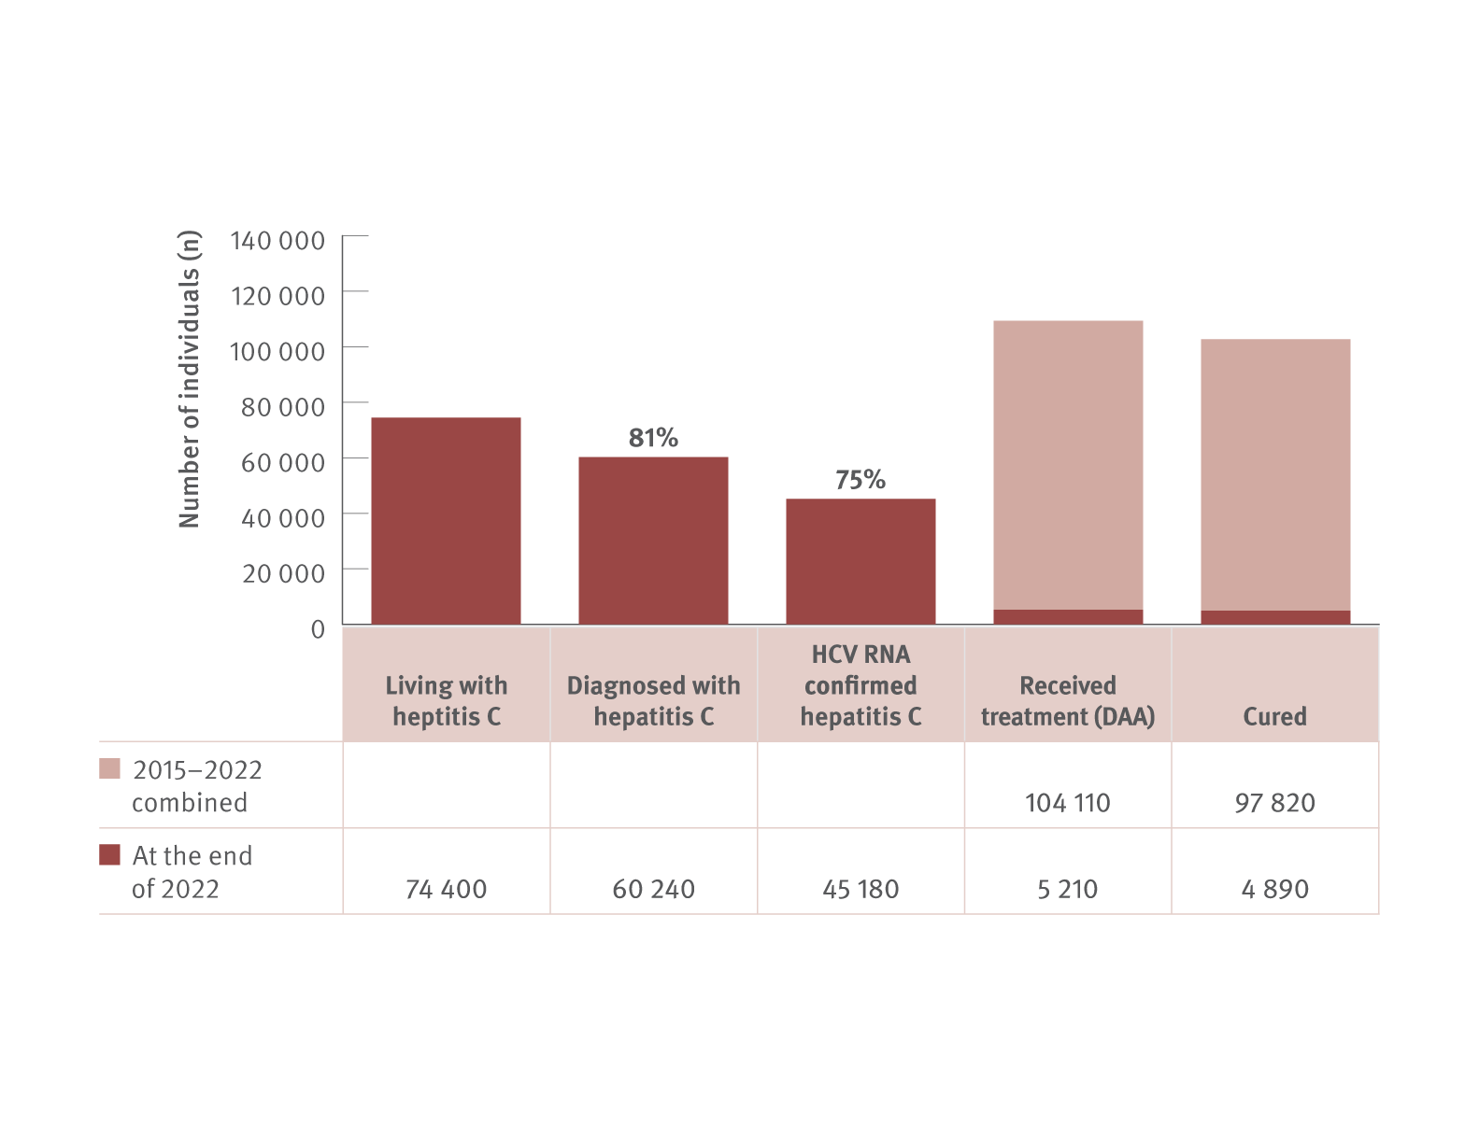
Figure 34. The hepatitis C diagnosis and care cascade, HIV, viral hepatitis and sexually transmissible infections in Australia, Annual Surveillance Report
Uptake of treatment
Source: Updated by Kirby Institute, from the HIV, viral hepatitis and sexually transmissible infections in Australia: annual surveillance report 2021.(2,3,4)
Notes:
Notes: The diagnosis and care cascade estimates were derived using mathematical modelling; mathematical modelling uses available data from observational research studies and administrative datasets to derive estimates like the population prevalence of hepatitis C, accounting for uncertainties. Living with hepatitis C is the estimated number of individuals in the overall population who had detectable HCV RNA in 2022; diagnosed with hepatitis infection is the estimated number of individuals living with chronic HCV in 2022 who have been previously diagnosed (HCV antibody positive or HCV RNA); HCV RNA confirmed hepatitis C is the estimated number of individuals who are confirmed with HCV from RNA testing; received DAA treatment is the observed number of individuals who received treatment with DAAs since 2015 (cumulative) and in 2022 recorded in the PBS database; and cured is the estimated number of treated individuals who achieved undetectable HCV RNA post‑treatment since 2015 (cumulative) and in 2022.

Slide 51
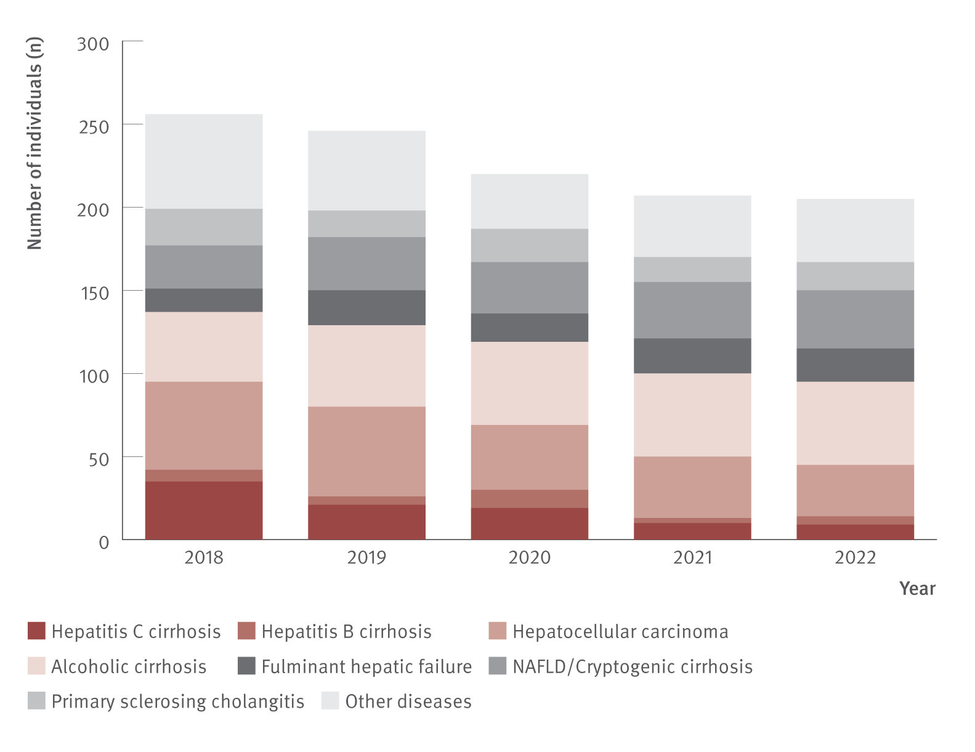
Figure 35. Number of Australian adult liver transplant recipients by primary diagnosis and year of first transplant, Australia and New Zealand Liver and Intestinal Transplant Registry, 2018–2022
Morbidity
Source: Australia and New Zealand Liver and Intestinal Transplant Registry.⁽³⁸⁾
Notes:
Notes: Australian transplant recipients only. Adults defined as 16 years or older. NAFLD: non‑alcoholic fatty liver disease.

Slide 52
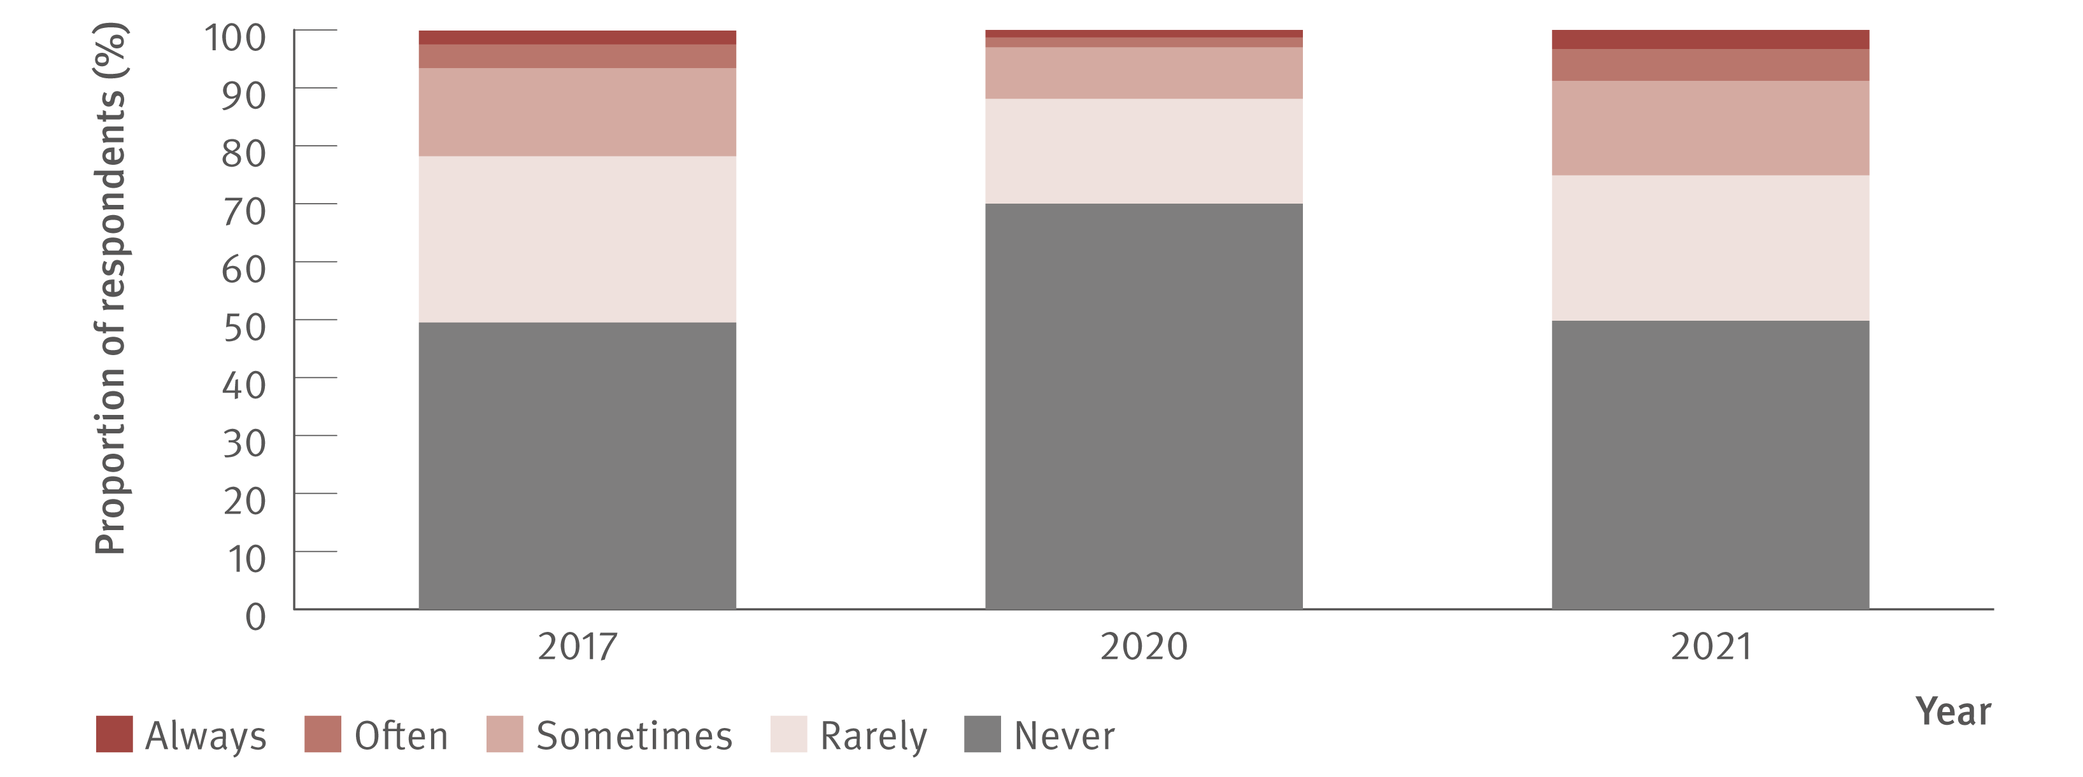
Figure 36. Reports of negative behaviour towards people because of their hepatitis C status by the Australian public, 2017–2021
Stigma and discrimination
Source: Stigma Indicators Monitoring Project.(41)
Notes:
Notes: In 2017, the Stigma Indicator was included in the Australian Survey of Social Attitudes (n=1 001). The Australian Survey of Social Attitudes collects data from a representative sample of the Australian adult population, randomly selected from the Australian Electoral roll. In 2020, the Stigma Indicator was included in an online survey of Australian adults (N=2 010). Participants were recruited via paid social media advertising. In 2021, the Stigma Indicator was included in an online survey of Australian adults (N=2 251). Participants were recruited via a Qualtrics research panel.

Slide 53
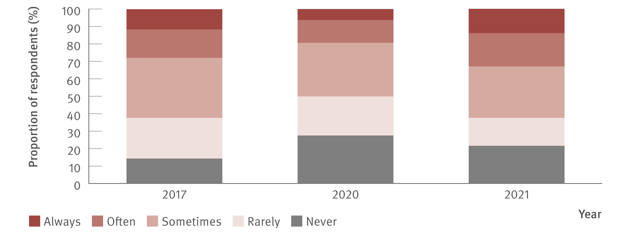
Figure 37. Reports of negative behaviour towards people because of their injecting drug use by the Australian public, 2017–2021
Stigma and discrimination
Source: Stigma Indicators Monitoring Project.(41)
Notes:
Notes: In 2017, the Stigma Indicator was included in the Australian Survey of Social Attitudes (n=1 001). The Australian Survey of Social Attitudes collects data from a representative sample of the Australian adult population, randomly selected from the Australian Electoral roll. In 2020, the Stigma Indicator was included in an online survey of Australian adults (N=2 010). Participants were recruited via paid social media advertising. In 2021, the Stigma Indicator was included in an online survey of Australian adults (N=2 251). Participants were recruited via a Qualtrics research panel.

Slide 54
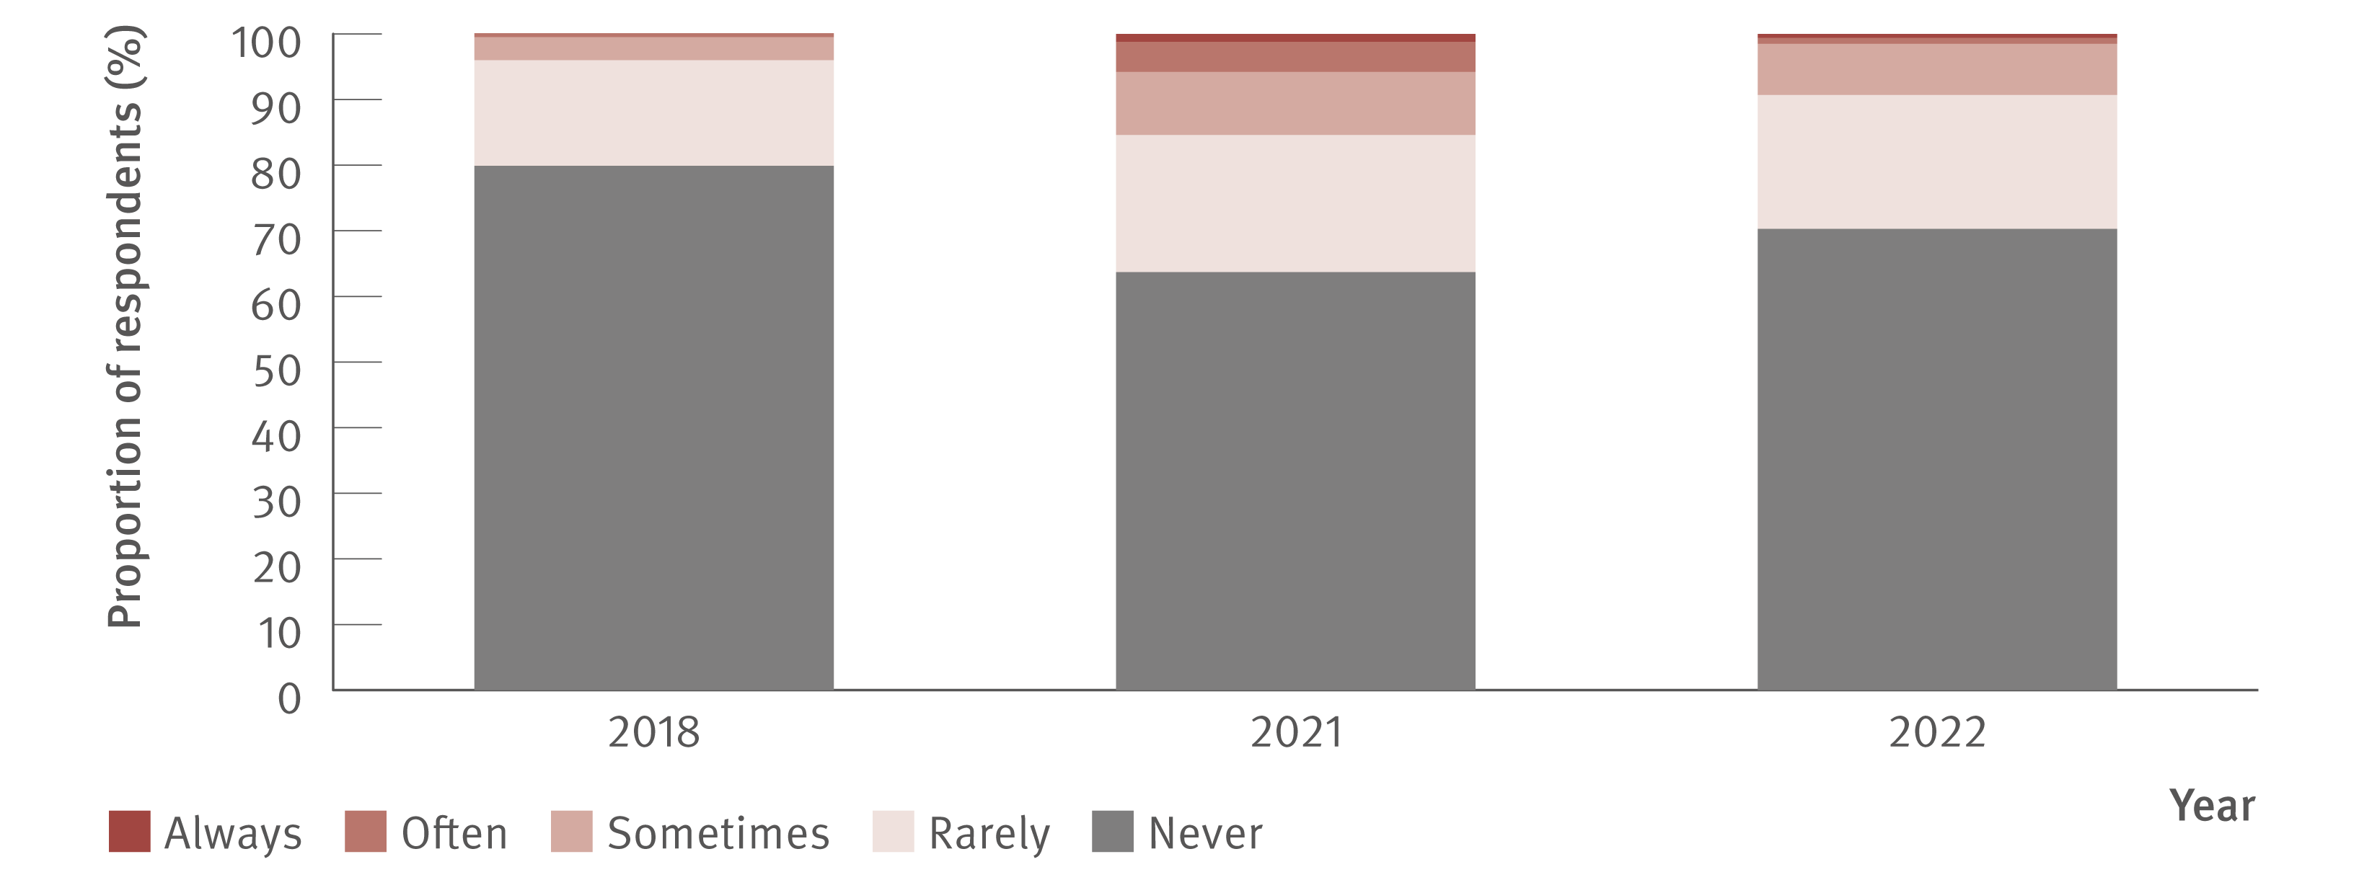
Figure 38. Reports of negative behaviour towards people because of their hepatitis C status by healthcare workers, 2018–2022
Stigma and discrimination
Source: Stigma Indicators Monitoring Project.(40)
Notes:
Notes: In 2018, the Stigma Indicator was included in an online survey of Australian healthcare workers (N=551). The survey was promoted by ASHM and via paid social media advertising. In 2021 and 2022, the Stigma Indicator was included in online surveys of Australian healthcare workers (N=907 and N=1 993, respectively). Participants for these surveys were recruited via Qualtrics research panels.

Slide 55
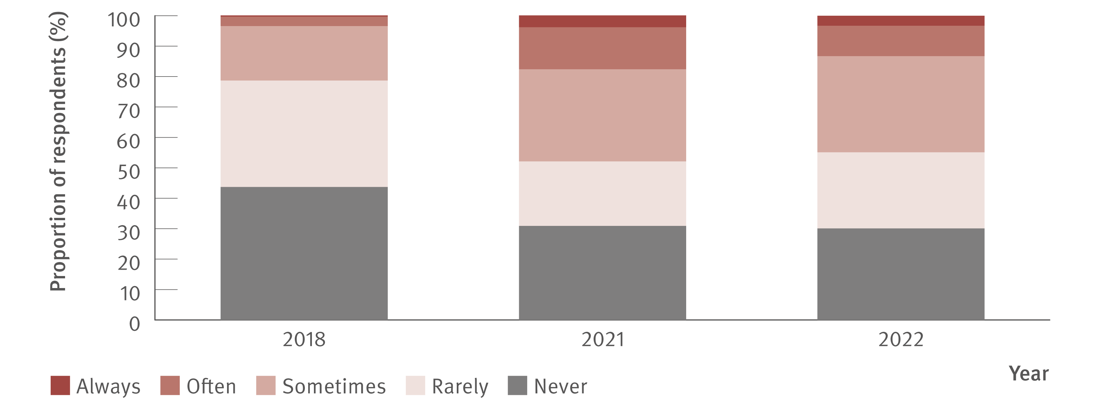
Figure 39. Reports of negative behaviour towards people because of their injecting drug use by healthcare workers, 2018–2022
Stigma and discrimination
Source: Stigma Indicators Monitoring Project.(40)
Notes:
Notes: In 2018, the Stigma Indicator was included in an online survey of Australian healthcare workers (N=551). The survey was promoted by ASHM and via paid social media advertising. In 2021 and 2022, the Stigma Indicator was included in online surveys of Australian healthcare workers (N=907 and N=1 993, respectively). Participants for these surveys were recruited via Qualtrics research panels.

Slide 56
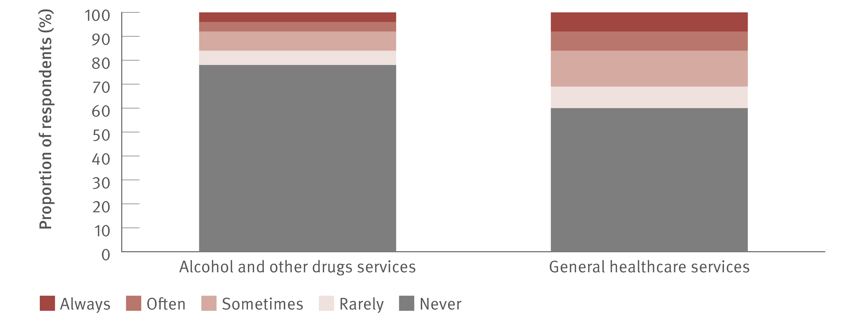
Figure 40. Reports of experiencing stigma when visiting healthcare services, Illicit Drug Reporting System, 2022
Stigma and discrimination
Source: Adapted from Sutherland et al. Drug Trends Bulletin Series. 2022.(45)

Slide 57
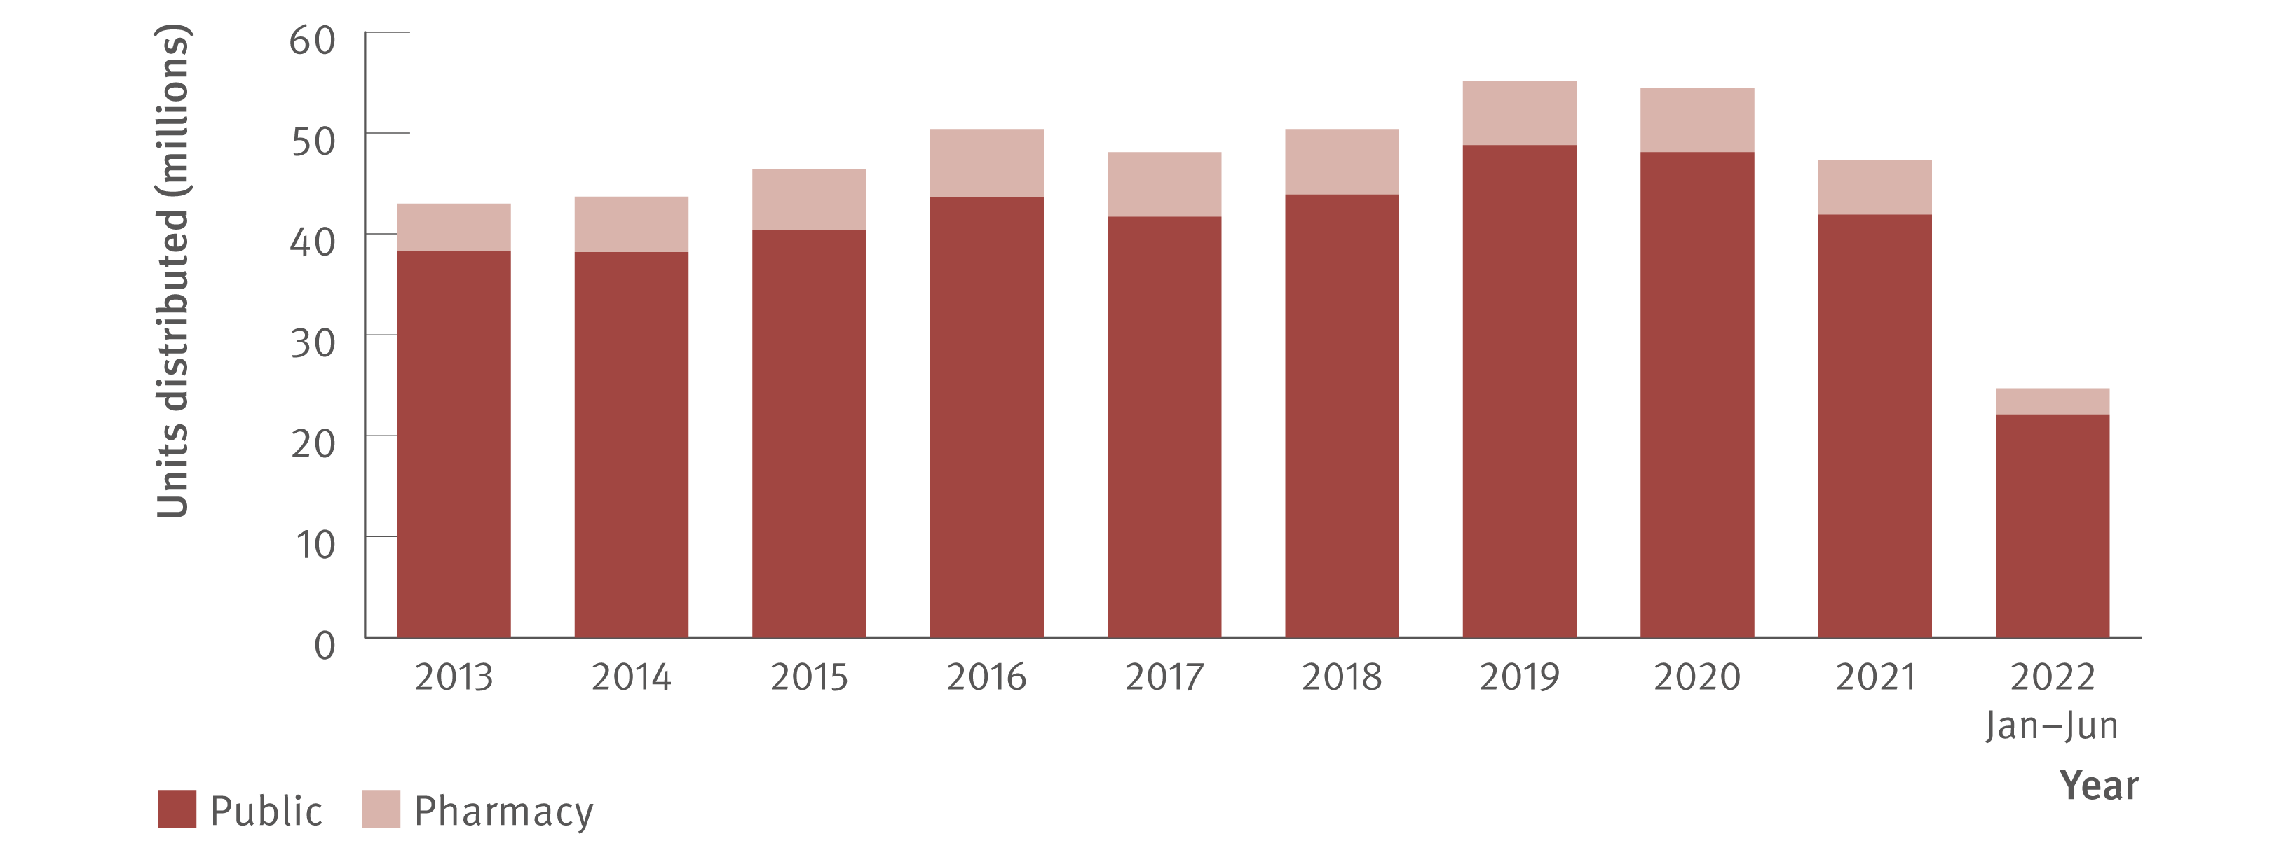
Figure 41. Number of needle and syringe units distributed by sector, Needle Syringe Program National Minimum Data Collection, 2013–June 2022
Prevention
Source: Needle Syringe Program National Minimum Data Collection: National Data Report 2022.(48) Notes: July–December 2022 data not available at the time of reporting.

Slide 58
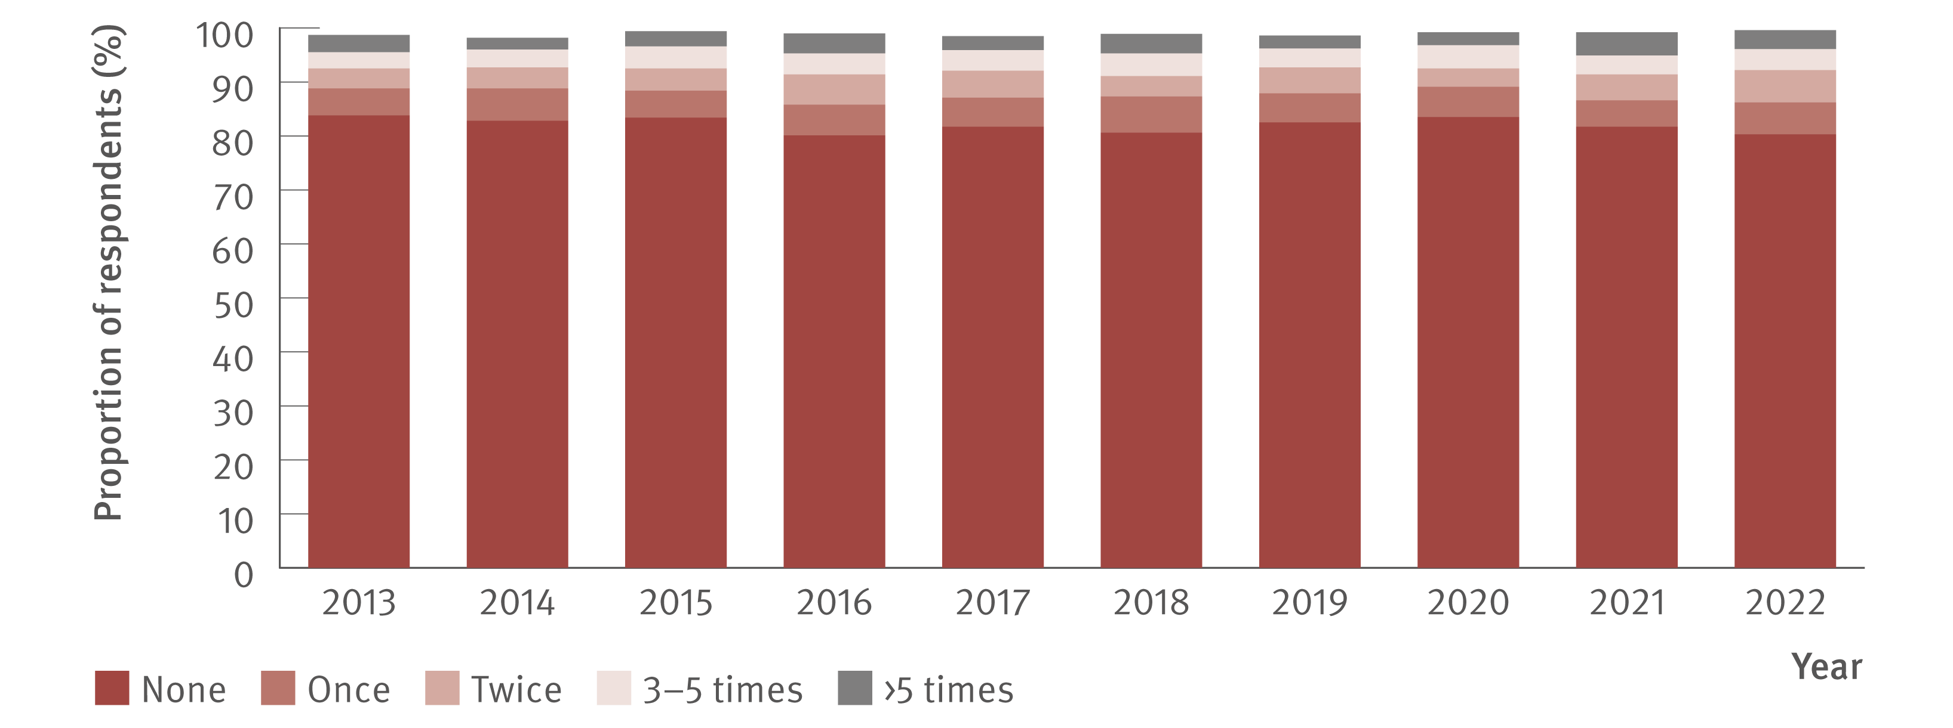
Figure 42. Proportion of Australian Needle Syringe Program Survey respondents reporting re‑use of someone else’s needles and syringes in the past month, 2013–2022
Prevention
Source: Australian Needle Syringe Program Survey. National Data Report 2018–2022.(18) Australian Needle Syringe Program Survey 25 year National Data Report 1995–2019.(23)
Notes:
Notes: Not reported not included. Injection risk behaviour variables are presented among those who injected in the previous month, not the entire sample. For 2013 to 2022, sample size was (in order): 2 111, 2 141, 2 071, 1 993, 2 314, 2 452, 2 333, 1 173, 1 259, and 1 581.

Slide 59

Figure 43. Proportion of respondents reporting borrowing and lending of needles, sharing of injecting equipment, and re‑use of needles in the past month, national, Illicit Drug Reporting System, 2013–2022
Prevention
Source: Australian Drug Trends 2022: key findings from the National Illicit Drug Reporting System (IDRS) Interviews.(45) Notes: *Includes spoons, water, tourniquets, and filters.

Slide 60

Figure 44. Proportion of GBM who reported any drug injection in the six months prior to the survey by HIV status, national, Gay Community Periodic Survey, 2013–2022
Prevention
Source: Annual Report of Trends in Behaviour 2022: HIV and STIs in Australia.(49,50) Notes: Unadjusted data.

Slide 61

Figure 45. Annual change in people living with chronic hepatitis C, hepatitis C incidence (all), treatment coverage, and liver‑related deaths (viraemic and cured) in Australia 2030 (2010–2030) with World Health Organization HCV elimination targets (dotted lines: Panel B: 80% and 90% reductions in incidence, Panel C: 80% eligible treated, and Panel D: 65% reduction in deaths)
Modelling elimination
Source: Updated from Kwon et al., J Viral Hepat. 2019⁽²⁾ and Kwon et al., PLoS One. 2021.⁽³⁾
Notes:
Notes: We assumed a pessimistic roll‑out scenario corresponding to 40% less people being treated with DAA therapy than 2021, an intermediate roll‑out scenario corresponding to the annual number treated equalling the number in 2022, and an optimistic scenario where the annual number treated increased back to the 2021 level.

Slide 62

Table 2. Scenarios for the annual number of people in Australia receiving DAA
Modelling elimination
Source: Updated from Kwon et al., J Viral Hepat. 2019⁽²⁾ and Kwon et al., PLoS One. 2021.⁽³⁾
Notes:
Notes: We assumed a pessimistic roll‑out scenario corresponding to 40% less people being treated with DAA therapy than 2021, an intermediate roll‑out scenario corresponding to the annual number treated equalling the number in 2022, and an optimistic scenario where the annual number treated increased back to the 2021 level.

Slide 63

Figure 46. Adherence to scheduled ultrasounds among people with cirrhosis and cured of hepatitis C, attending a Victorian hospital liver clinic, between 2003 and 2022, (N=108)
Modelling elimination
Source: Adapted from Cumming et al. 2023.(52)

Slide 64

Figure 47. Average additional simulated life years gained per 100 simulated people over a 10‑year simulated period by the public health intervention
Modelling elimination
Source: Adapted from Cumming et al. 2023.(52)

Slide 65

Table 3. Public health intervention scenarios modelled, with the approximate change in model inputs for each scenario
Modelling elimination
Source: Adapted from Cumming et al. 2023.(52)
Notes:
Notes: BCLC: Barcelona Clinic Liver Cancer, US: ultrasound. In the model a non‑adherent person attends none of their six‑monthly scheduled ultrasounds, a completely adherent person attends all scheduled ultrasounds, and a partially adherent person attends some of their scheduled ultrasounds. The percentage of ultrasounds attended by a partially adherent person is modelled using the input ‘partial adherence attendance.’

Slide 66
Reference List
1. Alavi M, Law MG, Valerio H, et al. Declining hepatitis C virus-related liver disease burden in the
direct-acting antiviral therapy era in New South Wales, Australia. J Hepatol. 2019;71(2):281–288.
doi: https://doi.org/10.1016/j.jhep.2019.04.014.
2. Kwon JA, Dore GJ, Grebely J, et al. Australia on track to achieve WHO HCV elimination targets
following rapid initial DAA treatment uptake: a modelling study. J Viral Hepat. 2019;26(1):83–92.
doi: https://doi.org/10.1111/jvh.13013.
3. Kwon JA, Dore GJ, Hajarizadeh B, et al. Australia could miss the WHO hepatitis C virus elimination
targets due to declining treatment uptake and ongoing burden of advanced liver disease complications.
PLoS One. 2021;16(9):e0257369. doi: https://doi.org/10.1371/journal.pone.0257369.
4. King J, McManus H, Kwon JA. HIV, viral hepatitis and sexually transmissible infections in
Australia: annual surveillance report 2023. Sydney, Australia: Kirby Institute, UNSW Sydney; 2023.
Available at: https://www.kirby.unsw.edu.au/research/reports (accessed 1st December, 2023).
doi: https://doi.org/10.26190/f5ph-f972.
5. Kirby Institute. Progress towards hepatitis C elimination among Aboriginal and Torres Strait
Islander people in Australia: monitoring and evaluation report 2021. Sydney, Australia: Kirby Institute,
UNSW Sydney; 2021. Available at: https://kirby.unsw.edu.au/report/progress-towards-hepatitis-celimination-among-aboriginal-and-torres-strait-islander-people (accessed 26th August, 2023).
6. Dore GJ, Feld JJ. Hepatitis C virus therapeutic development: in pursuit of “perfectovir”. Clin Infect
Dis. 2015;60(12):1829–1836. doi: https://doi.org/10.1093/cid/civ197.
7. Doyle JS, Aspinall E, Liew D, et al. Current and emerging antiviral treatments for hepatitis C infection.
British J Clinical Pharmacol. 2013;75(4):931–943. doi: https://doi.org/10.1111/j.1365-2125.2012.04419.x.
8. Australian Government, Department of Health. Fifth National Hepatitis Strategy 2018–2022. Canberra,
Australia: Australian Government, Department of Health; 2018. Available at: https://www.health.gov.au/
resources/publications/fifth-national-hepatitis-c-strategy-2018-2022 (accessed 19th August, 2023).
9. King J, McManus H, Kwon JA, et al. HIV, viral hepatitis and sexually transmissible infections in
Australia: annual surveillance report 2022. Available at: https://www.kirby.unsw.edu.au/research/
reports/asr2022 (accessed 2nd November, 2023).
10. Australian Government, Department of Health. National Notifiable Disease Surveillance
System. Canberra, Australia: Australian Government, Department of Health; 2022. Available at:
https://www.health.gov.au/initiatives-and-programs/nndss (accessed 18th September, 2023).
11. O’Keefe D, Horyniak D, Dietze P. From initiating injecting drug use to regular injecting: retrospective
survival analysis of injecting progression within a sample of people who inject drugs regularly. Drug Alcohol
Depend. 2016;158:177–180. doi: https://doi.org/10.1016/j.drugalcdep.2015.11.022.
12. Burnet Institute, Kirby Institute, and National Reference Laboratory. The Australian Collaboration
for Coordinated Enhanced Sentinel Surveillance of Sexually Transmissible Infections and Blood Borne
Viruses (ACCESS). Melbourne, Australia: Burnet Institute, Kirby Institute, and National Reference
Laboratory; 2022. Available at: https://accessproject.org.au/ (accessed 15th May, 2023).
13. Callander D, Moreira C, El-Hayek C, et al. Monitoring the control of sexually transmissible infections
and blood-borne viruses: protocol for the Australian Collaboration for Coordinated Enhanced Sentinel
Surveillance (ACCESS). JMIR Res Protoc. 2018;7(11):e11028. doi: https://www.researchprotocols.
org/2018/11/e11028/.
14. Nguyen L, Stoové M, Boyle D, et al. Privacy-preserving record linkage of deidentified records
within a public health surveillance system: evaluation study. J Med Internet Res. 2020;22(6):e16757.
doi: https://www.jmir.org/2020/6/e16757/.
15. ASHM. National Hepatitis C Testing Policy 2020. Sydney, Australia: ASHM; 2020. Available at:
http://testingportal.ashm.org.au/national-hcv-testing-policy/ (accessed 1st June, 2023).

Slide 67
16. Hepatitis C Virus Infection Consensus Statement Working Group. Australian recommendations for
the management of hepatitis C virus infection: a consensus statement (2022). Melbourne, Australia:
Gasteroenterological Society of Australia, 2022. Available at: https://www.hepcguidelines.org.au/
(accessed 3rd October, 2023).
17. Bradley C, Hengel B, Crawford K, et al. Establishment of a sentinel surveillance network for sexually
transmissible infections and blood borne viruses in Aboriginal primary care services across Australia:
the ATLAS project. BMC Health Services Research. 2020;20(769). doi: https://doi.org/10.1186/s12913020-05388-y.
18. Heard S, Zolala F, Maher L. Australian Needle Syringe Program Survey National Data Report
2018–2022: prevalence of HIV, HCV and injecting and sexual behaviour among NSP attendees. Sydney,
Australia: Kirby Institute, UNSW Sydney; 2023. Available at: https://www.kirby.unsw.edu.au/research/
reports/australian-nsp-survey-national-data-report-2018-2022 (accessed 1st September, 2023).
19. Australian Government. Medicare Australia Statistics. Canberra, Australia: Australian Government,
Department of Human Services; 2023. Available at: http://medicarestatistics.humanservices.gov.au/
statistics/mbs_item.jsp (accessed 5th August, 2023).
20. Vujcich D, Roberts M, Brown G, et al. Are sexual health survey items understood as intended
by African and Asian migrants to Australia? Methods, results and recommendations for qualitative
pretesting. BMJ Open. 2021;11(12):e049010. doi: https://doi.org/10.1136/bmjopen-2021-049010.
21. Vujcich D, Roberts M, Gu Z, et al. Translating best practice into real practice: methods, results and
lessons from a project to translate an English sexual health survey into four Asian languages. PLoS One.
2021;16(12):e0261074. doi: https://doi.org/10.1371/journal.pone.0261074..
22. Vujcich D, Brown G, Durham J, et al. Strategies for recruiting migrants to participate in a sexual
health survey: methods, results, and lessons. Int J Environ Res Public Health. 2022;19(19):12213.
doi: https://doi.org/10.3390/ijerph191912213.
23. Heard S, Iversen J, Geddes L, et al. Australian NSP survey: prevalence of HIV, HCV and injecting and
sexual behaviour among NSP attendees, 25 year National Data Report 1995–2019. Sydney, Australia:
Kirby Institute, UNSW Sydney; 2020. Available at: https://kirby.unsw.edu.au/report/australian-nspsurvey-25-year-national-data-report-1995-2019 (accessed 15th April, 2023).
24. Scott N, Sacks-Davis R, Wade AJ, et al. Australia needs to increase testing to achieve hepatitis C
elimination. Med J Aust. 2020;212(8):365–370. doi: https://doi.org/10.5694/mja2.50544.
25. Martin NK, Thornton A, Hickman M, et al. Can hepatitis C Virus (HCV) direct-acting antiviral
treatment as prevention reverse the HCV epidemic among men who have sex with men in the
United Kingdom? Epidemiological and modeling insights. Clin Infect Dis. 2016;62(9):1072–1080.
doi: https://doi.org/10.1093/cid/ciw075.
26. Scott N, McBryde ES, Thompson A, et al. Treatment scale-up to achieve global HCV incidence
and mortality elimination targets: a cost-effectiveness model. Gut. 2017;66(8):1507–1515.
doi: http://dx.doi.org/10.1136/gutjnl-2016-311504.
27. Kirby Institute. Monitoring hepatitis C treatment uptake in Australia (Issue 13). Sydney, Australia:
Kirby Institute, UNSW Sydney; July 2023. Available at: https://www.kirby.unsw.edu.au/research/reports/
monitoring-hepatitis-c-treatment-uptake-australia-issue-13-july-2023 (accessed 4th August, 2023).
28. National Prisons Hepatitis Network. Sydney, Australia: Kirby Institute, UNSW Sydney; 2023.
Available at: https://www.nphn.net.au/about (accessed 5th November, 2023).
29. Yee J, Carson J, Hanson J, et al. Real world efficacy of antiviral therapy in chronic hepatitis C in
Australia (REACH-C). Sydney, Australia: Kirby Institute, UNSW Sydney; 2023. Available at: https://
kirby.unsw.edu.au/project/reach-c (accessed 7th October, 2023).
30. Carson JM, Hajarizadeh B, Hanson J, et al. Retreatment for hepatitis C virus direct acting
antiviral therapy virological failure in primary and tertiary settings: the REACH-C cohort. J Viral Hepat.
2022;29(8):661–676. doi: https://doi.org/10.1111/jvh.13705.
31. Carson JM, Barbieri S, Matthews GV, et al. National trends in retreatment of HCV due to reinfection
or treatment failure in Australia. J Hepatol. 2022;78(2):260–270. doi: https://doi.org/10.1016/j.
jhep.2022.09.011.
32. Carson J, Barbieri S, Matthews GV, et al. Increasing national trend of direct-acting antiviral
discontinuation among people treated for HCV 2016–2021. Hepatol Commun. 2023;7(4):e0125.
doi: https://doi.org/10.1097/HC9.0000000000000125.

Slide 68
33. Traeger MW, Pedrana AE, van Santen DK, et al. The impact of universal access to direct-acting
antiviral therapy on the hepatitis C cascade of care among individuals attending primary and community
health services. PLoS One. 2020;15(6):e0235445. doi: https://doi.org/10.1371/journal.pone.0235445.
34. Merone L, Ashton S, Harris A, et al. A complex increase in hepatitis C virus in a correctional
facility: bumps in the road. Aust NZ J Public Health. 2022;46(3):377–381. doi: https://doi.
org/10.1111/1753-6405.13238.
35. Hajarizadeh B, Grebely J, Byrne M, et al. Evaluation of hepatitis C treatment-as-prevention
within Australian prisons (SToP-C): a prospective cohort study. Lancet Gastroenterol Hepatol.
2021;6(7):533–546. doi: https://doi.org/10.1016/S2468-1253(21)00077-7.
36. Cunningham EB, Hajarizadeh B, Bretana NA, et al. Ongoing incident hepatitis C virus infection
among people with a history of injecting drug use in an Australian prison setting, 2005–2014: the
HITS-p study. J Viral Hepat. 2017;24(9):733–741. doi: https://doi.org/10.1111/jvh.12701.
37. Butler T, Simpson M. National prison entrants’ blood-borne virus survey report 2004, 2007, 2010,
2013 and 2016. Sydney, Australia: Kirby Institute, UNSW Sydney; 2017. Available at: https://www.kirby.
unsw.edu.au/research/reports/national-prison-entrants-bloodborne-virus-and-risk-behaviour-surveyreport-2004-2007-2010-2013-and-2016 (accessed 22nd August, 2023).
38. Australian and New Zealand Liver and Intestinal Transplant Registry. Melbourne, Australia: Austin
Hospital; 2023. Available at: https://www.anzlitr.org/ (accessed 24th August, 2023).
39. Broady TR, Cama E, Brener L, et al. Responding to a national policy need: development of a stigma
indicator for blood-borne viruses and sexually transmissible infections. Aust NZ J Public Health.
2018;42(6):513–515. doi: https://doi.org/10.1111/1753-6405.12809.
40. Broady T, Brener L, Cama E, et al. Stigma snapshot: health care workers 2022. Sydney, Australia:
Centre for Social Research in Health, UNSW Sydney; 2022. Available at: https://www.unsw.edu.au/
arts-design-architecture/our-research/research-centres-institutes/centre-social-research-health/ourprojects/stigma-indicators-monitoring-project (accessed 3rd October, 2023).
41. Broady T, Brener L, Cama E, et al. Stigma snapshot: general public 2021. Sydney, Australia:
Centre for Social Research in Health, UNSW Sydney; 2022. Available at: https://www.unsw.edu.au/
arts-design-architecture/our-research/research-centres-institutes/centre-social-research-health/ourprojects/stigma-indicators-monitoring-project (accessed 3rd October, 2023).
42. Burnet Institute and Kirby Institute. Australia’s progress towards hepatitis C elimination: annual
report 2022. Melbourne, Australia: Burnet Institute; 2022. Available at: https://www.burnet.edu.au/
knowledge-and-media/research-reports-plus-policy-briefs/australia-s-progress-towards-hepatitis-celimination-annual-report-2022/ (accessed 5th September, 2023).
43. Broady T, Brener L, Cama E, et al. Stigma snapshot: people who inject drugs 2021. Sydney,
Australia: Centre for Social Research in Health, UNSW Sydney; 2022. Available at: https://www.unsw.
edu.au/arts-design-architecture/our-research/research-centres-institutes/centre-social-researchhealth/our-projects/stigma-indicators-monitoring-project (accessed 5th October, 2023).
44. Broady T, Brener L, Cama E, et al. Stigma snapshot: people living with hepatitis C 2021. Sydney,
Australia: Centre for Social Research in Health, UNSW Sydney; 2022. Available at: https://www.unsw.
edu.au/arts-design-architecture/our-research/research-centres-institutes/centre-social-researchhealth/our-projects/stigma-indicators-monitoring-project (accessed 3rd October, 2023).
45. Sutherland R, Uporova J, King C, et al. Australian Drug Trends 2022: key findings from the National
Illicit Drug Reporting System (IDRS) Interviews. Sydney, Australia: National Drug and Alcohol Research
Centre, UNSW Sydney; 2022. Available at: https://ndarc.med.unsw.edu.au/project/illicit-drugreporting-system-idrs (accessed 8th October, 2023).
46. Broady TR, Brener L, Horwitz R, et al. Reducing stigma towards people living with HIV and people
who inject drugs using social norms theory: an online study with Australian health care workers.
Drug Alcohol Depend. 2023;249:109953. doi: https://doi.org/10.1016/j.drugalcdep.2023.109953.
47. Treloar C, Cama E, Lancaster K, et al. A universal precautions approach to reducing stigma
in health care: getting beyond HIV-specific stigma. Harm Reduction Journal. 2022;19(1):74.
doi: https://doi.org/10.1186/s12954-022-00658-w.
48. Heard S, Iversen J, Geddes L, et al. Needle Syringe Program National Minimum Data Collection:
National Data Report 2022. Sydney, Australia: Kirby Institute, UNSW Sydney; 2022. Available at: https://
www.kirby.unsw.edu.au/sites/default/files/documents/NSP-NMDC-2022_National-Data-Report.pdf
(accessed 25th September, 2023).
49. Broady T, Cama E, Rance J, et al. Annual Report of Trends in Behaviour 2022: HIV and STIs in
Australia. Sydney, Australia: Centre for Social Research in Health, UNSW Sydney; 2022. Available
at: https://www.unsw.edu.au/research/csrh/our-projects/annual-report-of-trends-in-behaviour
(accessed 25th September, 2023).

Slide 69
50. Holt M, Lea T, Mao L, et al. Adapting behavioural surveillance to antiretroviral-based HIV
prevention: reviewing and anticipating trends in the Australian Gay Community Periodic Surveys.
Sex Health. 2017;14(1):72–79. doi: https://doi.org/10.1071/SH16072.
51. Lubel JS, Roberts SK, Strasser SI, et al. Australian recommendations for the management of
hepatocellular carcinoma: a consensus statement. Med J Aust. 2021;214(10):475–483. doi: https://
doi.org/10.5694/mja2.50885.
52. Cumming J, Scott N, Howell J, et al. Improving hepatocellular carcinoma screening outcomes in
patients with cirrhosis who have been successfully treated for hepatitis C: a Markov chain model.
Paper presented at: International HIV Coinfection and Viral Hepatitis Elimination Conference; July 2023;
Brisbane, Australia. Available at: https://az659834.vo.msecnd.net/eventsairaueprod/productionashm-public/00decd0deea648cea64ac9b9d57fb6aa (accessed 1st November, 2023).
53. Ampt FH, El Hayek C, Agius PA, et al. Anorectal swabs as a marker of male-to-male sexual exposure
in STI surveillance systems. Epidemiol Infect. 2017;145(12):2530–2535. doi: https://doi.org/10.1017/
S095026881700098X.
54. Prince DS, Pipicella JL, Fraser M, et al. Screening Emergency Admissions at Risk of Chronic Hepatitis C
(SEARCH) to diagnose or ‘re-diagnose’ infections is effective in Australia. J Viral Hepat. 2021;28(1):121–128.
doi: https://doi.org/10.1111/jvh.13393.
55. Valerio H, Alavi M, Conway A, et al. Declining prevalence of current HCV infection and increased
treatment uptake among people who inject drugs: the ETHOS Engage study. Int J Drug Policy.
2022;105:103706. doi: https://doi.org/10.1016/j.drugpo.2022.103706.
56. Bartlett SR, Yu A, Chapinal N, et al. The population level care cascade for hepatitis C in British
Columbia, Canada as of 2018: impact of direct acting antivirals. Liver Int. 2019;39(12):2261–2272.
doi: https://doi.org/10.1111/liv.14227.
57. Aisyah DN, Shallcross L, Hully AJ, et al. Assessing hepatitis C spontaneous clearance and understanding
associated factors: a systematic review and meta-analysis. J Viral Hepat. 2018;25(6):680–698.
doi: https://doi.org/10.1111/jvh.12866.
58. Grebely J, Larney S, Peacock A, et al. Global, regional, and country-level estimates of hepatitis C
infection among people who have recently injected drugs. Addiction. 2019;114(1):150–166.
doi: https://doi.org/10.1111/add.14393.
59. Iversen J, Dore GJ, Starr M, et al. Estimating the Consensus hepatitis C Cascade of Care among people
who inject drugs in Australia: pre and post availability of direct acting antiviral therapy. Int J Drug Policy.
2020;83:102837. doi: https://doi.org/10.1016/j.drugpo.2020.102837.
60. Seeff LB, Hollinger FB, Alter HJ, et al. Long-term mortality and morbidity of transfusion-associated
non-A, non-B, and type C hepatitis: a National Heart, Lung, and Blood Institute collaborative study.
Hepatology. 2001;33(2):455–463. doi: https://doi.org/10.1053/jhep.2001.21905.
61. Morgan RL, Baack B, Smith BD, et al. Eradication of hepatitis C virus infection and the
development of hepatocellular carcinoma: a meta-analysis of observational studies. Ann Intern Med.
2013;158(5):329–337. doi: https://doi.org/10.7326/0003-4819-158-5-201303050-00005.
62. Di Marco V, Calvaruso V, Ferraro D, et al. Effects of eradicating hepatitis C virus infection in patients
with cirrhosis differ with stage of portal hypertension. Gastroenterology. 2016;151(1):130–139.e132.
doi: https://doi.org/10.1053/j.gastro.2016.03.036.
63. Nahon P, Bourcier V, Layese R, et al. Eradication of hepatitis C virus infection in patients with
cirrhosis reduces risk of liver and non-liver complications. Gastroenterology. 2017;152(1):142–156.
doi: https://pubmed.ncbi.nlm.nih.gov/27641509/.
64. Morisco F, Federico A, Marignani M, et al. Risk factors for liver decompensation and
HCC in HCV-cirrhotic patients after DAAs: a multicenter prospective study. Cancers (Basel).
2021;13(15):3810. doi: https://doi.org/10.3390/cancers13153810.
65. Australian Government, Department of Health. Australian national notifiable diseases and case
definitions. Canberra, Australia: Australian Government, Department of Health; 2023. Available at:
https://www1.health.gov.au/internet/main/publishing.nsf/Content/cdna-casedefinitions.htm
(accessed 7th June, 2023).

Slide 70
Acknowledgements
Full Methods and Acknowledgements at: https://burnet.edu.au/aushepC
This report was funded by the EC Australia Partnership with support from the Burnet Institute Strategic Investment Scheme.
Consultation with community
The following organisations are thanked for their generous contributions during consultation processes:
ASHM
Australian Injecting and Illicit Drug Users League (AIVL)
Health Equity Matters
Hepatitis Australia
National Aboriginal Community Controlled Health Organisation (NACCHO)
National Association of People with HIV Australia (NAPWHA)
NSW Community Restorative Centre (CRC)

